Slide 1
Rahr and Sons Expansion
Chad Madding and Chris Ballenger

Slide 2


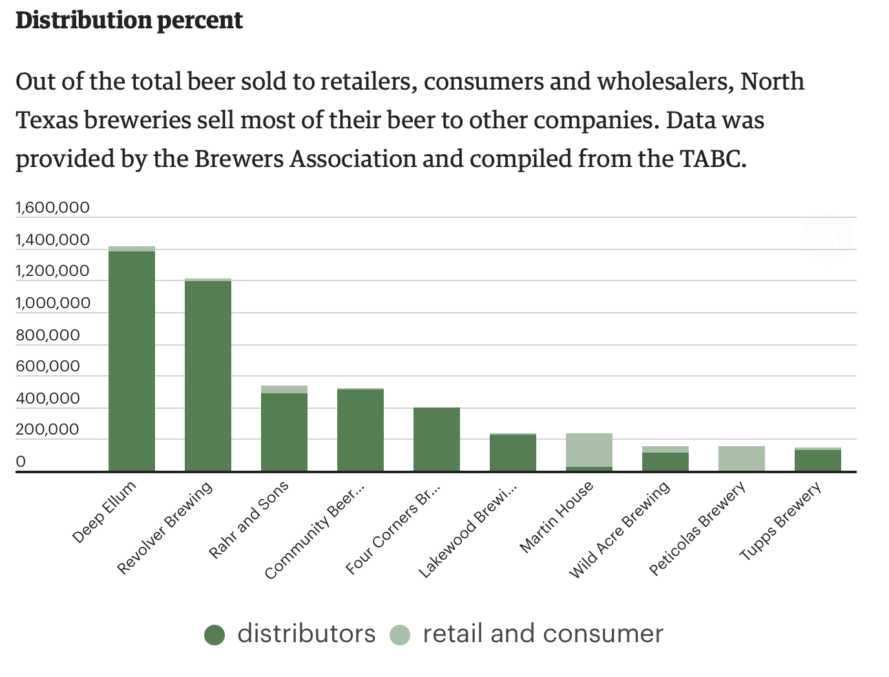

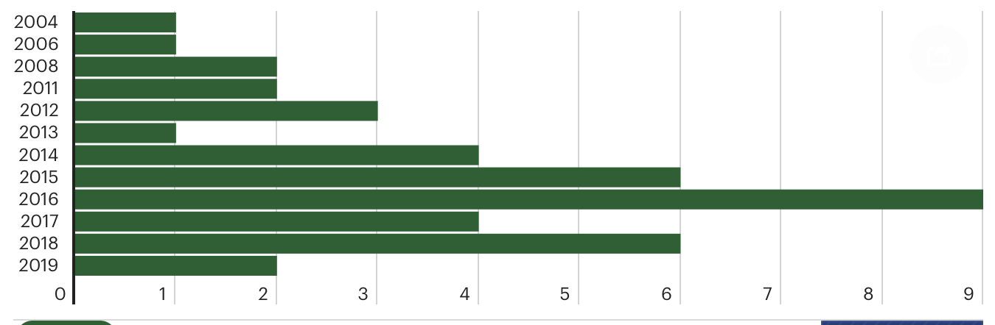
Framing the Problem
Analytics
Prescriptive Analytics to determine optimal location for brew pub and explain why breweries fail
Predictive Analytics to forecast volumes and beer styles
91% of beers sold by Rahr and Sons is through distributors. In contrast, Martin House (brewpub) has 89% of its sales direct to consumer and retail.
Rahr was established in 2004 as one of the first breweries in DFW. Since then they are the 3rd largest by volumes.
Communication / Execution
Pitch the idea to the CEO who manages the Private Equity Firm who owns Rahr and Sons (fictional) and CMO \ CIO of Rahr and Sons detailed overview of data and how to execute
We want to determine where the next best location is to expand Rahr’s brewpub in order continue to stay competitive.
https://www.bizjournals.com/dallas/news/2019/03/20/business-of-north-texas-beer.html

Slide 3
Expand Rahr & Sons Brewing Co.
Rahr & Sons Brewing Company started in 2004 as a full scale brewery, in a time where Craft Breweries was still new. In the 15 years Dallas / Fort Worth Craft Beer scene exploded with now over 80+ breweries and brewpub. Most popular being brewpubs.
According to Untappd, beer social rating application, Rahr has only 32 unique beers while its competitor down the street as a brew pub has made over 160 unique beers. Rahr is constraint as a brewery and its large scale operation.
We want to help Rahr grow, by determine a second location to open a brew pub with a smaller ”pilot” brew house.

Slide 4
Data
We plan to use demographic data (arcgis) to determine the optimal point for a brewpub
We will determine what reasons breweries may have failed in the past and learn from its mistakes by using the popular beer rating application UnTappd

