Slide 1
Re-imagining Assessment Choices
Colin Madland

Slide 2

Welcome

Slide 3
What is Assessment?

Slide 4
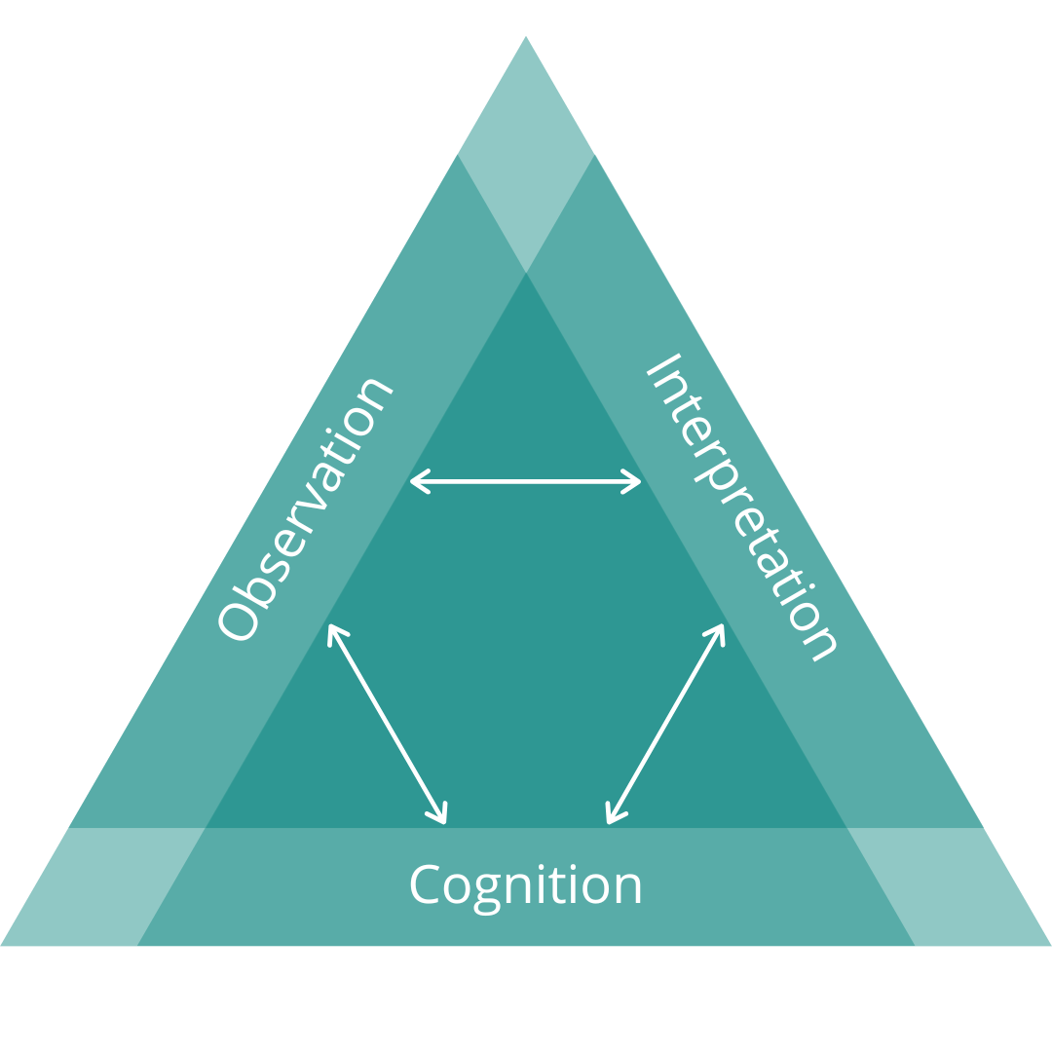
Assessment Triangle

Slide 5
(Pellegrino et al., 2001)

Slide 6
A grade is an inadequate report of an inaccurate judgement by a biased and variable judge of the extent to which a student has attained an undefined level of mastery of an unknown proportion of an indefinite material.
(Feldman, 2019, p. 25)

Slide 7
Purposes of Assessment…
…of learning …for learning …as learning
(Earl, 2013)

Slide 8
learning is ontological
“The mission of Trinity Western University, as an arm of the Church, is to develop godly Christian leaders: positive, goal-oriented university graduates with thoroughly Christian minds; growing disciples of Jesus Christ who glorify God through fulfilling the Great Commission, serving God and people in the various marketplaces of life.”

Slide 9
teaching is ontological

Slide 10
assessing is ontological

Slide 11
Assessment Identity
beliefs | feelings | knowledge | skills
(Looney et al., 2017)

Slide 12
Discuss with your group how you would characterize your assessment identity as it is and how it came to be.

Slide 13
Highlights?
Notes:
Poll: Enter 1-3 words at a time that summarize your assessment identity. (WordCloud)

Slide 14
Agency in Assessment
Notes:
Poll: What method of reporting assignment grades to learners best fits your current practice? - percentage scale (e.g., 74%) - raw score (e.g., 19/26) - letter grade (e.g., A+, A, A- … C-, D, F) - proficiency scale (e.g. Excellent, Meets Expectations, Revision Needed, Not Assessable) - a combination of the above - other (please specify)

Slide 15
letter.grade | quality.characteristics
A | Outstanding, excellent work; exceptional performance with …
B | Good, competent work; laudable performance with…
C | Adequate, reasonably satisfactory work; fair performance but infrequent evidence …
D | Minimally acceptable work; relatively weak performance with …
F | Inadequate work; poor performance that indicates a lack of understanding …

Slide 16
The University-wide system of percentage equivalents is shown in the table below [upcoming slide]. Faculty members may deviate from this scale; however, if they do so, they must indicate, in their course syllabus, the percentage equivalency system they use.

Slide 17
What do you notice? What do you wonder?

Slide 18
letter.grade | percentage | grade.point
A+ | 90-100 | 4.3
A | 85-89 | 4.0
A- | 80-84 | 3.7
B+ | 77-79 | 3.3
B | 73-76 | 3.0
B- | 70-72 | 2.7
C+ | 67-69 | 2.3
C | 63-66 | 2.0
C- | 60-62 | 1.7
D+ | 57-59 | 1.3
D | 53-56 | 1.0
D- | 50-52 | 0.7
F | Below 50 | 0.0
Percentage Equivalents

Slide 19
Breakout Cooperative Activity
10 mins
shared MS Excel file which contains simulated grade data from a class of 100 learners who completed 11 assignments, two papers, one midterm exam, and one final exam.
all items in the gradebook are recorded as a raw score out of 100
download the file and open in MS Excel
using the tools in Excel, decide as a group how you would report these learners’ final letter grades
calculate the grades in the columns to the right of the data
Use the TWU Standard Grading System
Notes:
https://mytwu-my.sharepoint.com/:x:/g/personal/colin_madland_twu_ca/EWFESCk49hFIvdhXM_YrZlwBUs5ZCTvQIiQZ9olWTNWdVg?e=ed9rWu

Slide 20
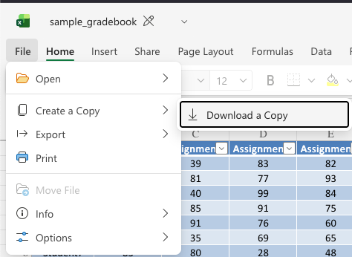

Slide 21
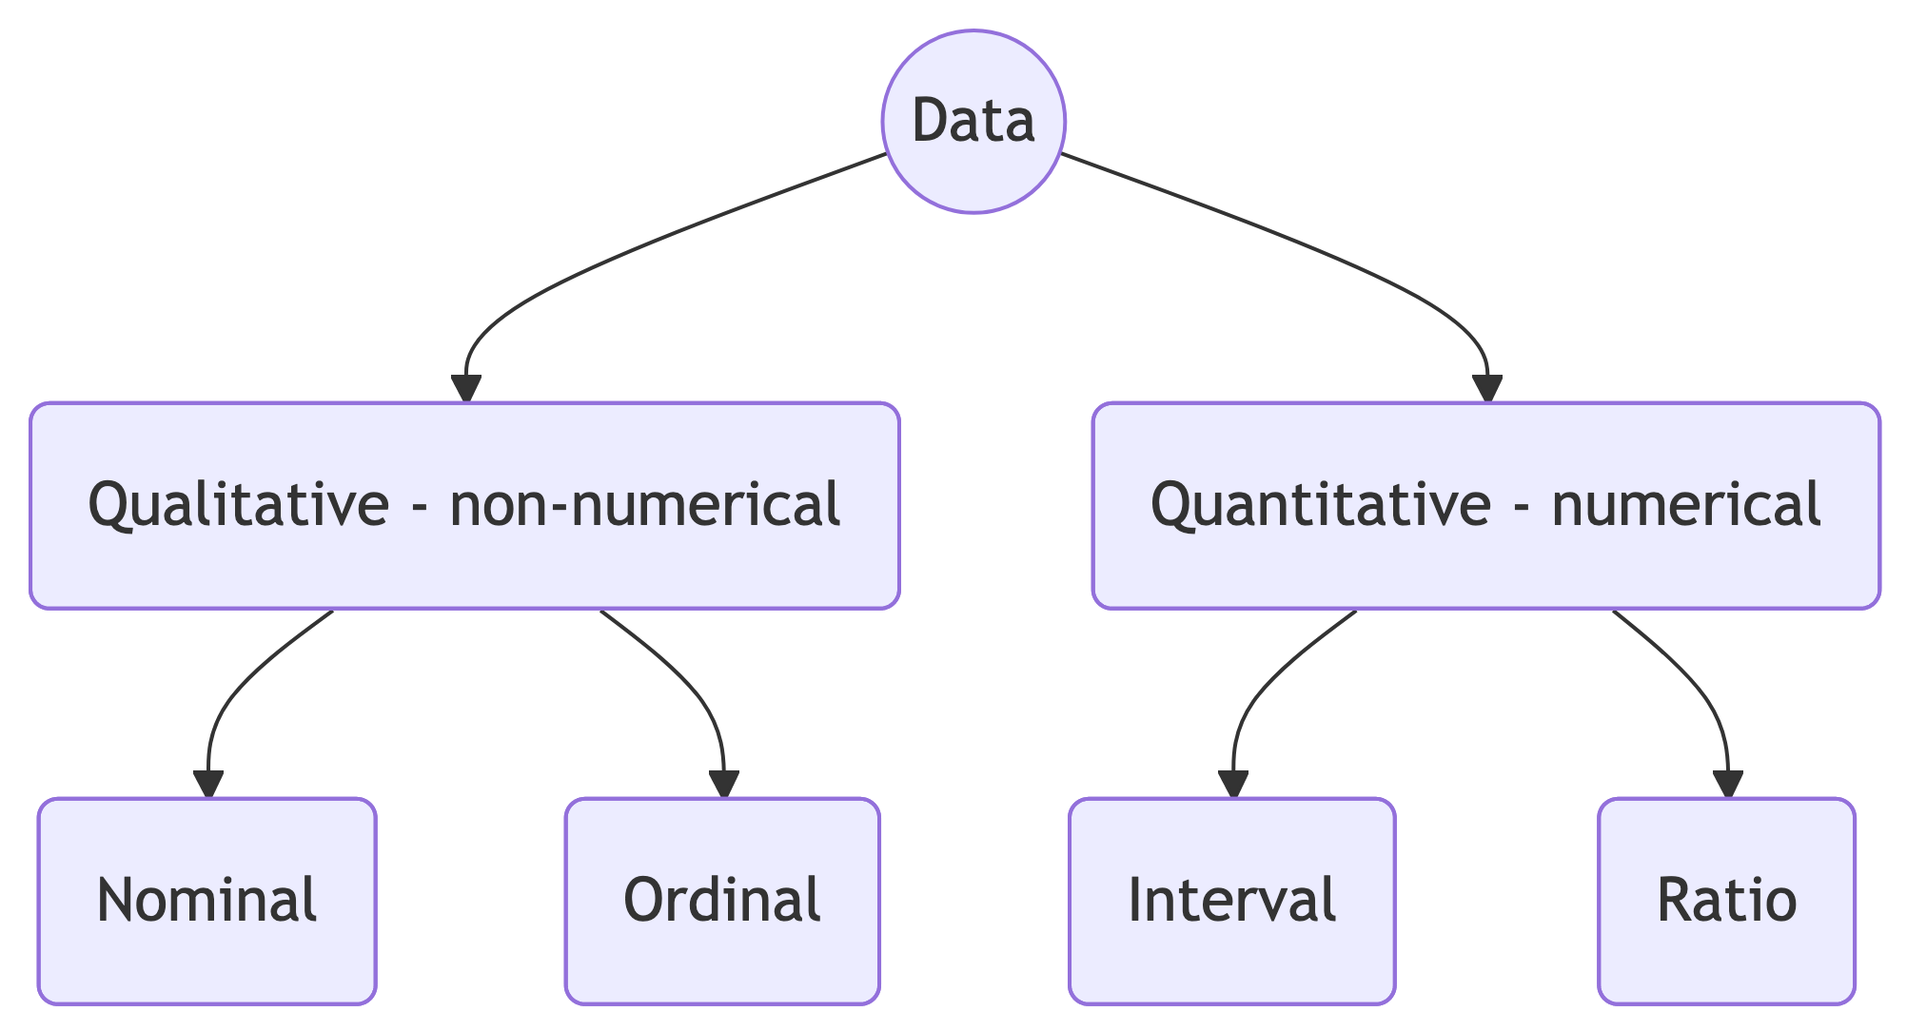
Data Types

Slide 22
Data Type | Mean | Equidistant | True Zero
Nominal | ❌ | ❌ | ❌
Ordinal | ❌ | ❌ | ❌
Interval | ✅ | ✅ | ❌
Ratio | ✅ | ✅ | ✅

Slide 23
GRADE DATA IS ORDINAL!
averages don’t make sense
no true zero

Slide 24
Validity and Reliability

Slide 25
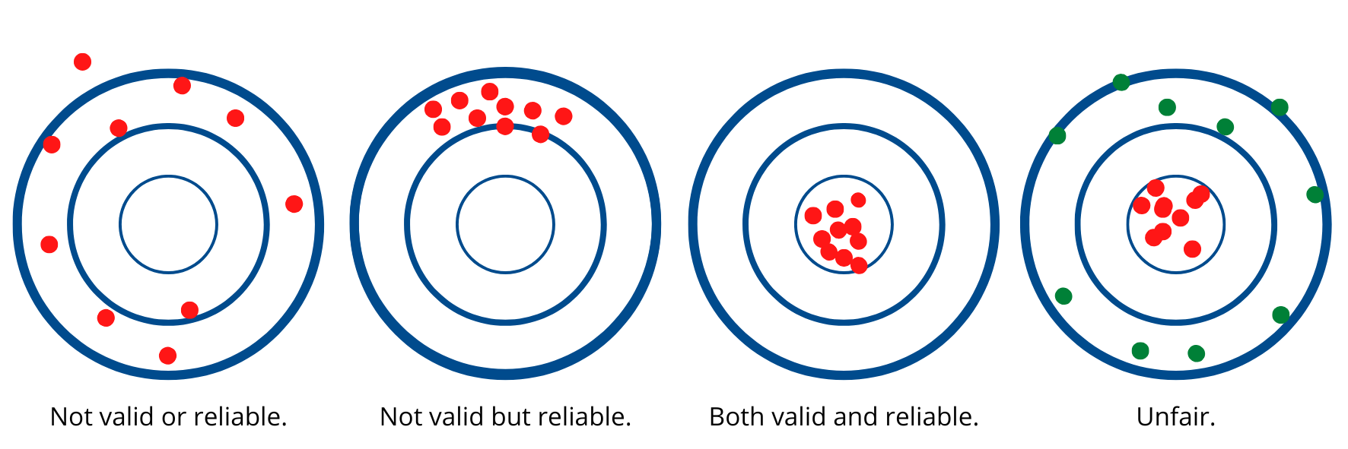

Slide 26
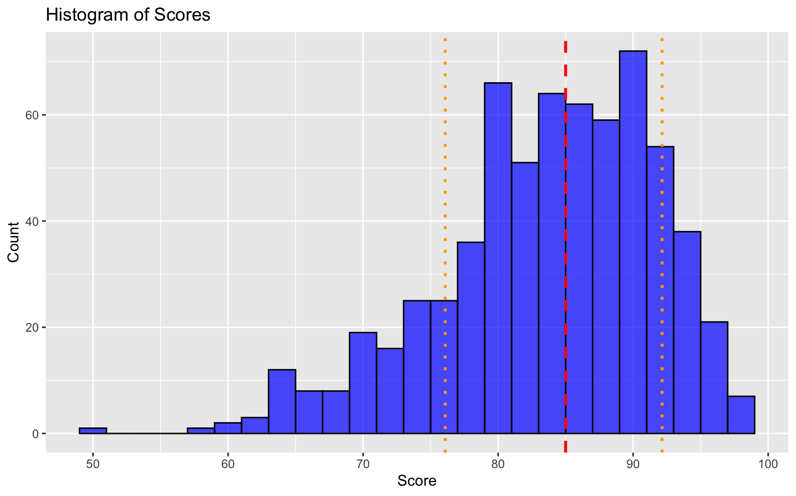
Notes:
https://mytwu-my.sharepoint.com/:u:/g/personal/colin_madland_twu_ca/EdaTKeQImyZJk4o8TNQbBvgBo7G8Bg-PvRDwZhIUGAqwTQ?e=hAglQl

Slide 27
(Starch, 1913; Starch & Elliott, 1912)

Slide 28
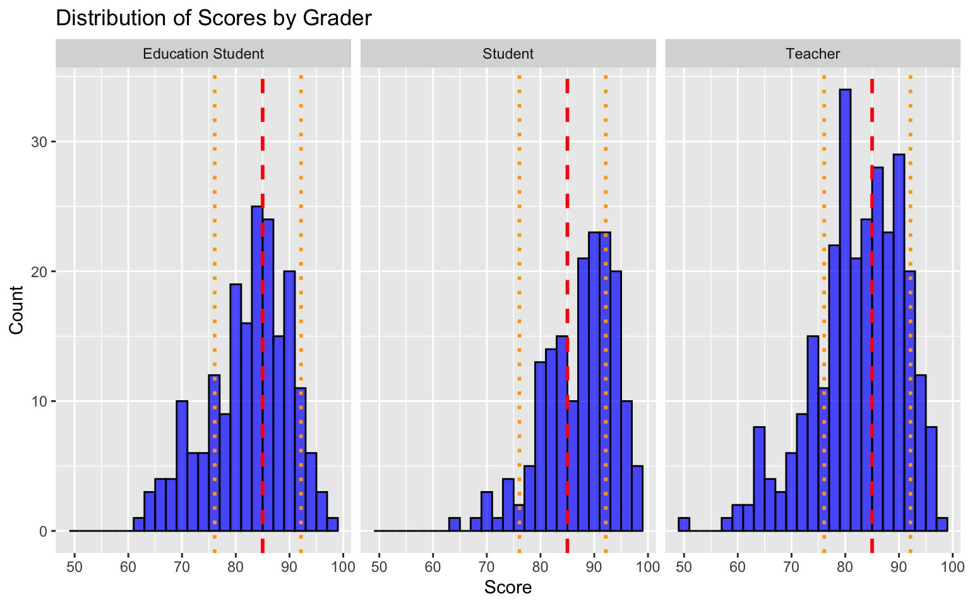

Slide 29
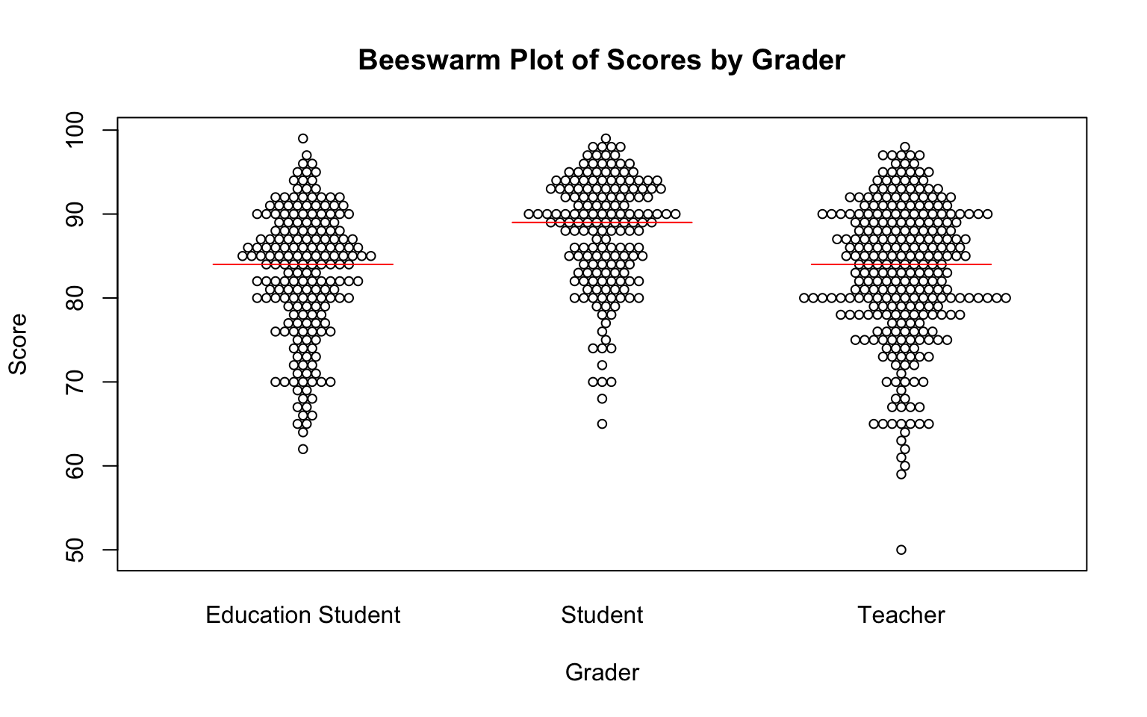

Slide 30
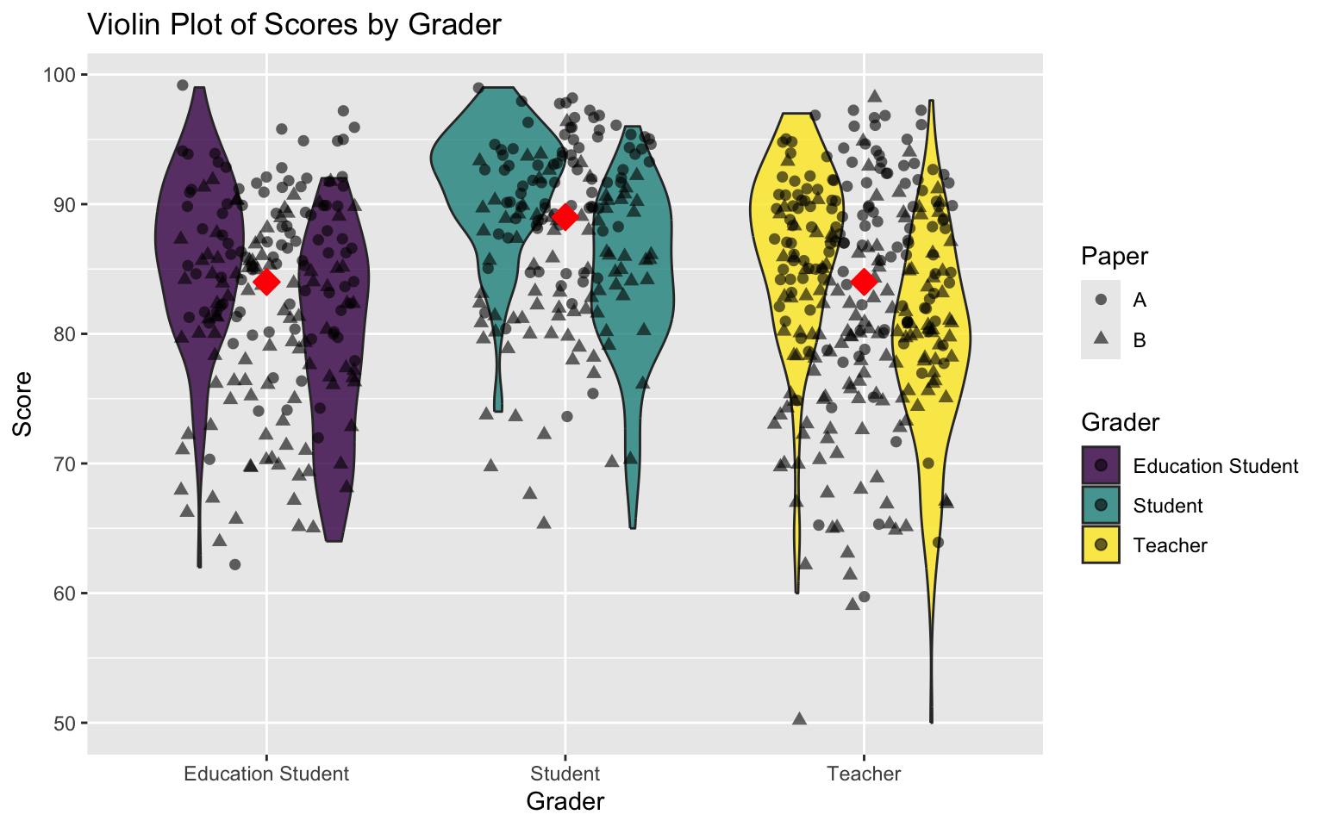

Slide 31
Breakout Conversation
download ‘starch-elliott.zip’ and extract to view the images
discuss in your group to make sense of what you see
all of the plots are different visualizations of the same data

Slide 32
Where to go from here?

Slide 33
Clearly-defined outcomes
- ‘Learners will be able to…’ - [verb] - [level of proficiency] - not ‘learners will [verb]’ (that’s an activity, not an outcome) - pay attention to the verb - remember vs. apply - define vs. create

Slide 34
Grades communicate progress
fewer categories of quality (5-13)
not assessable, emerging, developing, proficient, extending
not assessable, revision needed, meets expectations, excellent
🏗️, ✏️, 👏🏿, 💅🏽, ✨

Slide 35
Closed feedback loops
Knowledge of Results

Slide 36
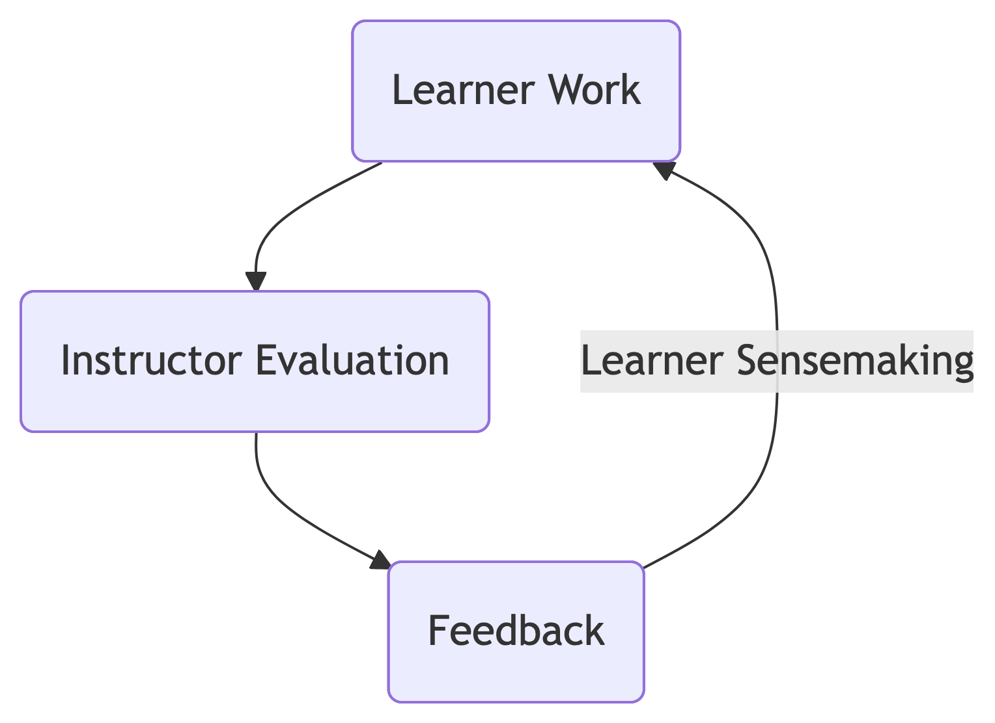
Feedback Loops

Slide 37
Reassessment without penalty
Important
This does NOT mean ‘reassessment without limit’!

Slide 38
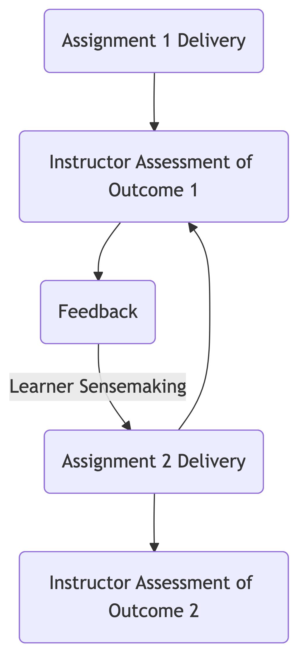
Reassessment without penalty

Slide 39
Knowledge emerges only through invention and re-invention, through the restless, impatient, continuing, hopeful inquiry human beings pursue in the world, with the world, and with each other. (Freire, 1990, p. 72)

Slide 40
Stop. Be outside. Think.

Slide 41
cmad.land - slides

Slide 42
References
Earl, L. M. (2013). Assessment as learning: Using classroom assessment to maximize student learning (Second edition). Corwin Press.
Feldman, J. (2019). Grading for equity: What it is, why it matters, and how it can transform schools and classrooms. Corwin, a SAGE Company.
Freire, P. (1990). Pedagogy of the oppressed. Penguin.
Looney, A., Cumming, J., van der Kleij, F. M., & Harris, K. (2017). Reconceptualising the role of teachers as assessors: Teacher assessment identity. Assessment in Education: Principles, Policy & Practice, 25, 442–467. https://doi.org/10/gfkfk6
Pellegrino, J. W., Chudowsky, N., & Glaser, R. (2001). Knowing What Students Know: The Science and Design of Educational Assessment. National Academies Press. https://doi.org/10.17226/10019
Starch, D. (1913). Reliability and Distribution of Grades. Science, 38(983), 630–636. https://doi.org/10.1126/science.38.983.630
Starch, D., & Elliott, E. C. (1912). Reliability of the Grading of High-School Work in English. The School Review, 20(7), 442–457. https://doi.org/10.1086/435971

