Slide 1
Teaching, Learning, and AI
Colin Madland, Derrick Mohamed

Slide 2

Welcome

Slide 3
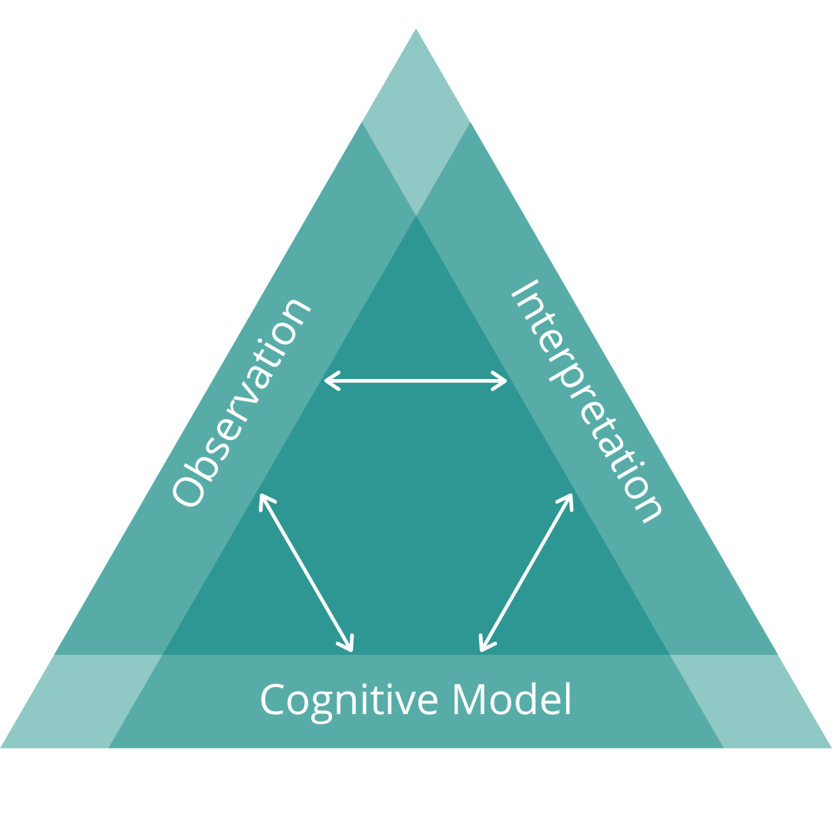
Assessment Triangle

Slide 4
(Pellegrino et al., 2001)

Slide 5
Purposes of Assessment…
…of learning …for learning …as learning
(Earl, 2013)

Slide 6
Teaching, learning, and assessing are all ontological

Slide 7
Assessment Identity
beliefs | feelings | knowledge | skills
(Looney et al., 2017)

Slide 8
Agency in Assessment

Slide 9
Percentage Equivalents
letter.grade | percentage | grade.point
A+ | 90-100 | 4.3
A | 85-89 | 4.0
A- | 80-84 | 3.7
B+ | 77-79 | 3.3
B | 73-76 | 3.0
B- | 70-72 | 2.7
C+ | 67-69 | 2.3
C | 63-66 | 2.0
C- | 60-62 | 1.7
D+ | 57-59 | 1.3
D | 53-56 | 1.0
D- | 50-52 | 0.7
F | Below 50 | 0.0

Slide 10
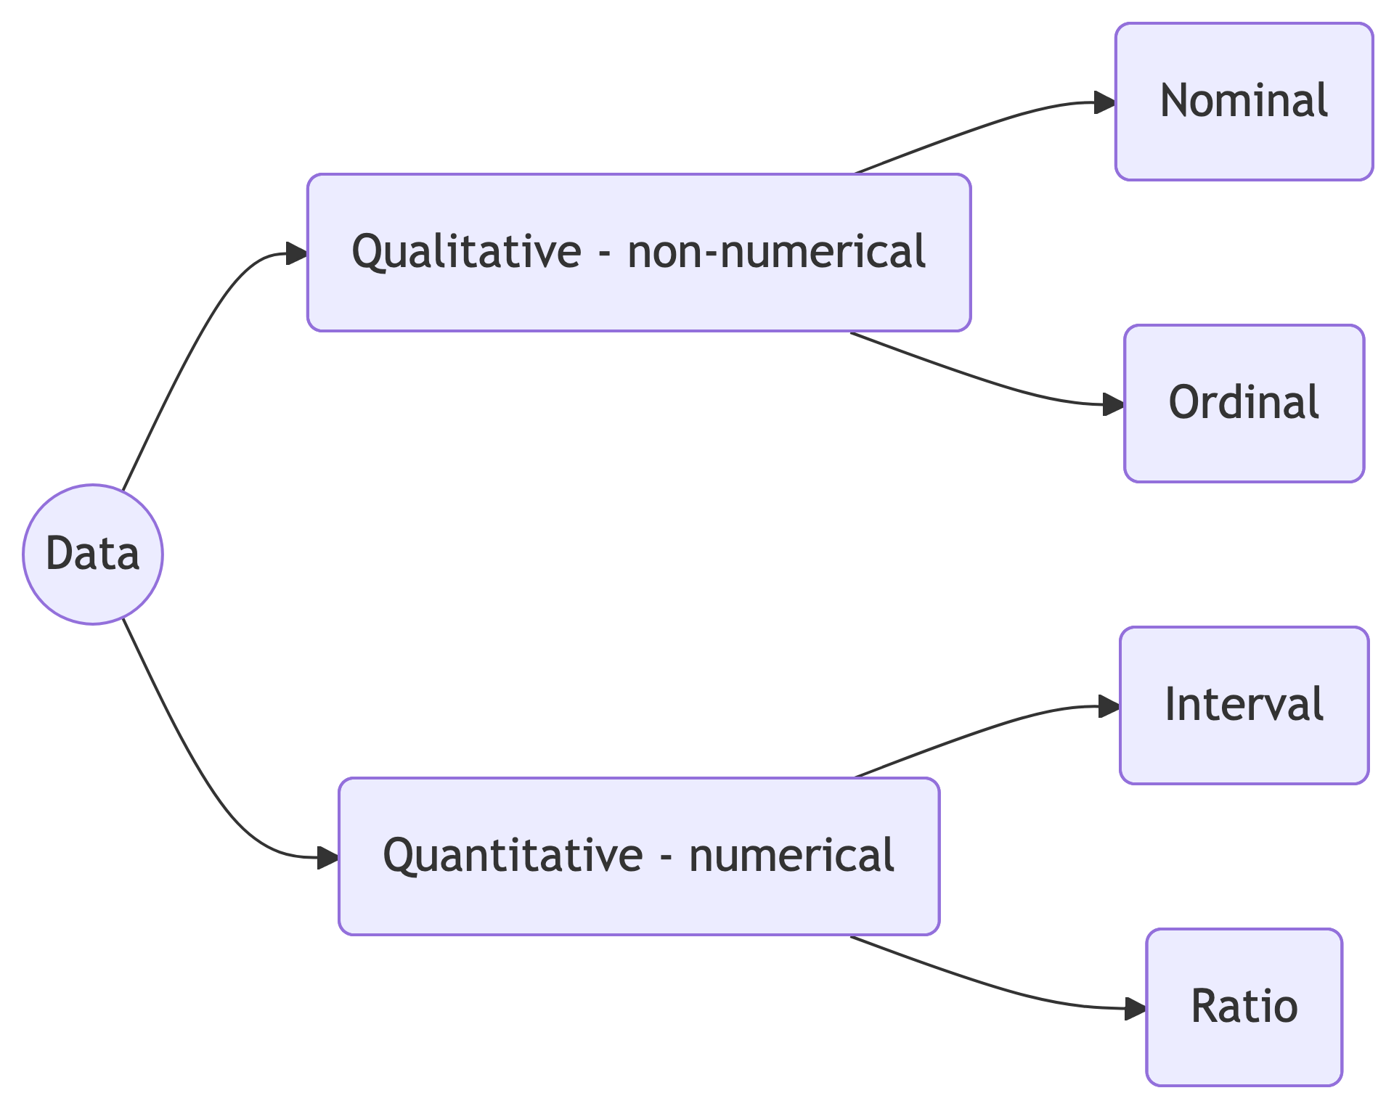
Data Types

Slide 11
Data Type | Mean | Equidistant | True Zero
Nominal | ❌ | ❌ | ❌
Ordinal | ❌ | ❌ | ❌
Interval | ✅ | ✅ | ❌
Ratio | ✅ | ✅ | ✅

Slide 12
GRADE DATA IS ORDINAL!
averages don’t make sense
no true zero

Slide 13
Reliability of Grades

Slide 14
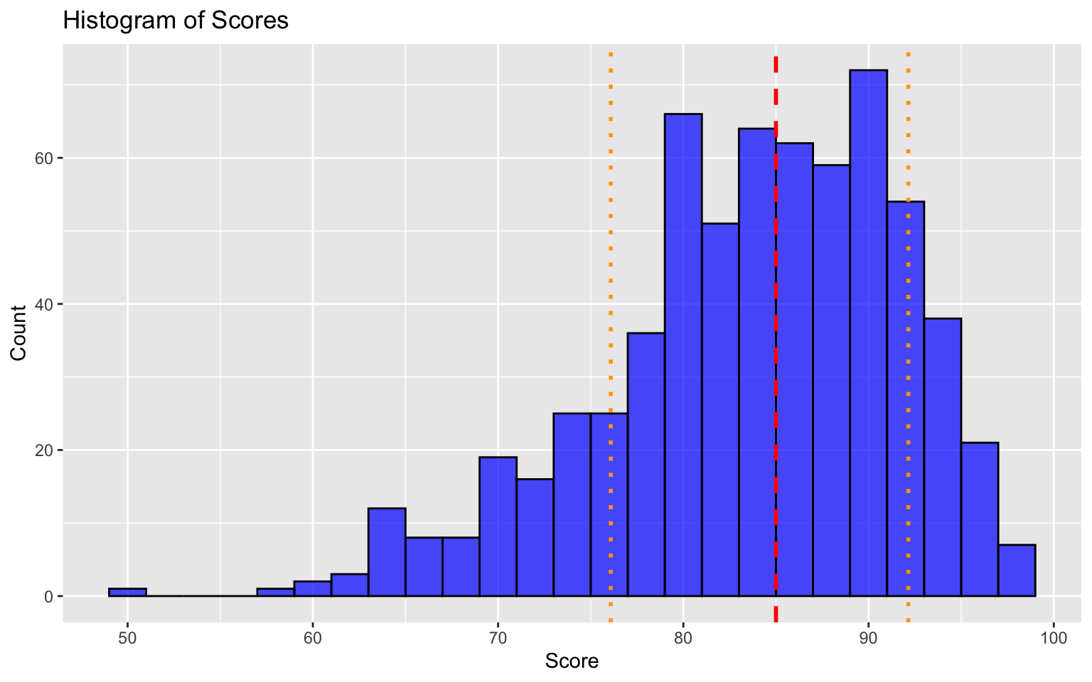

Slide 15
(Starch, 1913; Starch & Elliott, 1912)

Slide 16
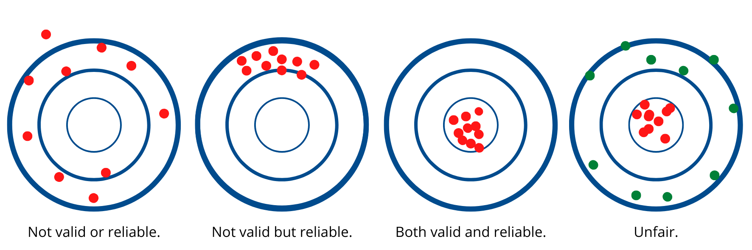
AI and Validity of Grades

Slide 17
Mega Breakouts - an Unconference Experience
Instructions at the top of the doc

Slide 18
Knowledge emerges only through invention and re-invention, through the restless, impatient, continuing, hopeful inquiry human beings pursue in the world, with the world, and with each other. (Freire, 1990, p. 72)

Slide 19
Stop. Be outside. Think.

Slide 20
cmad.land - slides

Slide 21
References
Earl, L. M. (2013). Assessment as learning: Using classroom assessment to maximize student learning (Second edition). Corwin Press.
Freire, P. (1990). Pedagogy of the oppressed. Penguin.
Looney, A., Cumming, J., van der Kleij, F. M., & Harris, K. (2017). Reconceptualising the role of teachers as assessors: Teacher assessment identity. Assessment in Education: Principles, Policy & Practice, 25, 442–467. https://doi.org/10/gfkfk6
Pellegrino, J. W., Chudowsky, N., & Glaser, R. (2001). Knowing What Students Know: The Science and Design of Educational Assessment. National Academies Press. https://doi.org/10.17226/10019
Starch, D. (1913). Reliability and Distribution of Grades. Science, 38(983), 630–636. https://doi.org/10.1126/science.38.983.630
Starch, D., & Elliott, E. C. (1912). Reliability of the Grading of High-School Work in English. The School Review, 20(7), 442–457. https://doi.org/10.1086/435971

