Slide 1

IM/2016/046
Evenza
Smart Event Management & Resourcing Platform

Slide 2
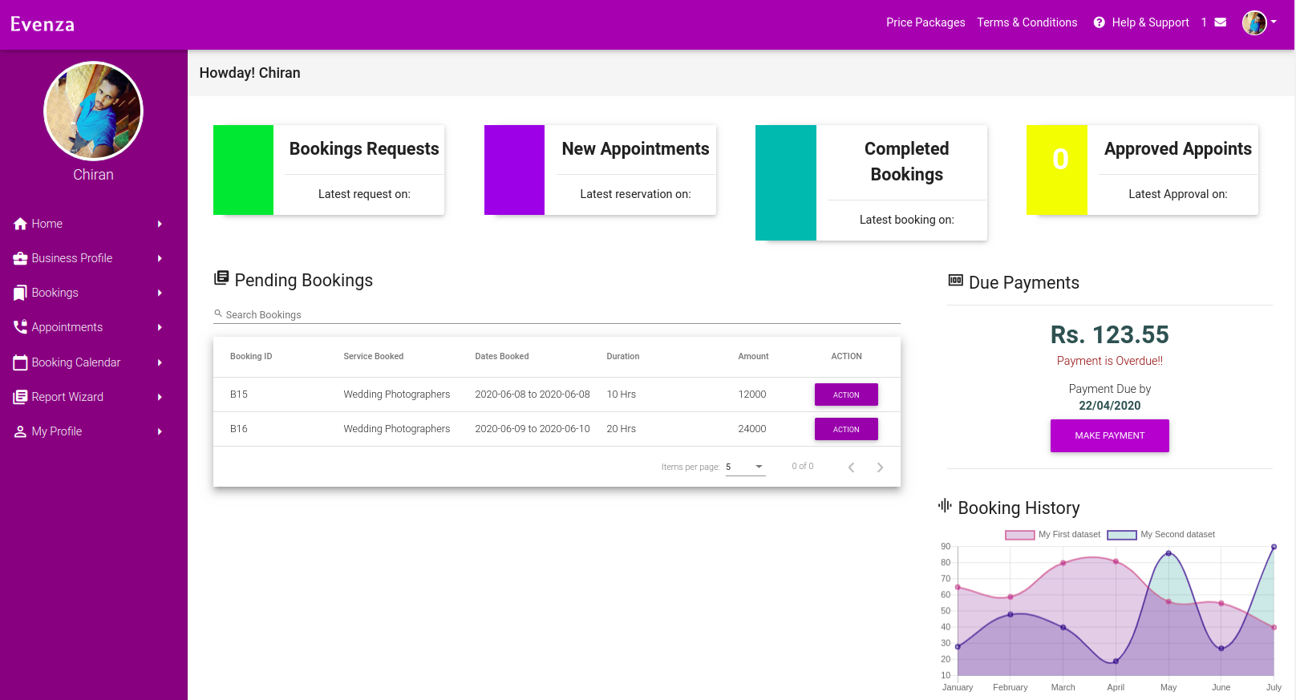
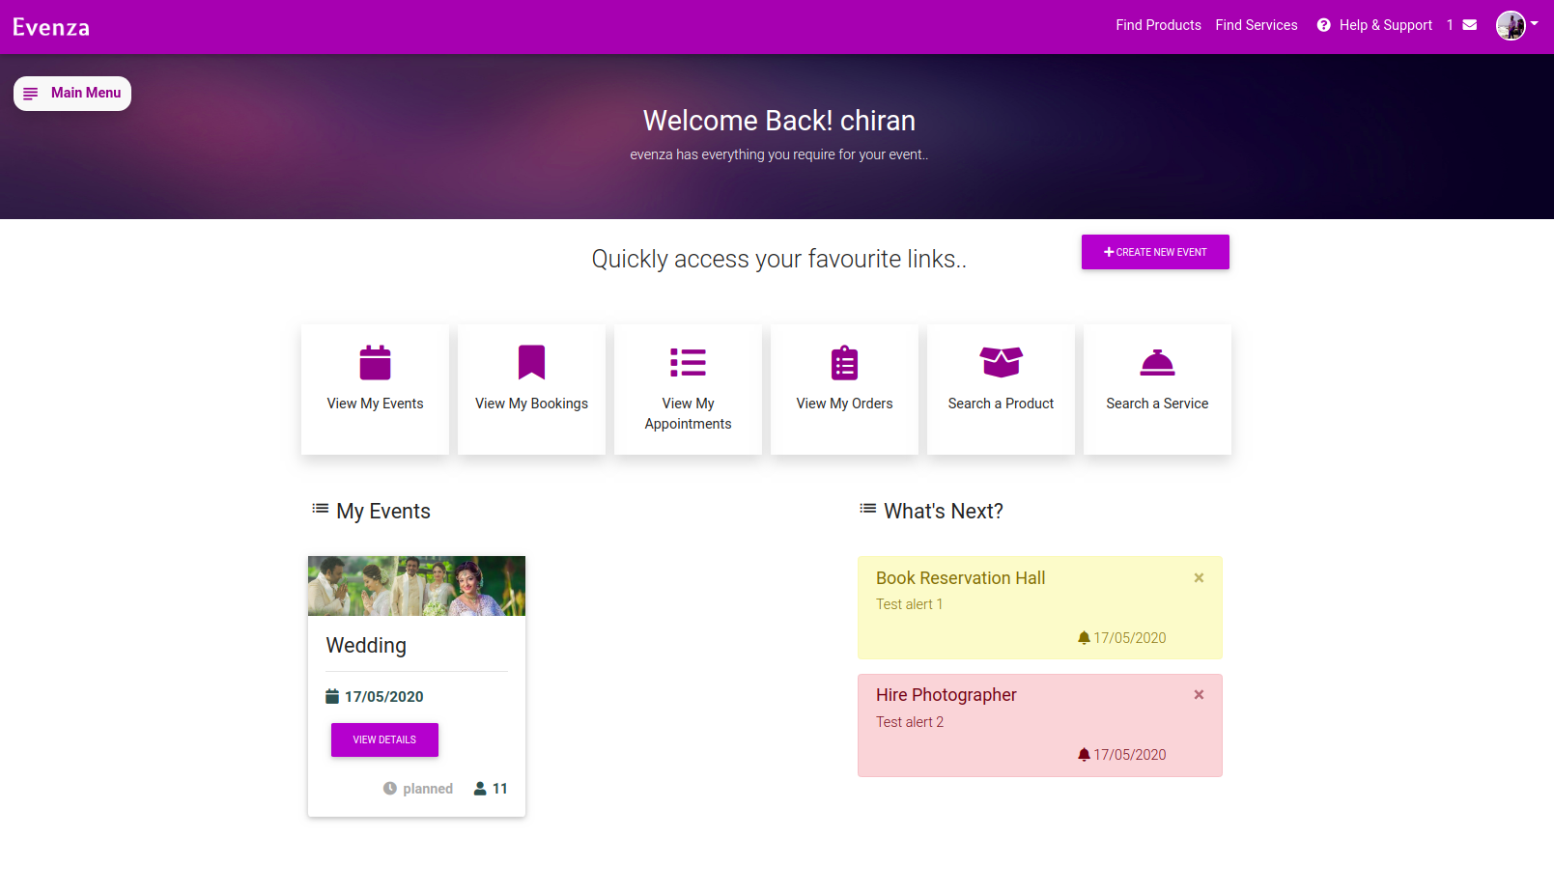
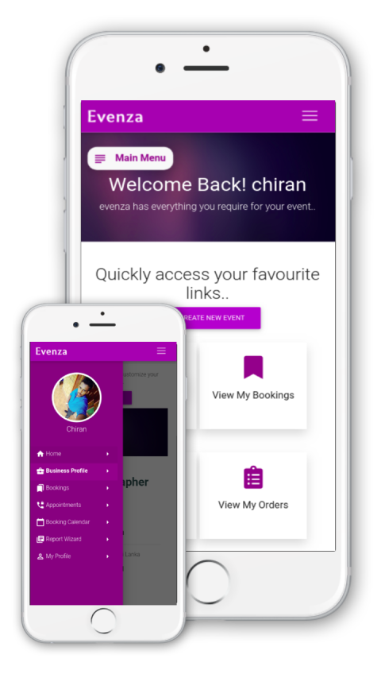
What is Evenza?
A web based platform to connect Customers (need to plan an event) to Service Providers while providing smart event planing, scheduling & participant management capabilities

Slide 3
What Evenza does?
Event Planners
Service Providers
Create & Schedule events with Event Planner
Search & Book Service Providers
Sellers Sell their products (Event specific)
Service Providers Sell their Services
Place a Booking
Visit Appoint-ment
Event Publishing & participant management

Slide 4

Technology Stack
Frontend: Angular (8)
Backend: Node JS, Express
Database: MongoDB
RESTful API

Slide 5
Modular Programming..
Module based Development approch..
8 Modules :
Home & Authentication
Service
Product
ServiceProvider
Seller
EventPlanner
Event
Administrator

Slide 6
Design Patterns & Architectures

Slide 7
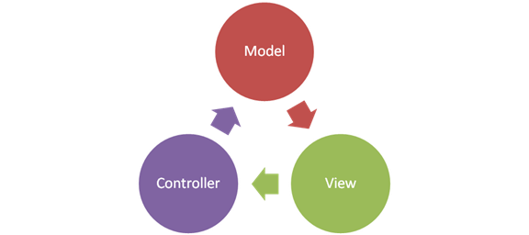
Design Patterns Used..
MVC Architecture
Design Patterns Used..
Adaptor Design Pattern (Ex: Body parser, Multer)
Observer Design Pattern (Ex: Subjects/ Observables)
Singleton Design Pattern (Ex: Providers)
OOP Concepts
Code Formatting & Best Practises

Slide 8
Other Libraries & Frameworks

Slide 9
Libraries/ Frameworks used..
Angular Material - UI Library
Multer - Image uploading & handeling
Body Parser - JSON object Parsing
Mongoose - Secure MongoDB database controller
JSON Web Tokens - Secure Authentication & Authorization
Nodemailer - Email message handeling
JsPDF & htmlCanvas - Report extracting & printing
chart.js/ Mongo Charts - Reports & Charts visualization
Node Corn - Schedule and Manage tasks

Slide 10





APIs/ Services used..
Google Maps API (GeoCoder, Places, Metrix) - Location Services
Google Cloud Storage API - Images & File Uploads/ Hosting
PayPal API - Payment Collection, Recieving
Heroku API & Services - Backend Application Hosting
Socket.io - Socket Services for Realtime Chat, Notification Hadling

Slide 11
Releases..
Web Based System Developed, Tested and Deployed
On Google Cloud App Engine (PaaS)
Database Deployed on Cloud
- Realtime, Clustered on MongoDB Atlas
PWA ( Prgressive web Application) Developed for Mobiles
Complete Documentation (User Guides, Design, API Docs)
http://evenza.biz

Slide 12
Demonstration

Slide 13
Requirements Specification(SRS)

Slide 14

ID | Functional Requirement | Status
1 | Shall be able to create and manage user accounts
2 | Shall be able to login to the system
3 | Shall be able to create business profiles
4 | Shall be able to manage products/services (by service providers)
5 | Shall be able to search for products/services
6 | Shall be able to book/request appointments for services
7 | Shall be able to order products
8 | Shall be able to send cancellation/ modification requests for bookings/appointments
9 | Shall be able to respond for bookings/appointments
10 | Shall be able to provide a booking calendar for service providers.
11 | Shall be able to record booking and purchase history.
12 | Shall be able to get customer feedback.

Slide 15
ID | Functional Requirement | Status
13 | Shall be able to provide a set of event types toselect.
14 | Shall be able to get event details for selected event type from customers.
15 | Shall be able to generate an event plan for selected event type.
16 | Shall be able to show notifications related to eventplan.
17 | Shall be able to record event plan details.
18 | Shall be able to generate reports.
19 | Shall be able to send invitations to event participants.
20 | Shall be able to send event related notifications to participants.
21 | Shall be able to backup data.
22 | Should be able to get participants registered to the relevant event.
23 | Should be able to manage registered users.
24 | Should be able to receive payments.

Slide 16
Thank You

Slide 17
Q & A

