Slide 1

IM/2016/046
Evenza
Smart Event Management & Resourcing Platform

Slide 2
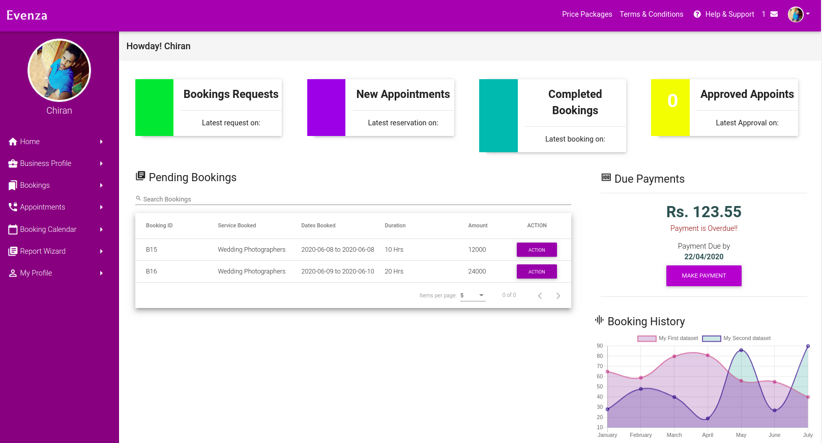
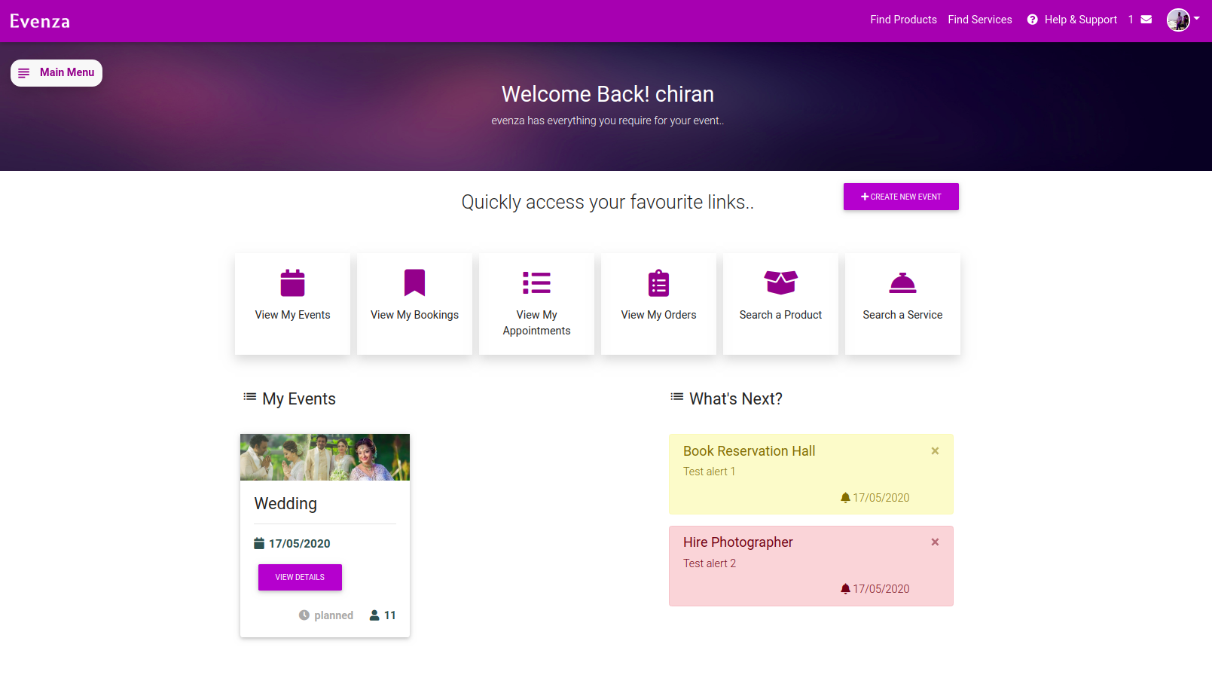
What is Evenza?
A web based platform to connect Event planners and Service Providers while providing smart event planing, scheduling & participant management capabilities

Slide 3
What Evenza does?
Event Planners
Service Providers
Create & Schedule events with Event Planner
Search & Book Service Providers
Sellers Sell their products (Event specific)
Service Providers Sell their Services
Place a Booking
Visit Appoint-ment
Event Publishing & participant management

Slide 4

Technology Stack
Frontend: Angular (8)
Backend: Node JS, Express
Database: MongoDB
RESTful API

Slide 5
Modular Programming..
Module based Development approch..
8 Modules :
Home & Authentication
Service
Product
ServiceProvider
Seller
EventPlanner
Event
Administrator

Slide 6
Modular Programming..
Module based Development approch..
8 Modules :
Home & Authentication
Service
Product
ServiceProvider
Seller
EventPlanner
Event
Administrator

Slide 7
Demonstration

Slide 8
Design Patterns & Architectures

Slide 9
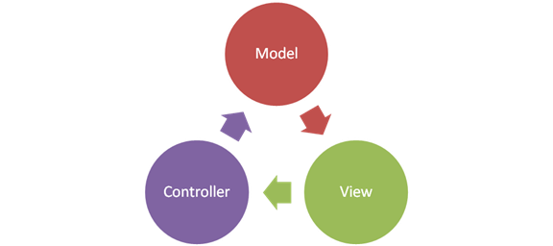
Design Patterns..
Design Patterns Used..
Adaptor Design Pattern (Ex: Body parser)
Observer Design Pattern (Ex: Subjects/ Observables)
Singleton Design Pattern (Ex: Providers)
MVC Architecture

Slide 10
Other Libraries & Frameworks

Slide 11
Libraries/ Frameworks used..
Angular Material - UI Library
Multer - Image uploading & handeling
Body Parser - JSON object Parsing
Mongoose - Secure MongoDB database controller
JSON Web Tokens - Secure Authentication & Authorization
Nodemailer - Email message handeling
JsPDF & htmlCanvas - Report extracting & printing
chart.js - Data visualization & Report generation
Google Maps API - Location Services

Slide 12
Requirements Specification(SRS)

Slide 13

ID | Functional Requirement | Status
1 | Shall be able to create and manage user accounts
2 | Shall be able to login to the system
3 | Shall be able to create business profiles
4 | Shall be able to manage products/services (by service providers)
5 | Shall be able to search for products/services
6 | Shall be able to book/request appointments for services
7 | Shall be able to order products
8 | Shall be able to send cancellation/ modification requests for bookings/appointments
9 | Shall be able to respond for bookings/appointments
10 | Shall be able to provide a booking calendar for service providers.
11 | Shall be able to record booking and purchase history.
12 | Shall be able to get customer feedback.

Slide 14

ID | Functional Requirement | Status
13 | Shall be able to provide a set of event types toselect.
14 | Shall be able to get event details for selected event type from customers.
15 | Shall be able to generate an event plan for selected event type.
16 | Shall be able to show notifications related to eventplan.
17 | Shall be able to record event plan details.
18 | Shall be able to generate reports.
19 | Shall be able to send invitations to event participants.
20 | Shall be able to send event related notifications to participants.
21 | Shall be able to backup data.
22 | Should be able to get participants registered to the relevant event.
23 | Should be able to manage registered users.
24 | Should be able to receive payments.

Slide 15
Thank You

