Slide 1
ABAP Course
Chapter 1: Introduction to ABAP Programming

Slide 2
Copyright 2008 UCC TU München All rights reserved
Weitergabe und Vervielfältigung dieser Publikation oder von Teilen daraus sind, zu welchem Zweck und in welcher Form auch immer, ohne die ausdrückliche schriftliche Genehmigung durch HCC TU München nicht gestattet. In dieser Publikation enthaltene Informationen können ohne vorherige Ankündigung geändert werden.
Microsoft®, WINDOWS®, NT®, EXCEL®, Word®, PowerPoint® und SQL Server® sind eingetragene Marken der Microsoft Corporation.
IBM®, DB2®, OS/2®, DB2/6000®, Parallel Sysplex®, MVS/ESA®, RS/6000®, AIX®, S/390®, AS/400®, OS/390® und OS/400® sind eingetragene Marken der IBM Corporation.
ORACLE® ist eine eingetragene Marke der ORACLE Corporation.
INFORMIX®-OnLine for SAP und Informix® Dynamic ServerTM sind eingetragene Marken der Informix Software Incorporated.
UNIX®, X/Open®, OSF/1® und Motif® sind eingetragene Marken der Open Group.
Citrix®, das Citrix-Logo, ICA®, Program Neighborhood®, MetaFrame®, WinFrame®, VideoFrame®, MultiWin® und andere hier erwähnte Namen von Citrix-Produkten sind Marken von Citrix Systems, Inc.
HTML, DHTML, XML, XHTML sind Marken oder eingetragene Marken des W3C®, World Wide Web Consortium, Massachusetts Institute of Technology.
JAVA® ist eine eingetragene Marke der Sun Microsystems, Inc.
JAVASCRIPT® ist eine eingetragene Marke der Sun Microsystems, Inc., verwendet unter der Lizenz der von Netscape entwickelten und implementierten Technologie.
SAP, SAP Logo, R/2, RIVA, R/3, SAP ArchiveLink, SAP Business Workflow, WebFlow, SAP EarlyWatch, BAPI, SAPPHIRE, Management Cockpit, mySAP, mySAP.com und weitere im Text erwähnte SAP-Produkte und -Dienstleistungen sowie die entsprechenden Logos sind Marken oder eingetragene Marken der SAP AG in Deutschland und anderen Ländern weltweit. MarketSet und Enterprise Buyer sind gemeinsame Marken von SAP Markets und Commerce One.
Alle anderen Namen von Produkten und Dienstleistungen sind Marken der jeweiligen Firmen.
Die Verwendung der Screenshots wurde mit dem jeweiligen Eigner abgesprochen.

Slide 3
Agenda
Introduction to ABAP
The use of ABAP in SAP systems
Development prerequisites
First program ‚Hello World!‘ + Exercise
Online help for ABAP

Slide 4
Agenda
1
To define what is ABAP
2
To discuss a brief history about ABAP Programming
3
To understand the use of ABAP in SAP systems
4
To know the different development prerequisites
5
To create your first ABAP Program

Slide 5
What is ABAP?
ABAP stands for Advanced Business Application Programming.
It is programming language for developing applications for the SAP system.
ABAP was established by SAP way back 1980. It’s a programming language similar to COBOL and PASCAL.

Slide 6
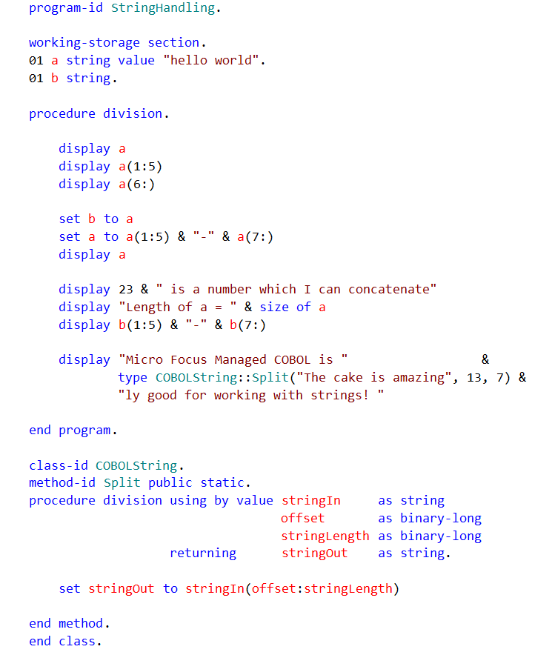
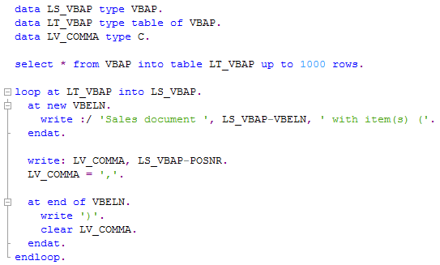
What is ABAP?
ABAP
COBOL

Slide 7
What is ABAP?
In the early 70s, ABAP stood for “Allgemeiner Berichts-Aufbereitungs Prozessor” which means General Report Preparation Processor.
ABAP is also called as ABAP/4L which stands for “Fourth Generation Language” or 4GL.

Slide 8
Historical view on ABAP
1950
Machine code
….
Assembler
1954
Fortran
Cobol
LISP
….
PL1
1968
Smalltalk
Pascal
….
1980
ABAP
C++
….
Java
1992
ABAP Objects
Source: Following SAP AG

Slide 9
Compiling ABAP
Presentation
layer
SAPGui
SAPGui
SAPGui
Calls program
for the first time
Short message
about compiling
Runs program
Application
layer
Application
server
Application
server
Application
server
Compiling
Database
layer
Database
server
Database
server
Database
server
Program has to
be compiled
Return compilation
ABAP
Source
code
ABAP
Compilation
Source: Following SAP AG

Slide 10
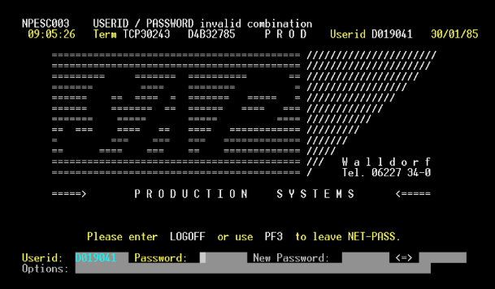
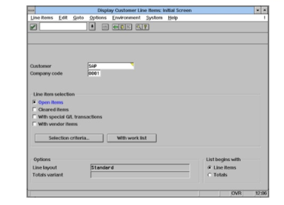
Advantages of ABAP
Fully compatible to older versions
SAP R/2
SAP R/3

Slide 11
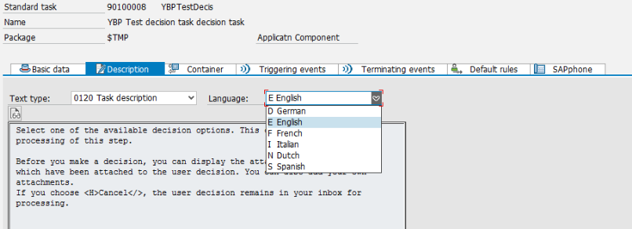
Advantages of ABAP
Multilanguage Support

Slide 12

Advantages of ABAP
Embedded SQL Statements
Database-specific SQL statements can be embedded that are passed unchanged from the Native SQL interface to a database system, and executed there.

Slide 13
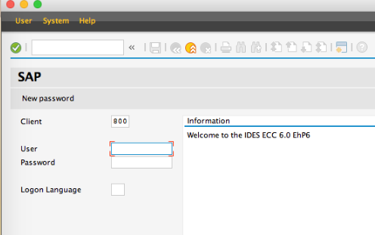
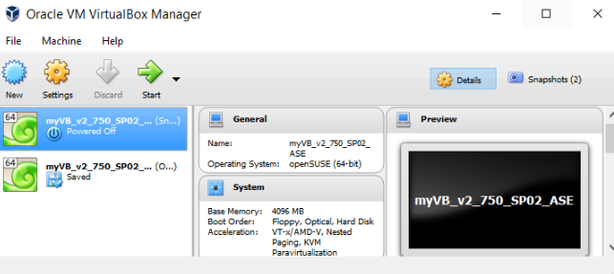
Advantages of ABAP
Platform independent
SAP allows ABAP programs to work on any platform(operating system).

Slide 14
Advantages of ABAP
Database independent
ABAP programs have two options for accessing the database interface: Open SQL and Native SQL.

Slide 15
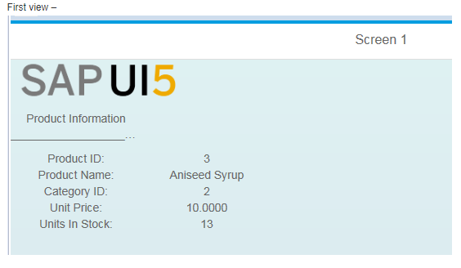
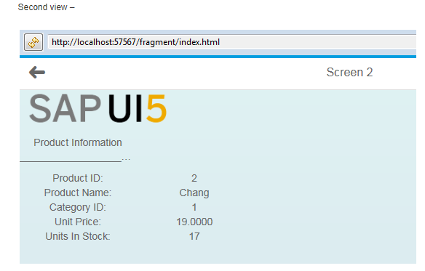
Advantages of ABAP
Reusability of code fragments

Slide 16
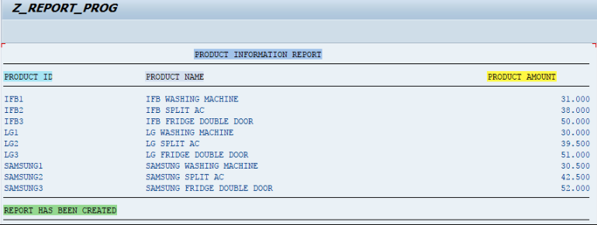
Two types of programs in SAP-ABAP
1. Report Programs
A report is a program that typically reads and analyzes data in database tables without changing the database.

Slide 17
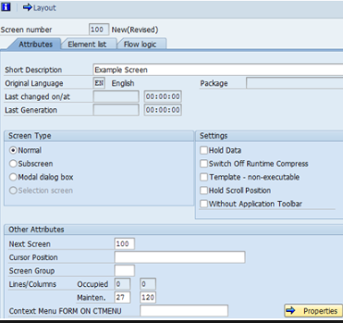
Two types of programs in SAP-ABAP
2. Dialog Programs (Dynpros)
Dialog programs are created with type as 'M' - Module Pool. They cannot be executed independently and must be attached to at least one transaction code in which you specify an initial screen.

Slide 18
ABAP Repository
Client 900
Client 901
Application
data
User
accounts
Application
data
User
accounts
Client dependent
Customizing
Client dependent
Customizing
Client independent customizing
FI
CO
PP
TR
PS
PY
BC
KM
PA
FS
…
Repository (tables, programs, function groups …)
Divided into development classes
Source: Own illustration

Slide 19
Prerequisites for ABAP development
Access to repository (is maintained in client settings)
User with development profile and access key
Own package and own transport request
Pay attention to the namespaces

Slide 20
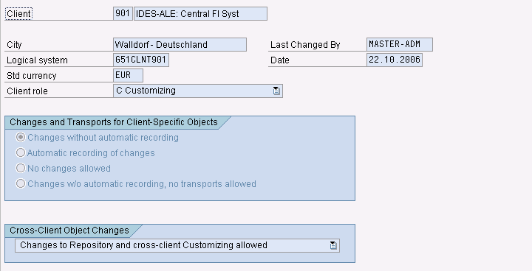
Prerequisites for ABAP development
Access to repository (is maintained in client settings)
Access to repository is needed
Check access in transaction SCC4

Slide 21
Prerequisites for ABAP development
User with development profile and access key
The access key allows development of new programs or changes to existing one
Access key are always username dependent!
Access keys must be requested from SAP as license cost increase by the number of development users
Access keys can be obtained from your local UCC

Slide 22
Prerequisites for ABAP development
Own package and own transport request
Own packages enable you to group your developments
Transport requests enable you to transport new developments to other SAP systems
You may develop new programs using the local package $TMP, but transport of these developments is not possible

Slide 23
Prerequisites for ABAP development
Pay attention to the namespaces
Only use namespace Y and Z, e.g. ZZ_* or YY_* as these are customer namespaces
SAP uses namespace from A to X for own programs and implementations
Changing SAP objects is not possible unless you have a modification key

Slide 24
Transport of ABAP developments
Development
System (DEV)
Quality Assurance
System (QAS)
Production
System (PROD)
Source: Own illustration
Developments are transported from DEV to QAS using transport requests
Exporting transport requests creates files for transportation
You may either import all or only one transport request in your destination system

Slide 25
Transport hierarchy
Project
Transport
request
Transport
request
Transport
request
Task
Task
Task
Task
Task
Task
Developer
Developer
Developer
Developer
Developer
Source: Own illustration

Slide 26
Transport requests in repository
Client 900
Client 901
Application
data
User
accounts
Application
data
User
accounts
Client dependent
Customizing
Client dependent
Customizing
Client independent customizing
FI
CO
PP
TR
PS
HR
BC
KM
PA
FS
…
Transport request 1
Transport request 2
Source: Own illustration

Slide 27
Transport requests: releasing and exporting
Release of transport requests can be done in Transport Manager TA SE09 or SE10
First release all tasks, then release transport request
Tasks have to be released by each developer
In urgent situations a task can be taken over to complete the export

Slide 28
The first program: Hello World!
Create a new package
Create a new transport request
Create the new program
Enter access key
Adjust program attributes
Assign program to package
Save, check and activate program
Release and export new program

Slide 29
First ABAP Program: ‘Hello World!’
REPORT Z_FIRSTPROG.
WRITE ‘Hello World!’.
Indicates that the program is a report program.
Operational keyword

Slide 30
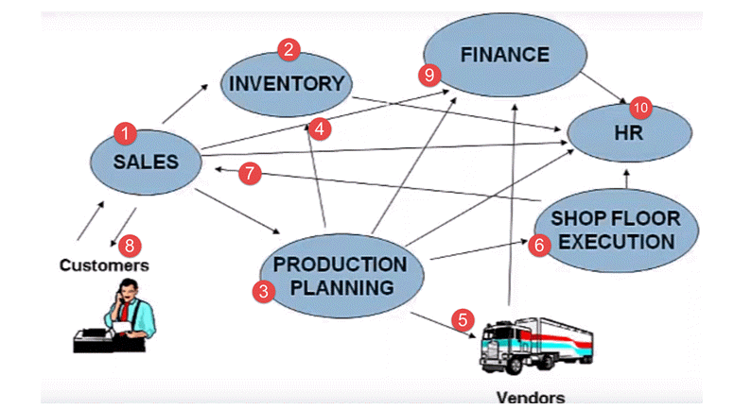
Why SAP?

Slide 31
Online help for ABAP
ABAP help (http://help.sap.com/saphelp_nw04/helpdata/de/d3/2e974d35c511d1829f0000e829fbfe/frameset.htm)
SAP marketplace (www.service.sap.com)
SAP Community Network (www.sdn.sap.com)
Transaction ABAPDOCU
Books:
ABAP-Objects, SAP PRESS, ISBN-13: 978-1592290796
The Official ABAP Reference, SAP PRESS, ISBN-13: 978-1592290390

