Slide 1

Day One:
Welcome to Data Engineering
Christian Alcaria
Notes:
Café Enchancia workshop. Use README.md, Discovery Call/Facilitator_Notes.md and VALIDATION.md for setup, scope and expected results. The agenda remains four hours; supporting setup, sales-rule and scope slides fit within existing discussion/demo slots.

Slide 2


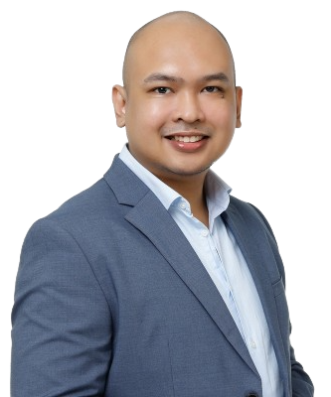




Your Facilitator
Professional Profile
Microsoft & Data Platform Specialist
Data & Technology Expertise
Industry Expertise
Databricks
BPO
Automotive
Healthcare
7 Years
Professional Experience
E-commerce
Azure Synapse
9x
Microsoft Certified
dbt
Practice Line Advisor
Microsoft Partner
Microsoft MVP Aspirant
Gumby Awardee
Data Community Champion
Microsoft Fabric
Snowflake
Certifications
Lean Agile
ITIL v4
Microsoft
Alteryx Development
Christian Alcaria, 3Cloud Lead Consultant / Data Engineer

Slide 3
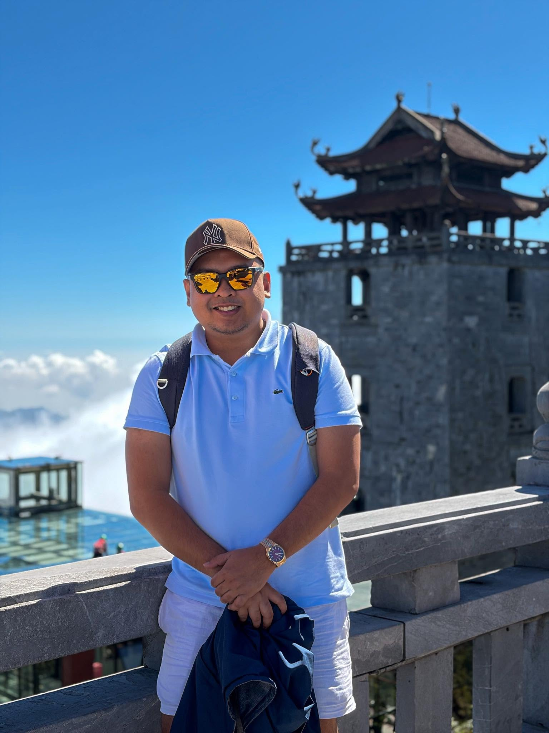
Your Facilitator – Outside of Work
Christian Alcaria
Data Enthusiast 📊📉
Car / DieCast Enthusiast 🚗
TCG Hobbyist 🎴🏴‍☠
PC / Console Gamer 🎮
Mountaineer ⛰️🧗
Weekend Warrior Athlete 🏃🥇
World Wanderer 🌍✈️
Disney Castle Chaser 🏰✨

Slide 4
About 3Cloud – A Cognizant Company
Microsoft US Power BI Partner and Azure Influencer awards
Expertise in business intelligence and Azure adoption, as listed on 3Cloud’s awards page. Learn more
Microsoft US Partner of the Year and US Azure Analytics
Customer impact through Microsoft solutions and cloud analytics.
Learn more
Microsoft Americas Channel US Partner of the Year
Innovation and business impact using Microsoft technologies.
Learn more
2021
2023
2025
2020
2022
2024
Microsoft US Azure
Influencer Partner Award
Helping customers adopt and succeed with Azure. Pragmatic Works, acquired by 3Cloud that year, also won the US Power BI Partner Award.
Learn more
Microsoft Worldwide Migration to Azure and Solution Assessments awards; US Solution Assessments and Modernizing Applications awards
Helping organizations assess, migrate, and modernize their technology.
Learn more
Microsoft Americas Partner of the Year — Data & AI; Health & Life Sciences
Delivering data, AI, and healthcare technology solutions.
Learn more

Slide 5

Code of Cooperation
Creating a productive, respectful, and enjoyable environment is key to our success. By following these simple guidelines, we can ensure that everyone feels valued, heard, and engaged.
Participant ID and Group Number
Please keep your participant ID and group number visible throughout the session.
Training Resources and Data
Use only assigned training resources, environments, and fictional data. Never share passwords, access tokens, or confidential information.
Active Participation
Rotate the keyboard so everyone gets hands-on experience. Collaborate, share ideas, and help your teammates learn.
Troubleshooting and Questions
Raise your hand when you encounter a blocker. Share the error message and what you have tried. Feel free to ask questions and learn from others.
Breaks Schedule
We will have two 10-minute breaks, followed by a final 5-minute break.

Slide 6
Form your Engineering Teams
01
02
03
  Form your Groups
  We need 10 groups, numbered 01-10
  Aim for 4-5 people per group
  Assign Roles
  Each group must assign the following roles:
  Driver
  Runs the notebook and explains each code change.
  Reviewer
  Checks the requirements, code, and results for accuracy.
  Recorder
  Documents team decisions, evidence, and any problems encountered.
  Presenter
  Explains the team's results and their business implications.
  Collaborate
  Work together to complete the assigned tasks.
  Review and discuss each change before implementing it.
  Make sure everyone understands the code and the results.
  Rotate team roles for each layer of the activity so that everyone has an opportunity to participate and develop different skills.
©2026 3Cloud, Proprietary & Confidential
6
Notes:
Café Enchancia workshop. Use README.md, Discovery Call/Facilitator_Notes.md and VALIDATION.md for setup, scope and expected results. The agenda remains four hours; supporting setup, sales-rule and scope slides fit within existing discussion/demo slots.

Slide 7
Group setup and run order
Use ten groups. README.md assigns each group a store and tip_group_01–10 schema.
Set store and target_schema in every notebook. Keep them consistent across layers.
Bronze source_path is /Volumes/ws_tip_demo/tip_demo_schema, without a country suffix.
Run Bronze, then Silver, then Gold for your assigned store. Compare VALIDATION.md.
Instructor: load all seven stores in one schema before running Gold with store = ALL.
©2026 3Cloud, Proprietary & Confidential
7

Slide 8
What Your Team Will Deliver
Your team must use Databricks and the Medallion Architecture to develop a solution that addresses a business need.
🥉
🥈
🥇
BRONZE LAYER
SILVER LAYER
GOLD LAYER
Create a Bronze table that preserves the original input records.
Create a Silver table with clearly defined transformation rules and data processing logic.
Save one Gold sales table. Query daily and product summaries.
DEMONSTRATE YOUR SOLUTION
Prepare the following deliverables:
Task Board: Track your team's tasks, progress, and responsibilities.
Acceptance Evidence: Provide evidence that your solution meets the requirements.
Two-Minute Demo: Demonstrate your solution, explain the results, and highlight how it addresses the business need.
©2026 3Cloud, Proprietary & Confidential
8
Notes:
Café Enchancia workshop. Use README.md, Discovery Call/Facilitator_Notes.md and VALIDATION.md for setup, scope and expected results. The agenda remains four hours; supporting setup, sales-rule and scope slides fit within existing discussion/demo slots.

Slide 9

Agenda
Time | Duration | Activity
 | 20 mins | Welcome, Code of Cooperation & Teams
 | 25 mins | Business Need, Roles and Ways of Working
 | 20 mins | Requirements and Backlog Activity
 | 10 mins | Break
 | 35 mins | Technical Demo and Story Breakdown, Group 1 Demo
 | 25 mins | Bronze Exercise and Checkpoint
 | 10 mins | Break
 | 30 mins | Silver Exercise and Checkpoint, Group 2 Demo
 | 25 mins | Gold Exercise, Group 3 Demo
 | 05 mins | Break
 | 25 mins | Group 4 – 10 Demos
 | 10 mins | Retrospective and Closing

Slide 10
How does a Project Start?
A stakeholder has a problem or decision to make.
The team clarifies value, scope, data and success measures.
The Product Owner helps prioritize the work.
Engineers investigate access, feasibility and dependencies.
The team delivers a small outcome and reviews the evidence.
©2026 3Cloud, Proprietary & Confidential
10
Notes:
Café Enchancia workshop. Use README.md, Discovery Call/Facilitator_Notes.md and VALIDATION.md for setup, scope and expected results. The agenda remains four hours; supporting setup, sales-rule and scope slides fit within existing discussion/demo slots.

Slide 11

Café Enchancia
Our fictional client
As data engineers, students turn sales and product records into trusted reports on bestsellers and store performance.
Seven stores. Three countries. One PHP reporting view using New York dates.

Slide 12

Project Roles: Product and Delivery
Product Owner
Scrum Master
Clarifies value and orders the backlog
Supports collaboration and improvement
Ex: Confirms which sales measures matter
Ex: Helps remove recurring impediments
Project Manager
Stakeholder
Coordinates schedule, resources and risk
Explains rules and evaluates usefulness
Ex: Tracks access dependencies
Ex: Defines which orders count as sales
©2026 3Cloud, Proprietary & Confidential
12
Notes:
Café Enchancia workshop. Use README.md, Discovery Call/Facilitator_Notes.md and VALIDATION.md for setup, scope and expected results. The agenda remains four hours; supporting setup, sales-rule and scope slides fit within existing discussion/demo slots.

Slide 13
Project Roles: Engineering
Architect / Tech Lead
Data / Engineering Manager
Senior Data Engineer
Associate / Junior Engineer
Intern
Guides architecture, standards and technical decisions
Supports staffing, people and engineering capability
Solves complex problems, reviews and mentors
Delivers scoped tasks with support and review, Builds, tests and operates pipelines
Learns through supervised contributions
©2026 3Cloud, Proprietary & Confidential
13
Notes:
Café Enchancia workshop. Use README.md, Discovery Call/Facilitator_Notes.md and VALIDATION.md for setup, scope and expected results. The agenda remains four hours; supporting setup, sales-rule and scope slides fit within existing discussion/demo slots.

Slide 14
Ways of working
Sprint goal
Review progress at each layer checkpoint.
Create Notes
Track each task using the following statuses: To Do, In Progress, Review, and Done. Record blockers explicitly.
Task Ownership
Every task has a designated owner, and every change has an assigned reviewer.
Daily Check-in
Hold a short check-in to cover progress, next actions, and blockers.
Acceptance Criteria Define the evidence required to consider each task complete.
©2026 3Cloud, Proprietary & Confidential
14
Notes:
Café Enchancia workshop. Use README.md, Discovery Call/Facilitator_Notes.md and VALIDATION.md for setup, scope and expected results. The agenda remains four hours; supporting setup, sales-rule and scope slides fit within existing discussion/demo slots.

Slide 15
Ways of working
Workshop goal: trusted sales reporting from the supplied seven-day batch.
Track tasks as To Do, In Progress, Review and Done. Record blockers.
Each task has an owner. Each change has a reviewer.
Use short classroom iterations and check in at each layer checkpoint.
Acceptance criteria define the evidence required for completion.
©2026 3Cloud, Proprietary & Confidential
15
Notes:
Café Enchancia workshop. Use README.md, Discovery Call/Facilitator_Notes.md and VALIDATION.md for setup, scope and expected results. The agenda remains four hours; supporting setup, sales-rule and scope slides fit within existing discussion/demo slots.

Slide 16
Epic, user story and task
Level | Purpose | Workshop example
Epic | Business outcome | Trusted sales reporting for Café Enchancia.
User story | Who benefits and why | Bronze: trace source records. Silver: compare typed orders in PHP and New York dates. Gold: analyze all selected stores in one sales table.
Acceptance criteria | Observable proof | Bronze: source values and counts match. Silver: valid types, unique keys, correct FX and dates. Gold: one table; counts and totals reconcile.
Task | Implementation work | Read CSVs, validate and convert fields, union store records, verify outputs.
Definition of Done | Shared quality standard | Code reviewed, checks passed, acceptance evidence captured, notes updated.
©2026 3Cloud, Proprietary & Confidential
16
Notes:
Café Enchancia workshop. Use README.md, Discovery Call/Facilitator_Notes.md and VALIDATION.md for setup, scope and expected results. The agenda remains four hours; supporting setup, sales-rule and scope slides fit within existing discussion/demo slots.

Slide 17
Who shapes the backlog?
Stakeholder and Product Owner clarify the need and priority.
Tech Lead and engineers identify design choices and dependencies.
Engineers and QA make acceptance criteria testable.
The team refines and estimates the work together.
Open questions become visible decisions or blockers.
©2026 3Cloud, Proprietary & Confidential
17
Notes:
Café Enchancia workshop. Use README.md, Discovery Call/Facilitator_Notes.md and VALIDATION.md for setup, scope and expected results. The agenda remains four hours; supporting setup, sales-rule and scope slides fit within existing discussion/demo slots.

Slide 18
Requirements activity: 20 minutes
Read Discovery_Call.md: 8 minutes. The transcript is a separate file.
Record the problem, reporting outputs, source access and confirmed rules.
Use 8 minutes to draft one epic and the Bronze, Silver and Gold stories.
Use the final 4 minutes for three open questions and an access request.
Nominate one contact email. The instructor assigns your schema and store.
©2026 3Cloud, Proprietary & Confidential
18
Notes:
Café Enchancia workshop. Use README.md, Discovery Call/Facilitator_Notes.md and VALIDATION.md for setup, scope and expected results. The agenda remains four hours; supporting setup, sales-rule and scope slides fit within existing discussion/demo slots.

Slide 19
Epic and core stories
Epic E01: Trusted sales reporting for Café Enchancia across seven stores.
B01: As an engineer, I need raw store records preserved for traceability.
S01: As an analyst, I need validated orders with PHP sales and New York dates.
G01: As the owner, I need one sales table to compare stores and products.
©2026 3Cloud, Proprietary & Confidential
19
Notes:
Café Enchancia workshop. Use README.md, Discovery Call/Facilitator_Notes.md and VALIDATION.md for setup, scope and expected results. The agenda remains four hours; supporting setup, sales-rule and scope slides fit within existing discussion/demo slots.

Slide 20
Break: 10 minutes
When you return: access check and Tech Lead demonstration.
Keep your requirements notes and group number ready.
©2026 3Cloud, Proprietary & Confidential
20
Notes:
Café Enchancia workshop. Use README.md, Discovery Call/Facilitator_Notes.md and VALIDATION.md for setup, scope and expected results. The agenda remains four hours; supporting setup, sales-rule and scope slides fit within existing discussion/demo slots.

Slide 21
Technical foundation demo
Show the CSV contract, assigned store, source Volume and target schema.
Explain per-store Bronze and Silver tables, then one consolidated Gold table.
Select Spark compute. Confirm Volume access and target-table permissions.
Set store and target_schema. Bronze adds the country folder to source_path.
Run Bronze, Silver and Gold in order. Git and secret retrieval are optional follow-up topics.
©2026 3Cloud, Proprietary & Confidential
21
Notes:
Café Enchancia workshop. Use README.md, Discovery Call/Facilitator_Notes.md and VALIDATION.md for setup, scope and expected results. The agenda remains four hours; supporting setup, sales-rule and scope slides fit within existing discussion/demo slots.

Slide 22






Workshop architecture
Business delivery: CSV by email or network drive. Direct POS access is unavailable.
Volume staging
Instructor uploads
7 store CSVs
Bronze
Raw strings
One table per store
Silver
Typed records
PHP sales + NY date
Gold
One detail table
Summary queries
→
→
→
One-store group: 3 tables. Instructor all-store schema: 7 Bronze + 7 Silver + 1 Gold.
Students query the Gold table; a published dashboard is follow-up work.

Slide 23
Sales rules and expected results
One row is one single-product order. Keep COMPLETED and CANCELLED records.
Completed local sales = quantity × unit_price − whole-order discount.
PHP sales = local net sales × fixed FX rate, rounded to two decimals per order.
FX to PHP: PHP 1; USD 60; KRW 0.04. Tax is excluded; refunds are not supplied.
All-store archive: 25,824 orders; 24,747 completed; PHP 16,618,027.50 net sales.
©2026 3Cloud, Proprietary & Confidential
23

Slide 24
Workshop scope and reporting limits
Today: a fixed seven-day archive. Data is already clean; validate it before writing.
At 8 a.m. New York, the previous day is provisional under Asian midnight exports.
In this archive, October 19–24 have complete global New York date coverage.
Backlog: scheduled delivery, completeness flags, alerts and incremental history.
Backlog: corrected files, refunds, real tax rules, approved FX and a dashboard.
©2026 3Cloud, Proprietary & Confidential
24

Slide 25
Engineering habits during the lab
KISS: use the simplest logic that satisfies the requirement.
Give variables, tables and functions clear names.
Keep source paths and table names in configuration.
Extract repeated logic into a small function when useful.
Review generated code and explain every transformation.
©2026 3Cloud, Proprietary & Confidential
25
Notes:
Café Enchancia workshop. Use README.md, Discovery Call/Facilitator_Notes.md and VALIDATION.md for setup, scope and expected results. The agenda remains four hours; supporting setup, sales-rule and scope slides fit within existing discussion/demo slots.

Slide 26
User story breakdown activity
Break B01 into tasks with a clear owner and output.
Include access checks, implementation, validation and review.
Identify what could block each task.
One group presents its breakdown in two minutes.
The room checks whether every acceptance criterion has a task.
©2026 3Cloud, Proprietary & Confidential
26
Notes:
Café Enchancia workshop. Use README.md, Discovery Call/Facilitator_Notes.md and VALIDATION.md for setup, scope and expected results. The agenda remains four hours; supporting setup, sales-rule and scope slides fit within existing discussion/demo slots.

Slide 27
B01: Bronze acceptance criteria
All 14 expected source columns exist in the supplied order.
Preserve every selected store row. The seven-store total is 25,824.
Keep raw business fields as strings, including local amounts and timestamps.
Add source_file, source_path and ingested_at_utc to every row.
Rerunning the same batch preserves the selected store count without duplication.
©2026 3Cloud, Proprietary & Confidential
27
Notes:
Café Enchancia workshop. Use README.md, Discovery Call/Facilitator_Notes.md and VALIDATION.md for setup, scope and expected results. The agenda remains four hours; supporting setup, sales-rule and scope slides fit within existing discussion/demo slots.

Slide 28
Bronze lab: 25 minutes
Set store and target_schema. Read the CSV from the shared source Volume.
Check the 14 column names against the source contract.
Add source_file, source_path and ingested_at_utc without changing values.
Write ec_bronze_<store> in your assigned group schema.
Compare source values and counts. Capture evidence before and after rerun.
©2026 3Cloud, Proprietary & Confidential
28
Notes:
Café Enchancia workshop. Use README.md, Discovery Call/Facilitator_Notes.md and VALIDATION.md for setup, scope and expected results. The agenda remains four hours; supporting setup, sales-rule and scope slides fit within existing discussion/demo slots.

Slide 29
Break: 10 minutes
Next: type validation, New York reporting dates and PHP conversion.
©2026 3Cloud, Proprietary & Confidential
29
Notes:
Café Enchancia workshop. Use README.md, Discovery Call/Facilitator_Notes.md and VALIDATION.md for setup, scope and expected results. The agenda remains four hours; supporting setup, sales-rule and scope slides fit within existing discussion/demo slots.

Slide 30
S01: Silver acceptance criteria
Preserve the Bronze count and require unique transaction IDs.
Validate required fields, types, dates, quantities, discounts and statuses.
Retain local values. Derive UTC timestamps and New York reporting dates.
Calculate net sales after discounts, convert to PHP and round per order.
Keep cancellations with zero sales. Fail before writing if validation fails.
©2026 3Cloud, Proprietary & Confidential
30
Notes:
Café Enchancia workshop. Use README.md, Discovery Call/Facilitator_Notes.md and VALIDATION.md for setup, scope and expected results. The agenda remains four hours; supporting setup, sales-rule and scope slides fit within existing discussion/demo slots.

Slide 31
Silver lab: 30 minutes
Read ec_bronze_<store>; validate the source contract and selected store.
Convert dates, quantity, unit_price and discount_amount to agreed types.
Derive timestamp_utc and report_date_ny using the store time zone.
Calculate net_sales_php with fixed FX rates; cancellations contribute zero.
Write ec_silver_<store>. Check counts, keys, conversions and saved values.
©2026 3Cloud, Proprietary & Confidential
31
Notes:
Café Enchancia workshop. Use README.md, Discovery Call/Facilitator_Notes.md and VALIDATION.md for setup, scope and expected results. The agenda remains four hours; supporting setup, sales-rule and scope slides fit within existing discussion/demo slots.

Slide 32
G01: Gold acceptance criteria
Save ONE ec_gold_sales table at store_id + transaction_id grain.
Retain all selected Silver rows, including cancelled orders.
Use net_sales_php. Add units_sold, completed_orders and cancelled_orders.
Cancellations contribute zero sales, sold units and completed-order counts.
Reconcile counts and totals with Silver; reruns preserve business results.
©2026 3Cloud, Proprietary & Confidential
32
Notes:
Café Enchancia workshop. Use README.md, Discovery Call/Facilitator_Notes.md and VALIDATION.md for setup, scope and expected results. The agenda remains four hours; supporting setup, sales-rule and scope slides fit within existing discussion/demo slots.

Slide 33
Gold lab: 25 minutes
Select your assigned store. ALL requires seven Silver tables in one schema.
Combine selected Silver tables and add reporting measures. Do not reconvert FX.
Write one Gold table. A single-store refresh replaces only that store.
Query sales by New York day, store, country and product. No extra tables.
Compare with VALIDATION.md. Capture reconciliation and rerun evidence.
©2026 3Cloud, Proprietary & Confidential
33
Notes:
Café Enchancia workshop. Use README.md, Discovery Call/Facilitator_Notes.md and VALIDATION.md for setup, scope and expected results. The agenda remains four hours; supporting setup, sales-rule and scope slides fit within existing discussion/demo slots.

Slide 34
Quality checks across the layers
Bronze: schema, source traceability and complete record counts.
Silver: valid types, business rules and unique keys.
Gold: correct grain, metric definition and reconciled totals.
Pipeline: failure visibility and safe reruns.
A passing cell is useful evidence only when it tests the requirement.
©2026 3Cloud, Proprietary & Confidential
34
Notes:
Café Enchancia workshop. Use README.md, Discovery Call/Facilitator_Notes.md and VALIDATION.md for setup, scope and expected results. The agenda remains four hours; supporting setup, sales-rule and scope slides fit within existing discussion/demo slots.

Slide 35
Break: 5 minutes
Prepare a two-minute demonstration with your group.
©2026 3Cloud, Proprietary & Confidential
35
Notes:
Café Enchancia workshop. Use README.md, Discovery Call/Facilitator_Notes.md and VALIDATION.md for setup, scope and expected results. The agenda remains four hours; supporting setup, sales-rule and scope slides fit within existing discussion/demo slots.

Slide 36
Retrospective and next steps
What requirement changed the way you wrote the code?
Which check gave you the most confidence?
What would you improve before scheduling this pipeline?
Next practice: add one new rule and its validation check.
Confidence comes from preparation and repeated practice.
©2026 3Cloud, Proprietary & Confidential
36
Notes:
Café Enchancia workshop. Use README.md, Discovery Call/Facilitator_Notes.md and VALIDATION.md for setup, scope and expected results. The agenda remains four hours; supporting setup, sales-rule and scope slides fit within existing discussion/demo slots.

Slide 37
Thank you
Day 1 is the beginning.
You can build, question and improve the systems you work with.
Christian Alcaria
©2026 3Cloud, Proprietary & Confidential
37
Notes:
Café Enchancia workshop. Use README.md, Discovery Call/Facilitator_Notes.md and VALIDATION.md for setup, scope and expected results. The agenda remains four hours; supporting setup, sales-rule and scope slides fit within existing discussion/demo slots.

