Slide 1
SECURITY VULNERABILITIES
Manjunathan C.
Security Analyst

Slide 2
Synopsis
Introduction
Cross-Site Scripting
Types
Models
Impact and Prevention
Conclusion

Slide 3
Introduction
In this modern world everything is being modernized.
Just as security features are increasing day by day, at the same time users information being stolen Sometimes due to the Illegal hackers and sometimes due to the careless of the security system officials.
To identify and fix those vulnerabilities many organizations OWASP,PortSwigger have released many security standards based on the impact of the vulnerability.
Today I take a session about One of those vulnerabilities named Cross Site Scripting

Slide 4
Cross Site Scripting(XSS)- A7:2017
It is a type of injection, in which attacker inject their payload to retrieve sensitive information such as user cookies
An attacker can use XSS to send a malicious script to an unsuspecting user.
The end user’s browser has no way to know that the script should not be trusted, and will execute the script.
Because it thinks the script came from a trusted source, the malicious script can access any cookies, session tokens, or other sensitive information retained by the browser and used with that site.

Slide 5
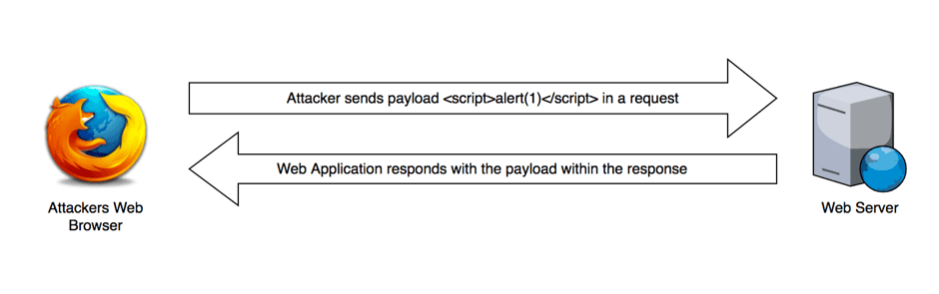
Reflected XSS
1.Reflected XSS:
Reflected XSS occurs when user input is immediately returned by a web application in an error message, search result, or any other response that includes some or all of the input provided by the user as part of the request, without that data being made safe to render in the browser, and without permanently storing the user provided data.

Slide 6
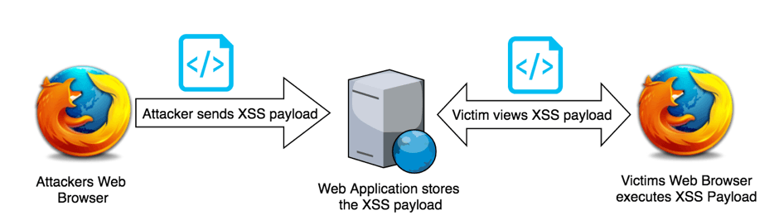
Stored XSS
2.Stored XSS:
Stored XSS generally occurs when user input is stored on the target server, such as in a database, in a message forum, visitor log, comment field, etc

Slide 7
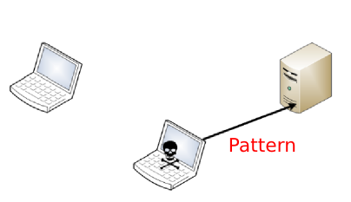
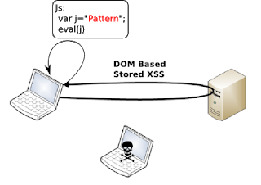
DOM Based XSS
3.DOM based XSS:
DOM based XSS, occurs when input can be controlled by a user and it’s output is rendered within the page. This allows an attacker to manipulate DOM objects that are rendered within a page typically with a payload crafted within the URL.

Slide 8
Model Reports
Reflected XSS: https://hackerone.com/reports/789652
Stored XSS: https://hackerone.com/reports/647130
DOM based XSS: https://hackerone.com/reports/949382

Slide 9
Impact & Prevention
Impact:
There is a reason why it has been in OWASP for 2013 and 2017. XSS can have huge implications for a web application and its users. User accounts can be hijacked, credentials could be stolen, sensitive data could be exfiltrated, and lastly, access to your client computers can be obtained.
Prevention:
Use Firewall, Add XSS filters, Encode(URL Encoding , HTML Encoding, Base64 encoding) the characters insert by the User, Don’t allow users to insert any unwanted special characters in input fields. Take care in Hidden fields also.

Slide 10
Conclusion
As always said, In internet nothing is 100% secure.
It is your duty to protect your information from being stolen
If you suspect any website or any data asking platform is not safe to protect your data, just leave from there.
Try to keep your data always private.
Finally don’t forget one thing you are the front-line defender of your data

Slide 11
THANK YOU!

