Slide 1
Password Attacks
MANJUNATHAN C.

Slide 2
Synopsis
Introduction
What is Password ?
Weak-Strong Passwords
Most Common Passwords
Password Attacks
Password Attacking Methods
Prevention
Conclusion

Slide 3
Introduction
Password attacks are one of the most common forms of corporate and personal data breach.
A password attack is simply happens when a Hacker tries to steal your password
There are many methods to Crack the password

Slide 4
Password
A PASSWORD is a string of characters used to verify the identity of the user during an authentication process.
Passwords provide the first line of defense against unauthorized access to your computer and personal information

Slide 5
Weak Passwords
Weak passwords always play a major role in any hack
A password that is easy to detect both by humans and by computer.
People often use obvious passwords such as the names of their children or their house number in order not to forget them.
Never ever use these types of passwords.

Slide 6
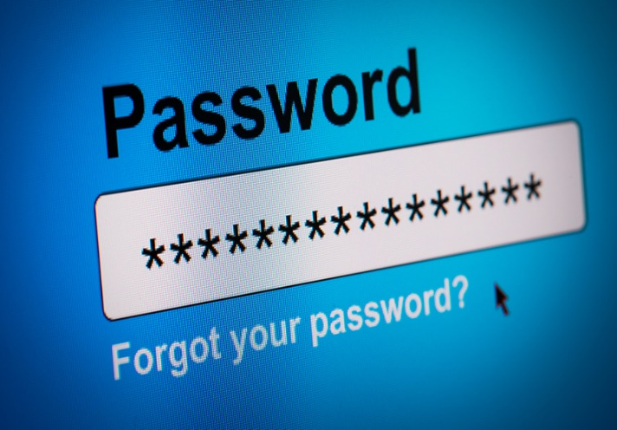
Strong Password
A minimum length of 8 characters with a limit of anywhere from 16 to 64 characters or possibly even higher
The inclusion of both uppercase and lowercase letters with case sensitivity
The use of at least one number
The use of at least one special character.
Ex: manju@123 is a weak password
M@nju!1Two3 is Strong Password

Slide 7
Most Common passwords
picture1
password
111111
12345
amd@123
iloveyou
1234567890
name@dob
qwerty
abcd@1234
000000
123123

Slide 8
What Is password attack?
Trying to steal your password without your Knowledge is known as Password attacks
In 2020, 81% of data breaches were due to compromised credentials.
Because passwords can only contain so many letters and numbers, passwords are becoming less safe.
Many passwords are poorly designed, so password attacks will remain a method of attack as long as passwords are being used.

Slide 9
Methods of Attack
Phishing
Man-in-the-middle attack
Brute force attack
Dictionary attack
Credential stuffing
Keyloggers

Slide 10
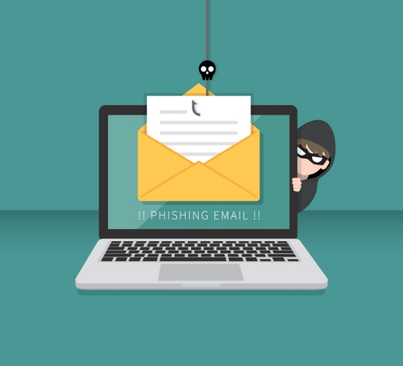
Phishing
Phishing is when a hacker posing as a trustworthy party sends you a fraudulent email, hoping you will reveal your personal information voluntarily.
Sometimes they lead you to fake "reset your password" screens.
Other times, the links install malicious code on your device.
Some Tools: Hidden Eye, King Phisher etc.

Slide 11
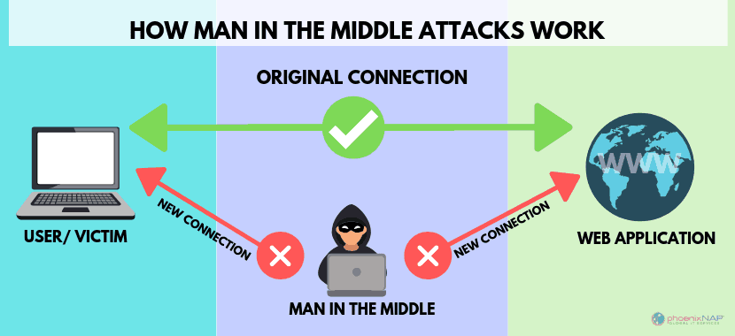
Man-in-the-middle attack
Man-in-the middle (MitM) attacks are when a hacker or compromised system sits in between two uncompromised people or systems and deciphers the information they're passing to each other, including passwords.
Some tools: Ettercap, BurpSuite, Owasp

Slide 12
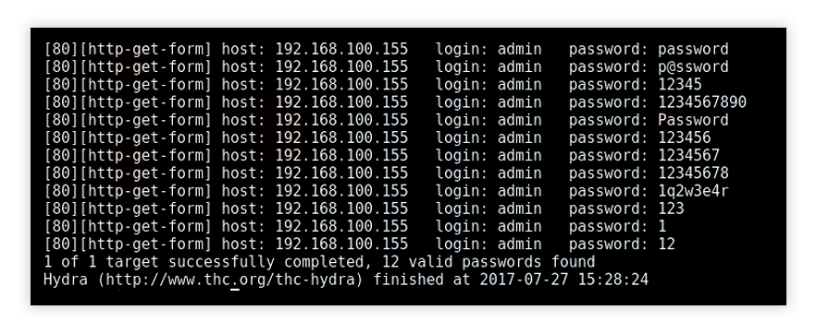
Brute force attack
In cryptography, a brute-force attack consists of an attacker submitting many passwords or passphrases with the hope of eventually guessing a combination correctly
Some tools: John The Ripper,HashCat, Aircrack-ng,Hydra

Slide 13
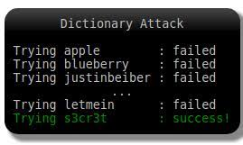
Dictionary attack
A type of brute force attack, dictionary attacks rely on our habit of picking "basic" words as our password, the most common of which hackers have collated into "cracking dictionaries.“
It has List of passwords.
Some tools: L0phtCrack, Ophcrack

Slide 14
Credential stuffing
If you've suffered a hack in the past, you know that your old passwords were likely leaked onto a disreputable website.
Credential stuffing takes advantage of accounts that never had their passwords changed after an account break-in.
Hackers will try various combinations of former usernames and passwords, hoping the victim never changed them.

Slide 15

Keyloggers
Keyloggers are a type of malicious software designed to track every keystroke and report it back to a hacker.
Typically, a user will download the software believing it to be legitimate, only for it to install a keylogger without notice.
Some tools: Spyrix, KidLogger

Slide 16
Preventing password attacks
Multi-factor authentication
Remote access
Biometrics
Changing
Don’t use password managers

Slide 17
Conclusion
In this modern world no password is safe.
It is your responsibility to protect yourself
Use a strong password
Take care when entering a password

Slide 18
THANK YOU !

