Slide 1
UK Energy Market:
DA Prices, Temperature, and Resource Mix

Slide 2
Data Sources
DataSet 1:
UKprice OFGEM UK Monthly Average Day Ahead Energy Prices 1/2015 - 2/2018
DataSet 2:
UKtemp UK National Weather UK Mean Temperature 1/2015 - 2/2018
DataSet 3:
UKmix OFGEM UK Average Energy Resource Mix 1/2015 - 2/2018

Slide 3
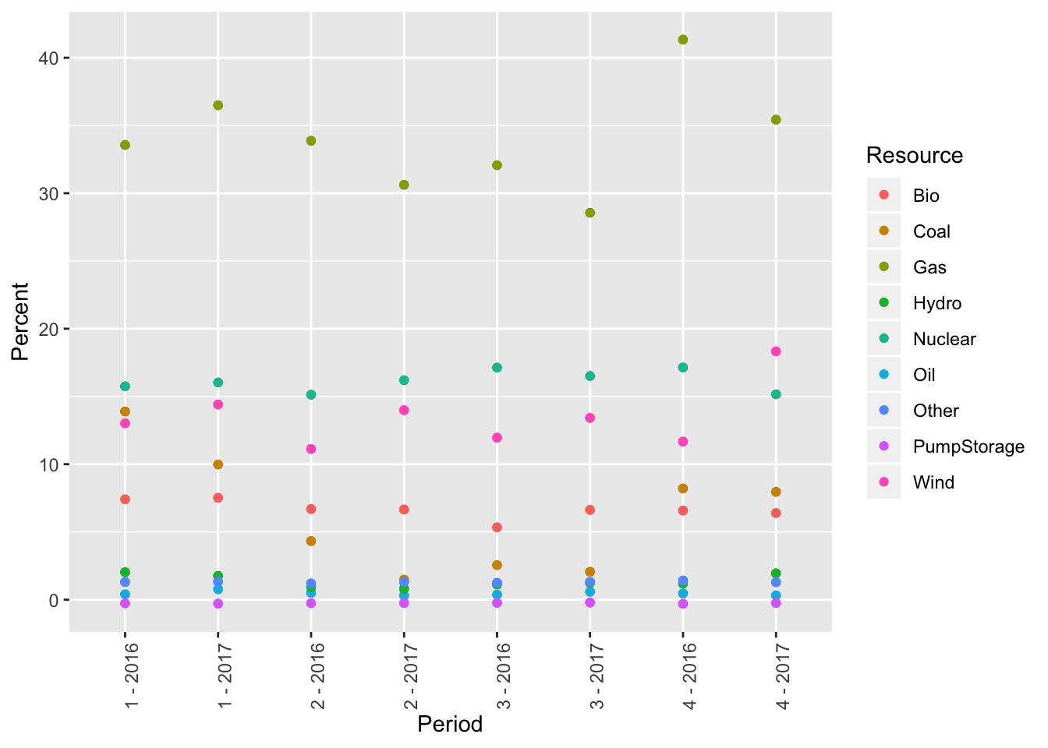
Resource Percentage by Quarter (2016, 2017)
Notes:
In this graph, we can see that the resource percentage is quite stable for each resource type. However, Wind has taken an upturn in the 4th quarter of 2017. That should be investigated further. This also shows us that Gas and Coal are increase their percentage more intensely in the winter quarters.

Slide 4
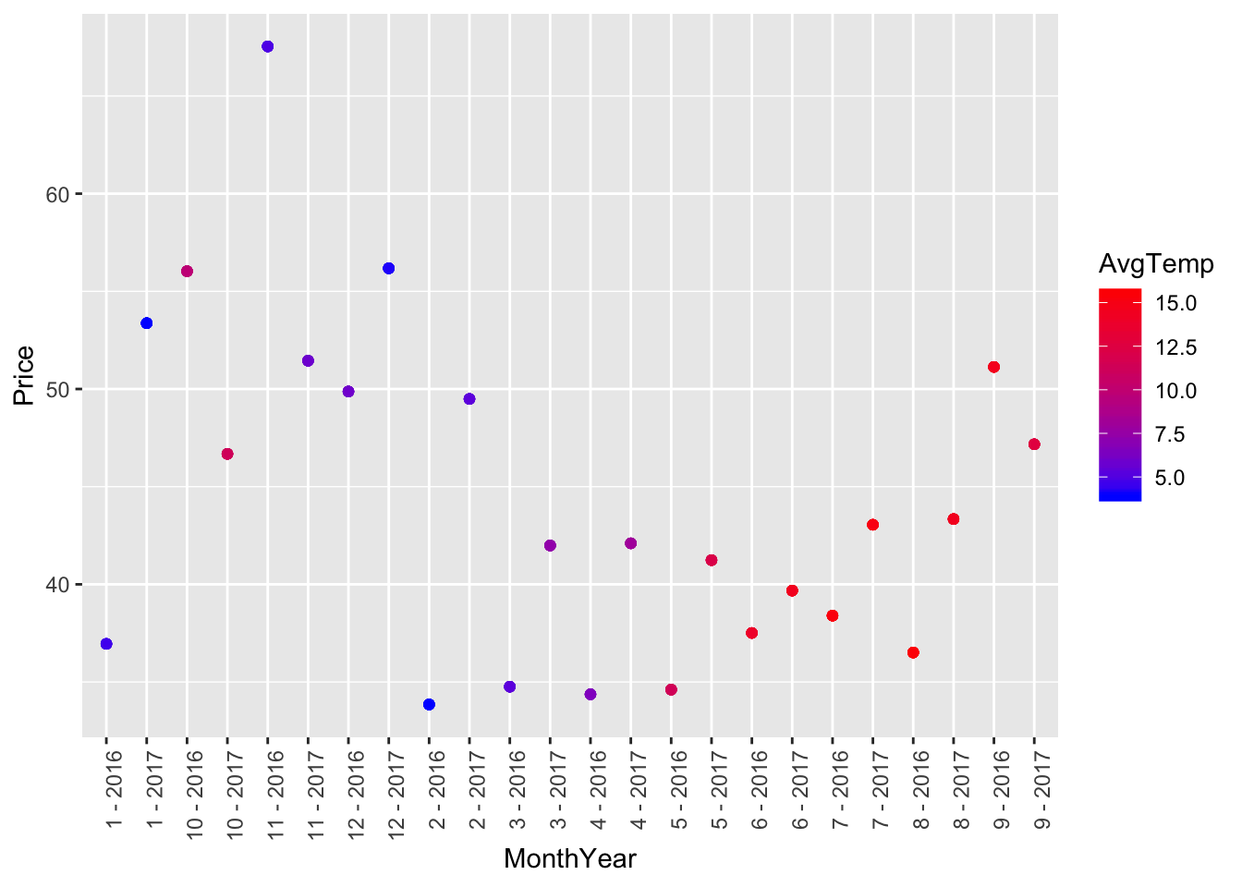
Price by Average Temperature
Notes:
Interestingly, I found that the eight highest prices, six or 75% of them were in the lowest Average Temperature range.
I found that the Highest Day Ahead Prices appeared to occur in correlation to the coldest mean Temperature. This finding would lend support to modeling the UK energy pricing market to mimic the NorthEastern US market (specifically, the PJM Independent System Operator area) as that area tends to have the highest prices during the coldest temperatures as well. In the PJM market, this is due to the prevalence of natural gas for central heating. Since central heating has a higher demand in the colder temperatures, then the natural gas demand is higher leading to higher input costs to power resources utilizing natural gas.

Slide 5
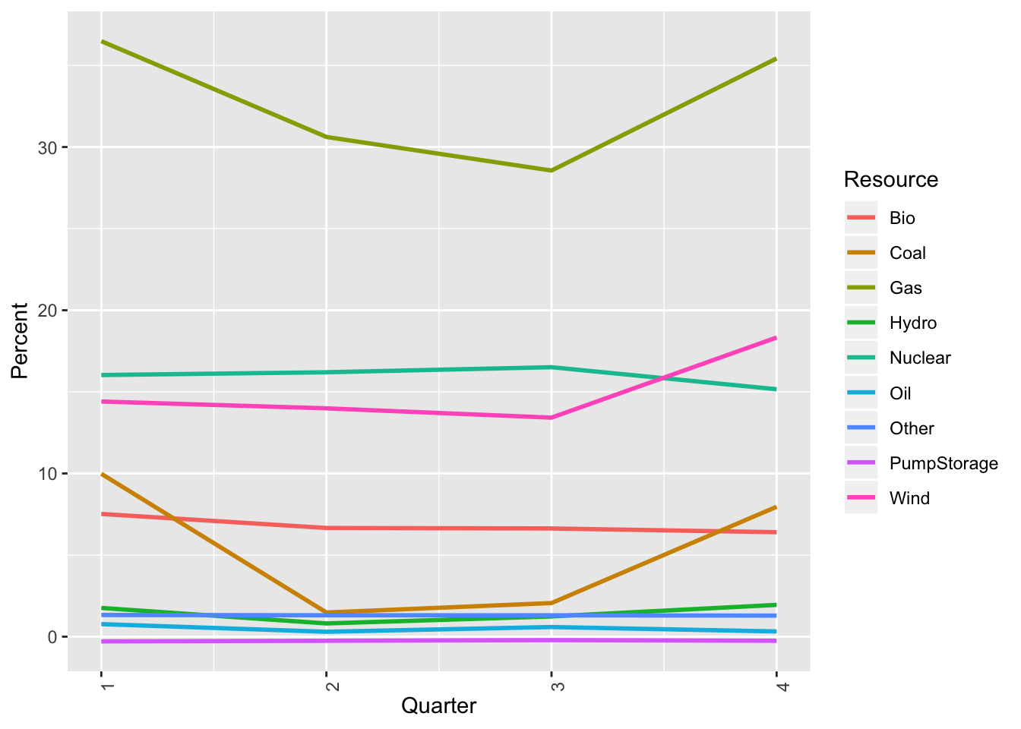
Resource Percentage by Quarter, 2017
Notes:
It looks like Wind is starting to take a more prominent role. This is something worth exploring in more detail at a later date.

Slide 6
Findings
While I was expecting to see some energy resources change their dominance in specific seasons, that did not end up being the case. The resource percentage distribution didn't change drastically from quarter to quarter as expected. The outlier in this was the fourth quarter 2017 increase in percentage of Wind Powered energy. This could be due to weather or additional wind capacity being brought online.
I found that the Highest Day Ahead Prices appeared to occur in correlation to the coldest mean Temperature. This finding would lend support to modeling the UK energy pricing market to mimic the NorthEastern US market (specifically, the PJM Independent System Operator area) as that area tends to have the highest prices during the coldest temperatures as well. In the PJM market, this is due to the prevalence of natural gas for central heating. Since central heating has a higher demand in the colder temperatures, then the natural gas demand is higher leading to higher input costs to power resources utilizing natural gas.
II found that certain resources are definitely seasonal, with Coal and Gas being the resources that are utilized more heavily in the colder quarters (1,4).

Slide 7
Next Steps
Additional research I could pursue is to overlay capacity online dates (new power plants) to provide a frame of reference for increased resource percentage. This could provide forecasted information for resource mix.
I would like to be able to dig deeper geographically to provide by congestion area instead of the entire country. This would allow for a more detailed pricing forecast.
The results of this analysis can be added to an energy pricing model.

