Slide 1

Blockchain
Cesar Marin Margaillan

Slide 2
What is Blockchain?

Slide 3
An incorruptible distributed digital ledger
A continuously growing set of public records (blocks)
Resistant to modification
Decentralized computing power and distribution

Slide 4

History
Some work on crypto-secure “block chains” and decentralized database networks done before. Nothing concrete.
No new technology involved, just put together in a new architecture/algorithm
Conceptualized in 2008 by “Satoshi Nakamoto” as a core component of the cryptocurrency Bitcoin.
Bitcoin became first digital currency to solve the double spending problem without use of a trusted authority.

Slide 5
How does it work?

Slide 6
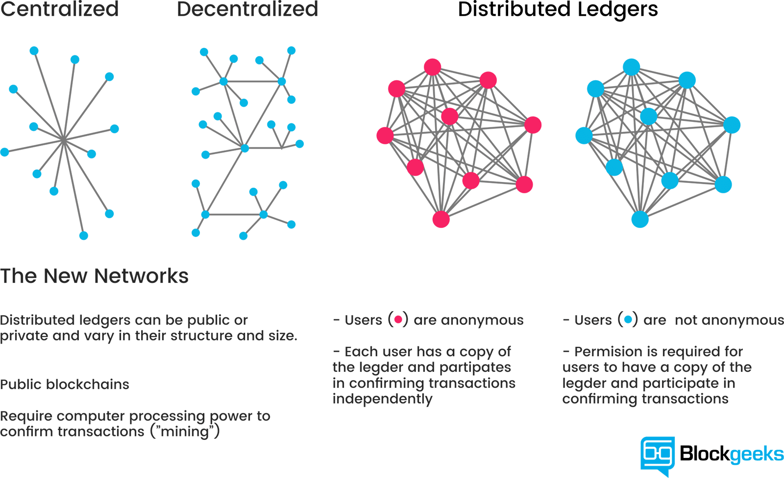
The Network
P2P decentralized database.
Every computer connected to the Blockchain network is considered a node.
Every node contains a copy of the ledger, which is a list of blocks (transactions).
Ledger blocks are hashed (and encoded into a Merkle tree), any minute change in the block results in a huge change of the hash.
Ledger is updated by all nodes periodically, so all changes are seen by all nodes.

Slide 7
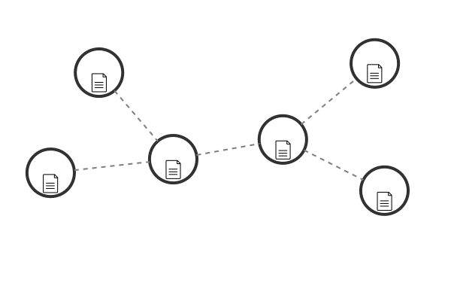
The Algorithm 1
Every node has a public and private key.
To insert a block into the Blockchain, a node signs their block with their private key. Their public key can be used to verify the signature as theirs.
Your private key serves as access to your wallet as well.
Once the block is verified by other nodes, it is added to the chain, where other nodes will work on it.
Adding a block to the chain

Slide 8
The Algorithm 2
Once a block is inserted into a chain, the node will advertise the change to the network.
Other nodes will then start working on the block, creating a hash of the first block.
Once the hash is created, the node that hashed the block will then add their own signature and advertise the change to the network.
Then other nodes will work on this new block, hash it and add their own signature, and so on.
The chain

Slide 9
Conflict Resolution
When there are conflicts of data in the ledger, the nodes simply choose whichever version has the longest chain of work.
This conflict can be simply an update to the chain (1 more block means it is chosen over the previous version without the newest signature)
The conflict can be another version of the original transaction (an attack to the chain).
Therefore, it cannot be so easy to add to the chain, otherwise attackers with more computing power could outgrow the original chain.

Slide 10
POW vs POS
Bitcoin uses Proof of Work for this. In order to add a block to the chain, the node has to solve a CPU intensive cryptographic puzzle.
Hash = h(nonce, data);
Ether (Ethereum) uses Proof of Stake, in which case the creator of the next block is chosen based on their stake of the assets (their wealth in the cryptocurrency in Ether’s case).
There are many other ways to validate the creation of a block, up to the implementer.
And many other ways to reach distributed consensus

Slide 11
The incentive to work
Nodes in the network need to be incentivized to perform the work on the network
As of today, it is done in the form of cryptocurrencies. Because of this, Bitcoin regulates their cryptocurrency by incrementing the difficulty on their proof of work.
This adds value to the currency, as it becomes harder to get Bitcoins as the complexity of the network increases.
It is up to the implementer to provide an incentive for the users.

Slide 12
So What?
How is this useful

Slide 13

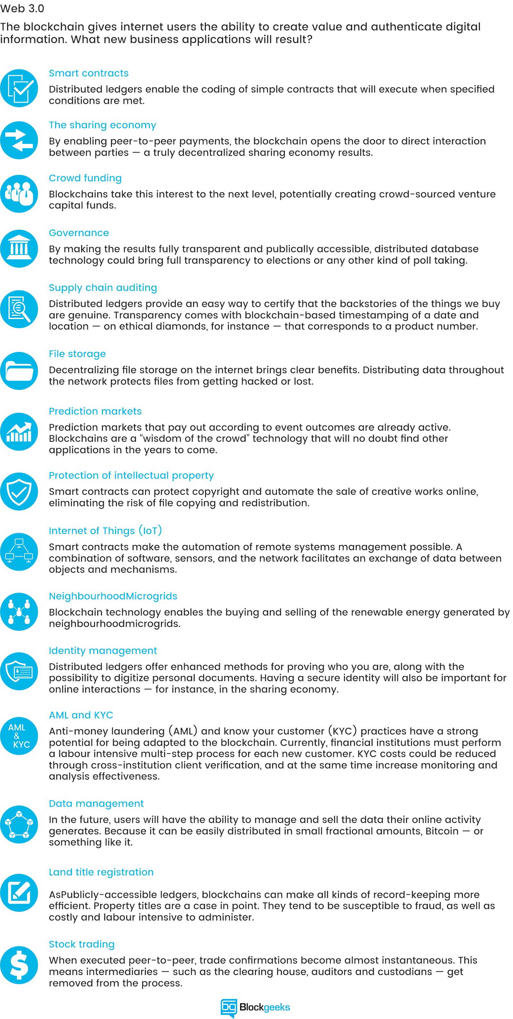
Applications of Blockchain
Smart Contracts
File Storage
Supply Chain Auditing
Protection of Intellectual Property
Anti-Money Laundering and Know-Your-Customer
Data Management
Title Registrations
Stock Trading

Slide 14
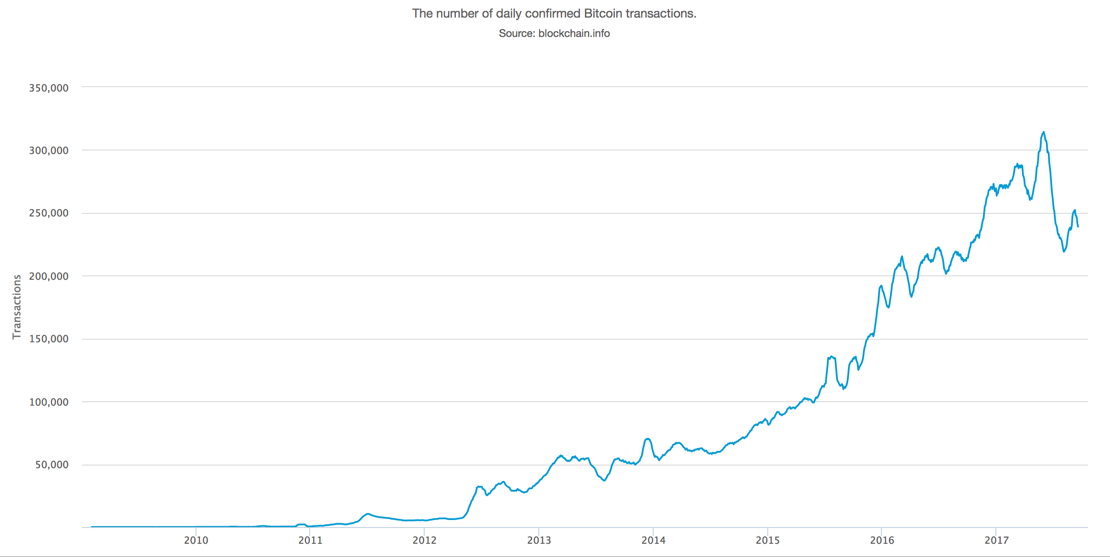
Trends & Growth

Slide 15
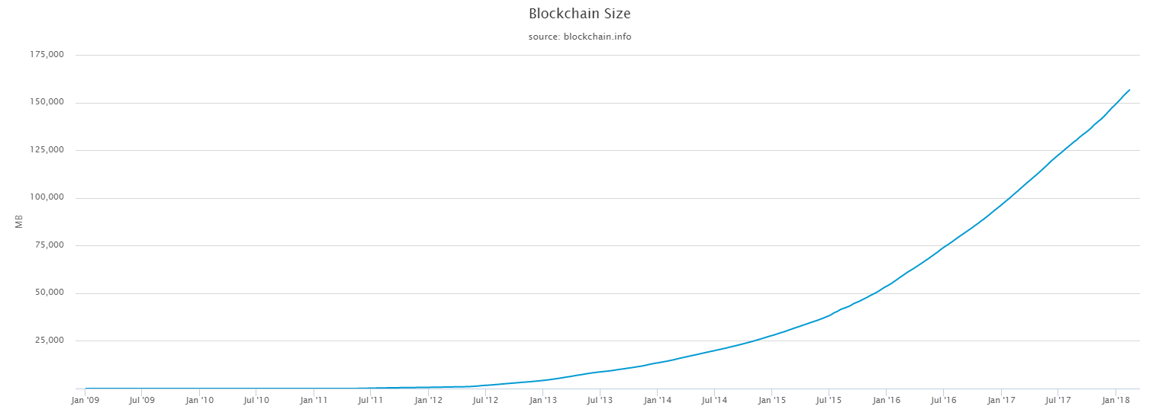
Trends & Growth

Slide 16
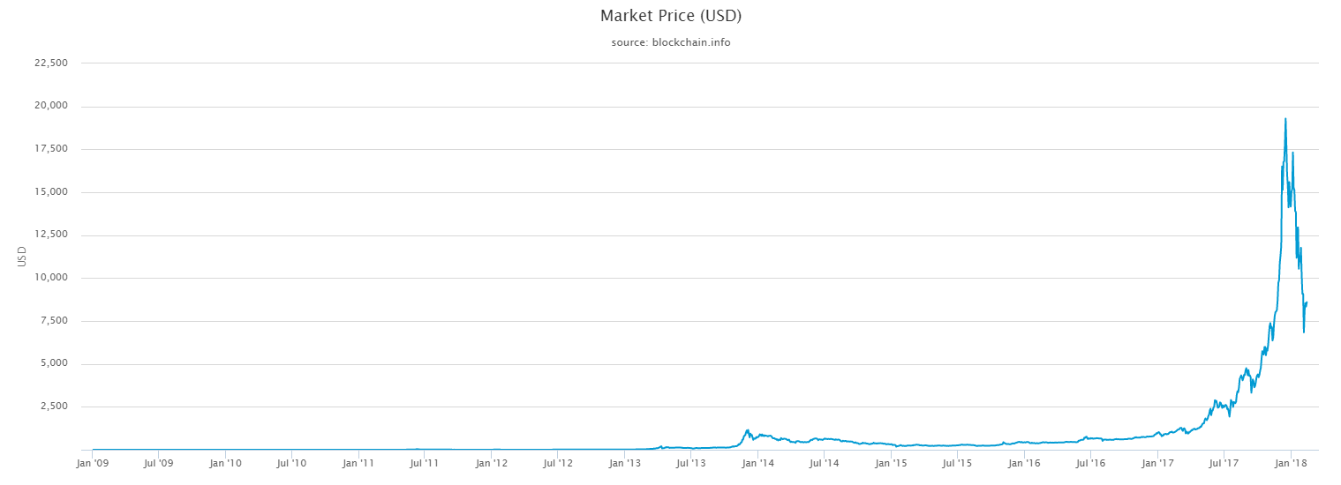
Trends & Growth

Slide 17
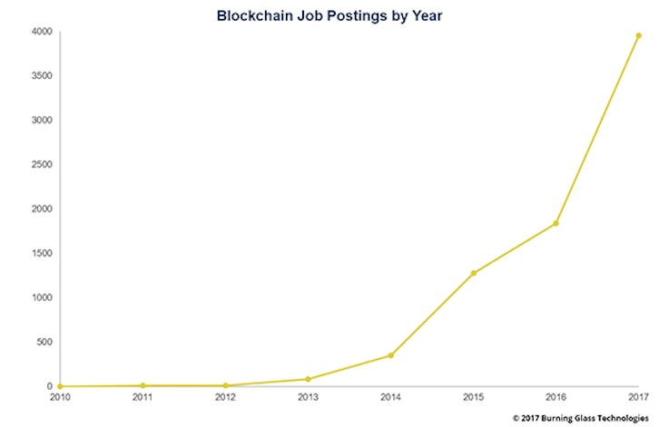
Trends & Growth
Increasing demand for Blockchain developers (top 20 fastest-growing job skills)
Demand grew 200% from last year
Second hottest job-skill in the market today

Slide 18
How do I get a piece of this cake?
I would suggest reading Bitcoin’s white paper
https://bitcoin.org/bitcoin.pdf/
Will help you understand the algorithms and techniques used
Read more white papers from other Blockchain/Crypto companies
Everyone has their own implementations, learn from the different architectures
Use the IBM Blockchain / Hyperledger environment to learn the actual programming & development
Lots of tutorials and guides to help you become a Blockchain developer

Slide 19
References
https://www.blockchain.com/
https://www.cnet.com/news/blockchain-explained-builds-trust-when-you-need-it-most/
https://blockgeeks.com/guides/what-is-blockchain-technology/
https://www.computerworld.com/article/3235972/it-careers/blockchain-jobs-continue-to-explode-offer-salary-premiums.html

Slide 20
Questions?

