Slide 1

EVEN IF YOU MISS, YOU’LL LAND AMONG THE STARS.
OF COURSE, THEN YOUR EYEBALLS WILL BOIL AND YOUR LUNGS EXPLODE
FROM DECOMPRESSION. BUT THAT’S WHAT YOU GET FOR BEING A DAMN SHOWOFF.

Slide 2
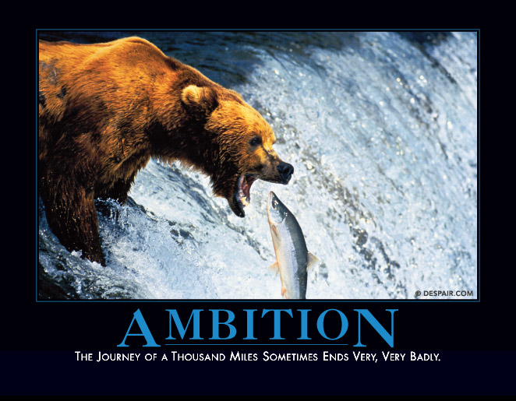
THE JOURNEY OF A THOUSAND MILES SOMETIMES ENDS VERY, VERY BADLY.

Slide 3

JUST BECAUSE YOU’VE ALWAYS DONE IT THAT WAY
DOESN’T MEAN IT’S NOT INCREDIBLY STUPID.

