Slide 1

Mexican COVID-19 Analysis
Cesar RobleS
10.26.2020
Notes:
Hello, Thank you for watching my Video Presentation for the IBM Advance Data Science Capstone. I am Cesar Robles and I'm going to analyse the COVID outbreak in Mexico.
Hope you can find this video interesting and useful.

Slide 2
Content
What is the COVID-19?
Extracting the information?
COVID-19 Distribution across Mexican States
COVID-19 in the mexican population
Daily Confirmed COVID-19 Cases in Mexico
Daily Deceased COVID-19 Reported cases in Mexico
Forecasting Using Time Series
SARIMAX Time Series Model
Notes:
For this brief presentation, I follown the next content.
* brief explanation of what is COVID
* Where we can find and download the information
* The distribution along the Mexican States
* How is affecting the Mexican population
* A daily confirm cases
* A daily deceased cases
* A brief explanation about the forecasting
* and a SARIMAM model

Slide 3
What is the COVID-19?
COVID-19 is the infectious disease caused by the coronavirus, SARS-CoV-2, which is a respiratory pathogen. WHO (World Health Organization) first learned of this new virus from cases in Wuhan, People’s Republic of China on 31 December 2019.
The virus was confirmed to have reached Mexico in February 2020. However, the National Council of Science and Technology (CONACYT) reported two cases of COVID-19 in mid-January 2020 in the states of Nayarit and Tabasco, one case per state.
As of October, there had been near 800,000 confirmed cases of COVID-19 in Mexico and circa 88,000 reported deaths, although the Secretariat of Health, through the "Programa Centinela" (Spanish for "Sentinel Program") estimated in mid July 2020 that there were more than 2,875,734 cases in Mexico, because they were considering the total number of cases confirmed as a statistical sample.
https://en.wikipedia.org/wiki/COVID-19_pandemic_in_Mexico
Notes:
The COVID outbreak is a infectious disease caused by the coronavirus, which is a respiratory pathogen.
It is affecting all the world, but for this analysis we will focus our attention to Mexico. In this case, the outbreak began on February 2020 and util today we have near 800,000 confirmed cases and 88,000 deceased.
The main idea is to understand how the COVID is propagatin along the Mexican states and how it affect in the near future.

Slide 4
Extracting the information
Retrieving the information from the Mexican source system. All the information is public, and anyone can download and interact with it.
The database is in the following link:
http://datosabiertos.salud.gob.mx/gobmx/salud/datos_abiertos/datos_abiertos_covid19.zip
The principal descriptors are in the following link:
http://datosabiertos.salud.gob.mx/gobmx/salud/datos_abiertos/diccionario_datos_covid19.zip
Both files are needed to understand the information collected by the Mexican Health Ministry. The information was splitted to avoid problems with the size volume.

Slide 5
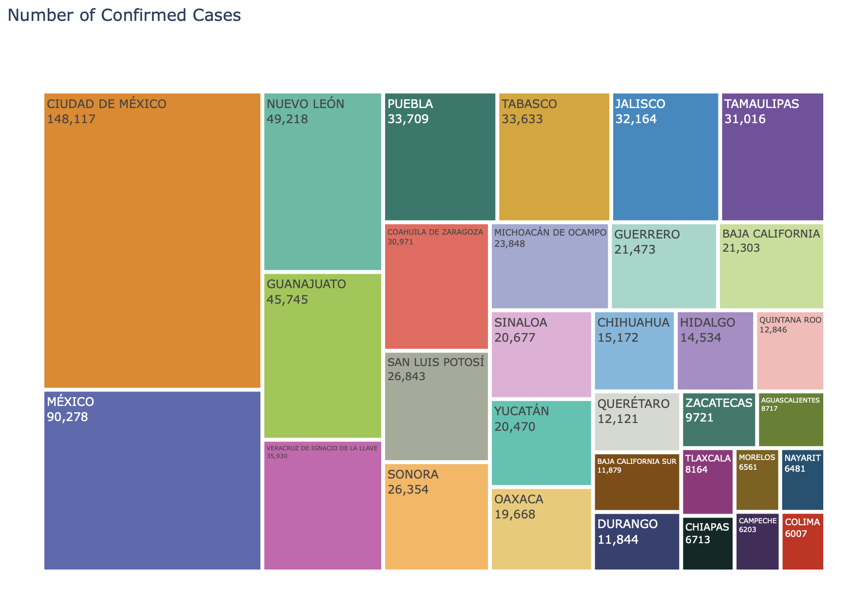
COVID-19 Distribution across Mexican States
The treemap on the left illustrates the COVID-19 distribution. The information represents the confirmed cases displaying the most affected in a big square and the less affected into a small square.

Slide 6
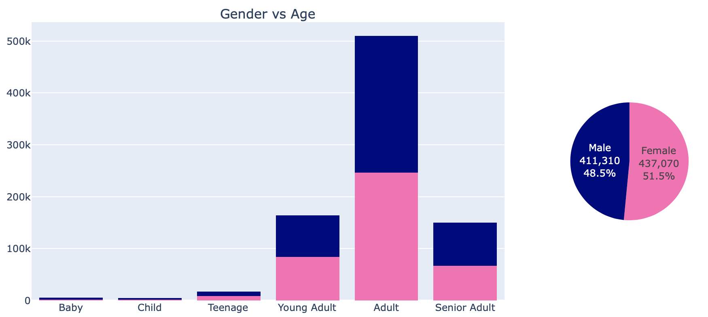
COVID-19 In the mexican population
Age | Classification
0 – 4 | Baby
5 - 8 | Child
9 - 17 | Teenage
18 - 30 | Young Adult
31 - 60 | Adult
Greater than 60 | Senior Adults
The age classification was done using the Mexican Age groups. This can be different by each country.
Women are the most affected and also the adults age range.

Slide 7
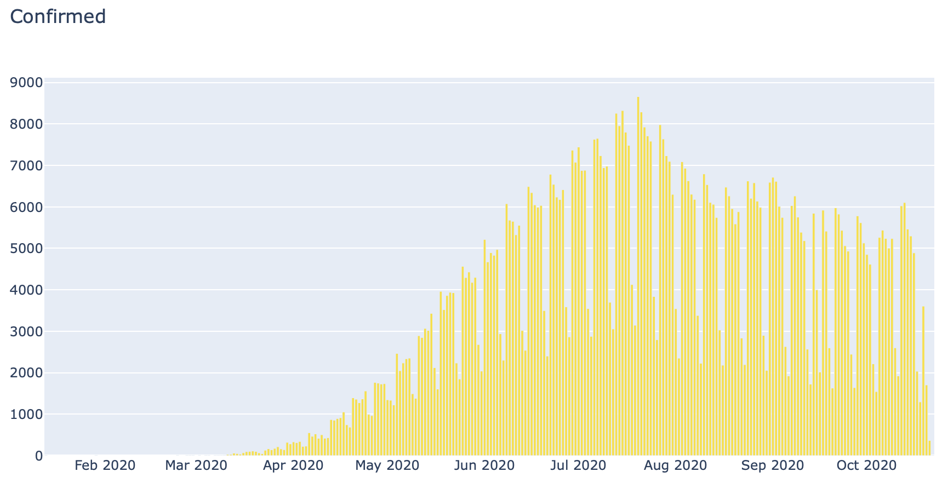
Daily Confirmed COVID-19 Cases in Mexico
The graphic in the left respresents the confirmed COVID-19 cases reported by the Sentinel Program.
Mexican government implement the Sentinel Program to easily detect and report the possible infected people. Unfortunately, this program doesn’t work well on weekends.c

Slide 8
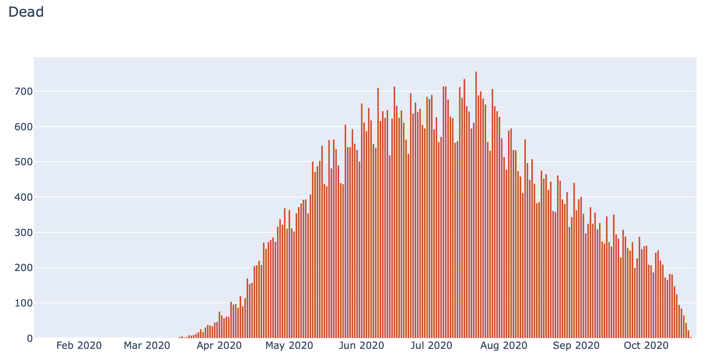
Daily Deceased COVID-19 cases reported in Mexico
The graphic on the right illustrates the deceased people in the country.
Such as in the previous chart, the numbers are reported using the Sentinel Program.

Slide 9
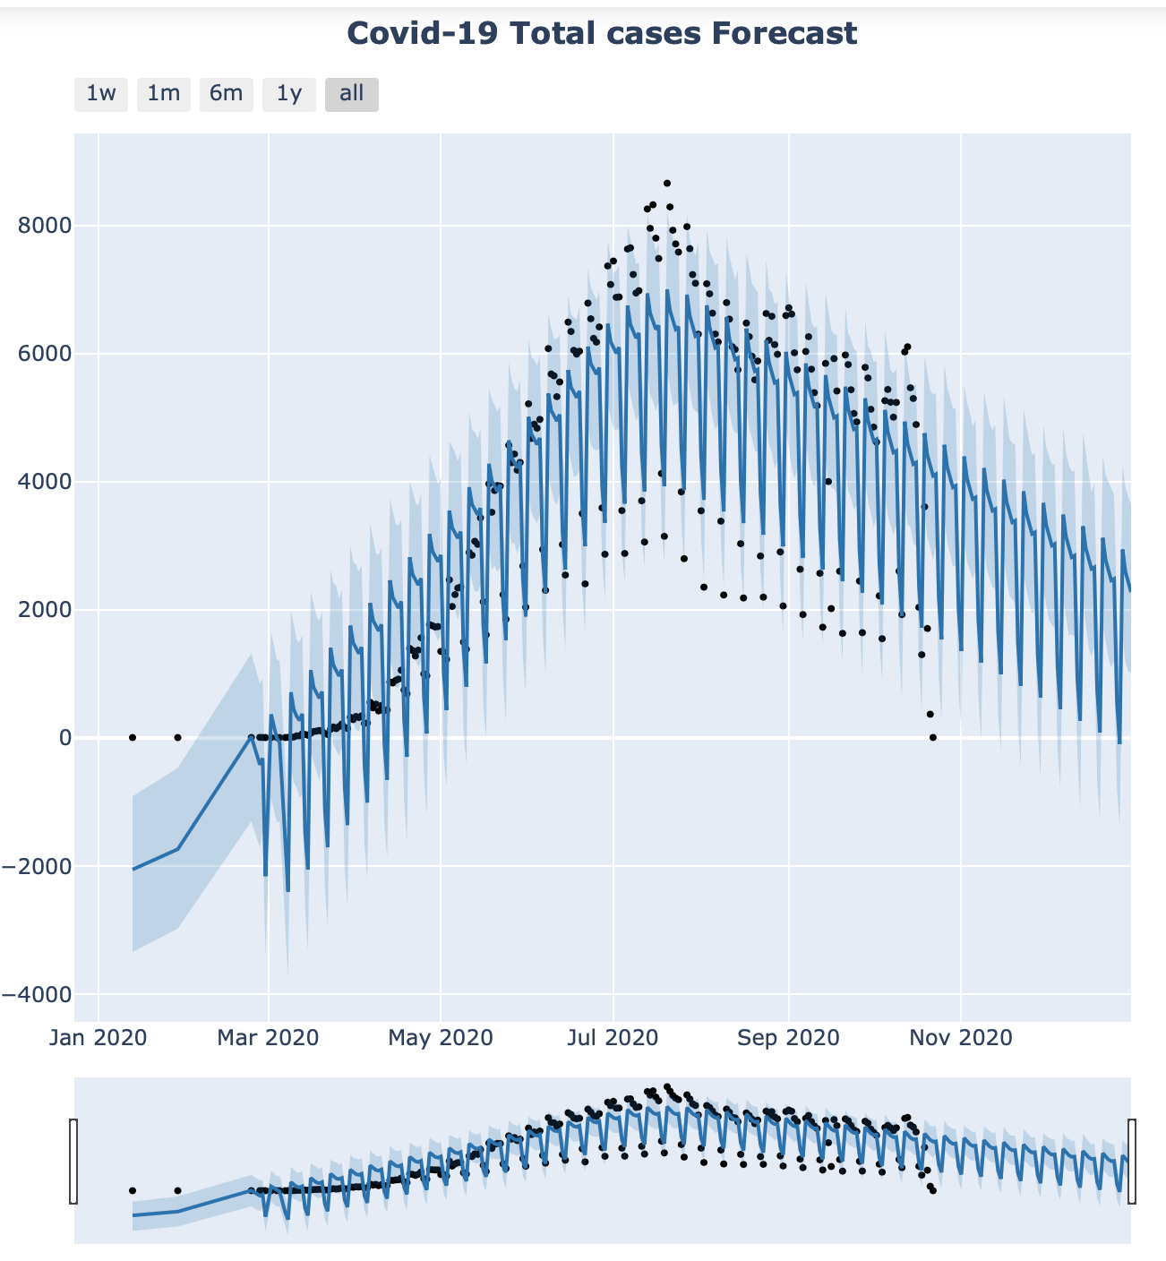
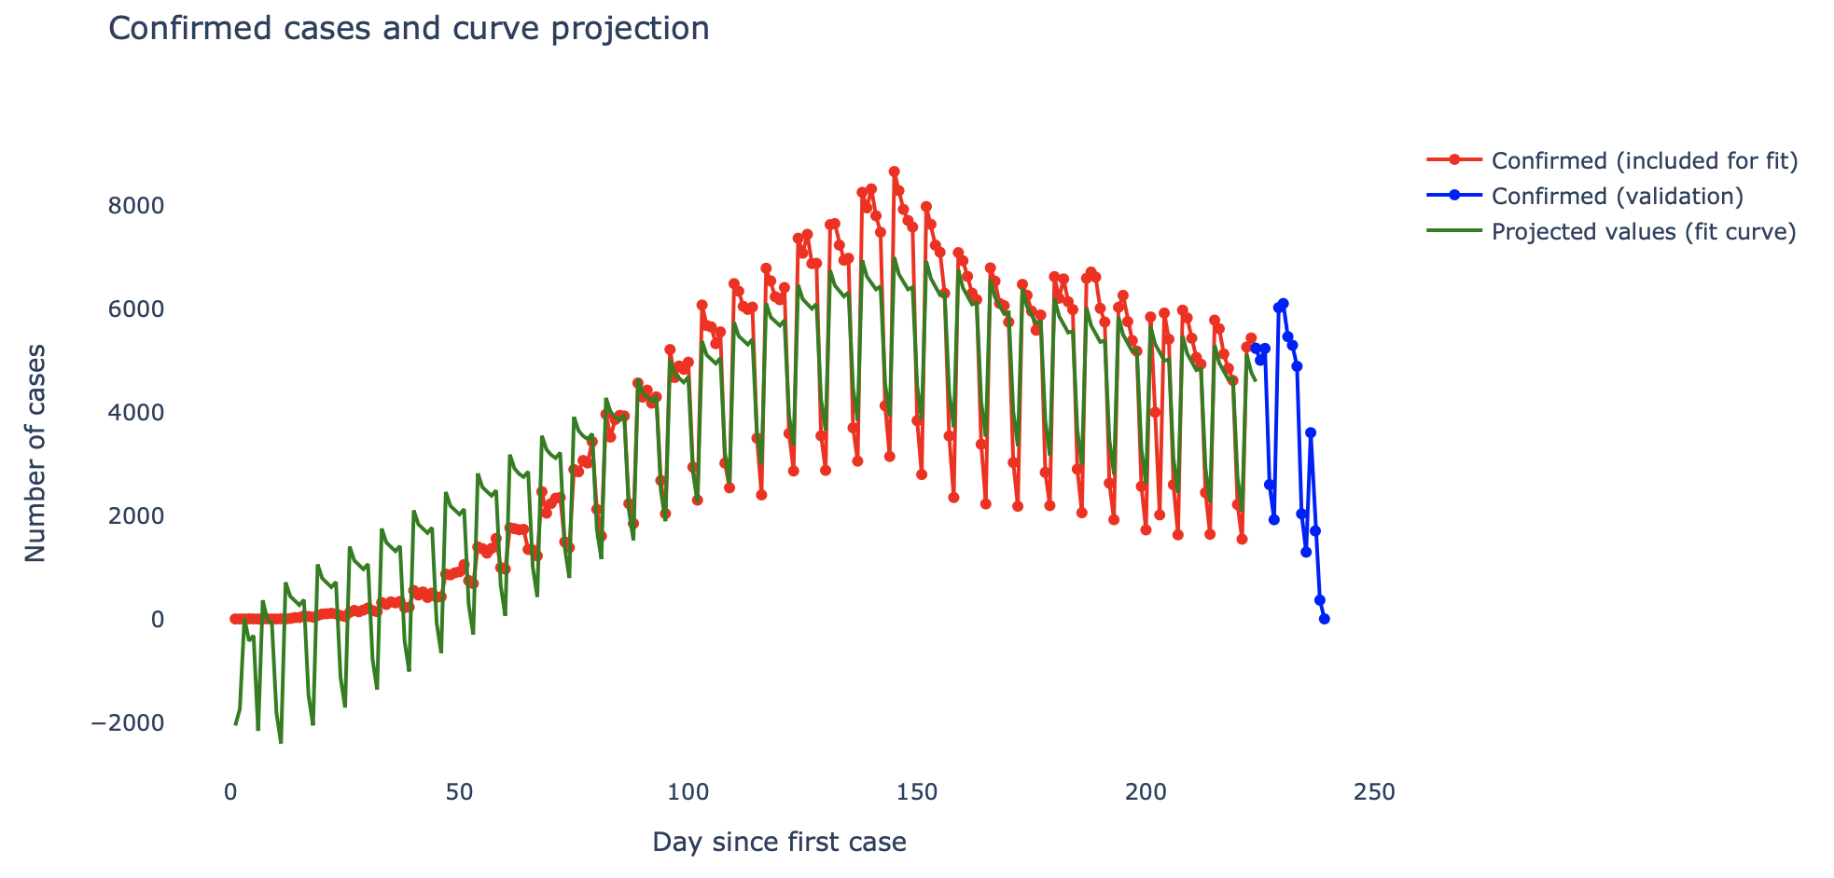
Forecasting Using Time Series
The forecasting was performed using the Facebook Prophet library.
The graphic on the left represents the forecast for the rest of the year considering only the confirmed cases.
The plot above shows the confirmed cases with its forecast and the projected values using the fit curve.

Slide 10
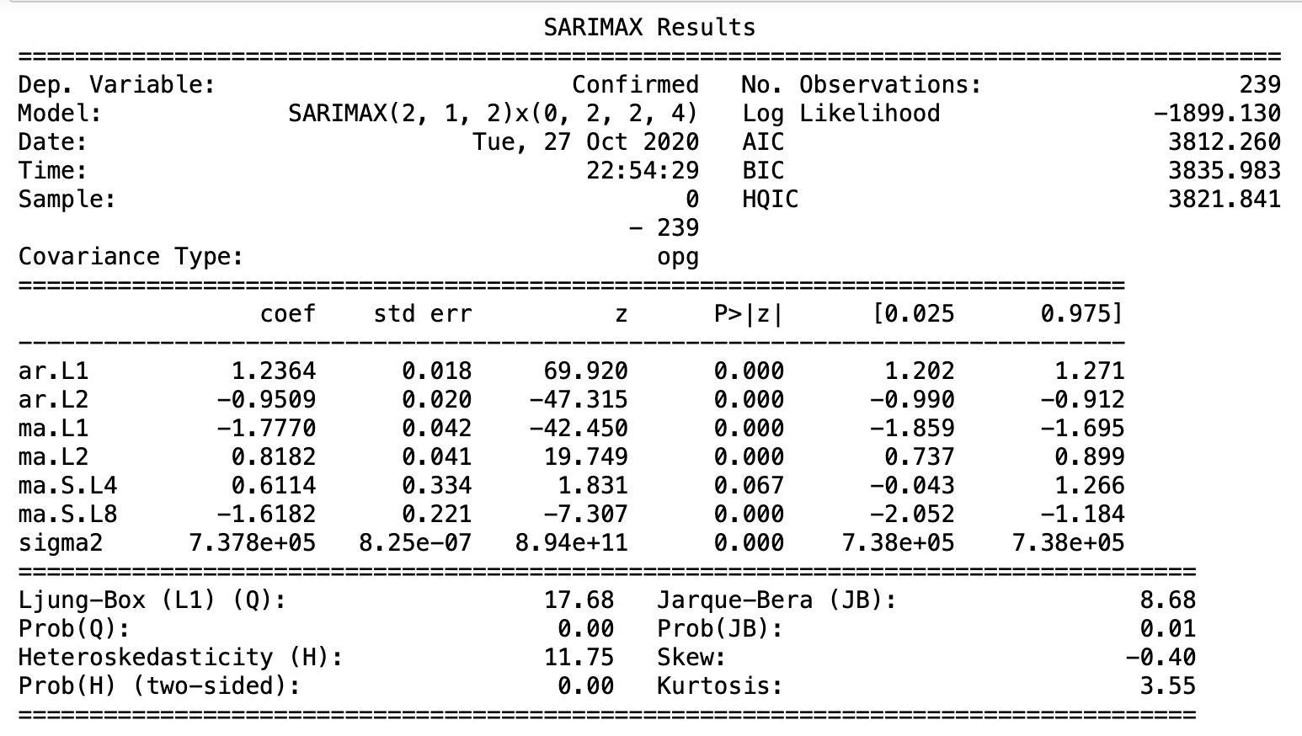
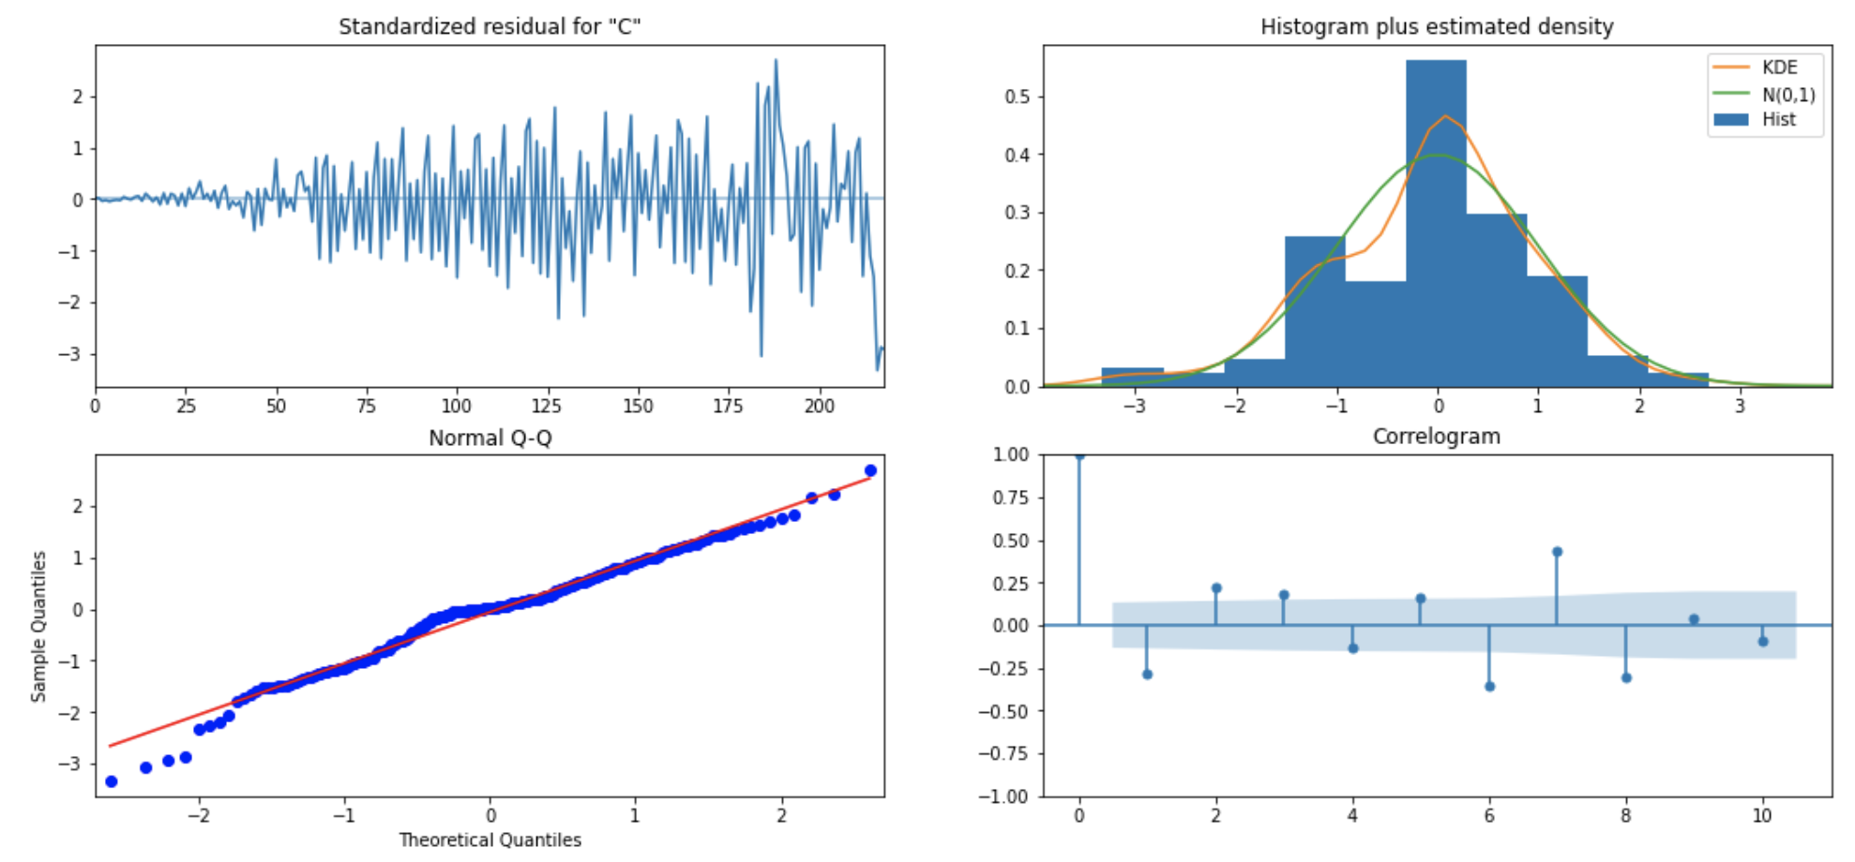
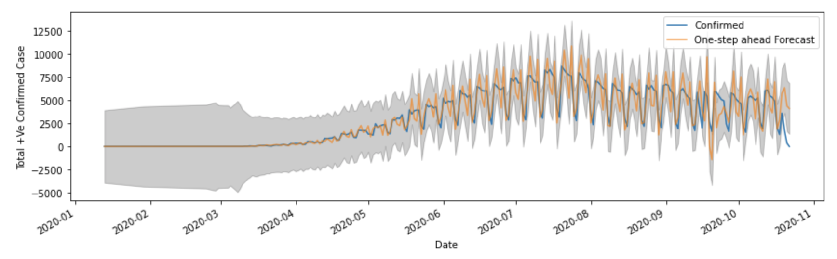
SARIMAX Time Series Model

Slide 11
Thank you for your kind attention!
Please visit my github to check the code:
https://github.com/cmaroblesg/Advanced_DataScience_Capstone

