Slide 1

Mexican COVID-19 Analysis
Cesar RobleS
10.26.2020

Slide 2
Content

Slide 3
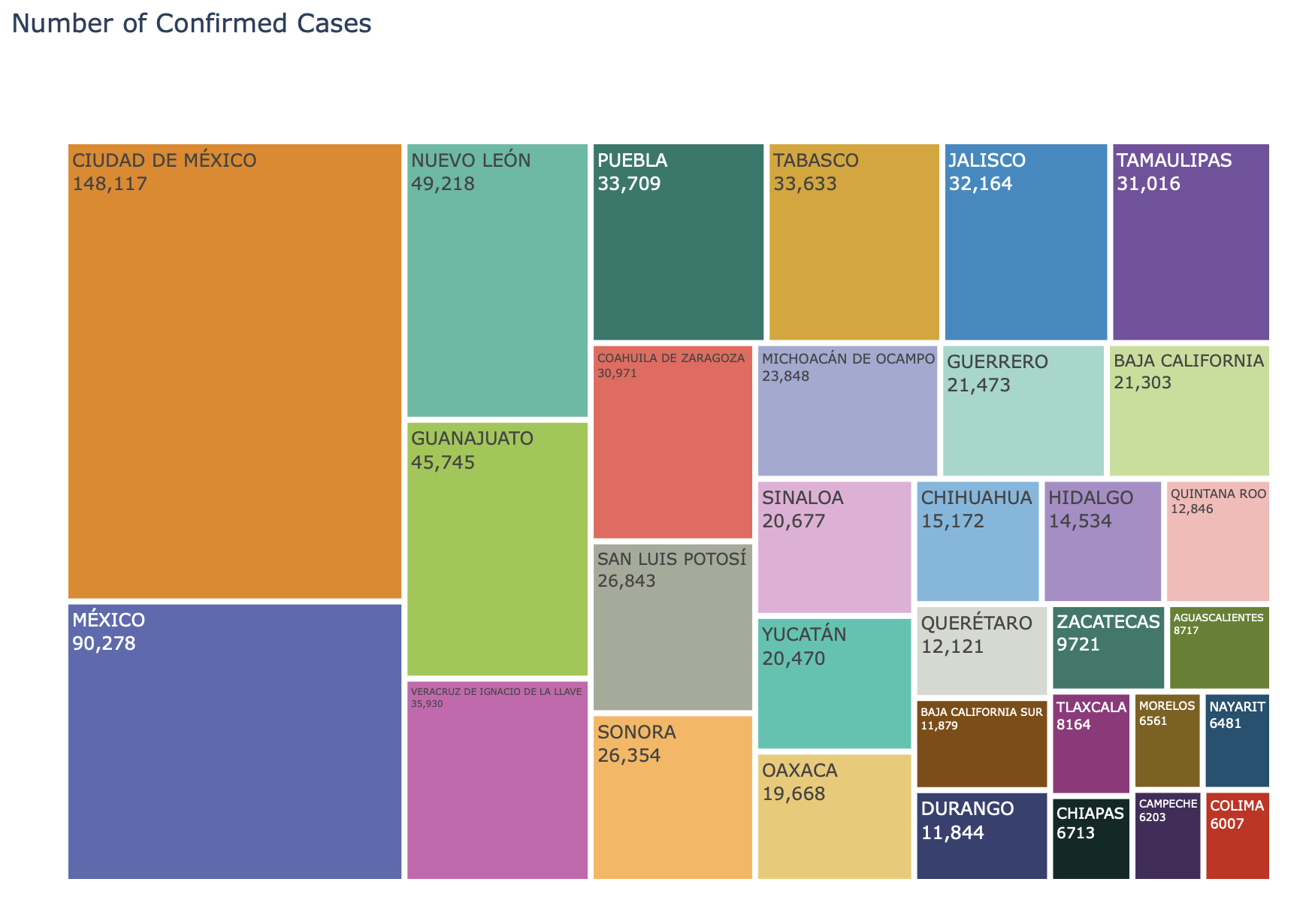
COVID-19 Distribution across Mexican States
The treemap on the left illustrates the COVID-19 distribution. The information represents the confirmed cases displaying the most affected in a big square and the less affected into a small square.

Slide 4
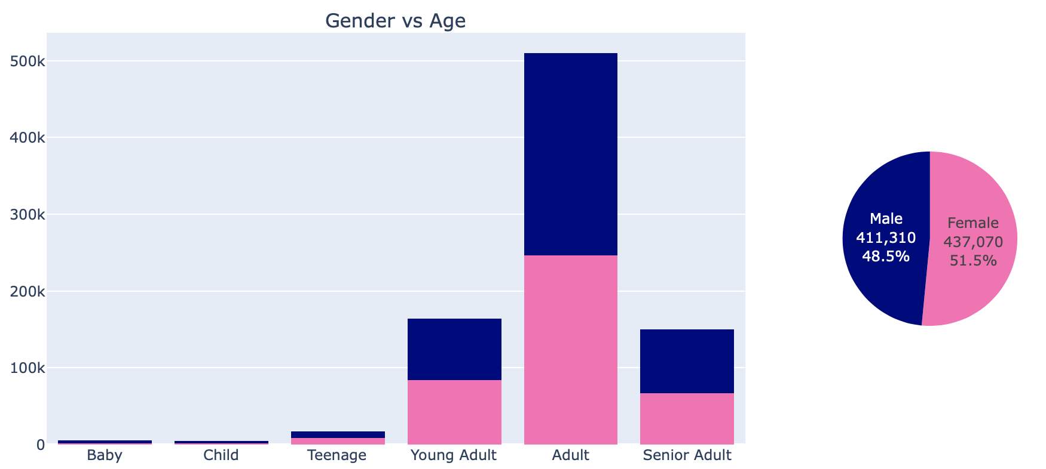
COVID-19 In the mexican population
Age | Classification
0 – 4 | Baby
5 - 8 | Child
9 - 17 | Teenage
18 - 30 | Young Adult
31 - 60 | Adult
Greater than 60 | Senior Adults
The age classification was done using the Mexican Age groups. This can be different by each country.
Women are the most affected and also the adults age range.

Slide 5
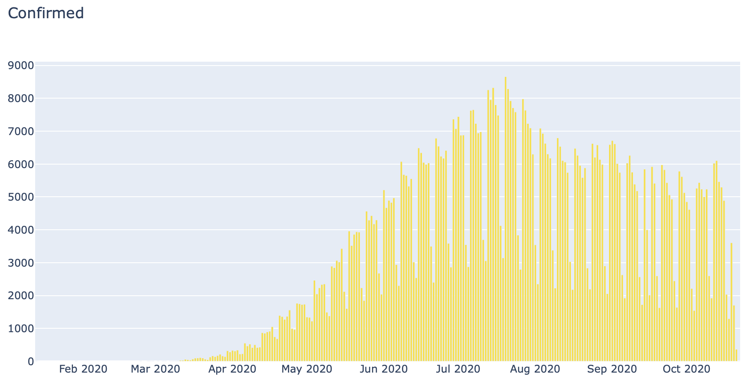
Daily Confirmed COVID-19 Cases in Mexico
The graphic in the left respresents the confirmed COVID-19 cases reported by the Sentinel Program.
Mexican government implement the Sentinel Program to easily detect and report the possible infected people. Unfortunately, this program doesn’t work well on weekends.c

Slide 6
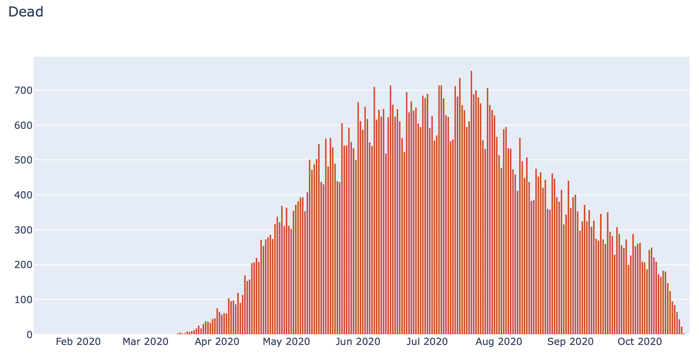
Daily Deceased COVID-19 reported in Mexico
The graphic on the right illustrates the deceased people in the country.
Such as in the previous chart, the numbers are reported using the Sentinel Program.

Slide 7
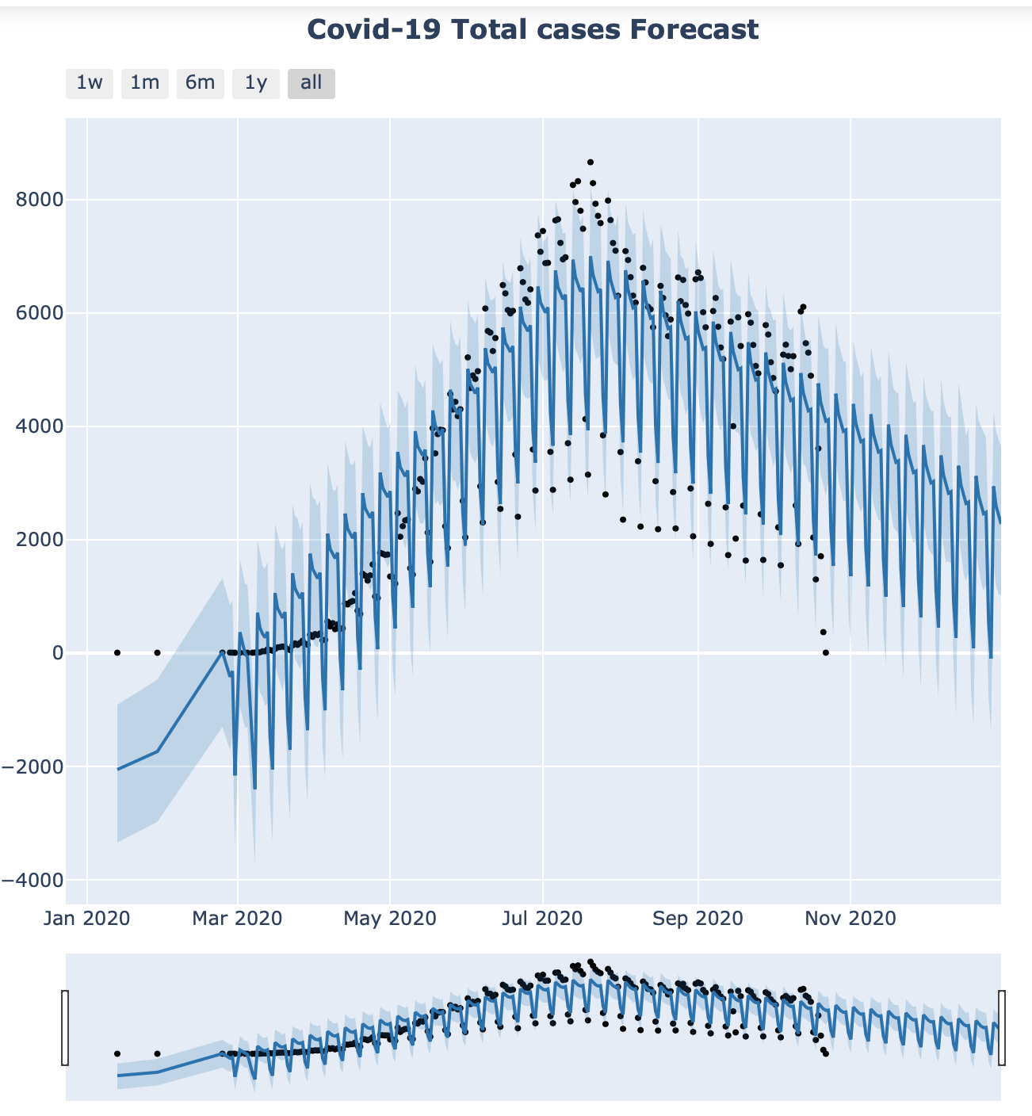
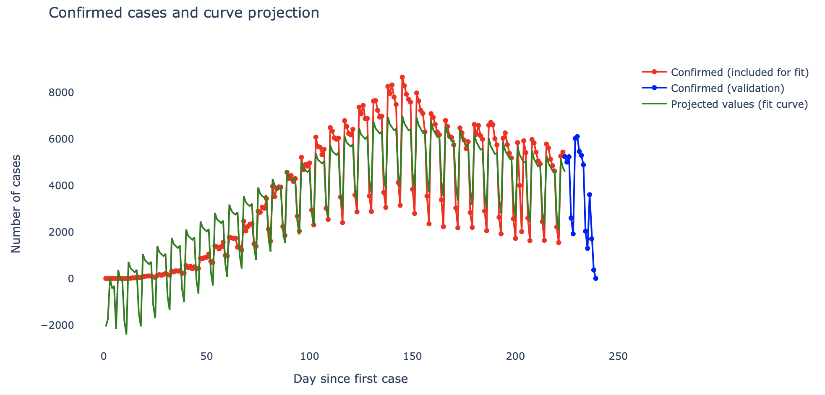
Forecasting Using Time Series
The forecasting was performed using the Facebook Prophet library.
The graphic on the left represents the forecast for the rest of the year considering only the confirmed cases.
The plot above shows the confirmed cases with its forecast and the projected values using the fit curve.

Slide 8
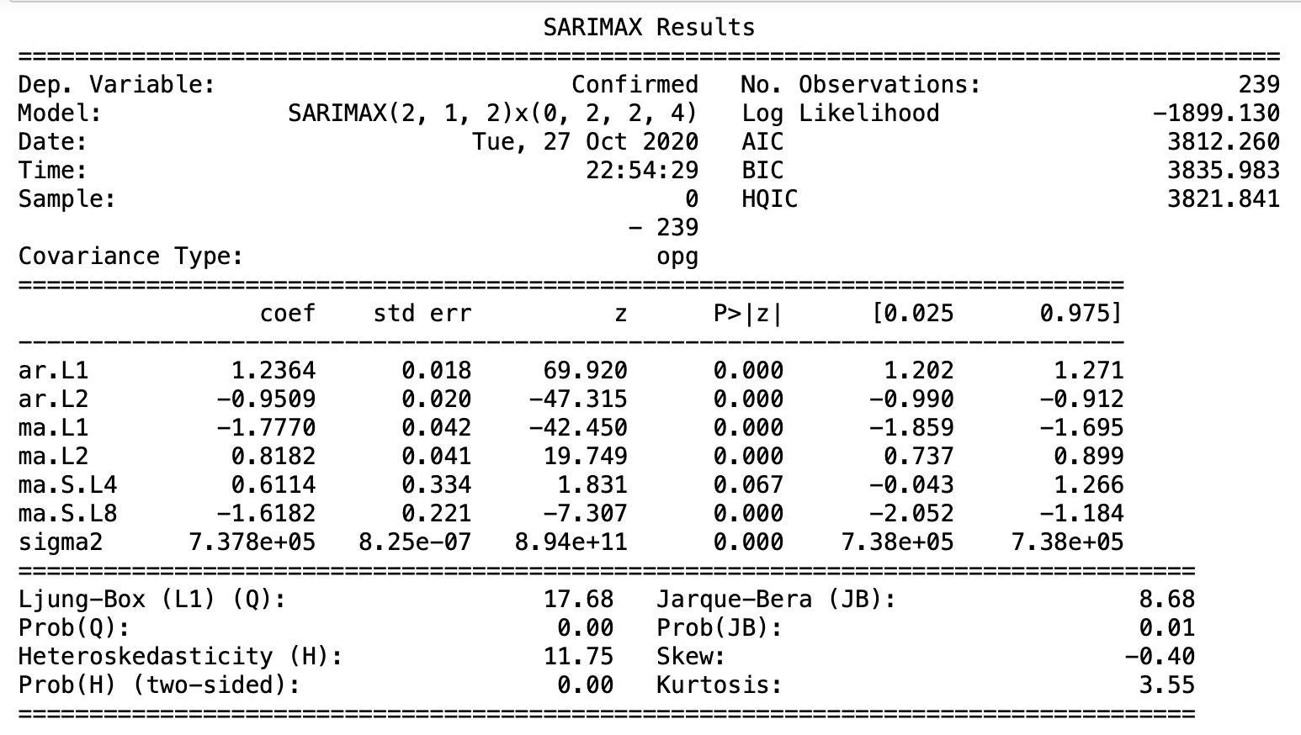
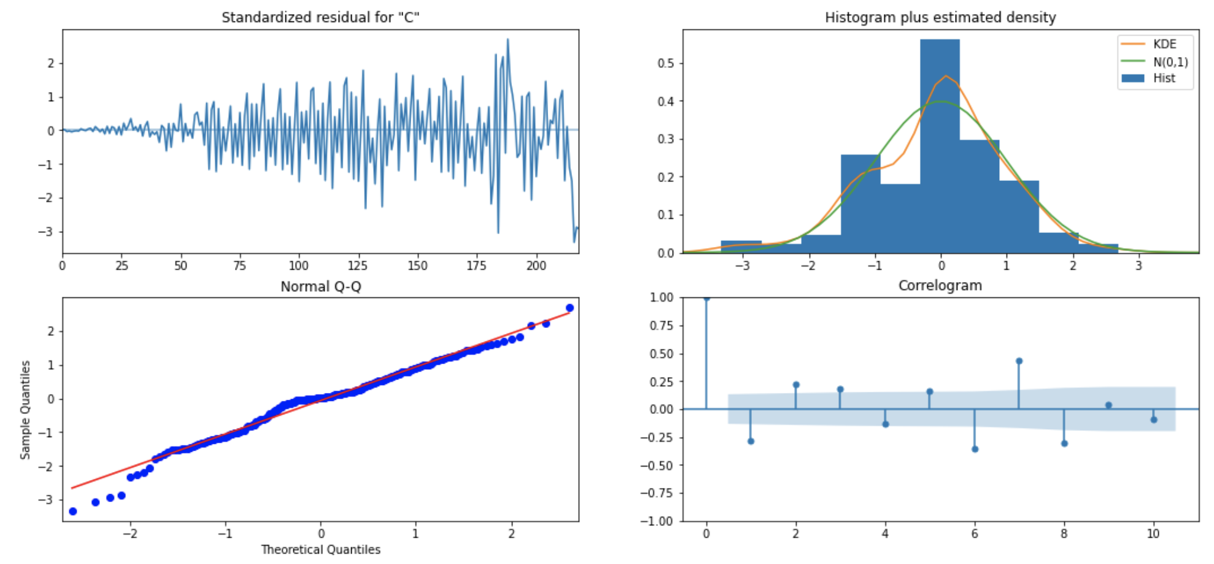
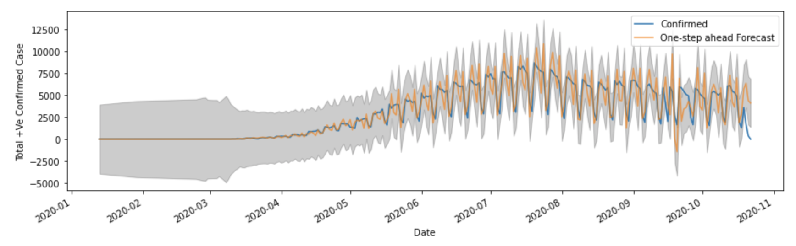
SARIMAX Time Series Model

