Slide 1

Mexican COVID-19 Analysis
Cesar RobleS
10.26.2020

Slide 2
Content

Slide 3
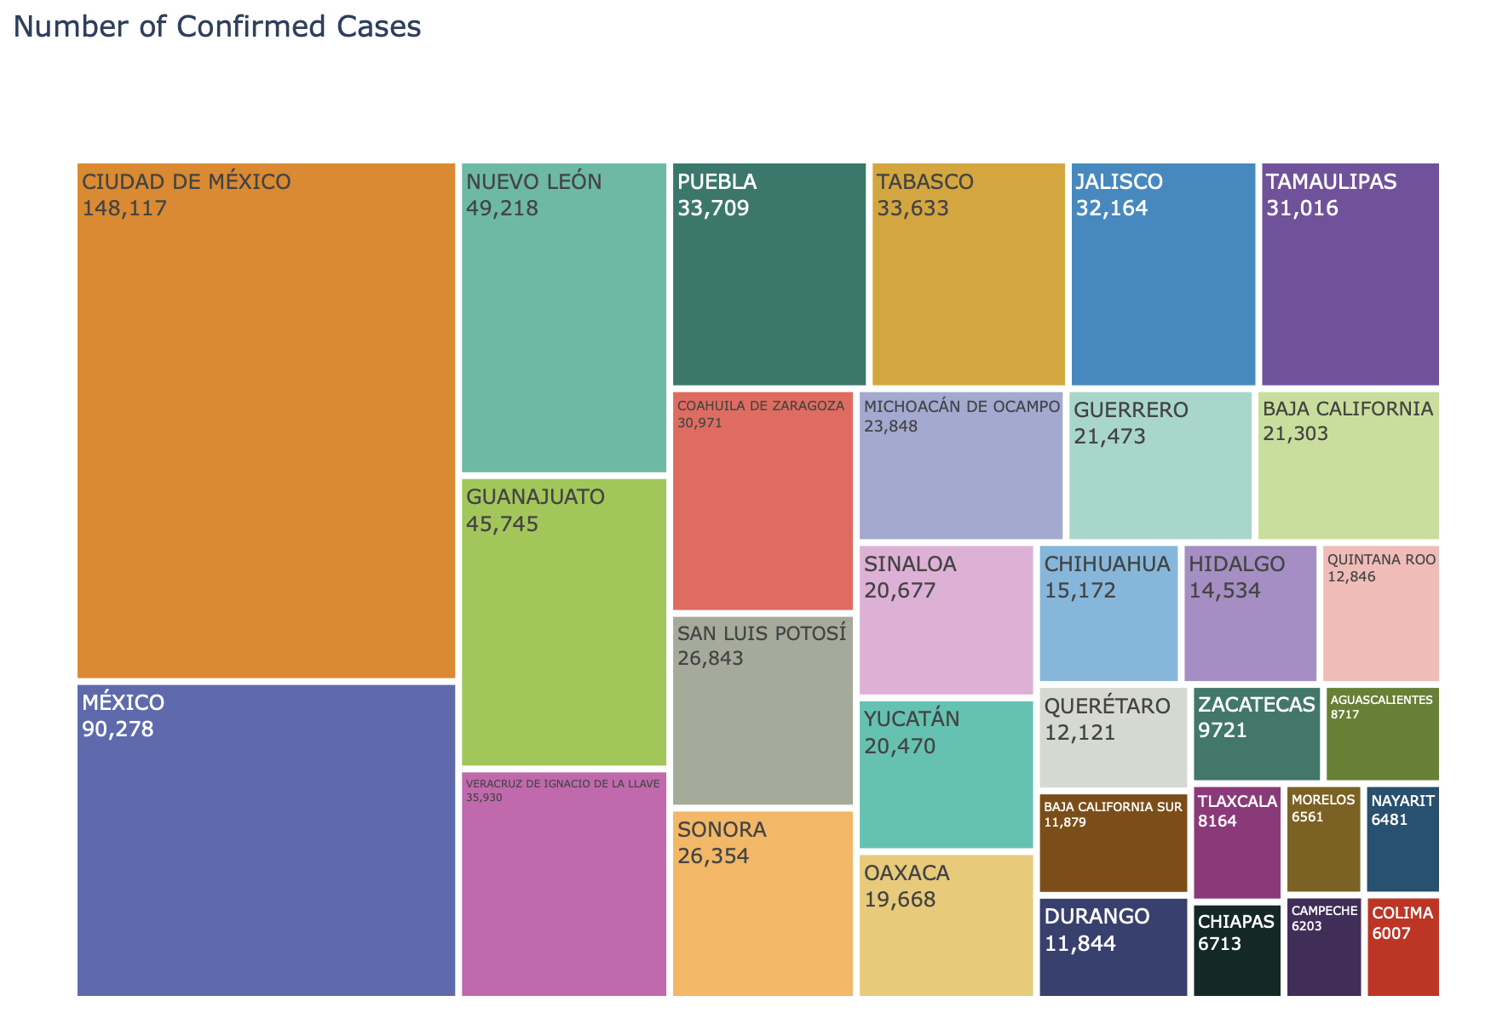
COVID-19 Distribution across Mexican States
The treemap on the left illustrates the COVID-19 distribution. The information represents the confirmed cases displaying the most affected in a big square and the less affected into a small square.

Slide 4
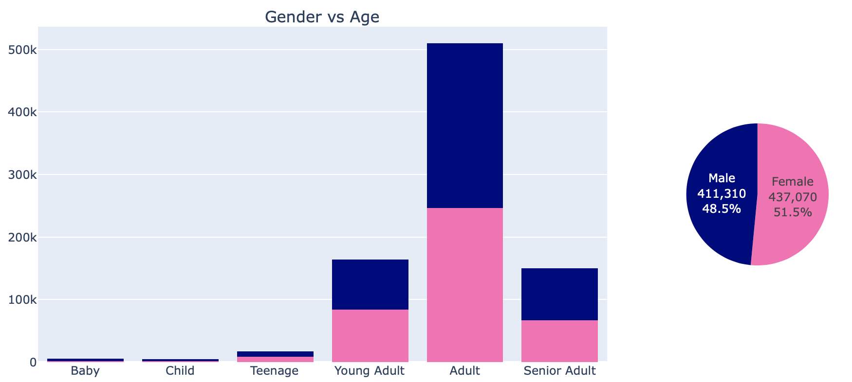
COVID-19 In the mexican population
Age | Classification
0 – 4 | Baby
5 - 8 | Child
9 - 17 | Teenage
18 - 30 | Young Adult
31 - 60 | Adult
Greater than 60 | Senior Adults
The age classification was done using the Mexican Age groups. This can be different by each country.
Women are the most affected and also the adults age range.

