Slide 1
Smart Data Tracing
Cesar Robles
Vice President Data & Analytics
Feb 20th, 2022

Slide 2
Banks
Information Technology on the Data Governance
In the Banks segments, the data is becoming a high-valuable active that need to be monitored and controlled. Many different software is used to trace the data, get the metadata and data linage and algo to apply data quality. Furthermore, to store the information and trace any changes become an important challenge nowadays.

Slide 3
The data tracing is very useful, and it is a little bit common when using ETL programs such as:
Ab Initio
Alterix
Nevertheless, those applications do not explore the information on real-time and you have to buy different modules to trace the data, to get the data lineage and also the metadata.
Also, those applications used the data stored into a database that sometime are not verify or they are not trustful.

Slide 4
Setting-up a system that can track all the changes to the database as well as its transformation.
Most of the time, the output date become with many different information that are not closely related to the original due to the governance and the masking process to consume the information by third party vendors.
In this case, the most important factors to be considered are the Integrity of the data, due to the privacy of the individuals, it is required also security to stored huge number of transactions.
Nevertheless, opensource solutions as well as interoperability are not needed because the information will be used by the Data Governance department to classified the information and determine its data quality.

Slide 5
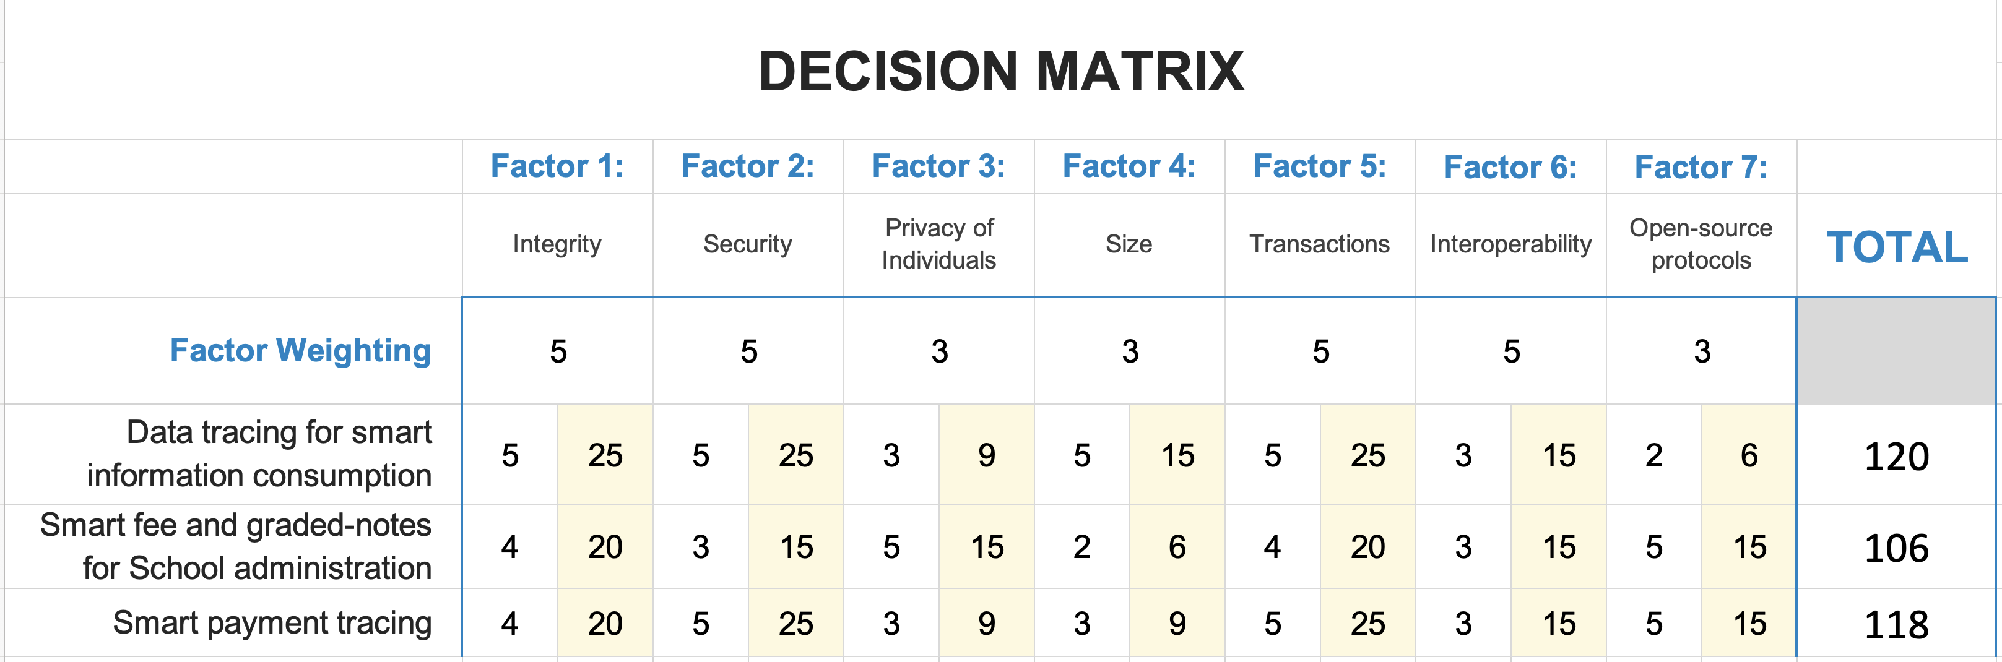

Slide 6
Smart Data Tracing
Incorporating smart tracing and a blockchain based technology would ensure the correct scalability, traceability, and data governance procedure, that will get the latest but right information stored in the cloud or any database.
In the Banks segments, the data is becoming a high-valuable active that need to be monitored and controlled.
Many different software is used to trace the data, get the metadata and data linage and algo to apply data quality.
Furthermore, to store the information and trace any changes become an important challenge nowadays.

Slide 7
In the Banks segments, the data is becoming a high-valuable active that need to be monitored and controlled.
Many different software is used to trace the data, get the metadata and data linage and algo to apply data quality. Furthermore, to store the information and trace any changes become an important challenge nowadays.

Slide 8
Getting the opportunity to traceback all the data, operations and contracts in real-time generating special alerts to detect any changes on the documentation, data and quality. Also, the possibility to store the information in small segments through the different databases and servers preserving its integrity and trustworthy.

Slide 9
Banks wants to smart-trace their data, our smart data tracer is a metadata and data lineage service that helps to detect any changes on the data in real-time.
Incorporating smart tracing and a blockchain based technology would ensure the correct scalability, traceability, and data governance procedure, that will get the latest but right information stored in the cloud or any database

Slide 10
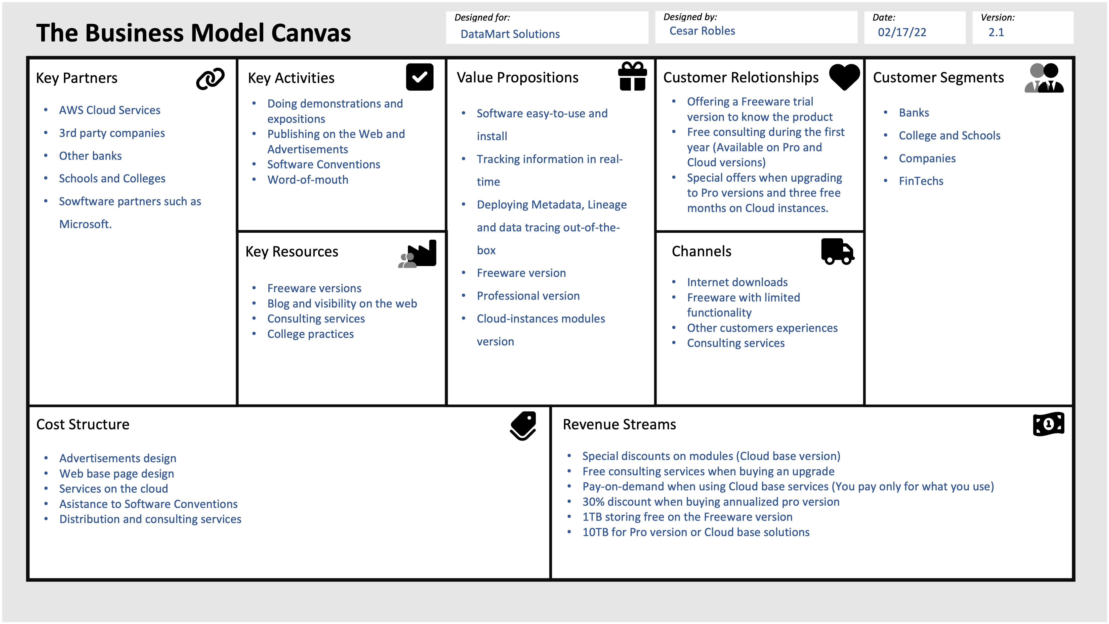

Slide 11
Banks and other enterprises need to have their information with the highly standards of quality, lineage and metadata to ensure their trustworthy.
This information need to be accurate and on-line most of the time. Furthermore, it is necessary to track any changes to the original information and store it online.
Giving the opportunity to the colleges, people and enterprises to know the product using freeware version of the software, they can test it and evaluate the application to fulfil their needs.
Consulting enterprises can also help to ensure the usability and the performance on the software.

Slide 12
Personal with Data Management training
Data Scientist and API Engineers
Cloud and Stand-alone architectures
Finance area
Human Resources
Accounting
The main potential partners will be the banks and third-party companies that consume the product
Also, the Freeware version that Colleges can use for their practices
AWS Cloud Services
3rd party companies
Other banks
Schools and Colleges
Sowftware partners such as Microsoft.

Slide 13
Cloud and home solutions
Competency that has structural solutions such as Ab Initio
Third party solutions that has complete integration with all the ETL such as Collibra
The sponsors and the partners because the enterprise is relatively new

Slide 14
Cesar Robles
Vice President Data & Analytics

