Slide 1
Cal Marples
19th January 2026

Slide 2
Evolution of cooperation in an epithelium
Jessie Renton and Karen M. Page
J R Soc Interface, Vol. 16, No. 152, March 2019
DOI: https://doi.org/10.1098/rsif.2018.0918

Slide 3
Outline
Tumour development requires production of diffusible growth factors.
Can be interpreted as cellular cooperation.
Game Theory: the mathematics of strategic interactions.
Under what conditions is cooperation favoured by natural selection?
How does this depend on the choice of model?
  Evolutionary graph theory
  Voronoi tessellation

Slide 4
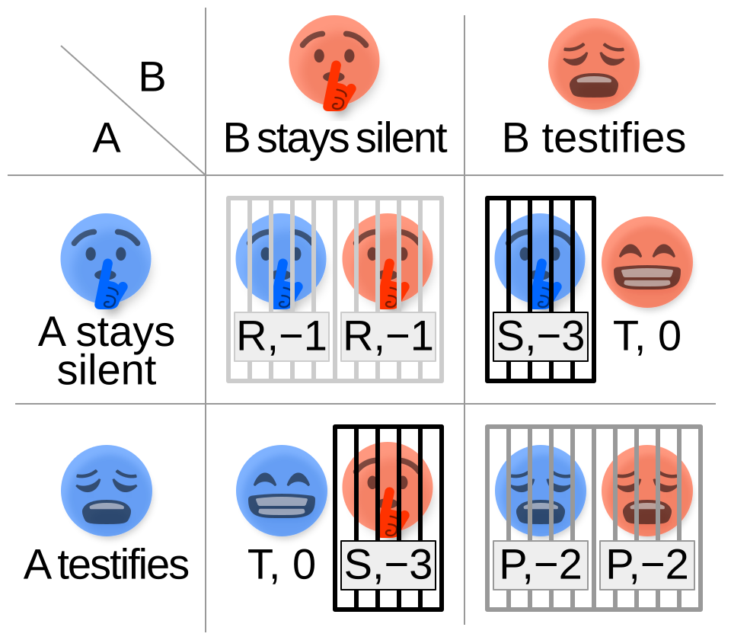

The Prisoner’s Dilemma
Two cell types:
  (C) : cooperator
  (D) : defector
Payoff matrix:
  $b$ : benefit from cooperating neighbour
  $c$ : cost for cooperating
Tragedy of the Commons
Image from Wikipedia

Slide 5
Evolutionary Graph Theory (EGT)
Start: all but one cell is a defector
On each step:
  Calculate cell ‘fitness’ from prisoner’s dilemma payoffs.
  Moran process: one cell dies and another divides.
The new cell occupies the site of the dead cell.
Continue until only one type remains.
Fixation Probability: How often does the cooperator type succeed?
Defector
Cooperator

Slide 6
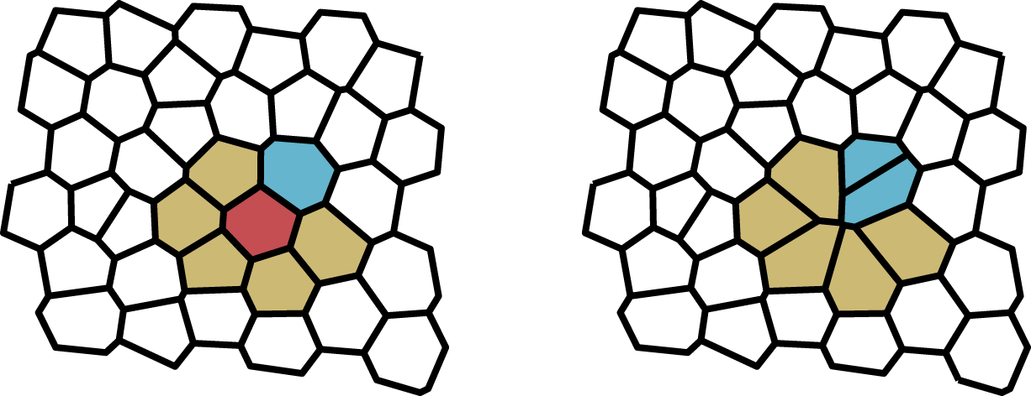
The Update Rule
Death-birth
  Choose a cell to die.
  One of its neighbours is chosen to reproduce.
Birth-death
  Choose a cell to reproduce.
  One of its neighbours is chosen to die.
Probability of reproducing is proportional to fitness.
Probability of death is uniform.

Slide 7
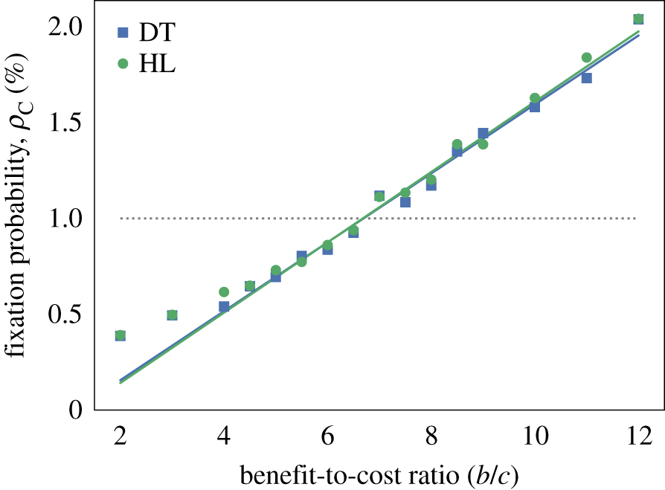
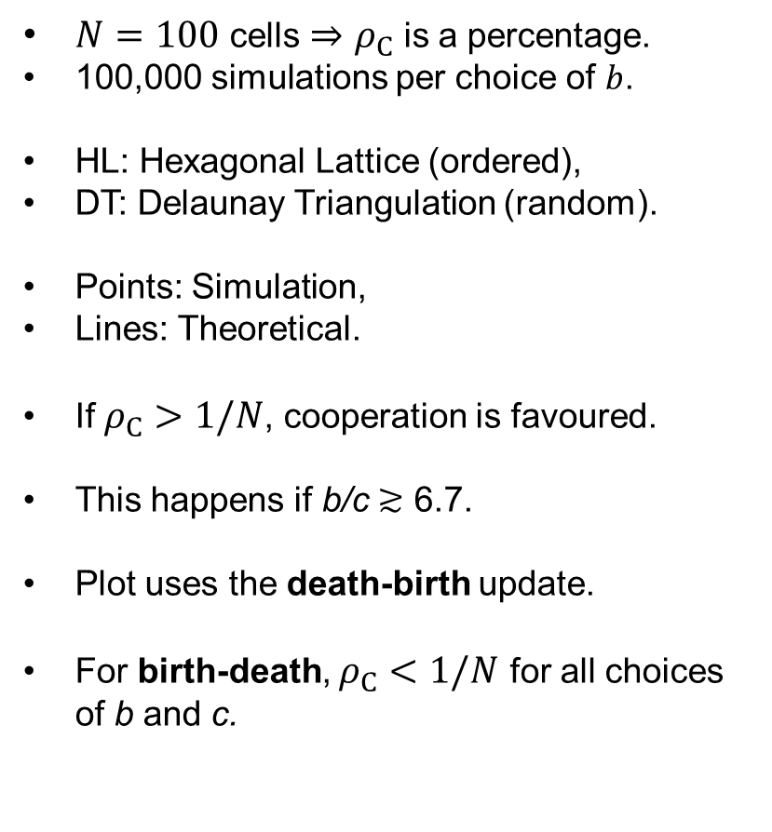
Death-birth Update
$N=100$ cells $⇒$ $ρ_{C}$ is a percentage.
100,000 simulations per choice of $b$.
HL: Hexagonal Lattice (ordered),
DT: Delaunay Triangulation (random).
Points: Simulation,
Lines: Theoretical.
If $ρ_{C}>1/N$, cooperation is favoured.
This happens if b/c $≳$ 6.7.
Plot uses the death-birth update.
For birth-death, $ρ_{C}<1/N$ for all choices of b and c.

Slide 8
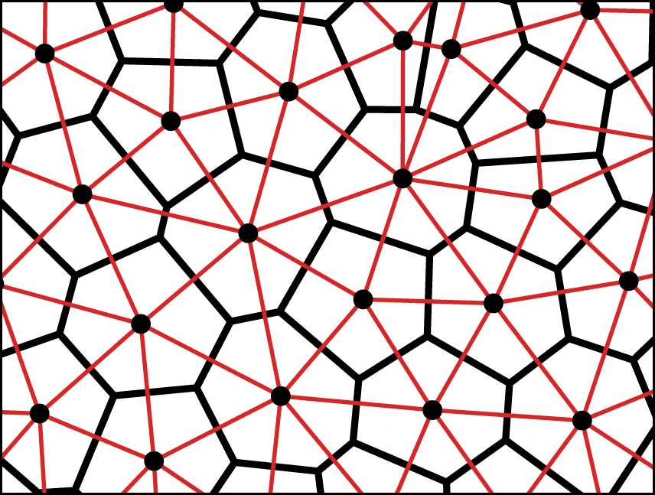
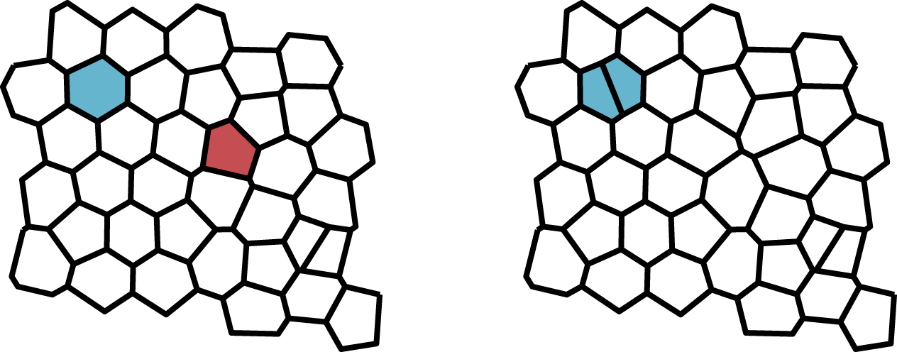
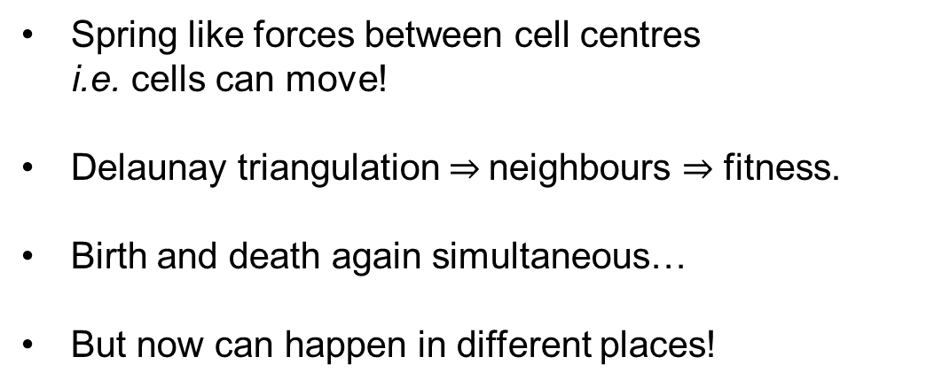
Voronoi Tesselation Model (VT)
Spring like forces between cell centres
i.e. cells can move!
Delaunay triangulation $⇒$neighbours $⇒$ fitness.
Birth and death again simultaneous…
But now can happen in different places!
Black points : cell centres
Thick black lines : Voronoi cells
Thin red lines : Delaunay triangulation

Slide 9
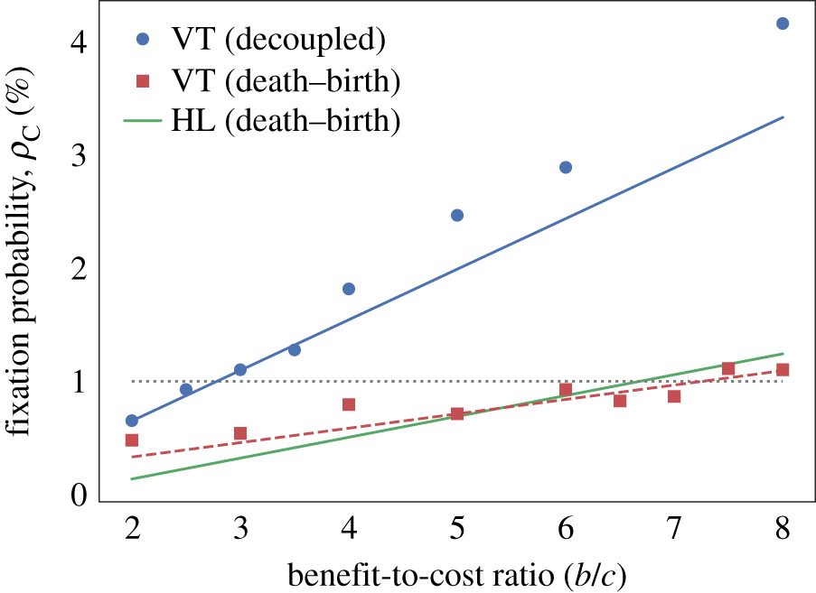
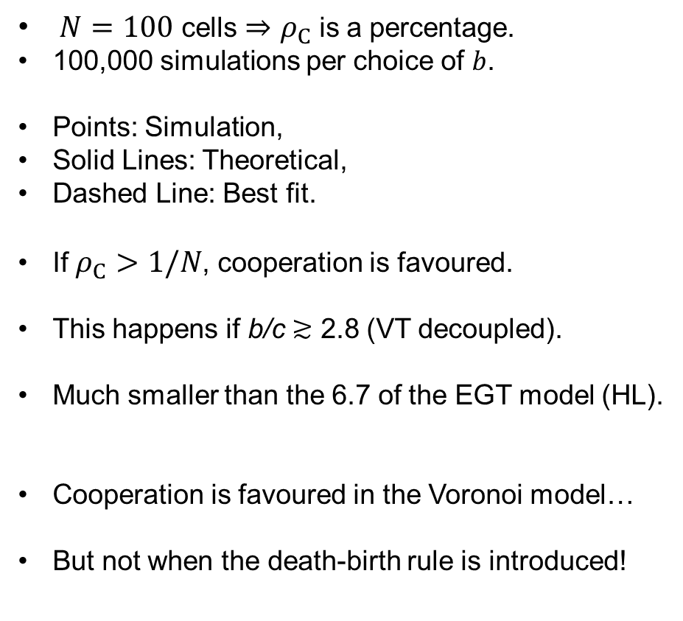
Model Comparison
$N=100$ cells $⇒$ $ρ_{C}$ is a percentage.
100,000 simulations per choice of $b$.
Points: Simulation,
Solid Lines: Theoretical,
Dashed Line: Best fit.
If $ρ_{C}>1/N$, cooperation is favoured.
This happens if b/c $≳$ 2.8 (VT decoupled).
Much smaller than the 6.7 of the EGT model (HL).
Cooperation is favoured in the Voronoi model…
But not when the death-birth rule is introduced!

Slide 10
Summary
Static graph models insufficient to study dynamics of an epithelium.
The choice of update rule determines the dynamics!
The VT model allows spatial decoupling of birth and death.
With spatial decoupling, cooperation is more likely to succeed!

Slide 11

“The needs of the many outweigh the needs of the few – or the one”

Slide 12
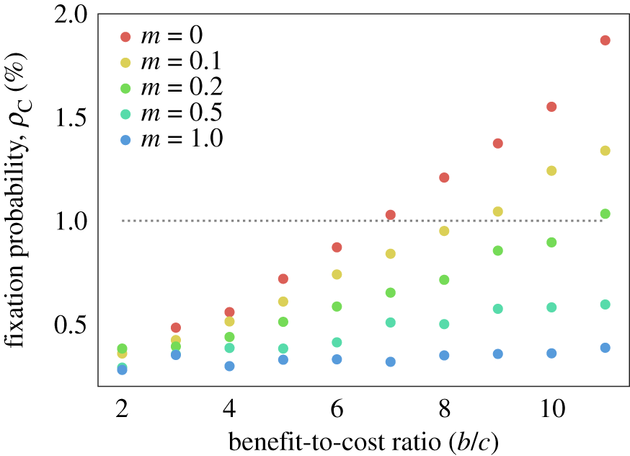
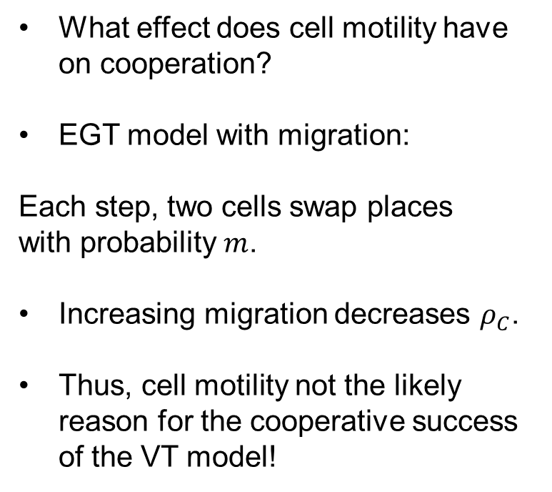
Cell Motility?
What effect does cell motility have on cooperation?
EGT model with migration:
Each step, two cells swap places
with probability $m$.
Increasing migration decreases $ρ_{C}$.
Thus, cell motility not the likely reason for the cooperative success of the VT model!

