Slide 1

Notes:
TITLE SLIDE — "Airflow Beyond the Cloud"
Stay on this slide while the audience settles. No need to narrate it.
Transition: "Hi everyone, I'm Constance..."

Slide 2
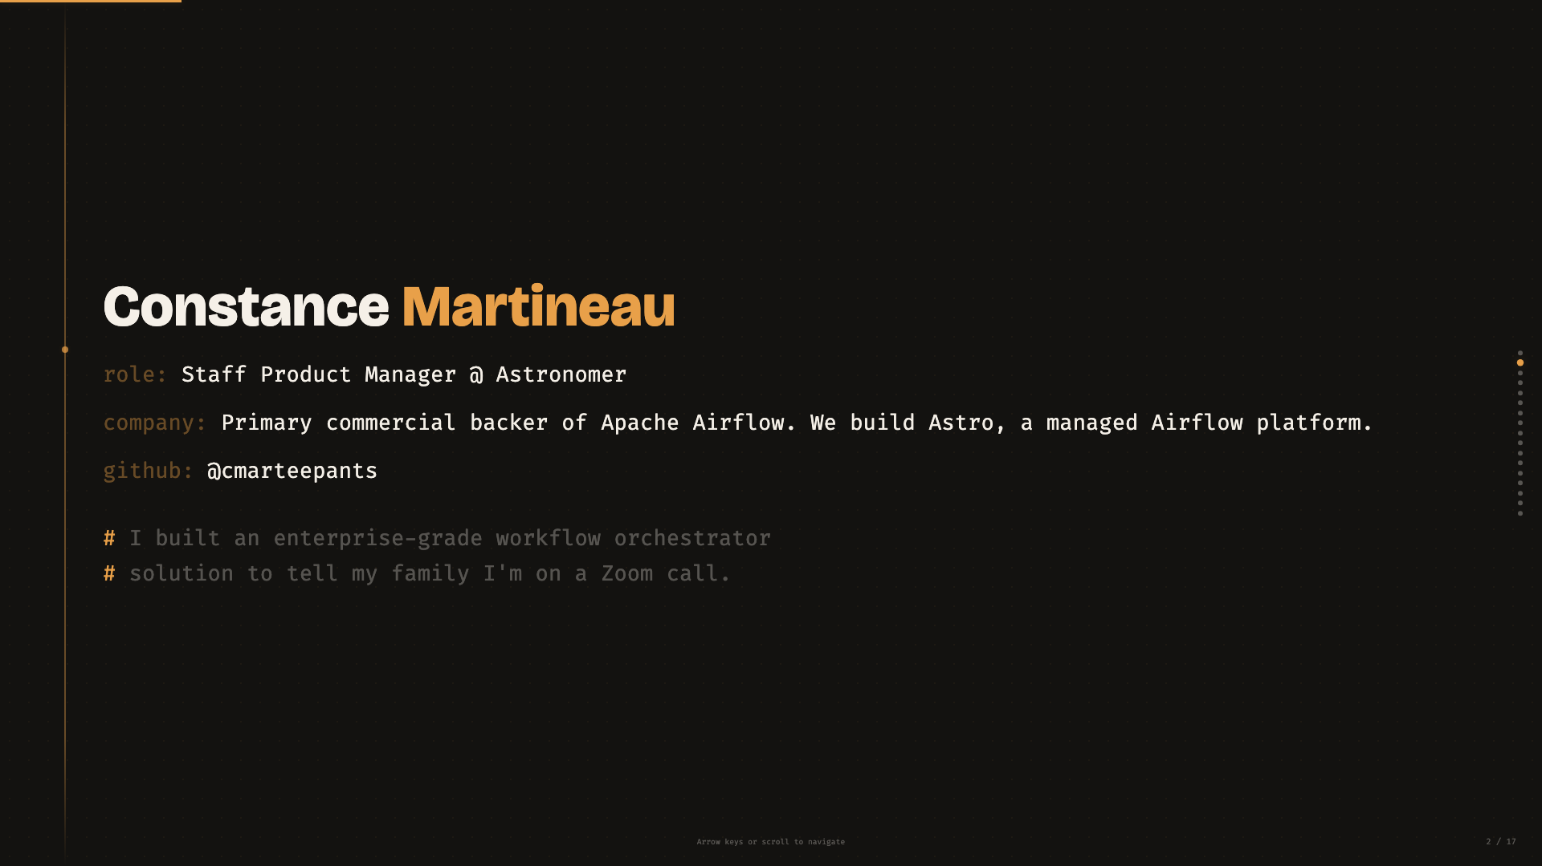
Notes:
BIO (~30s)
- "I'm Constance, Staff PM at Astronomer — we're the primary commercial backer of Apache Airflow."
- Read the comment line if the audience hasn't already: the self-deprecation sets the tone.
- Don't linger. This is a 30-second slide. Move to the photo.
Transition: "Let me show you what I built."

Slide 3
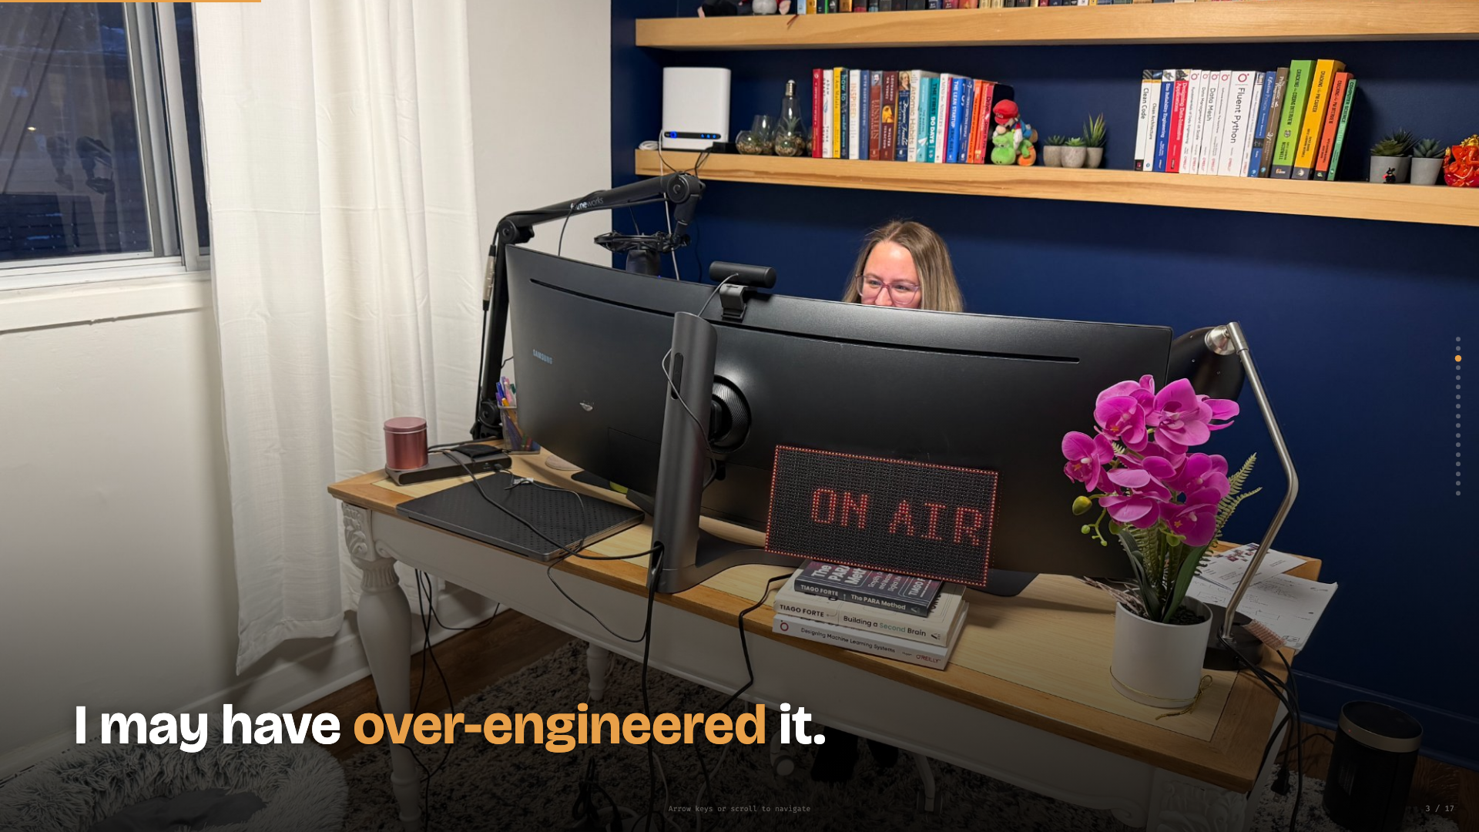
Notes:
HOOK (~1 min)
- Let the photo land for a beat. The audience will see the ON AIR sign and laugh.
- "I work from home. My family has no idea when I'm on a call. So I built a sign."
- "It says ON AIR when I'm in a meeting, FREE when I'm not."
- Pause. "And because I'm a product manager for a workflow orchestrator... I may have over-engineered it."
- "It's powered by Apache Airflow, running on a Raspberry Pi Zero. A $15 computer running enterprise software to change the color of some LEDs."
- The self-awareness IS the joke. Don't explain it. Let people laugh.
Transition: "For those of you who haven't used Airflow..."

Slide 4
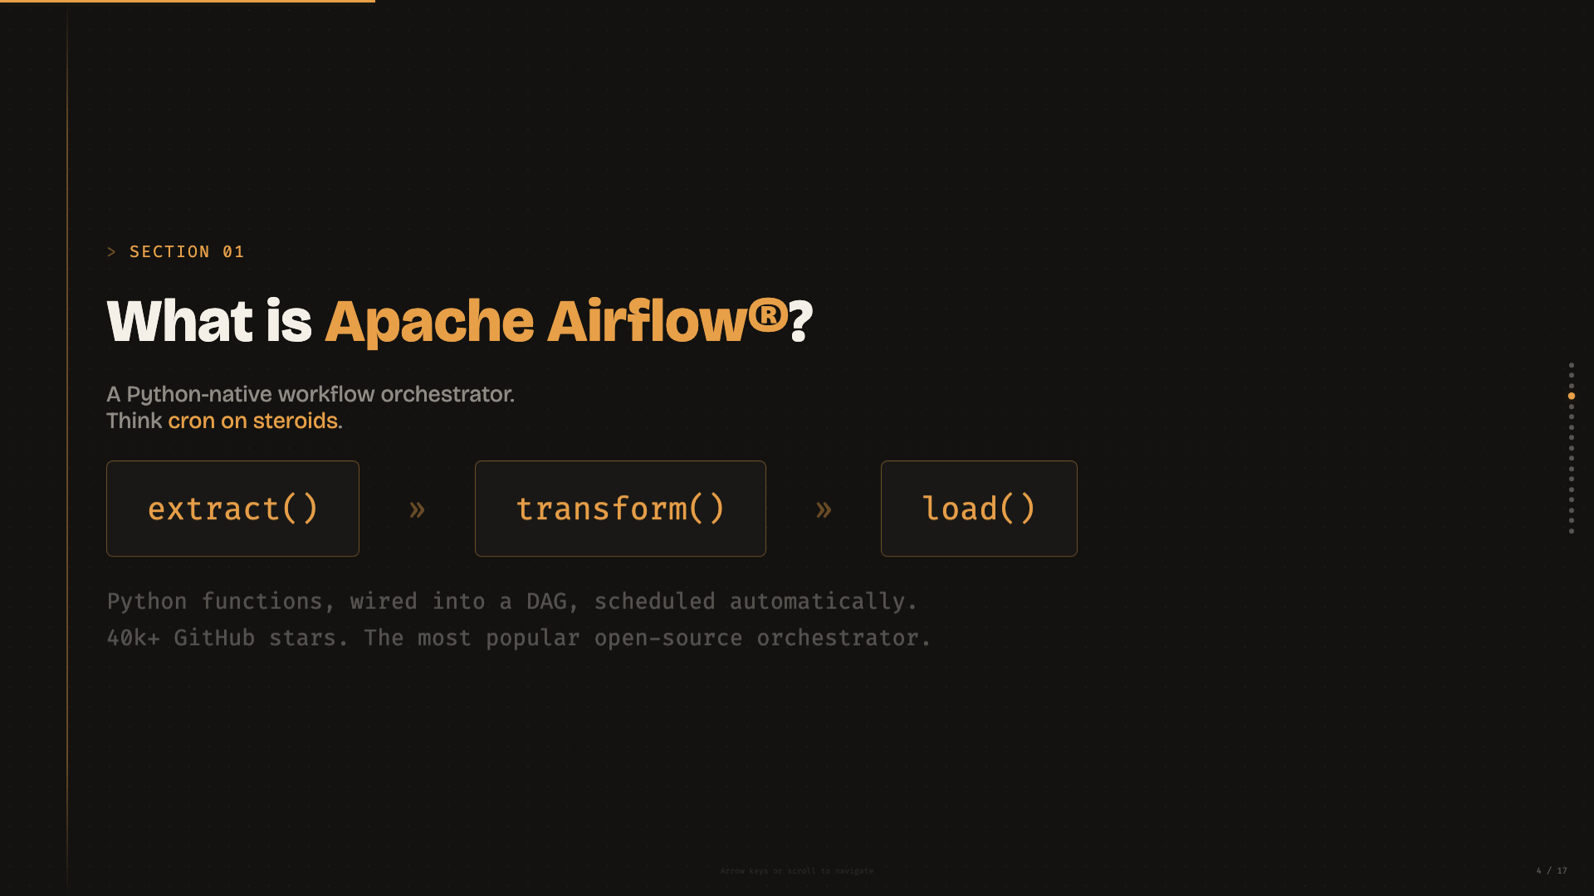
Notes:
WHAT IS AIRFLOW? (~1 min)
- "If you haven't used Airflow — it's a Python-native workflow orchestrator. Think cron on steroids."
- Point at the DAG diagram: "You write Python functions, wire them into a DAG — a directed acyclic graph — and Airflow handles scheduling, retries, monitoring, logging."
- "40k+ GitHub stars. The most popular open-source orchestrator."
- Don't go deep on Airflow internals. Just: it's Python, it runs tasks in order, it's popular.
Transition: "Typical use case..."

Slide 5
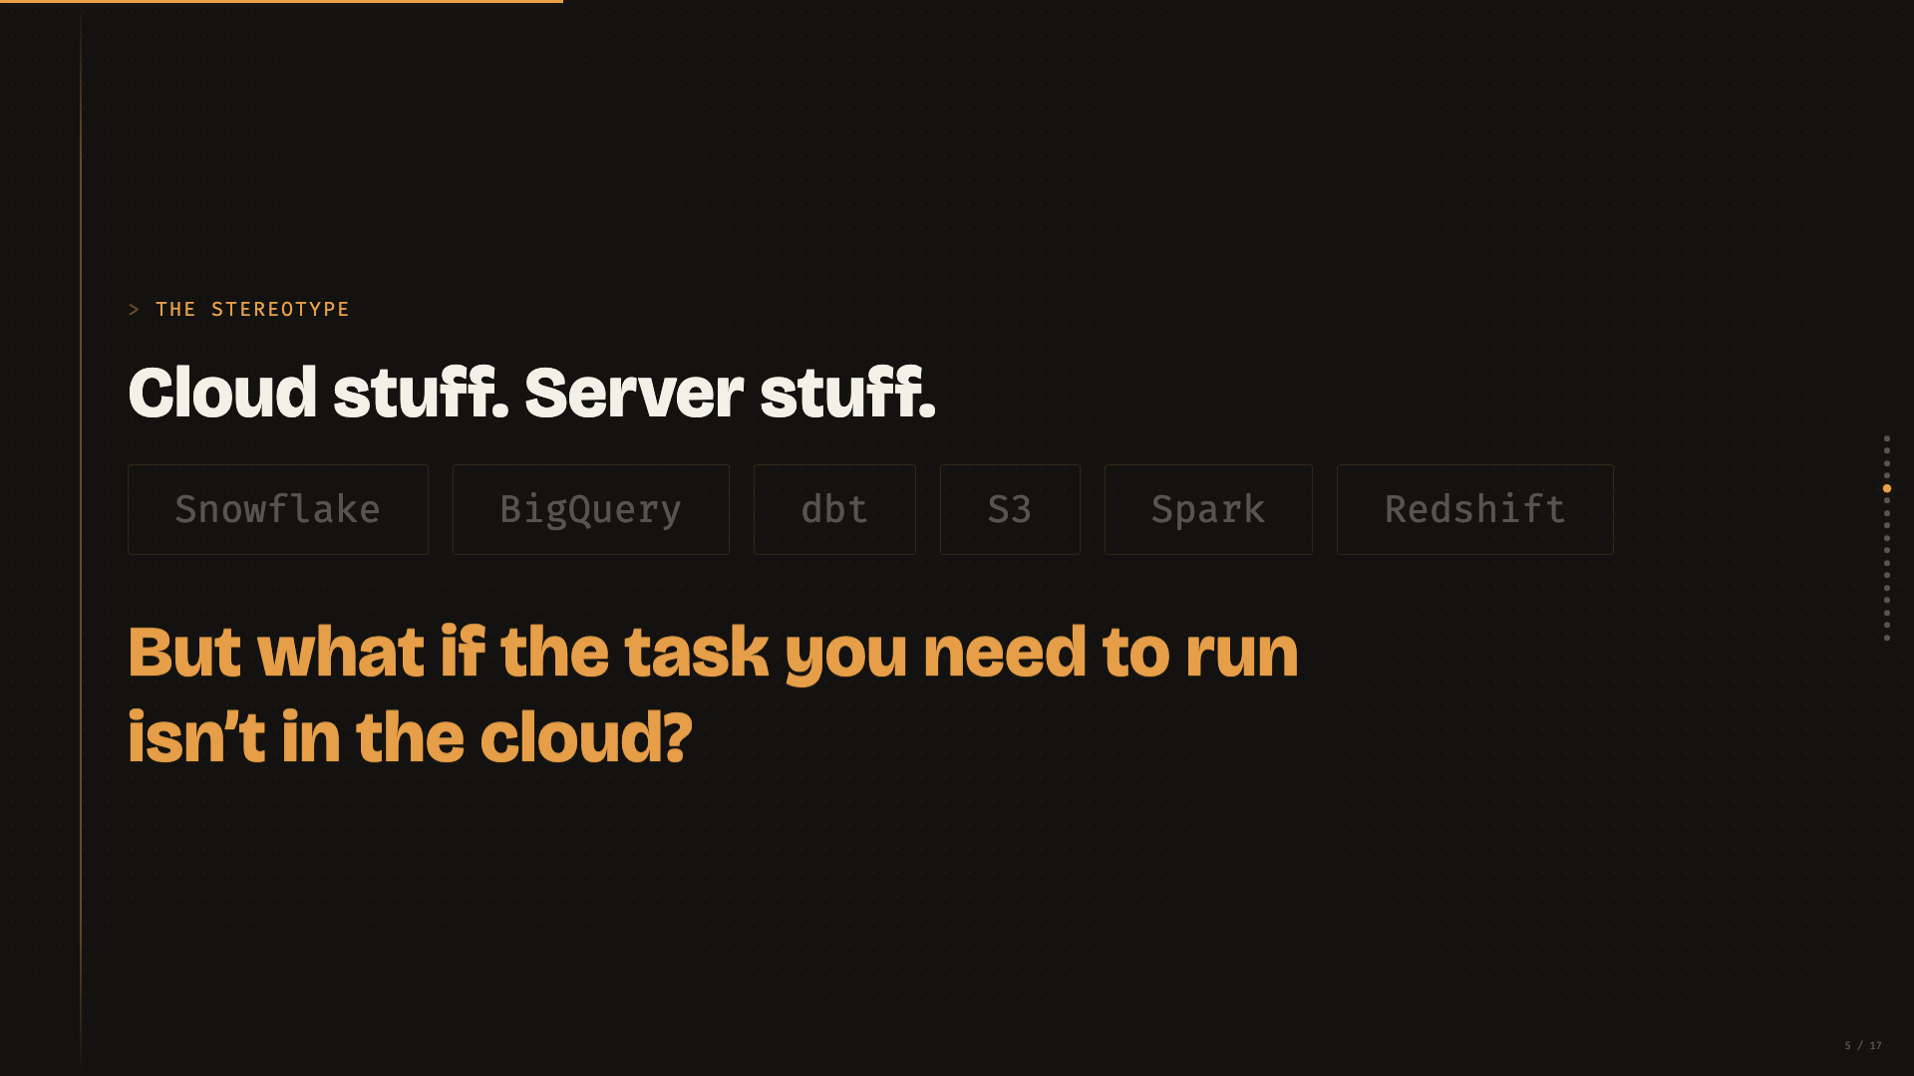
Notes:
THE STEREOTYPE (~1 min)
- Point at the badges: "Snowflake, BigQuery, dbt, S3 — this is what people think Airflow is for. Cloud stuff. Server stuff. Data pipelines."
- Pause. Then read the copper text slowly: "But what if the task you need to run... isn't in the cloud?"
- This is the pivot of the talk. Let it breathe.
Transition: "Airflow 3 introduced something that changes this."

Slide 6
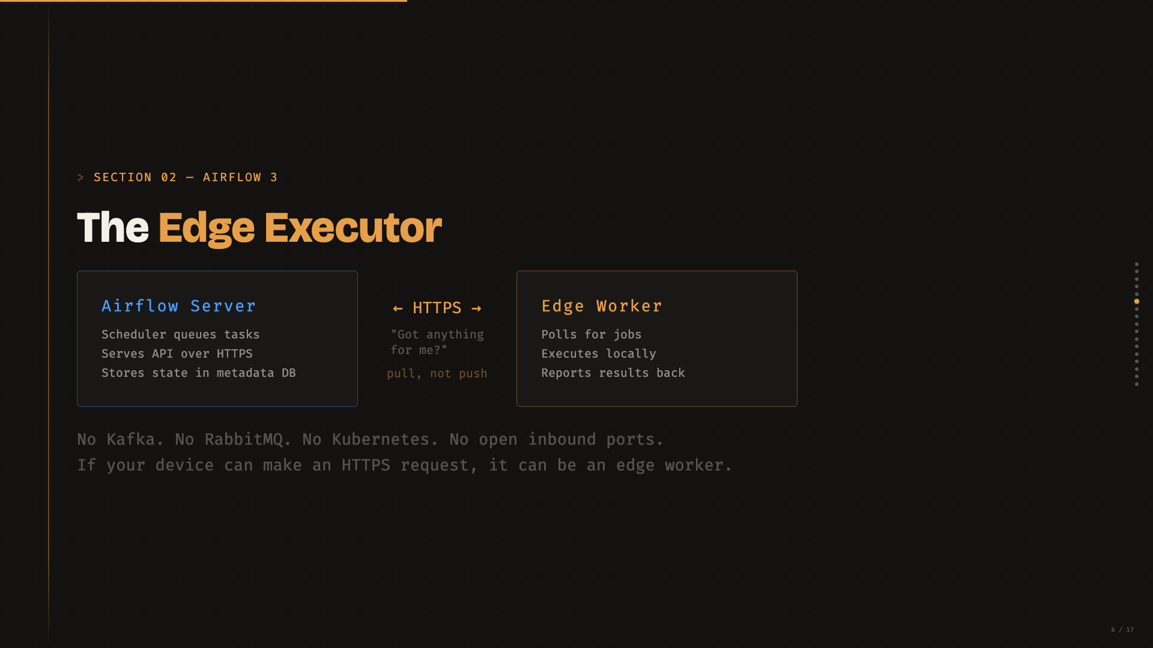
Notes:
EDGE EXECUTOR (~2 min)
- "Airflow 3 shipped in 2025. One of the new features: the Edge Executor."
- Point at the two boxes: "You install a worker on a remote device. That worker polls the Airflow server over HTTPS — 'Got anything for me?'"
- Emphasize: "Pull-based. Not push. The Pi reaches out."
- "No Kafka. No RabbitMQ. No Kubernetes. No open inbound ports."
- "If your device can make an HTTPS request, it can be an edge worker."
- Second key feature: "Multi-executor routing — one DAG can have tasks on different executors. Some on your server, some on a Pi."
Transition: "So what does this look like in practice?"

Slide 7
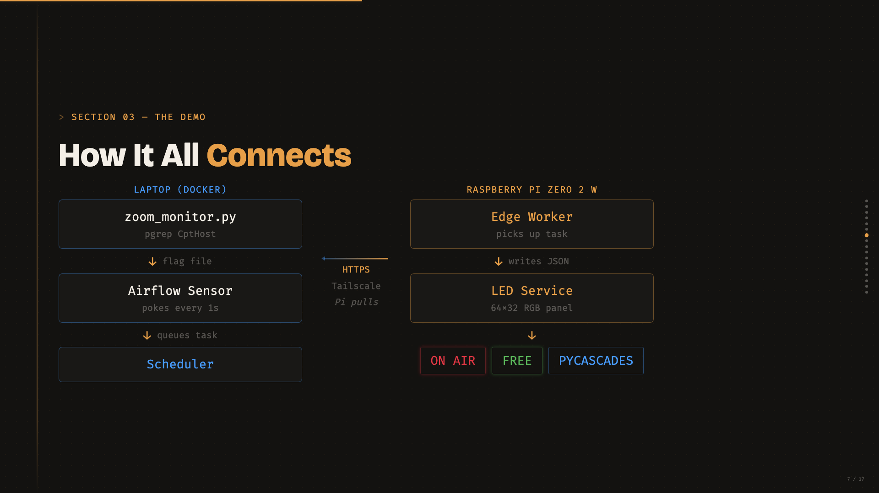
Notes:
ARCHITECTURE (~1.5 min)
- Walk through left column top to bottom: "On my laptop, a Python script watches for the Zoom process. When it sees it, it creates a flag file. Airflow has a sensor poking every second — it detects the flag. The scheduler queues an edge task."
- Point at the HTTPS arrow: "This is the connection. HTTPS over Tailscale. The Pi pulls — no inbound connections, no port forwarding."
- Walk through right column: "The edge worker picks up the task, writes a JSON state file. A separate LED service reads that file and drives the panel."
- Point at the colored badges: "ON AIR, FREE, or PYCASCADES — that's the idle state."
Transition: "Here's the actual hardware..."

Slide 8
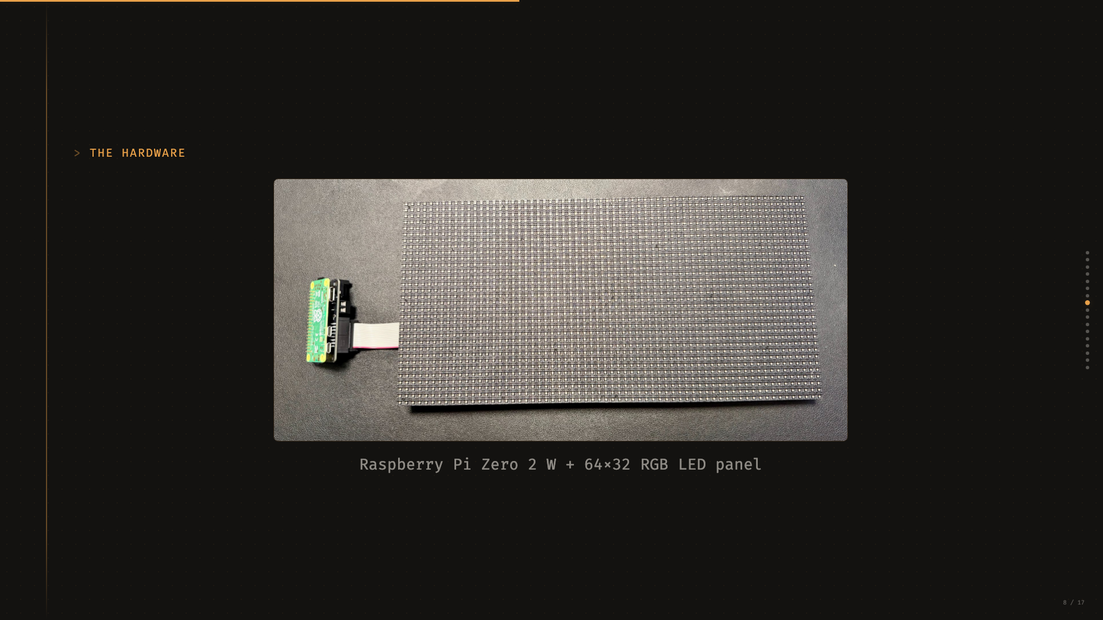
Notes:
HARDWARE (~30s)
- "This is the 64x32 RGB LED panel. Connected to a Pi Zero 2 W via an Adafruit RGB Matrix Bonnet and a ribbon cable."
- "The whole thing costs about $60 in parts."
- Keep it brief — the audience will see the real thing during the demo.
Transition: "Let me show you it working."

Slide 9
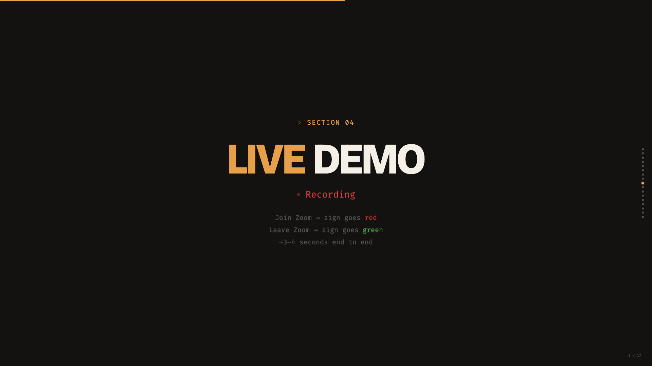
Notes:
LIVE DEMO (~4.5 min)
- Switch to showing the physical sign + Airflow UI. This slide is just a backdrop.
- Sequence: (1) Show idle sign, (2) Show Airflow UI with sensor poking, (3) Join Zoom call, (4) Watch sign go red (~3-4s), (5) Show UI again — set_on_air complete, wait_for_meeting_end running, (6) Leave Zoom, (7) Watch sign go green.
- FILL THE LATENCY GAP with narration. Don't stand in silence during the 3-4 seconds.
- Backup: "demo sim start" / "demo sim end" if Zoom is uncooperative. Use it without apology.
- The LED code aside: "About 200 lines of Python using rpi-rgb-led-matrix. It's in the repo."
Transition: "Let me show you the code that makes this work."

Slide 10
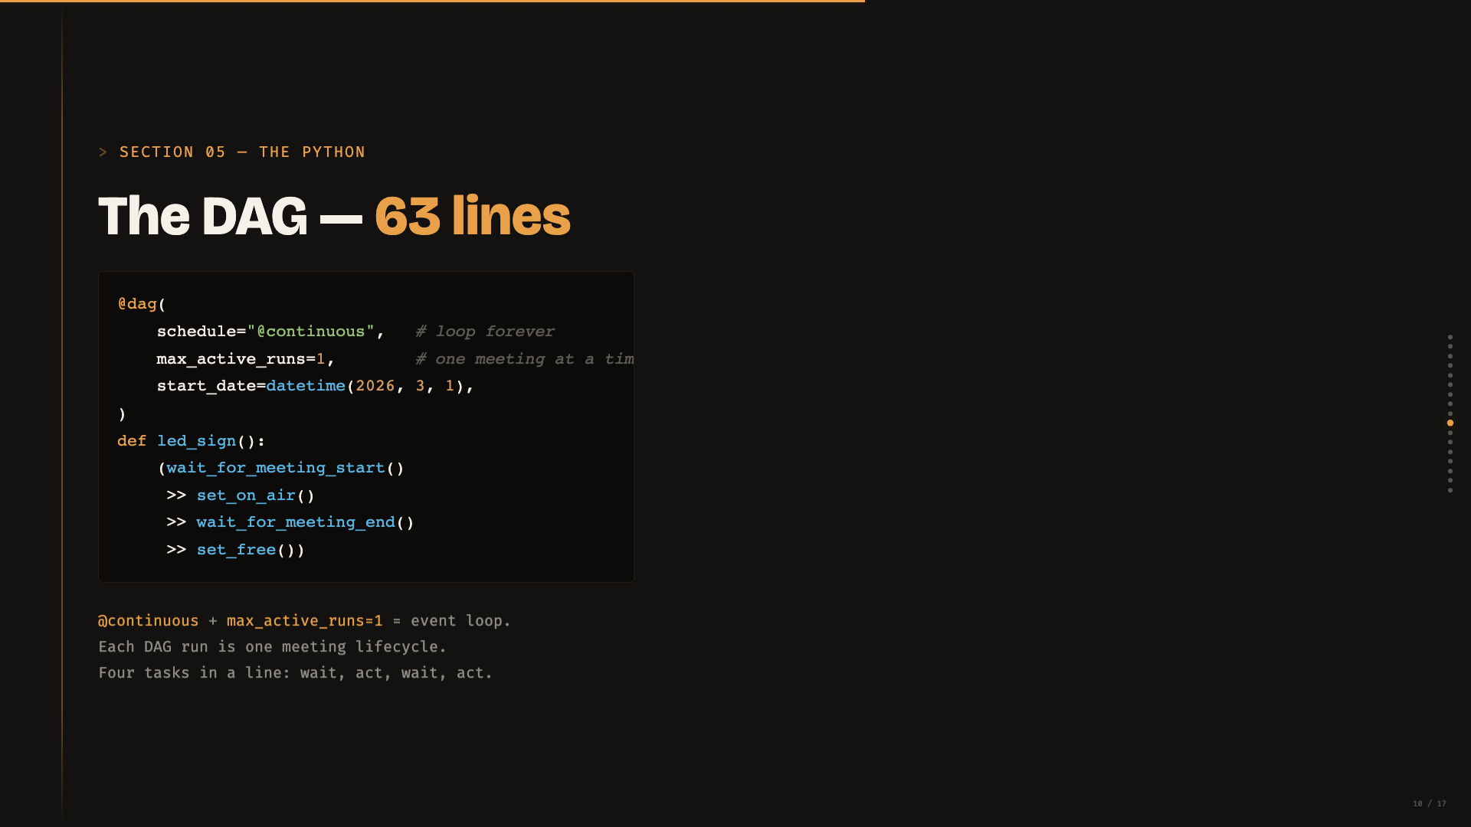
Notes:
DAG STRUCTURE (~1.5 min)
- "This is the entire DAG. 63 lines of Python, including comments."
- Point at @continuous: "Most people expect Airflow to run on a cron schedule. @continuous makes it behave like an event loop."
- "max_active_runs=1 — one meeting at a time."
- "Four tasks in a line: wait, act, wait, act. Simple state machine."
- The >> operator: "This is Airflow's way of saying 'runs after.' Just Python operator overloading."
Transition: "But here's the interesting part — where do these tasks actually run?"

Slide 11
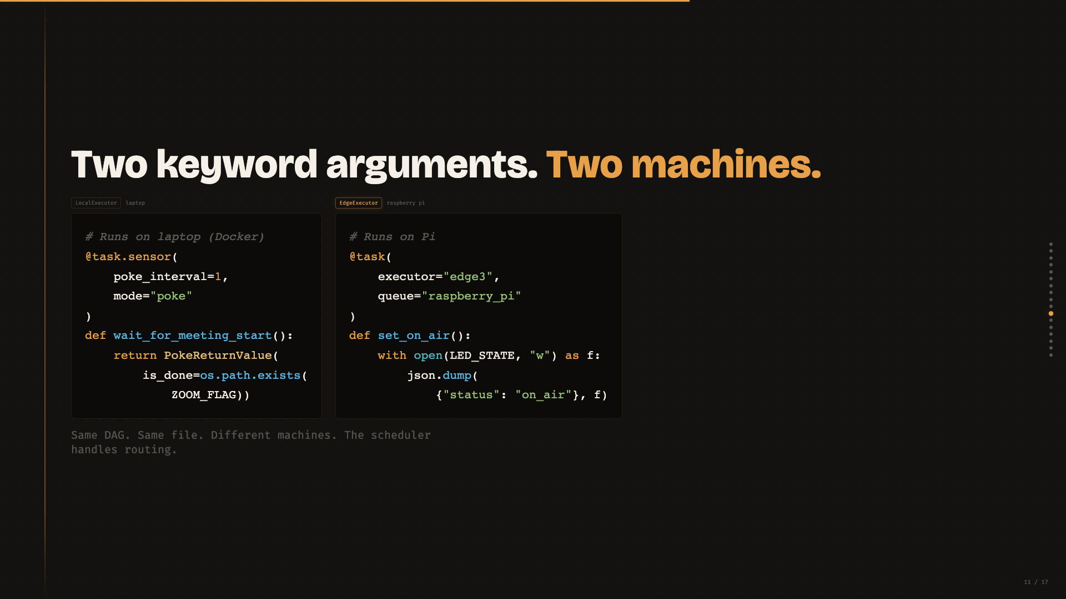
Notes:
MULTI-EXECUTOR TASK ROUTING (~1.5 min)
- "Left side: a sensor. Runs on the laptop inside Docker. It just checks if a file exists."
- "Right side: an edge task. executor='edge3', queue='raspberry_pi' — that's all it takes."
- "Same DAG, same file, different machines. Two keyword arguments."
- For Airflow users: "Multi-executor in one DAG was not possible before Airflow 3."
- For everyone else: "Two keyword arguments route a task from my laptop to a Raspberry Pi. That's it."
Transition: "Now, how do we actually detect the Zoom call?"

Slide 12
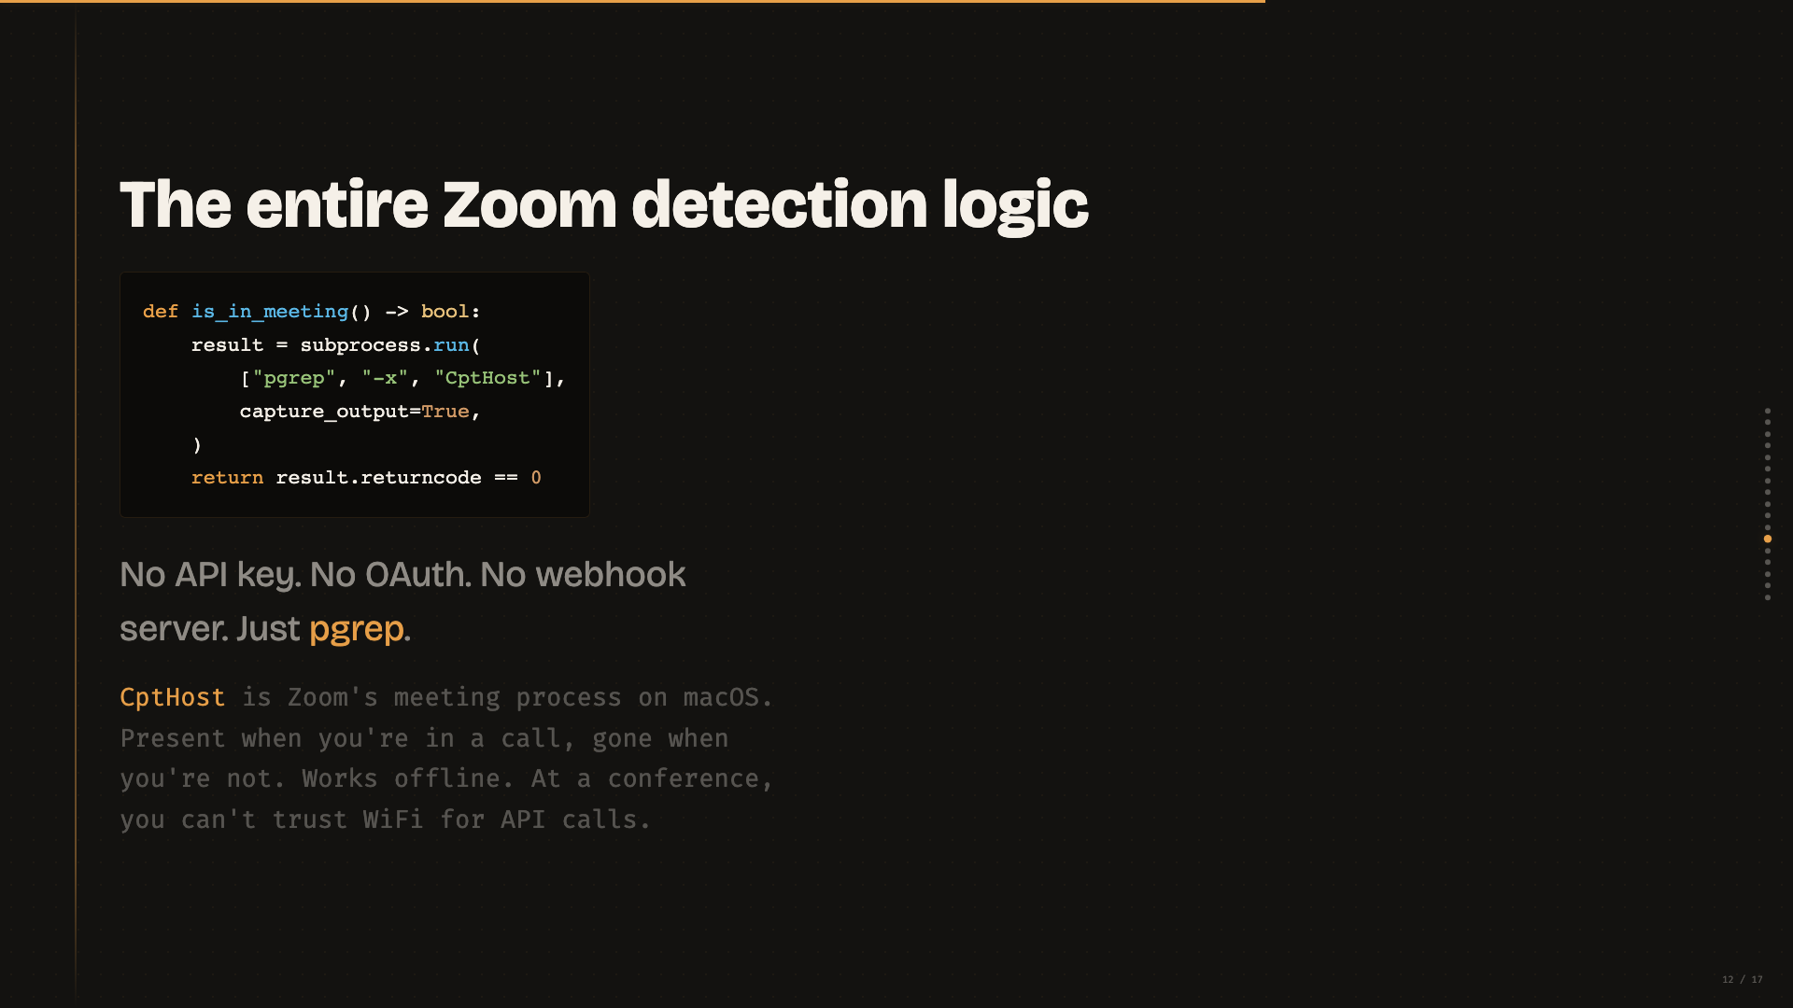
Notes:
ZOOM DETECTION (~1 min)
- Read it out: "This is the ENTIRE Zoom detection logic."
- "No API key. No OAuth. No webhook server. Just pgrep."
- Let people laugh. The contrast between the Airflow architecture and subprocess.run(["pgrep"]) is funny. Lean into it.
- "CptHost is Zoom's meeting process on macOS. At a conference, you can't trust WiFi for API calls. This works offline."
Transition: "One more pattern worth calling out..."

Slide 13
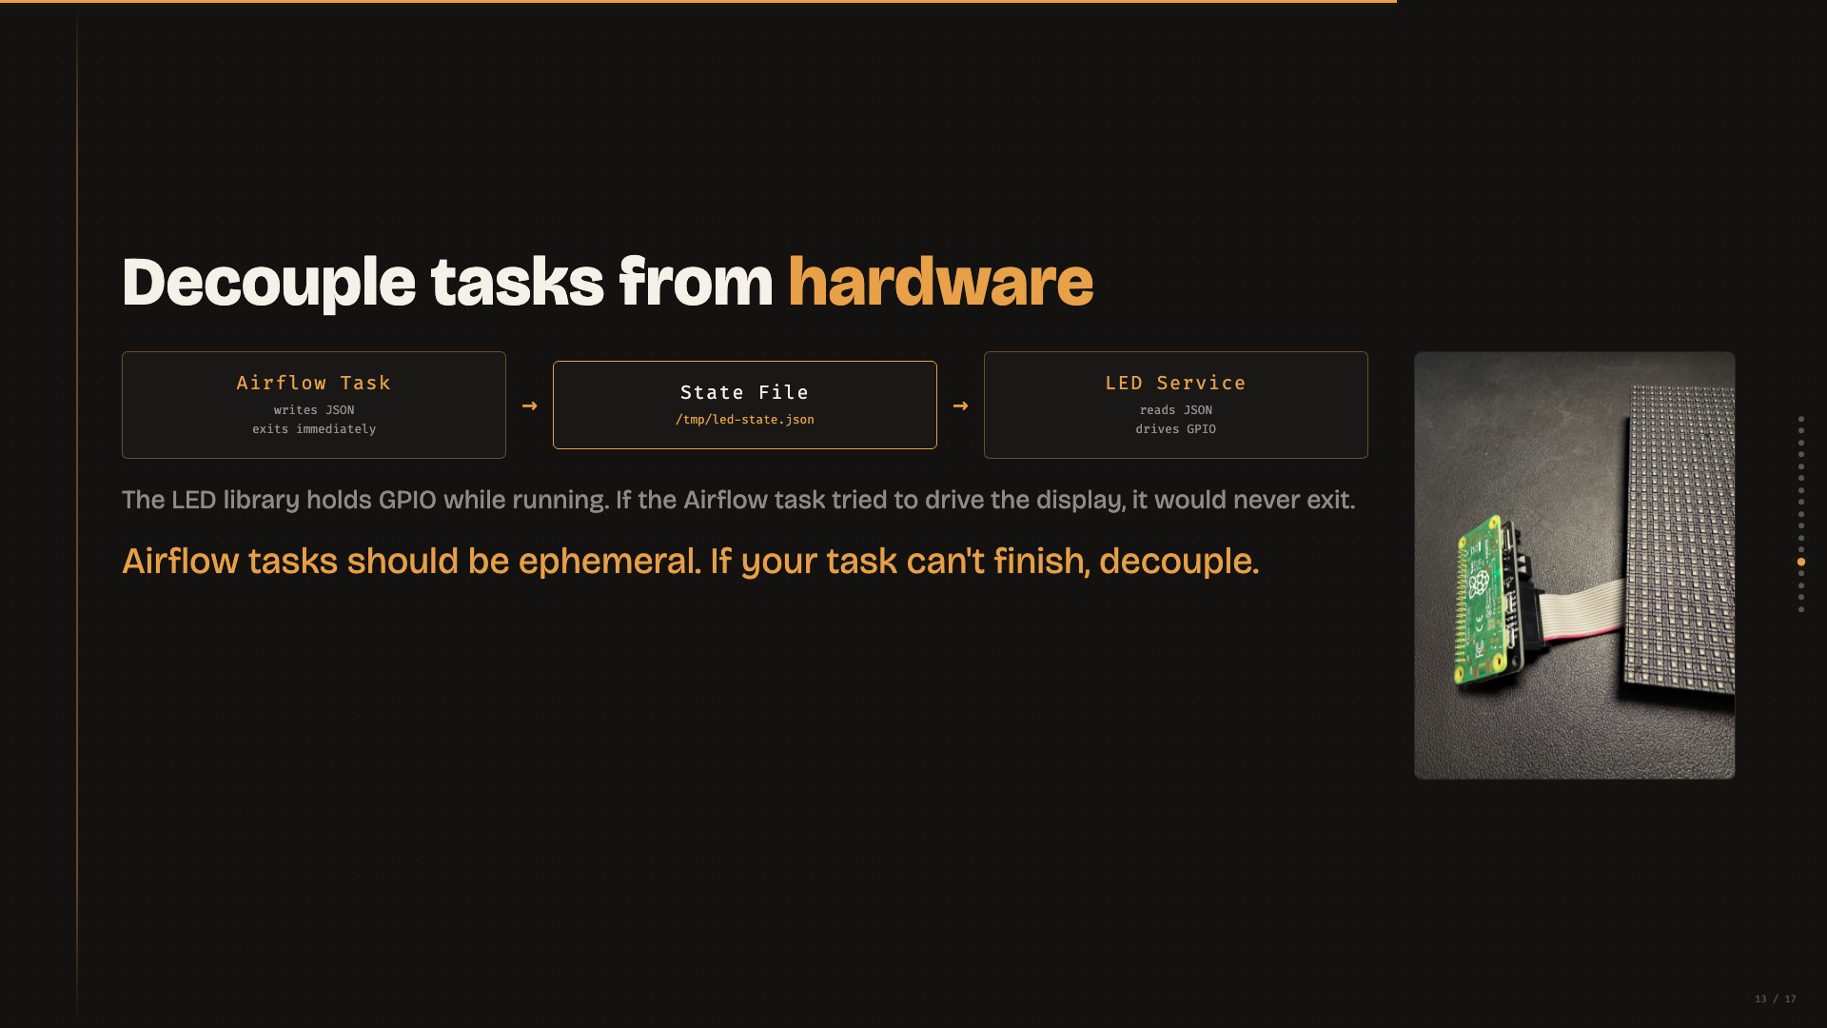
Notes:
STATE FILE PATTERN (~1 min)
- Point at the diagram: "Airflow task writes JSON, exits. LED service reads JSON, drives GPIO."
- "The LED library holds GPIO while it's running. If the Airflow task tried to drive the display, it would never exit — Airflow would kill it on timeout."
- Read the copper line: "Airflow tasks should be ephemeral. If your task can't finish, decouple."
- Point at the Pi photo: "That's the actual Pi with the bonnet and ribbon cable."
- This is a real engineering lesson. The audience should take away the state-file pattern even if they never touch an LED.
Transition: "So what did I learn from all this?"

Slide 14
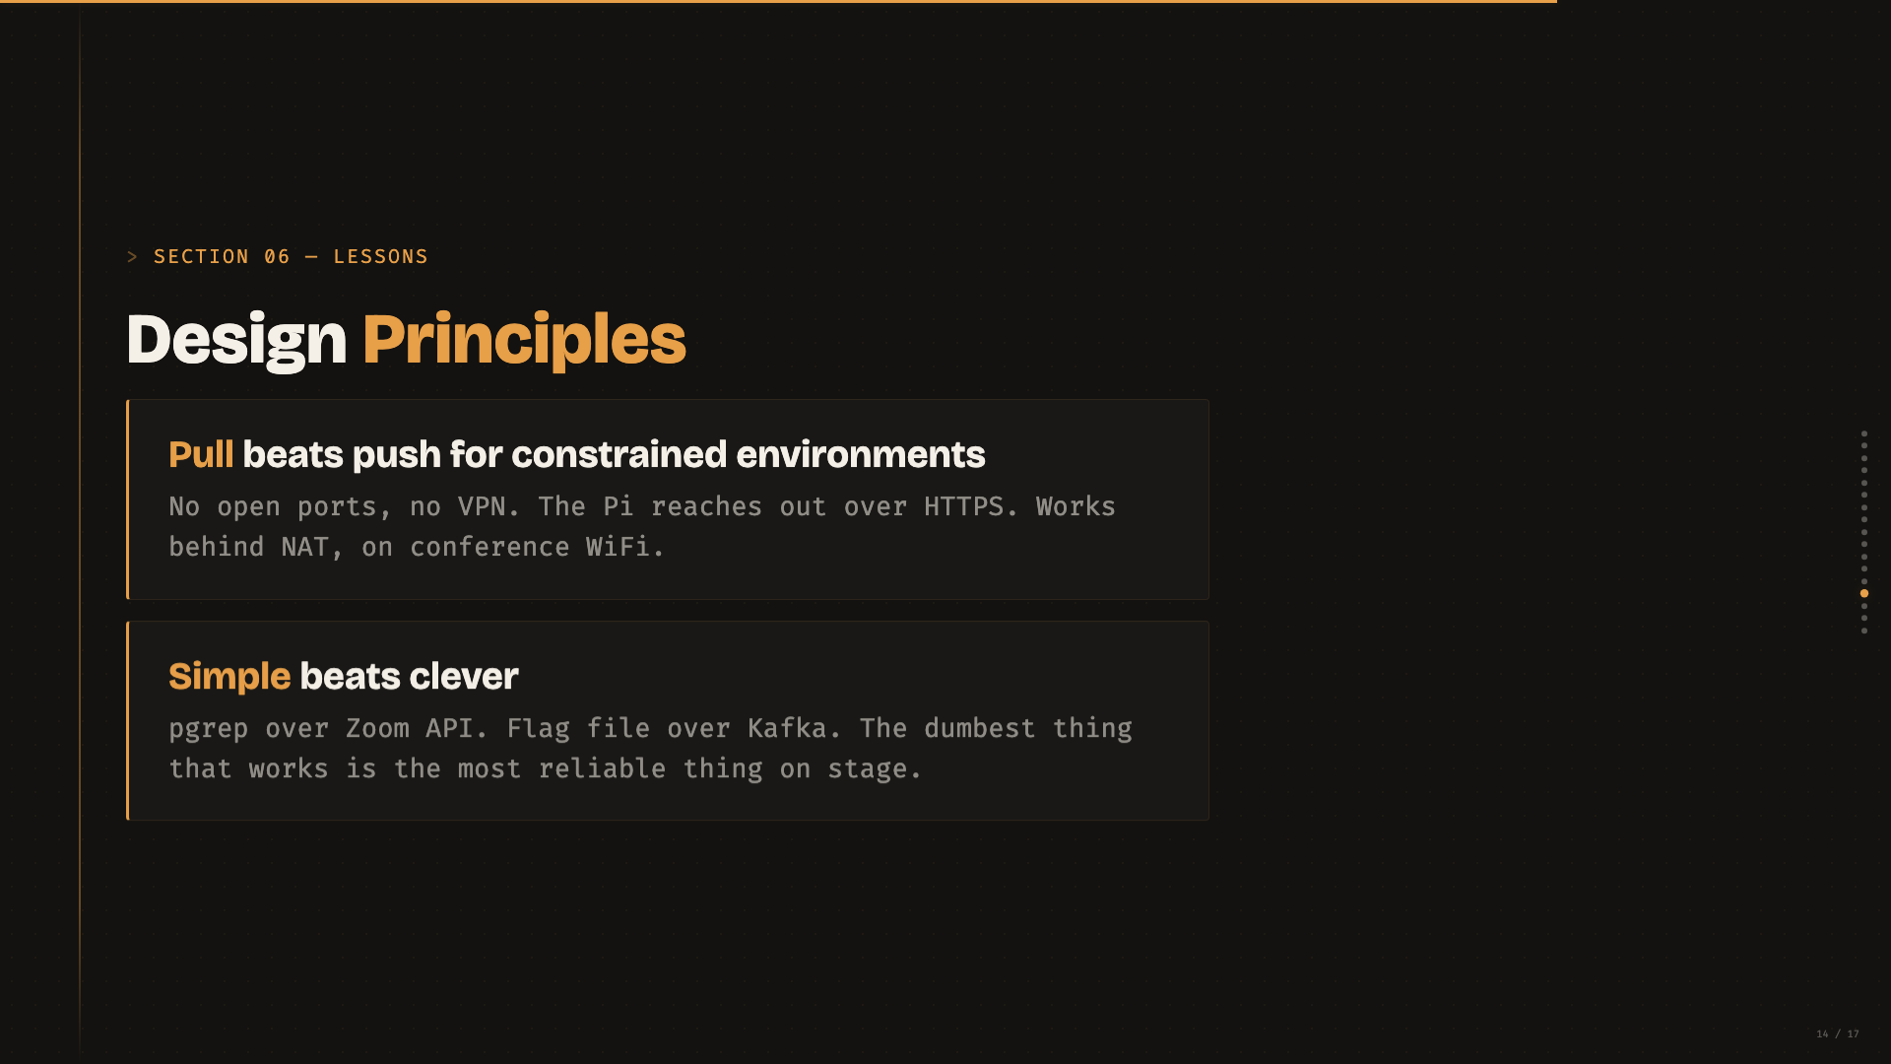
Notes:
DESIGN PRINCIPLES (~1.25 min)
- Pull beats push: "No open ports, no VPN. The Pi reaches out. Works behind NAT, on conference WiFi."
- Simple beats clever: "At every decision point, we picked the dumbest thing that works. That's why it's reliable enough to run live on stage."
Transition: Next slide for practical realities.

Slide 15
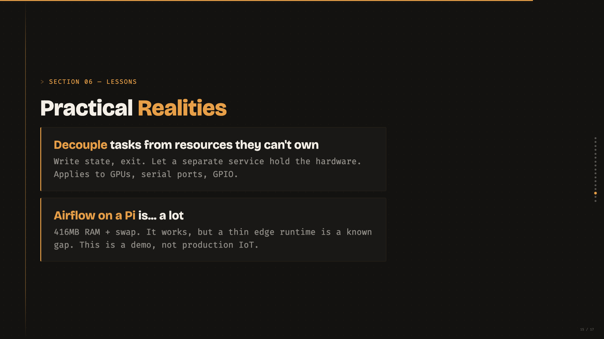
Notes:
PRACTICAL REALITIES (~1.25 min)
- Decouple: "Write state, exit. Let something else hold the hardware. GPUs, serial ports, GPIO — anything needing persistent access."
- Airflow on a Pi: "416MB RAM plus swap. It works. But I'm not going to pretend this is production-ready IoT. A thin edge runtime is a known gap — AIP-69 flags it."
- Be honest about limitations. The audience respects honesty over polish.
Transition: "So this was a toy project. But the pattern is real."

Slide 16
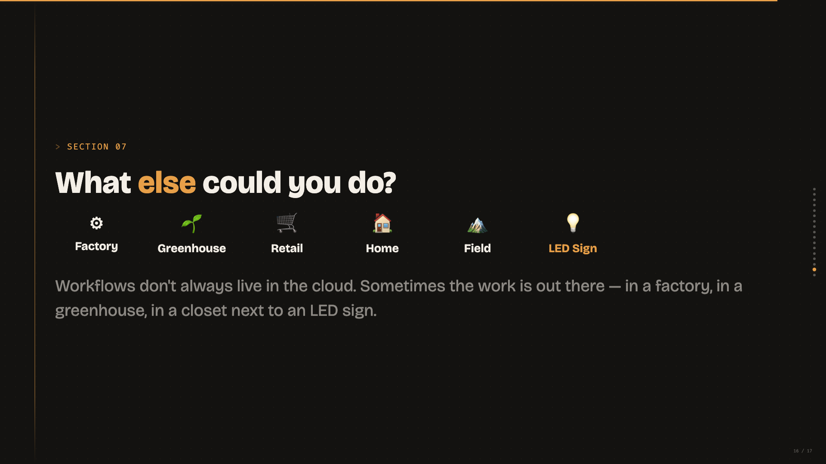
Notes:
BIGGER PICTURE (~2 min)
- Gesture across the icons: "Factory sensors. Greenhouse monitoring. Retail signage. Home automation — probably not the right tool, but it could."
- "Field research stations with intermittent connectivity — the pull model is perfect for that."
- Point at LED Sign (highlighted): "And a silly sign next to my desk."
- Read the closing line: "Workflows don't always live in the cloud. Sometimes the work is out there."
- Keep it aspirational, not prescriptive. You're planting seeds, not pitching a product.
Transition: "That's the talk."

Slide 17
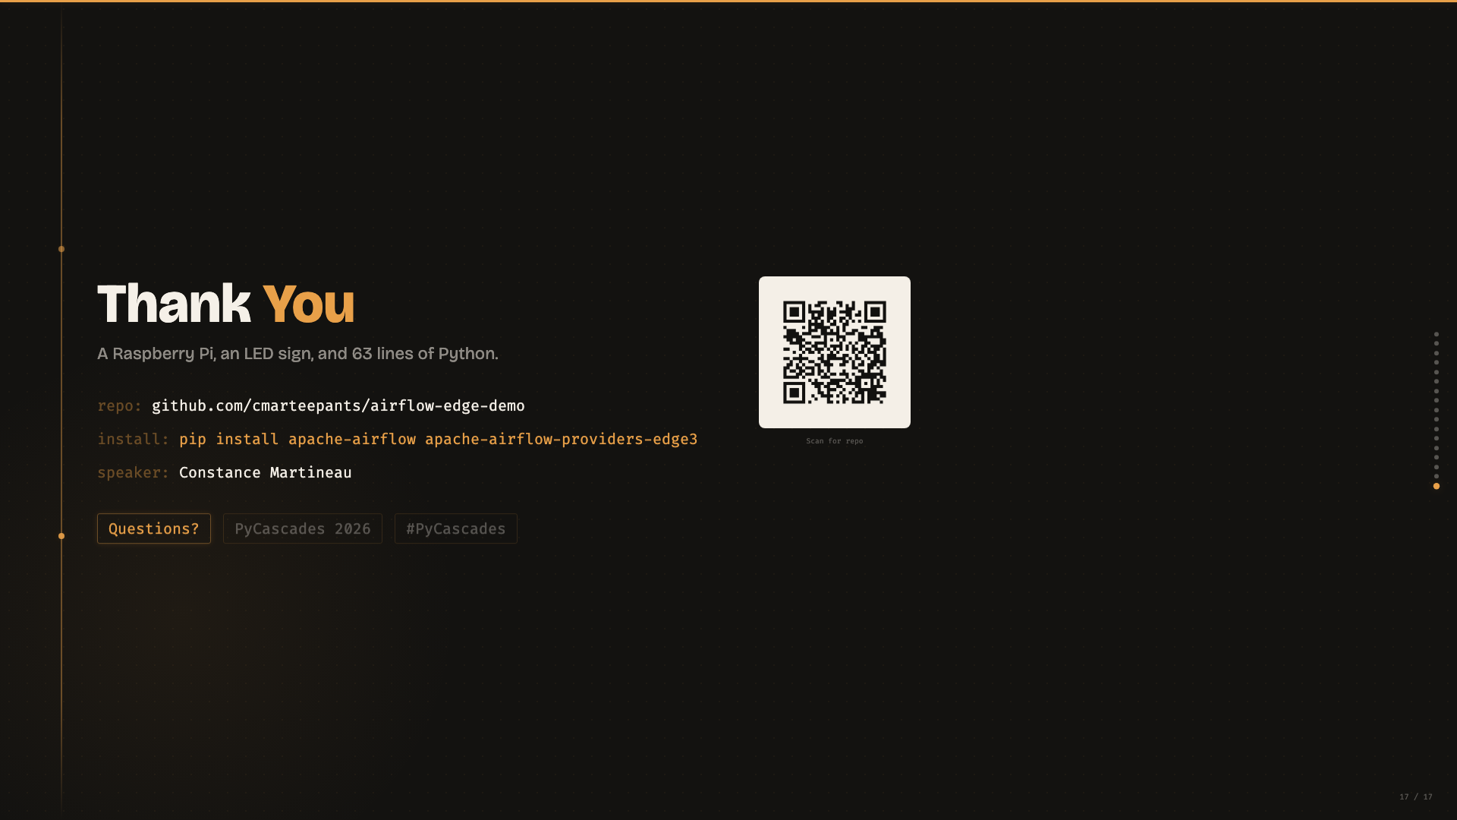
Notes:
WRAP-UP (~1 min)
- "The code is all open source — scan the QR code or hit the repo URL."
- "pip install apache-airflow apache-airflow-providers-edge3 — that's all you need to try this yourself."
- One-sentence callback: "Airflow beyond the cloud — it's a Raspberry Pi, an LED sign, and 63 lines of Python."
- "If you want to talk about Airflow, edge computing, or why someone would put an enterprise orchestrator on a $15 computer — come find me after. Thank you."
- Leave this slide up during Q&A.

