Slide 1
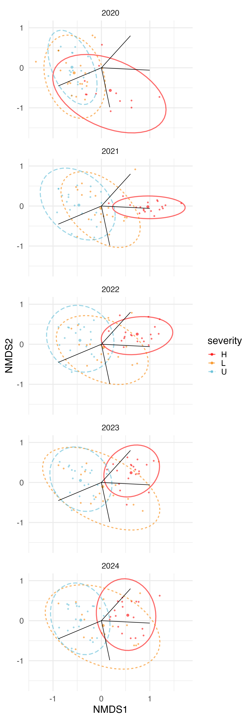
sla
resprouting
height
seedmass

Slide 2
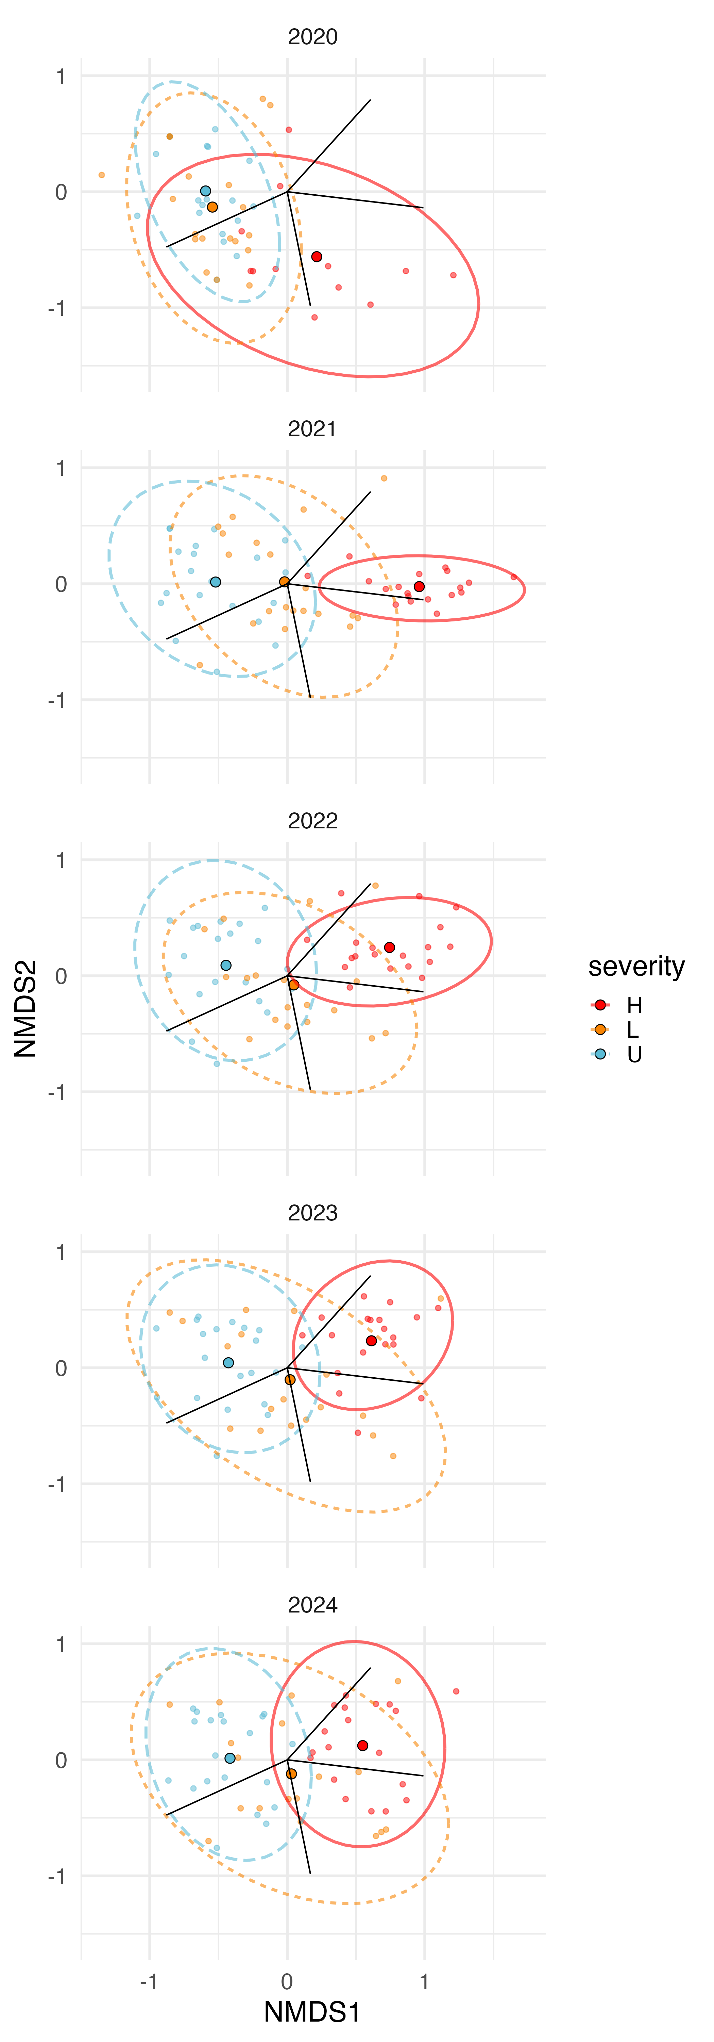
sla
height
resprouting
seedmass
sla
resprouting
height
seedmass
sla
height
resprouting
seedmass
sla
height
resprouting
seedmass
sla
height
resprouting
seedmass

