Slide 1
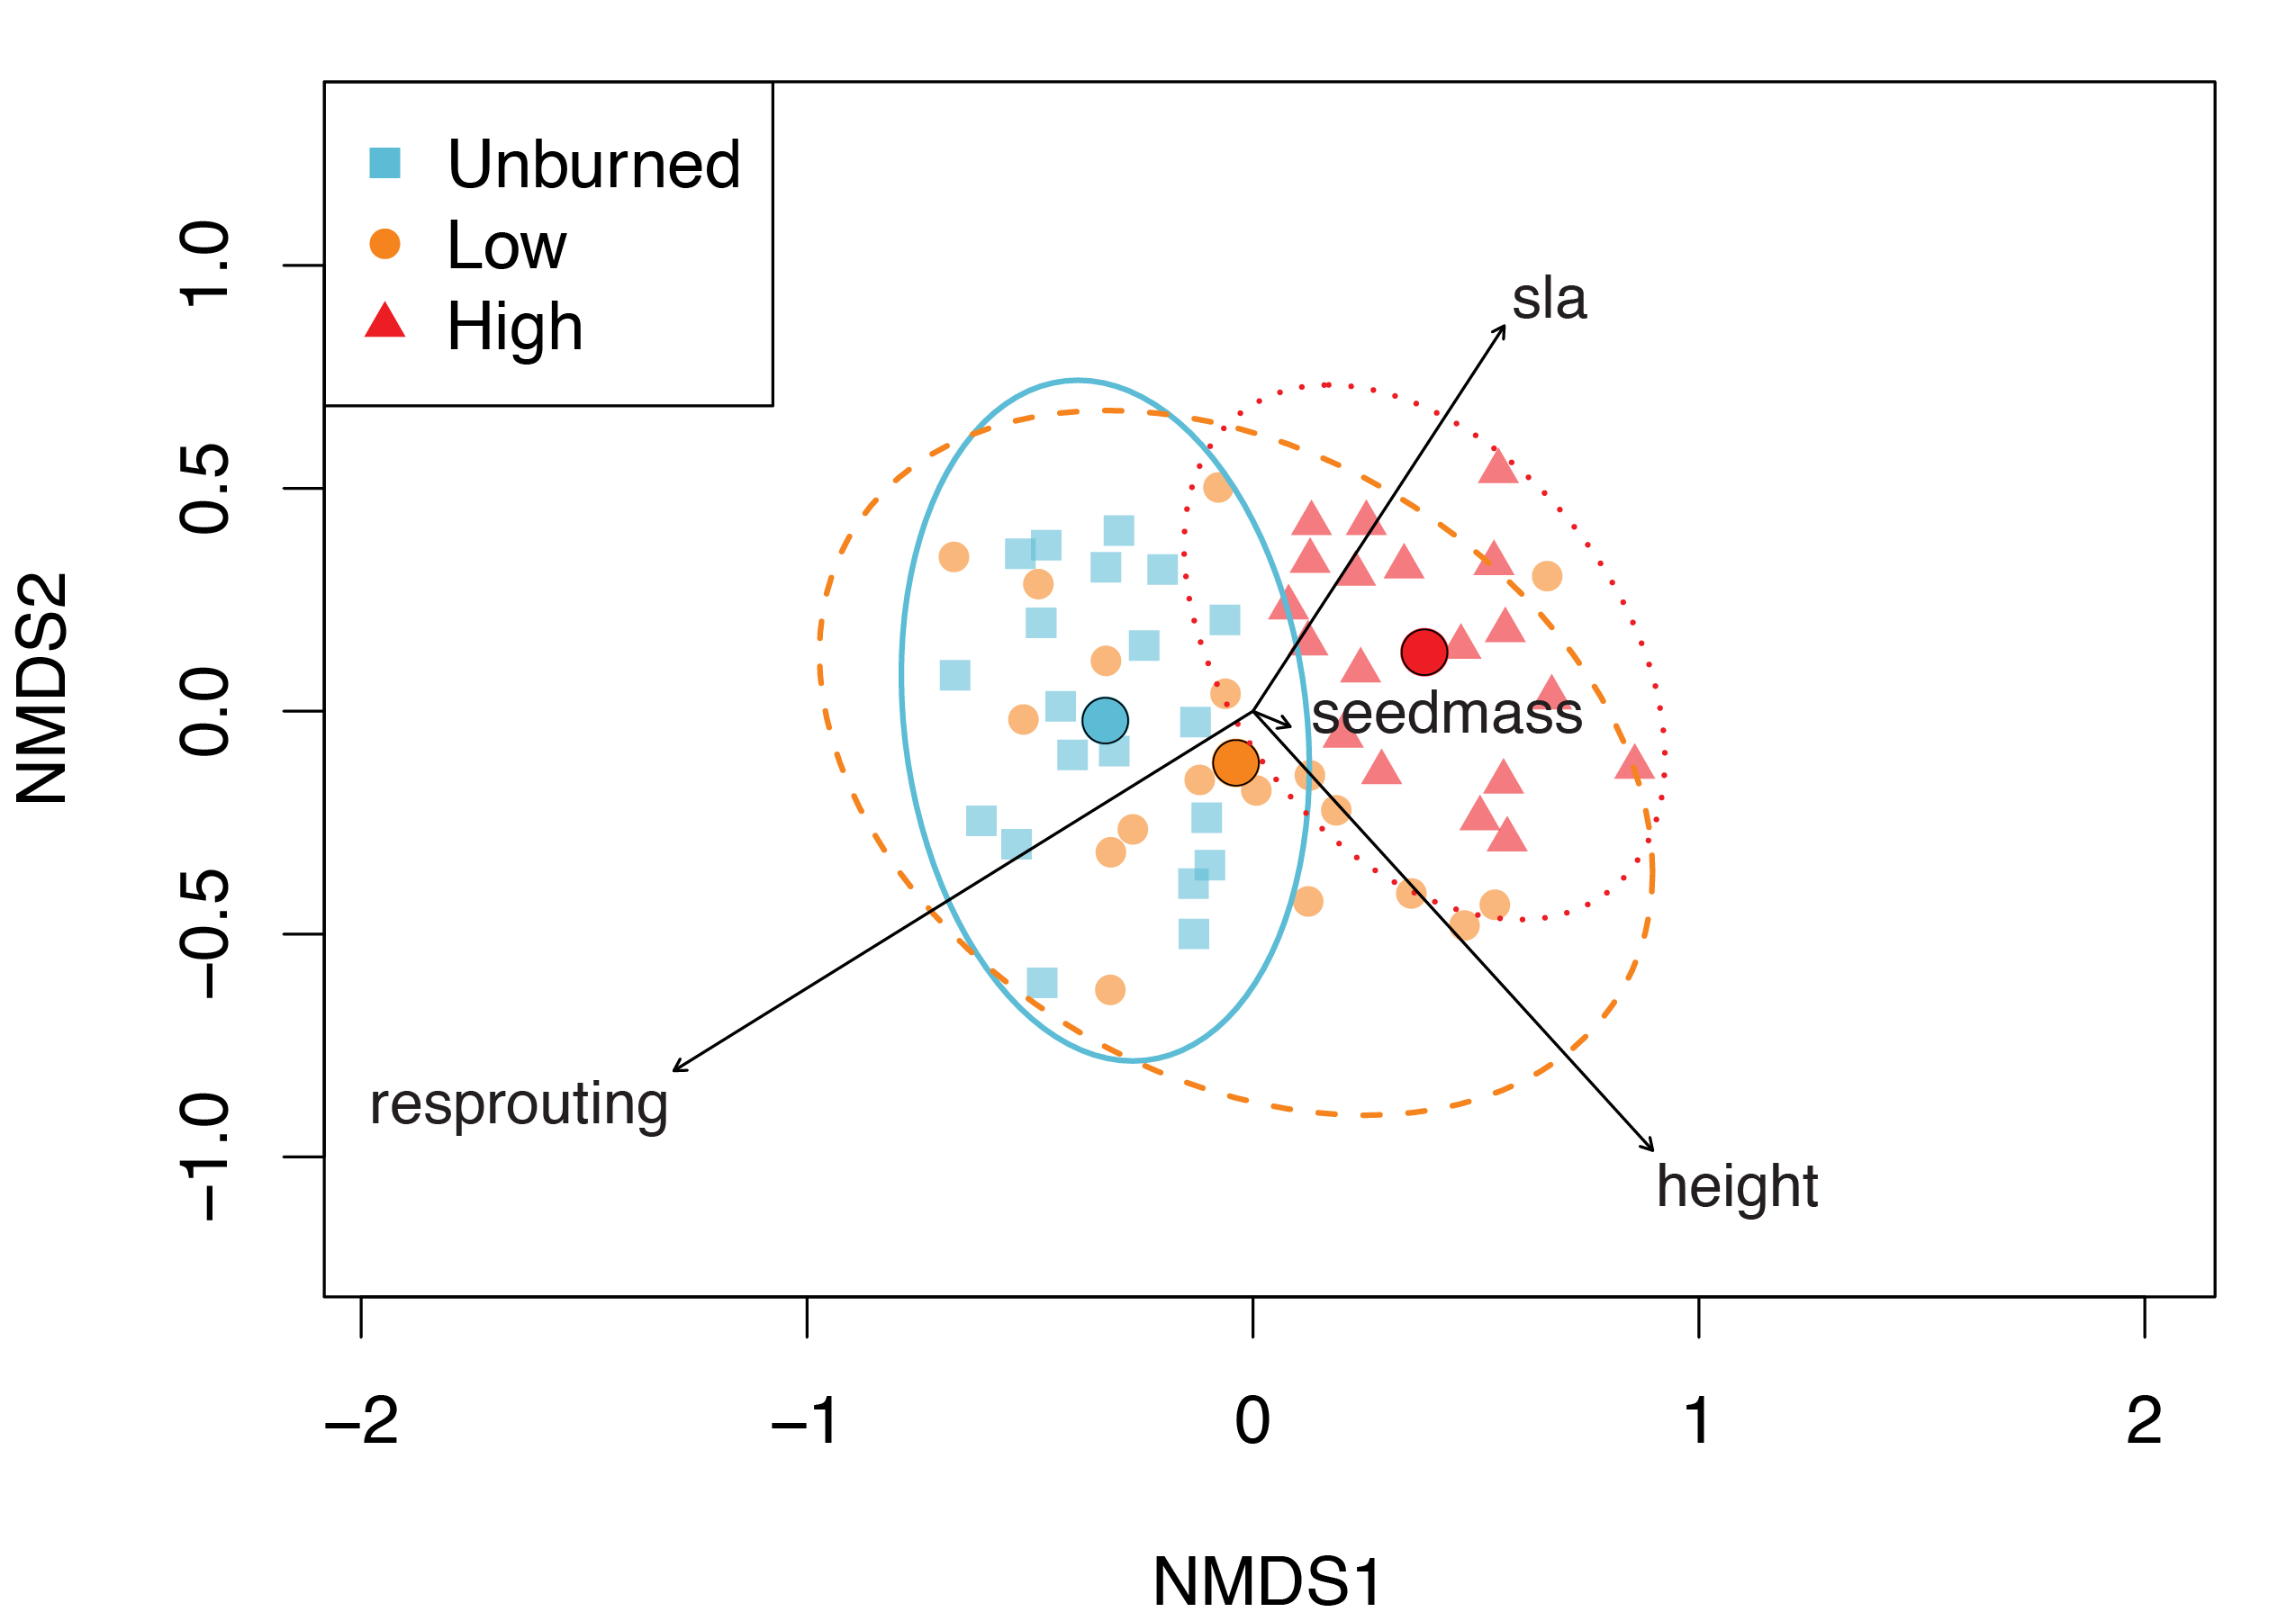
Figure 1. Results from the nonmetric multidimensional scaling (NMDS) analyses. Symbols represent individual plots in 2024 distributed according to taxonomic composition weighted by cover. Vectors indicate correlation between number of species with functional trait and NMDS axes.
Notes:
Figure 1. Results from the nonmetric multidimensional scaling (NMDS) analyses. Symbols represent individual plots in 2024 distributed according to taxonomic composition weighted by cover. Vectors indicate correlation between number of species with each trait and NMDS axes.

Slide 2
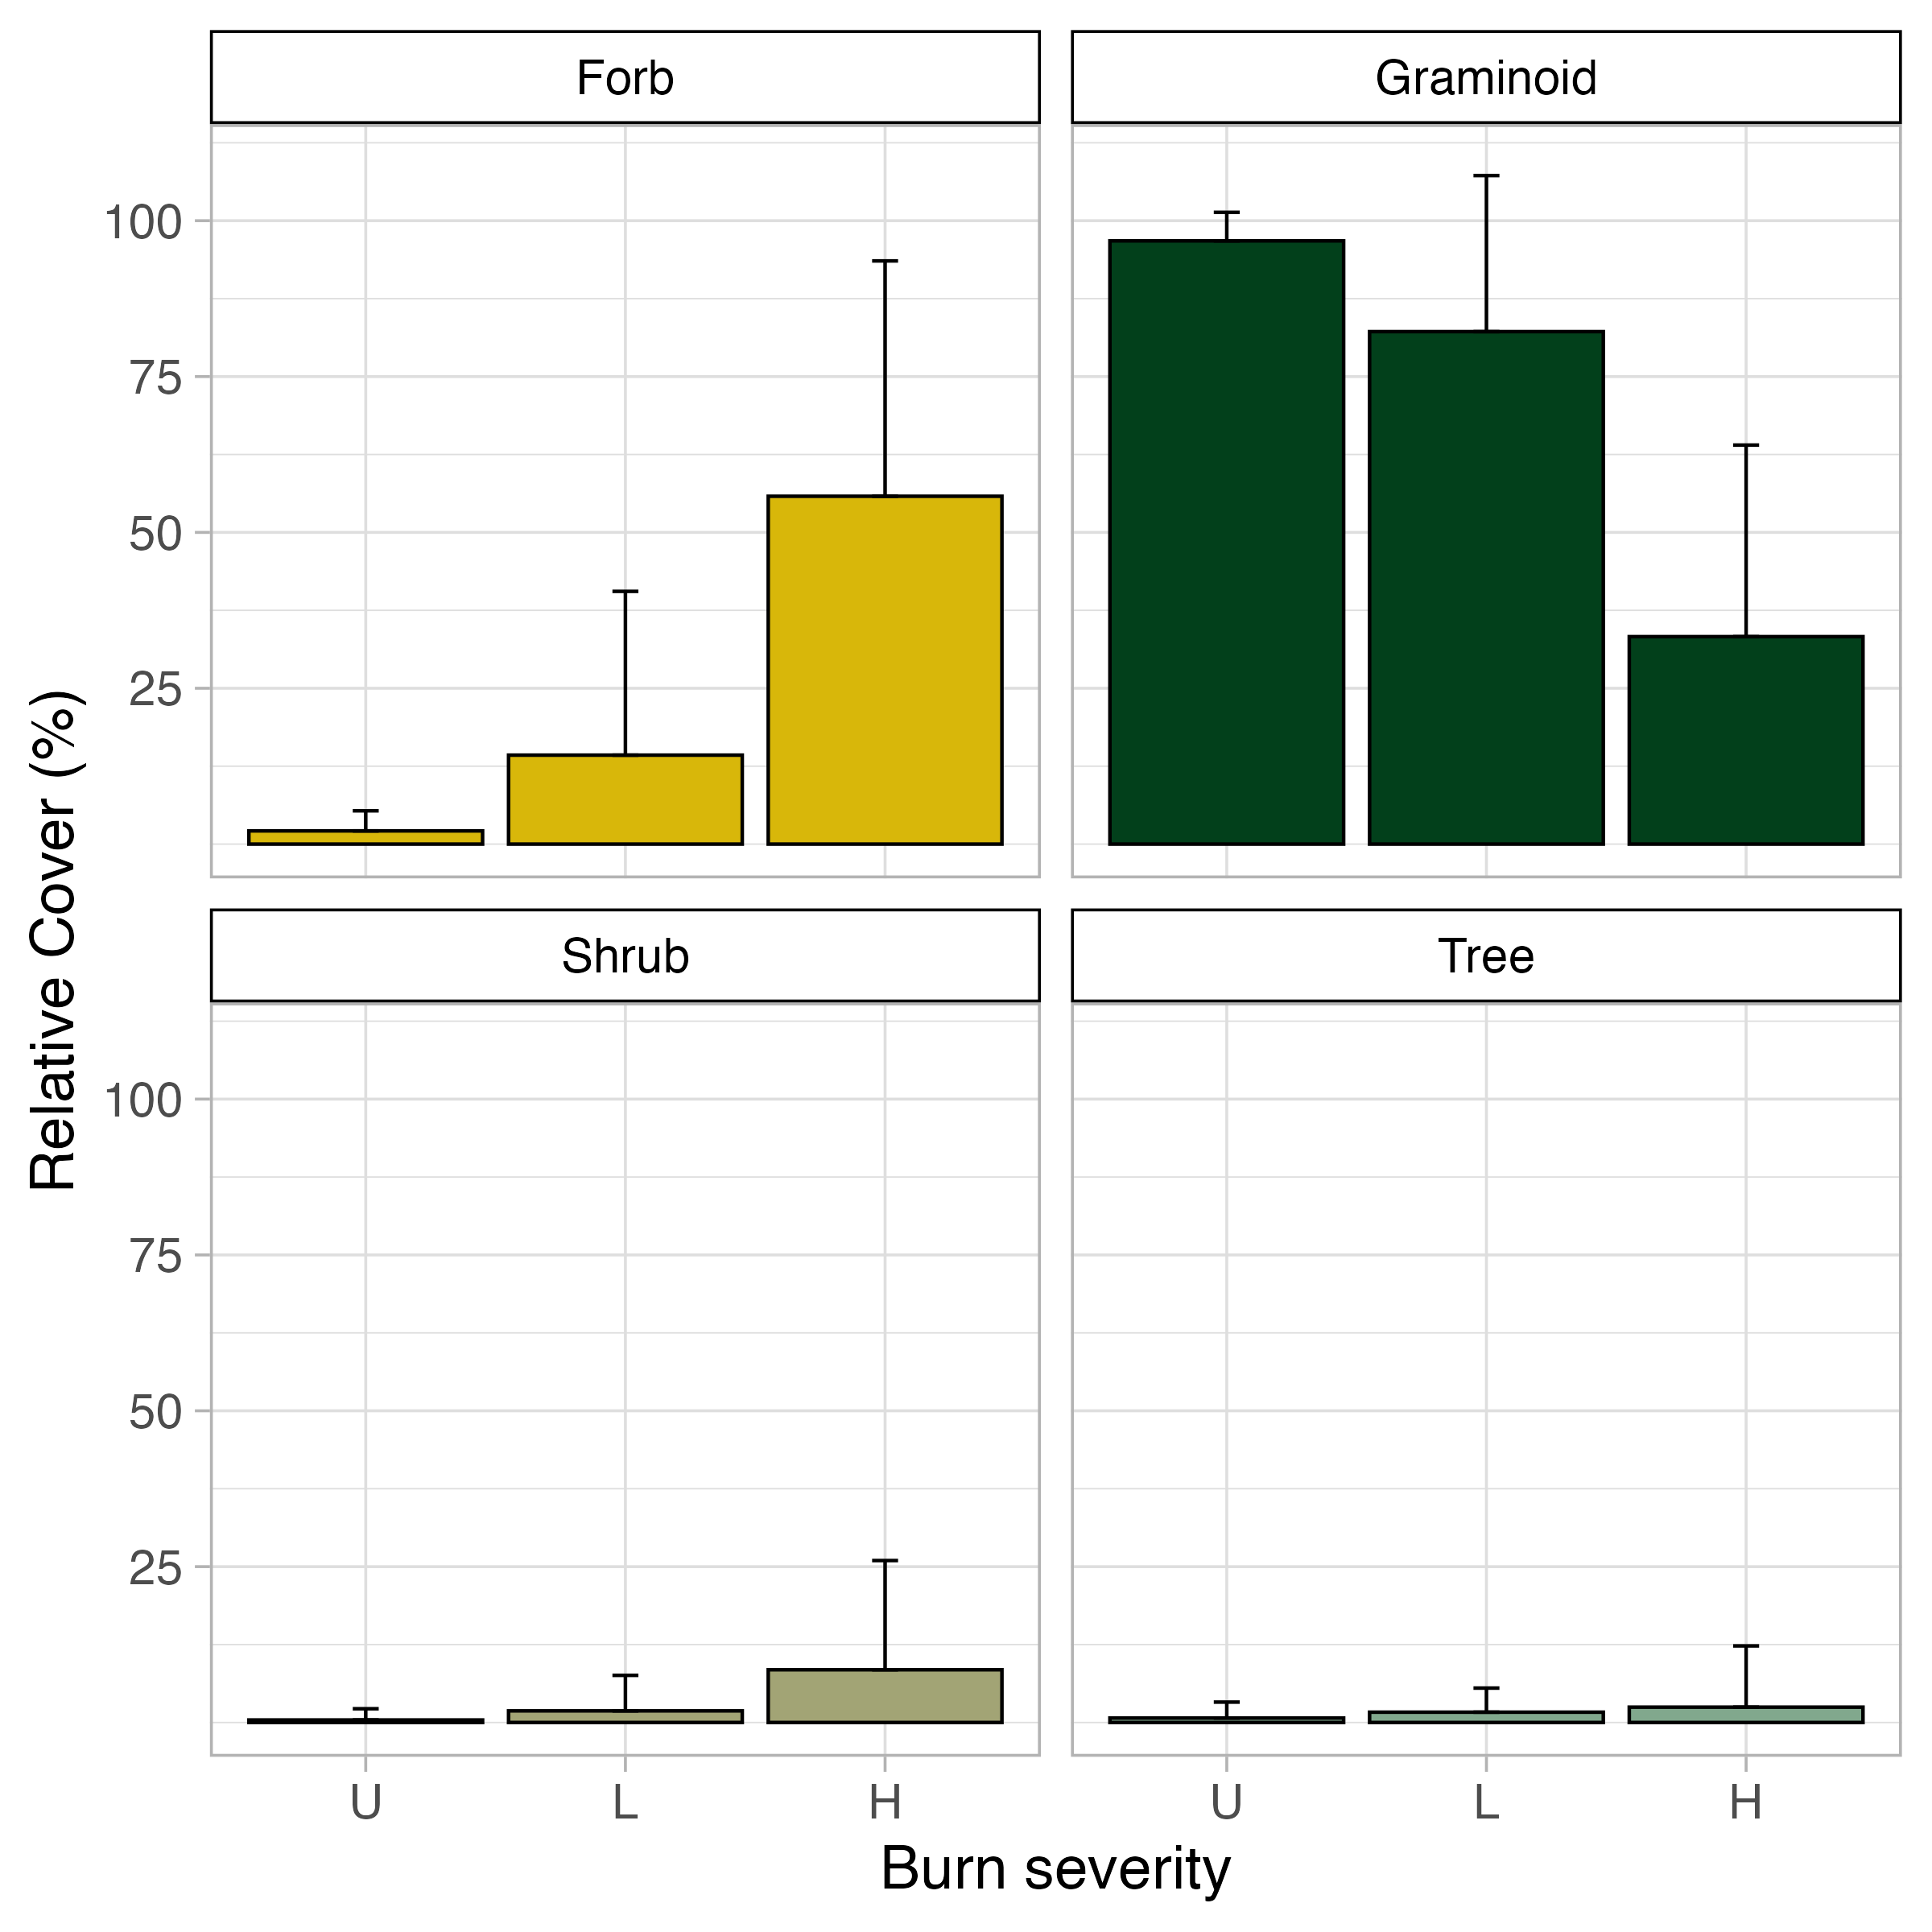
a
b
a
a
b
b
a
a
c
d
Figure 2. Relative cover for functional types (a forbs, b graminoids, c shrubs, d trees) across burn severities. Bars marked with different letters show functional group covers that are significantly different from each other among burn severities according to a Tukey's HSD test (p ≤ 0.05). Shrub and tree covers did not differ among severities.

Slide 3
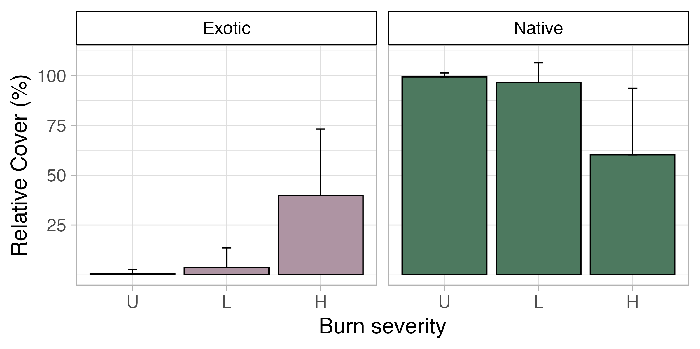
a
b
a
a
b
b
a
a
Figure 3. Relative cover for plant nativity (a exotic and b native species) across burn severities. Bars marked with different letters show covers that are significantly different from each other among burn severities according to a Tukey's HSD test (p ≤ 0.05).

Slide 4
Severity | Species | Indicator value | Mean relative cover in indicated severity
Unburned | Piptochaetium pringlei | 0.275 # | 66%
Low | Muhlenbergia straminea | 0.314 * | 44%
High | Verbascum thapsus | 0.618 *** | 39%
 | Lotus wrightii | 0.296 # | 9%
 | Ceanothus fendleri | 0.290 # | 10%
 | Linaria dalmatica | 0.284 # | < 1%
 | Festuca arizonica | 0.283 # | 6%
 | Pseudognaphalium macounii | 0.283 * | 4%
 | Elymus elymoides | 0.282 # | 6%
Table 1. Indicator species for unburned, low, and high severity, with mean relative cover values. p-values = 0.05 < #p < 0.1; *p < 0.05; **p < 0.01; ***p < 0.001. Signiﬁcant terms are shown in bold; terms in italics are marginally signiﬁcant. 9,999 permutations.
Notes:
Table 1. Indicator species for unburned, low, and high severity, with mean relative cover values. p-values = 0.05 < #p < 0.1; *p < 0.05; **p < 0.01; ***p < 0.001. Signiﬁcant terms are shown in bold; terms in italics are marginally signiﬁcant. 9,999 permutations.

Slide 5
Species | Unburned (20) | Low (18) | High (19)
Piptochaetium pringlei | 66 ± 41.6%, 15 | 26 ± 37.4%, 8 | None present
Muhlenbergia virescens | None present | 44 ± 43.6%, 10 | 25 ± 33.2%, 10
Verbascum thapsus | 2 ± 7.4%, 2 | 7 ± 23.6%, 3 | 39 ± 35.9%, 14
Lotus wrightii | 6 ± 22.4%, 3 | 4 ± 17.7%, 2 | 9 ± 24.2%, 6
Ceanothus fendleri | 4 ± 18.6%, 1 | 3 ± 8.9%, 2 | 10 ± 21.4%, 4
Linaria dalmatica | 0.2 ± 0.95%, 1 | None present | 0.8 ± 2.28%, 3
Festuca arizonica | 4 ± 14.0%, 4 | 4 ± 8.8%, 4 | 6 ± 11.0%, 5
Pseudognaphalium macounii | None present | 0 ± 0%, 1 | 4 ± 9.9%, 4
Elymus elymoides | 8 ± 21.3%, 9 | 7 ± 23.6%, 3 | 6 ± 10.1%, 8
Table 2. Indicator species analysis results with mean relative cover ± standard deviation, and number of plots in each treatment with species present. Bolded values indicate indicator status for the severity. Species with IndVal > 0.2 and p < 0.1 are shown. Cover values and number of plots are bolded for the fire severity that the species was an indicator for. Values in parentheses next to different fire severities indicate the number of plots per treatment.
Notes:
Table 2. Indicator species analysis results with mean relative cover ± standard deviation, and number of plots in each treatment with species present. Bolded values indicate indicator status for the severity. Species with IndVal > 0.2 and p < 0.1 are shown. Cover values and number of plots are bolded for the fire severity that the species was an indicator for. Values in parentheses next to different fire severities indicate the number of plots per treatment.

Slide 6
 | NMDS1 | NMDS2 | r² | p
SLA | 0.54632 | 0.83758 | 0.1368 | 0.019 *
height | 0.67436 | -0.73840 | 0.2265 | 0.001 ***
resprouting | -0.84986 | -0.52700 | 0.3000 | 0.001 ***
seed mass | 0.91992 | -0.39209 | 0.0011 | 0.981
Table 3. Envfit results for taxonomic NMDS ordinations. p-values = 0.05 < #p < 0.1; *p < 0.05; **p < 0.01; ***p < 0.001. Signiﬁcant terms are shown in bold; terms in italics are marginally signiﬁcant.
Notes:
Table 3. Envfit results for taxonomic NMDS ordinations. p-values = 0.05 < #p < 0.1; *p < 0.05; **p < 0.01; ***p < 0.001. Signiﬁcant terms are shown in bold; terms in italics are marginally signiﬁcant.

Slide 7
EXTRA FIGS AFTER THIS SLIDE

Slide 8
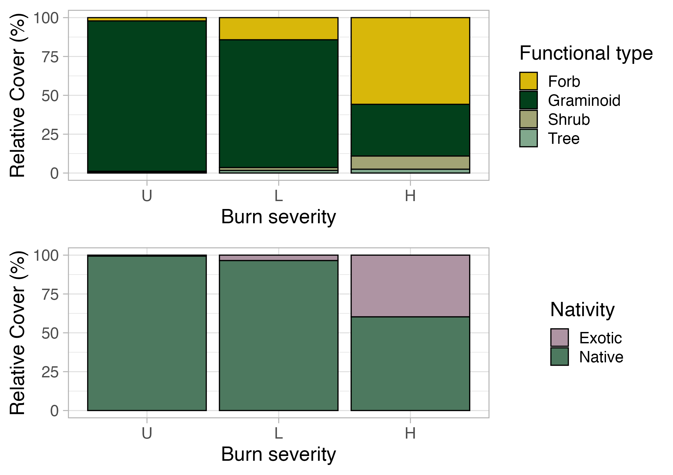
a)
b)
Figure 2. Relative cover for a) functional type across burn severity and for b) nativity status across burn severity.
Notes:
Figure 2. Relative cover for a) functional type across burn severity and for b) nativity status across burn severity.

Slide 9
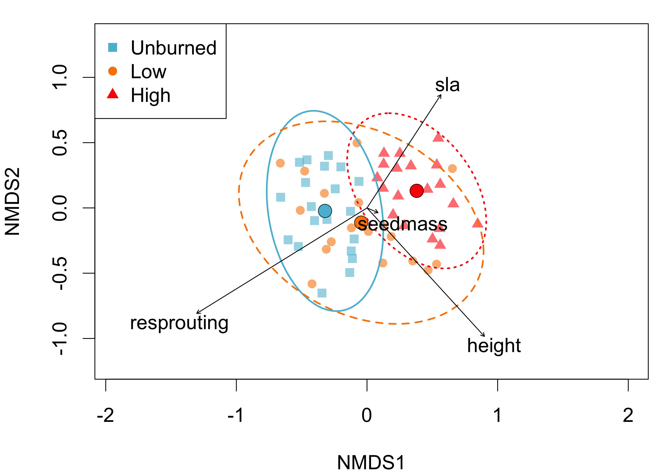
Figure 1. Results from the nonmetric multidimensional scaling (NMDS) analyses. Symbols represent individual plots in 2024 distributed according to taxonomic composition weighted by cover. Vectors indicate correlation between number of species with each trait and NMDS axes.
Notes:
Figure 1. Results from the nonmetric multidimensional scaling (NMDS) analyses. Symbols represent individual plots in 2024 distributed according to taxonomic composition weighted by cover. Vectors indicate correlation between number of species with each trait and NMDS axes.

Slide 10
Model | df | R² | F | P
Severity | 2 | 0.15756 | 5.0497 | 0.0001 ***
Residual | 54 | 0.84244 | NA | NA
Total | 56 | 1.00000 | NA | NA
Table 3. PerMANOVA results for taxonomic NMDS ordinations. p-values = 0.05 < #p < 0.1; *p < 0.05; **p < 0.01; ***p < 0.001. Signiﬁcant terms are shown in bold; terms in italics are marginally signiﬁcant.
Notes:
Table 3. PerMANOVA results for taxonomic NMDS ordinations. p-values = 0.05 < #p < 0.1; *p < 0.05; **p < 0.01; ***p < 0.001. Signiﬁcant terms are shown in bold; terms in italics are marginally signiﬁcant.

Slide 11
 | df | F | R² | p (adj)
Unburned vs Low | 1 | 2.499344 | 0.06491913 | 0.0354 *
Unburned vs High | 1 | 8.829928 | 0.19266728 | 0.0003 ***
Low vs High | 1 | 4.023983 | 0.10311563 | 0.0003 ***
Table 4. Pairwise Adonic comparisons of fire treatments on plot composition. Comparisons were conducted on plots distributed according to taxonomic composition weighted by cover. P-values were adjusted using the Bonferroni method. p-values = 0.05 < #p < 0.1; *p < 0.05; **p < 0.01; ***p < 0.001. Signiﬁcant terms are shown in bold; terms in italics are marginally signiﬁcant.
Notes:
Table 4. Pairwise Adonis comparisons of fire treatments on plot composition. Comparisons were conducted on plots distributed according to taxonomic composition weighted by cover. P-values were adjusted using the Bonferroni method. p-values = 0.05 < #p < 0.1; *p < 0.05; **p < 0.01; ***p < 0.001. Signiﬁcant terms are shown in bold; terms in italics are marginally signiﬁcant.

