Slide 1
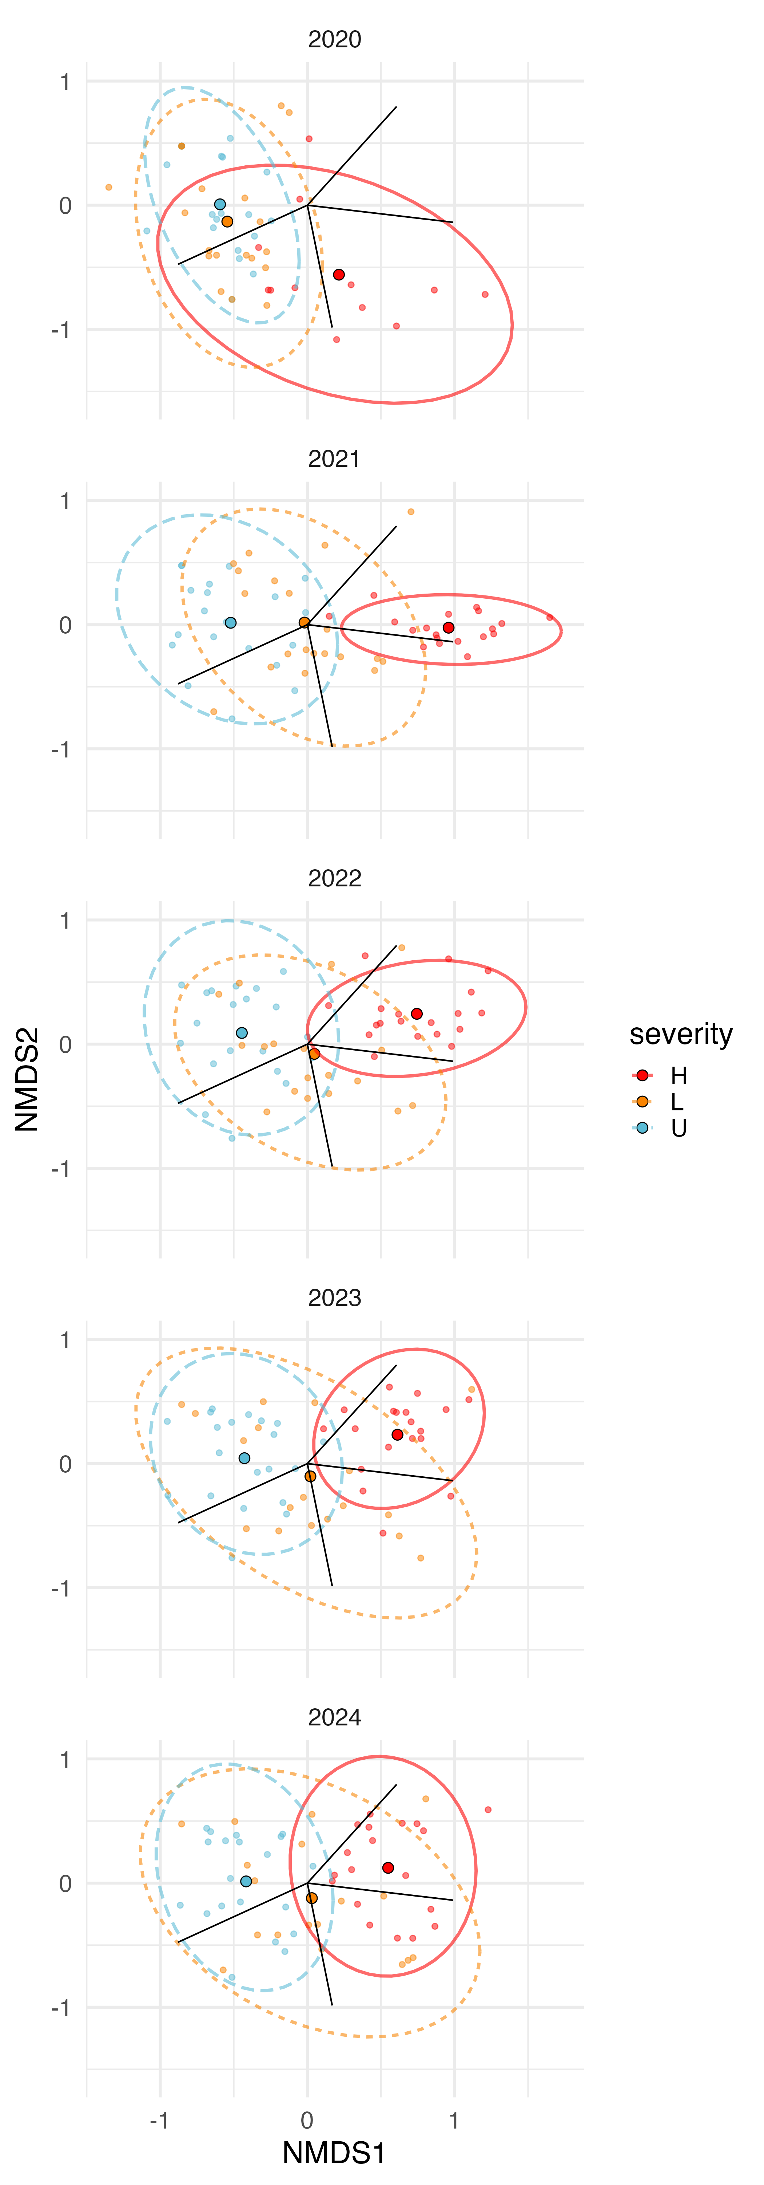
sla
height
resprouting
seedmass
sla
resprouting
height
seedmass
sla
height
resprouting
seedmass
sla
height
resprouting
seedmass
sla
height
resprouting
seedmass

