Slide 1



MILAN 2023-24
SentiDev Forge
Team Charaka

Slide 2

Team Charaka
ANIRUDH SRINIVASAN (CS20BTECH11059)
CHIRAG MEHTA (AI20BTECH11006)
RUTV KOCHETA (MA21BTECH11014)
PRANAV BALASUBRAMANIAN (AI21BTECH11023)
SURYAANSH JAIN (CS21BTECH11057)
DISHANK JAIN (AI20BTECH11011)

Slide 3
The Idea
Movie Review & Rating System
Comprehensive platform for movie enthusiasts
Access information about movies
Share their opinions through reviews and ratings and
Engage in various movie-related activities.
It incorporates cutting-edge technologies such as
NextAuth for user authentication
Autocomplete search for movie discovery
Machine Learning-generated text summarization for reviews, and
Sentiment analysis-based clustering of audience reviews.

Slide 4
USP
NextAuth Integration: Users can easily create accounts and log in through NextAuth, ensuring a secure and hassle-free experience.
Autocomplete Search: The system offers a user-friendly movie search feature with autocomplete suggestions, streamlining the process of discovering films.
Review and Rating Capabilities: Users can share their thoughts on movies, giving ratings and reviews, with the flexibility to edit or delete their contributions.
ML-Generated Opinion Summarization: The system employs machine learning to automatically summarize user reviews, providing concise and informative insights into a movie's reception.
Sentiment Analysis-Based Clustering: Audience reviews are clustered based on sentiment analysis, categorizing them into positive, negative, and neutral, facilitating quick comprehension of public opinion.

Slide 5
Motivation
User Empowerment: Enabling users to express their opinions and read others' reviews empowers them in making informed decisions about which movies to watch.
Data-Driven Insights: By utilizing machine learning for text summarization and sentiment analysis, the system offers data-driven insights into movies' reception, aiding both users and filmmakers.
Community Building: The platform fosters a sense of community among movie enthusiasts by providing a space for discussion and interaction.

Slide 6
Documentation
Find the detailed documentation here: https://github.com/cmaspi/Milan_Hackathon/blob/main/documentation/Report.pdf
Individual READMEs are present in the respective folders with setup instructions

Slide 7
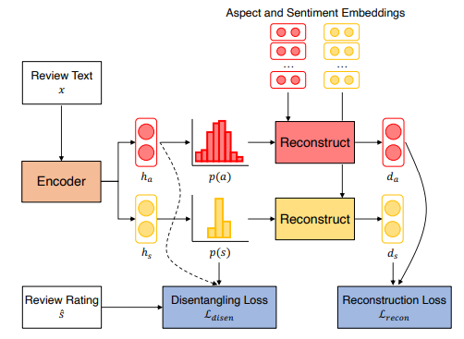
Opinion Summarization: PLANSUM
Model architecture of PLANSUM. The content plan is constructed as the average of the aspect and sentiment probability distributions induced by the content plan induction model. It is then passed to the decoder, along with the aggregated token encodings to generate the summary.

Slide 8
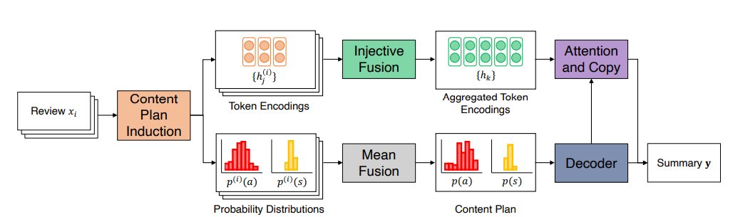
Opinion Summarization: Content Plan Induction
Model architecture of content plan induction model. The dotted line indicates that a reverse gradient function is applied

Slide 9
Review Clustering
We use Roberta model to categorize reviews as
Positive
Negative
Neutral
The model that we used is cardiffnlp/twitter-roberta-base-sentiment-latest

Slide 10
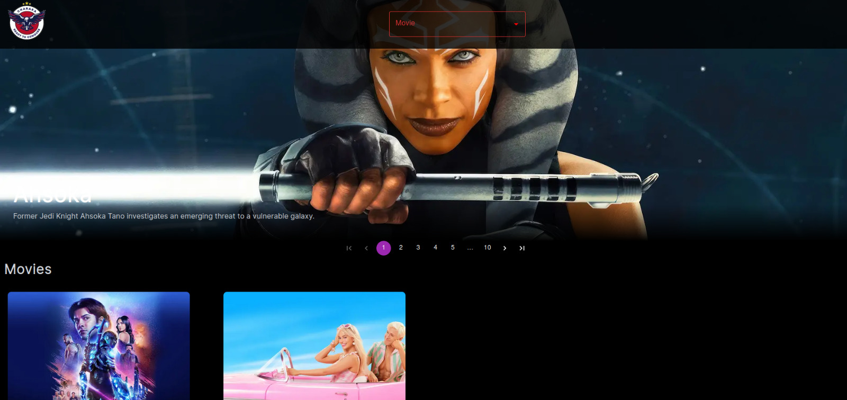
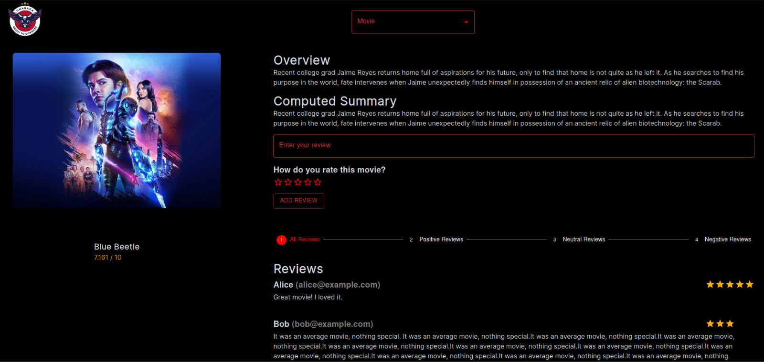
Frontend - Look and Feel

Slide 11
Thank You!

