Slide 1


MILAN 2023-24
Tihan Hackathon
Team Charaka

Slide 2

Team Charaka
ANIRUDH SRINIVASAN (CS20BTECH11059)
CHIRAG MEHTA (AI20BTECH11006)
DISHANK JAIN (AI20BTECH11011)
PRANAV BALASUBRAMANIAN (AI21BTECH11023)

Slide 3
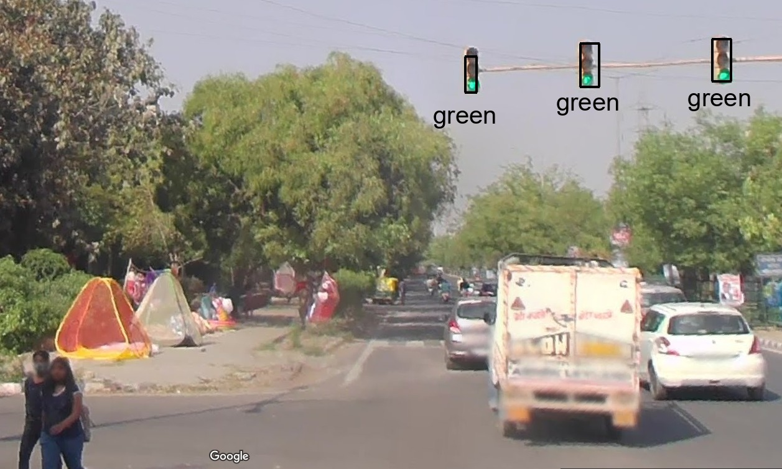
Problem Statement
Detecting and classifying traffic lights for autonomous driving and traffic management.

Slide 4
Detection
Bounding Box Detection on the Traffic Signal: MobileNet SSD v1 Model is used
MobileNet SSD v1 is primarily used for the task of object detection, which involves identifying and locating objects of interest within an image or video frame.
It can detect multiple object classes simultaneously.
In the COCO dataset, the 10th class is traffic lights

Slide 5
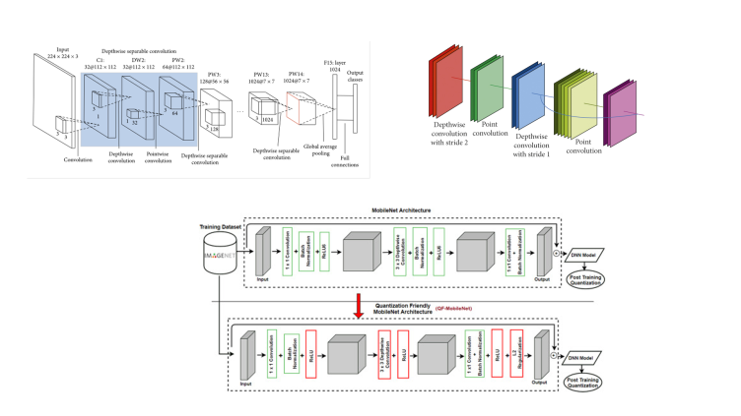
Architecture

Slide 6
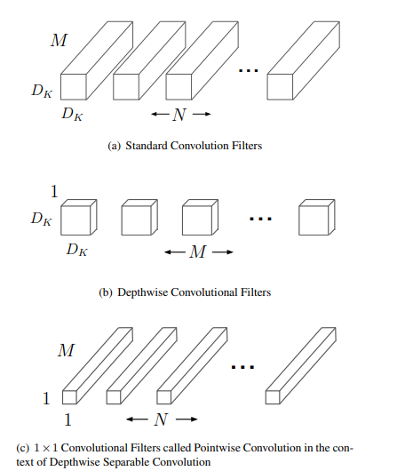
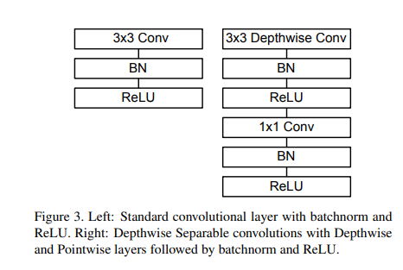
Pointwise and Depthwise Separable Convolution

Slide 7
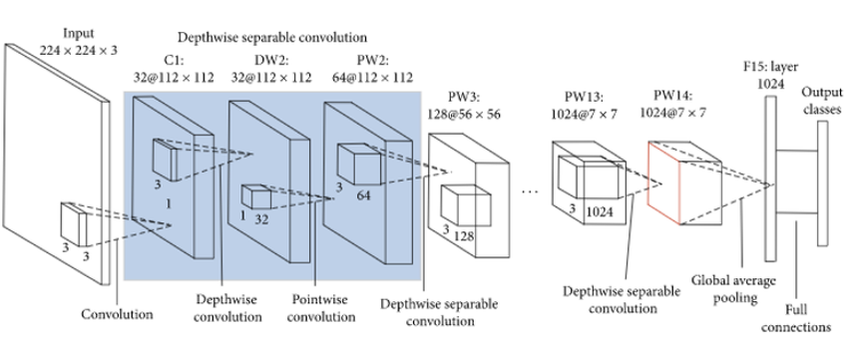
Why MobileNet?
Real-time Applications: MobileNet SSD v1 is designed to be lightweight and efficient, making it suitable for real-time or embedded applications where computational resources are limited.
Pre-Trained: The model is pre-trained to show good performance on object detection task, it has already been trained to detect traffic lights.

Slide 8
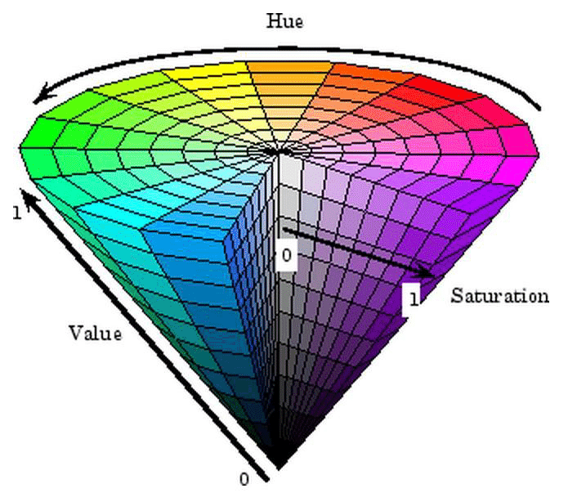
Color Classification
We use a simple algorithm to find the color of the traffic light
Convert image to HSV.
Use only the pixels which have high saturation.
Use the hue values to map to a color.

Slide 9
References
MobileNets: Efficient Convolutional Neural Networks for Mobile Vision Applications
LISA Traffic Light Dataset

Slide 10
Thank You!

