Slide 1

Team Machine
Matt Casey
Paige Colowich
Samuel Pennington

Slide 2
DATA
A Portuguese banking institution used data obtained through its marketing campaign to predict whether clients are likely to subscribe to a term deposit
Information recorded: duration of the call, the day/time of the call, the number of times the client has been called, whether previous call was successful, age, job, marital status, education, and loan history

Slide 3

PROBLEM
Which set of conditions will lead to a client subscribing to a term deposit?

Slide 4
ASSUMPTIONS
single people, people with higher incomes, people with personal loans and people with home loans were more likely
01
clients will be more likely to say yes if they did so the first time
02
Will respond if been contacted before
03

Slide 5

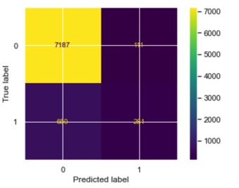
WHAT WORKED
Running RandomForestClassifier
Creating dummy variables
Creating the split
Creating new columns

Slide 6

WHAT DIDN’T WORK
RunningRandomForestRegressor (resulting in very low rsquared)
Decision Tree

Slide 7

SURPRISES AND LIMITATIONS
More predictors were not specific for a person
Richer individuals invest in other things like stocks
Barley any yeses

