Slide 1

PSM Technical Group Analysis of Telemarketing Efforts
Matt Casey
Paige Colowich
Samuel Pennington

Slide 2
Introduction
A Portuguese banking institution used data obtained through its marketing campaign to predict whether clients are likely to subscribe to a term deposit

Slide 3

PROBLEM
Which set of conditions will lead to a client subscribing to a term deposit?

Slide 4
ASSUMPTIONS
single people, people with higher incomes, people with personal loans and people with home loans were more likely
01
clients will be more likely to say yes if they did so the first time
02
Will respond if been contacted before
03

Slide 5
DATA
Client Information
Phone Call Information
Economic Indicators

Slide 6
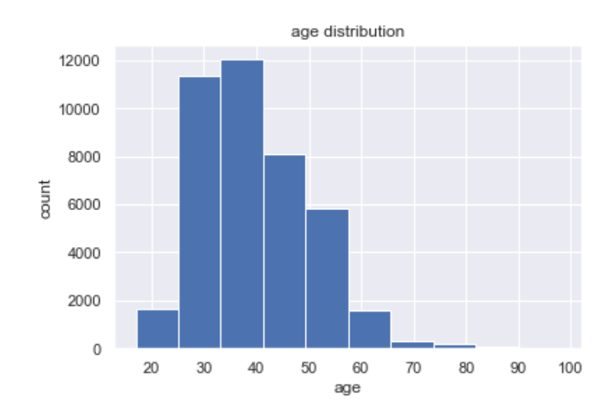
ISSUES WITH DATASET
Handle Missing Data
Grouping Data Values
Preparation For Dummy Variables

Slide 7
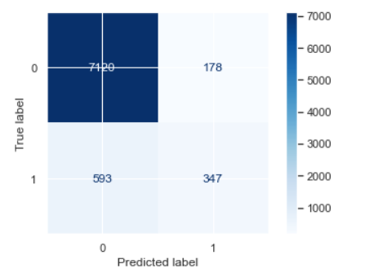
WHAT WORKED
Creating dummy variables
Creating new columns
Using RandomForestClassifier model
Using the Confusion Matrix

Slide 8

WHAT DIDN’T WORK
Running RandomForestRegressor (resulting in very low r-squared)
Decision Tree (overfitting)
Different feature combinations

Slide 9

SURPRISES AND LIMITATIONS
More predictors were not specific for a person
Information such as job type and education was not impactful
Only about 11% subscribed to a deposit

Slide 10
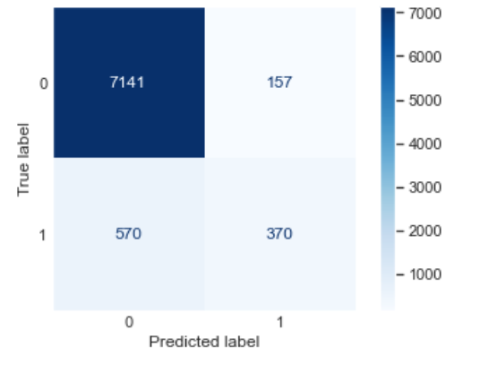
FINAL MODEL
RandomForestClassifier(n_estimators=100, max_depth=6, min_samples_split=14, min_samples_leaf=5, max_features=28, bootstrap=True)
Accuracy: 0.91175
Classification Report
Target | Precision | Recall | F1-score
0 | 0.93 | 0.98 | 0.95
1 | 0.70 | 0.40 | 0.51

