Slide 1
Athletes ETL Pipeline
Moving data from CSV to SQL Server using Python Pandas

Slide 2
Project Overview Athletes ETL Pipeline
Objectives
Read athlete data from CSV
Clean and validate records
Reject bad records
Remove duplicates
Load into SQL Server
Track execution metrics
Orchestrate with Airflow
Diagram
bios.csv -> Python ETL -> Validation Layer -> Dedupe Layer ->
SQL Server -> Audit Tables

Slide 3
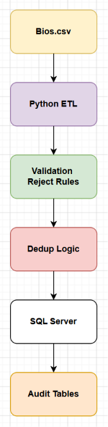
High-Level Architecture

Slide 4
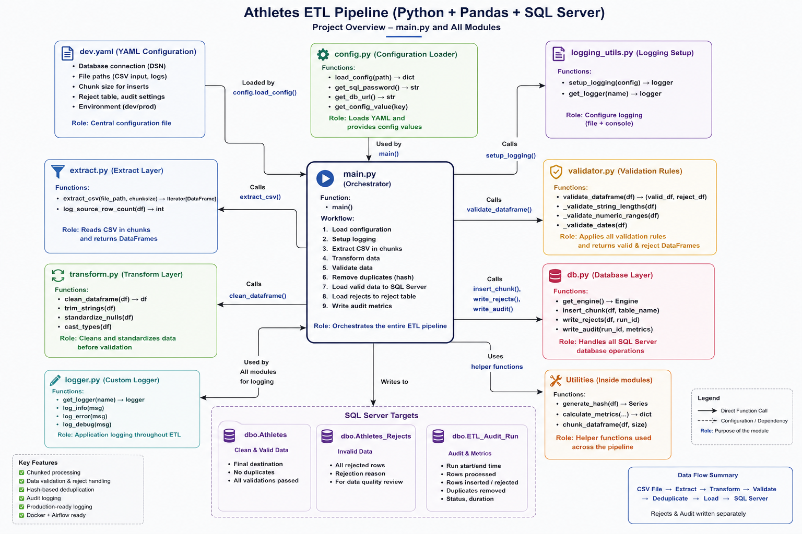
Architecture Overview: Application Architecture – Athletes ETL Pipeline Purpose: Show how the project is organized

Slide 5
Execution Flow (the Story)
This is the slide that explains what happens when someone runs: python -m athletes_etl.main
Step 1
main.py starts
Responsibilities
Entry point
Starts ETL
Coordinates all modules
Calls:
load_config()

Slide 6
Execution Flow (the Story) part 2
Step 2 config.py
Loads dev.yaml
Returns config dictionary
Containing
SQL Server connection
CSV location
Chunk size
Audit settings
Reject settings
Returns to main.py

Slide 7
Execution Flow (the Story) part 3
Step 3
logging_utils.py
Creates
Console logger
File logger
Returns logger

Slide 8
Execution Flow (the Story) part 4
Step 4
extract.py
Reads bios.csv
Returns Pandas DataFrame

Slide 9
Execution Flow (the Story) part 5
Step 5
transform.py
Performs
Trim strings
Clean values
Normalize columns
Standardize data
Returns Clean DataFrame

Slide 10
Execution Flow (the Story) part 6
Step 6
validator.py
Checks
String lengths
Numeric ranges
Dates
Nulls
Produces
Valid DataFrame
Reject DataFrame

Slide 11
Execution Flow (the Story) part 7
Step 7
Hash Deduplication
Creates Row Hash
Finds duplicates
Keeps
First occurrence
Removes
Duplicates

Slide 12
Execution Flow (the Story) part 8
Step 8
db.py
Writes
Valid rows dbo.Athletes
Writes rejects dbo.Athletes_Rejects
Writes metrics dbo.ETL_Audit_Run

Slide 13
Execution Flow (the Story) part 9
Step 9
main.py
Displays
ETL completed successfully
Logs
Execution time
Rows loaded
Rejects
Duplicates

Slide 14
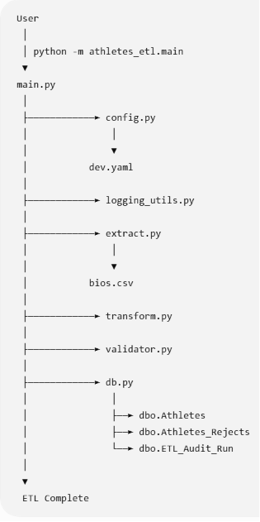
Sequence Diagram (In what order
are they executed? )

Slide 15
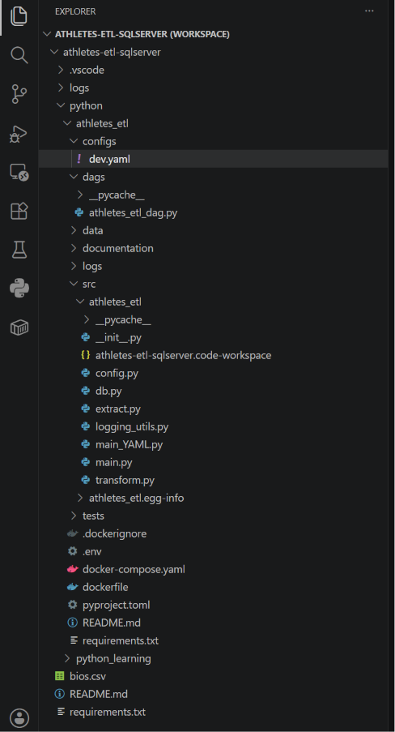
Folder Structure

Slide 16
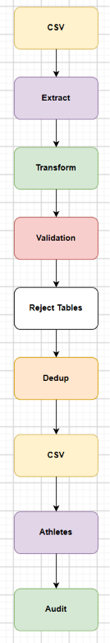
Data Flow Diagram

Slide 17
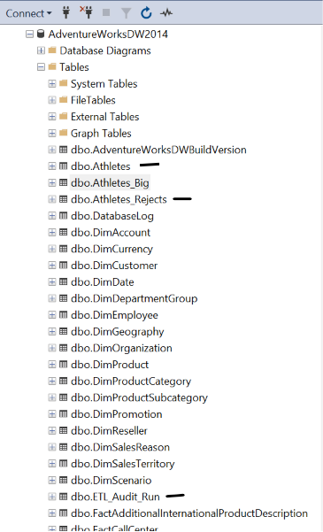
SQL Server Objects
Tables
dbo.Athletes
dbo.Athletes_Rejects
dbo.ETL_Audit_Run
Table | Purpose
Athletes | Final clean data
Athletes_Rejects | Invalid rows
ETL_Audit_Run | ETL metrics

Slide 18
Validation Rules
String Length Checks
name <= 200
born_city <= 100
born_region <= 100
NOC <= 50
Numeric Checks
height_cm 90-250
weight_kg 20-300
Date Checks
born_date > 1800
born_date <= today
died_date > born_date

Slide 19
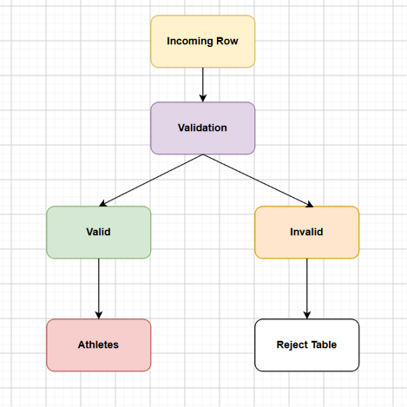
Reject Handling

Slide 20
Deduplication Logic
Current Logic:
Hash Columns
name
born_date
born_city
born_country
Process:
Results:
411 duplicates removed

Slide 21
Audit Framework
Captured Metrics:
Run ID
Start Time
End Time
Duration
Status
Rows Loaded
Rows Rejected
Rows Skipped
Diagram:
ETL Run
↓
Audit Table

Slide 22
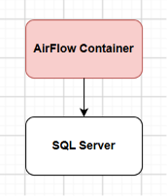
Docker Architecture
Diagram:
Volumes:
dags
src
configs
data

Slide 23
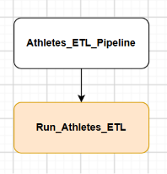
Airflow DAG
Diagram:
Execution:
python -m athletes_etl.main (Bash command)

Slide 24
Operational Runbook
Start
docker compose up -d (Bash)
Stop
docker compose down (Bash)
Check DAGs
docker exec -it airflow airflow dags list (Bash)
Trigger DAGs
docker exec -it airflow airflow dags trigger athletes_etl_pipeline (Bash)

Slide 25
Common Issues (Gotchas)
SQL Password Missing
Error:
Missing environment variable:
SQLSERVER_PASSWORD
Fix
Set SQLSERVER_PASSWORD
PYTHONPATH Missing
Error:
No module named athletes_etl
Fix:
PYTHONPATH=/opt/airflow/src

Slide 26
Common Issues (Gotchas) part 2
SQL Login Failures
Error:
Login failed for user etl_user
Fix
Set SQLSERVER_PASSWORD
Duplicate Inserts
Problem:
Multiple DAG runs
Fix:
Target-side duplicate check

Slide 27
Lessons Learned
Environment variables matter
Docker networking can be tricky
Airflow needs PostgreSQL metadata DB
Idempotent loads are essential
Audit logging simplifies support

Slide 28
Future Enhancements
Project 2 Roadmap:
Add:
Incremental loads
Partitioning
CDC
Data quality dashboard
CI/CD deployment

Slide 29
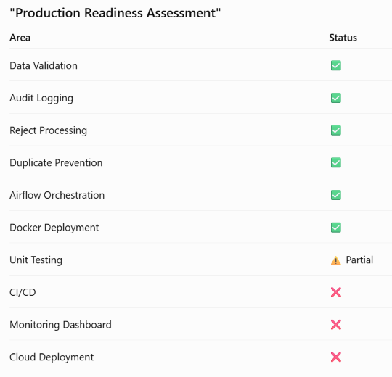
Production Readiness Assessment

Slide 30
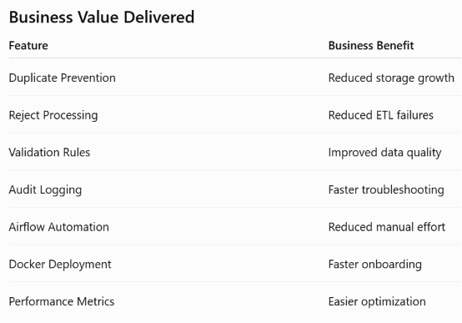
Business Value Delivered

Slide 31
Interview-Friendly Summary
"What value did your project provide?"
Answer:
The project was designed to reduce operational costs and improve reliability. It prevents duplicate data from being loaded, isolates bad records instead of failing the pipeline, captures audit information for faster troubleshooting, automates execution through Airflow, and standardizes deployment through Docker. These features reduce storage growth, manual intervention, support effort, and onboarding time while improving data quality and operational stability.

