Slide 1
CHINMAY’S ISRAEL PALESTINE CHATBOT
Designed with the help of hugging face

Slide 2
Contents
1) Overview
2) What is a Question Answering System?
3) Different types of QAS
4) Workflow
5) Scraping
6) Gradio App
7) Performance Improvement

Slide 3
OVERVIEW
This is an Abstractive QA chatbot developed to answer questions about the past and present of the Israel-Palestine conflict.
This project makes use of the BART long form QA model for conditional generation(imported from Hugging face) which has been fine tuned. This finetuning has been done by scraping numerous Wikipedia articles related to the conflict.
The data retrieved from these articles is stored in Chroma DB which is an open source embedding database
The UI of the chatbot has been made with the help of Gradio.

Slide 4
Question Answering System
A Question Answering system is a computer application that uses NLP to answer questions. They do this with the help of a knowledge base(context) they are trained on.
These systems understand the semantics of questions and retrieve information from structured or unstructured data sources and answer it in Natural Language
Although this chatbot will be able to answer basic questions related to the conflict, we can further improve its accuracy by feeding it more verified data from ethical reporters.
The more amount of data it is fed, the better it is going to perform. Just like a human.
This chatbot is an example of an Abstractive QAS.

Slide 5
Types of QAS
Extractive
ABSTRACTIVE
Extractive QAS extract the data from the context and directly give out the result.
Context:- New Delhi, the capital of India, has a population of over 30 million people. Delhi shares borders with the state of Uttar Pradesh in the east and with the state of Haryana in the remaining directions.
Question:- What is the population of New Delhi?
Answer:- New Delhi, the capital of India, has a population of over 30 million people.
Abstractive QAS goes beyond merely fetching the result by generating human like responses.
Context:- New Delhi, the capital of India, has a population of over 30 million people. Delhi shares borders with the state of Uttar Pradesh in the east and with the state of Haryana in the remaining directions.
Question:- What is the population of New Delhi?
Answer:- New Delhi has a population of over 30 million people.

Slide 6
Project Workflow
The data retrieved from Wikipedia is stored in the form of vectors in the chroma DB. Vectors in a database typically refer to representations of data in a vector space model.
When two sentences are similar to each other, they are “close-by” in the vector database and when they have no relation to each other, they are further apart. The metric to measure “closeness” of vectors used in this project is Cosine.
When the query is given, it is converted to a vector and we retrieve the 3 closest vectors from our chroma DB which will help us answer the question.
These documents are the “context” to the users question and BART puts down the answer in a Natural language.

Slide 7
Flowchart
Wikipedia
Chroma DB
Converted to vector
Converted to Vector
Chatbot
User Input
Retrieval of 3 documents based on cosine similarity
BART Model
Answer Generation in Natural Language

Slide 8
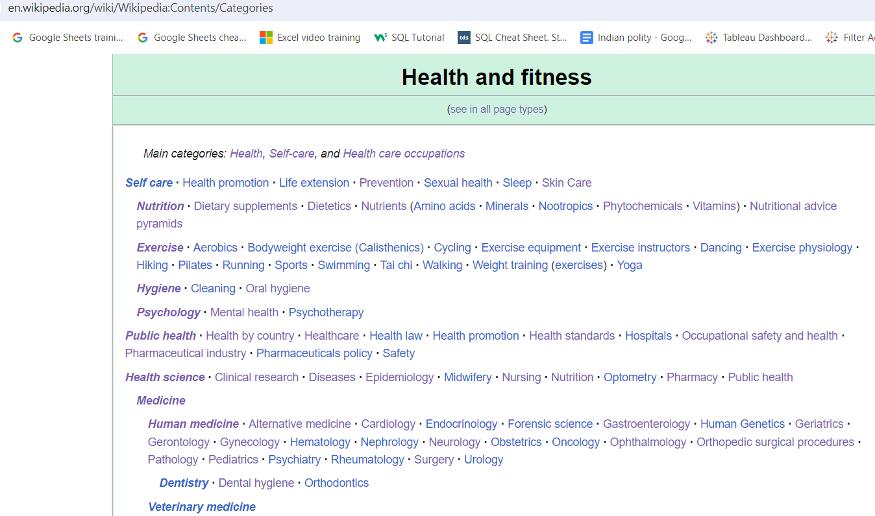
SCRAPING
Wikipedia has divided it’s articles into multiple categories. Often these categories contain numerous categories within them along with subcategories.
All these categories have plenty of articles or pages.
I have scraped categories along with multiple pages.

Slide 9
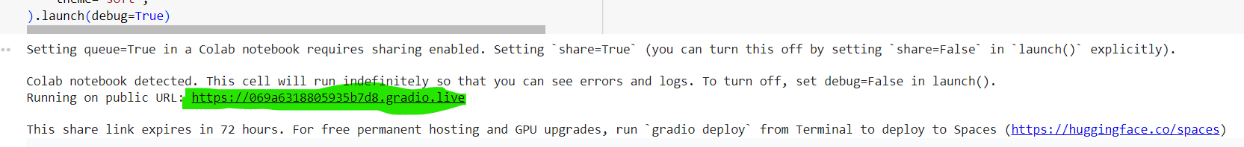
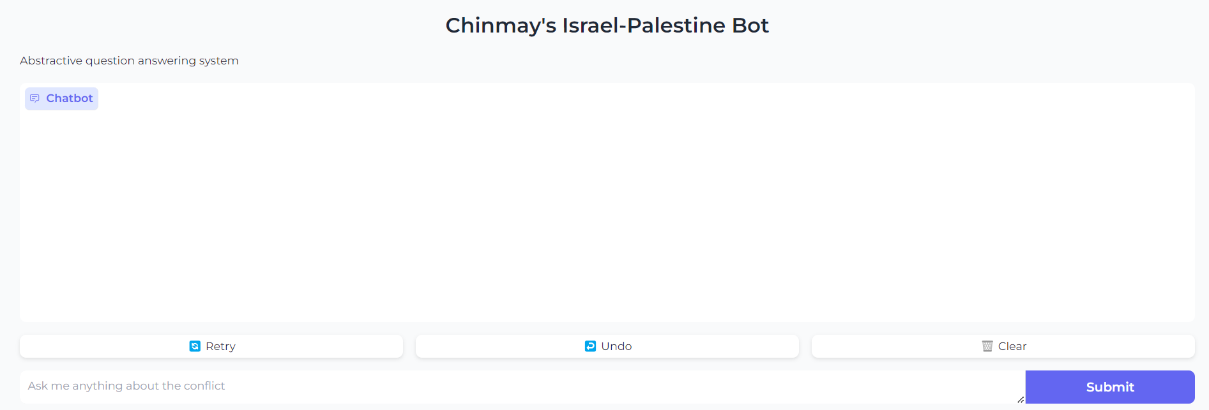
Chatbot interface
Clicking on the highlighted link launches the chatbot.
Since a lot of data is getting scraped and added to the chroma db, it should take about 5 minutes to run the notebook.

Slide 10
Performance Improvement
The performance of the model can drastically be improved by 2 things.
Training the model with the help of an open source LLM. Due to the lack of GPU, this project utilizes BART which has much fewer parameters compared to the open source LLM’s available in the market. These LLM’s will not only provide higher accuracy but will result in more natural responses from the bot.
Enhanced data quality from verifiable journalists and reporters would further improve the Chatbot.

