Slide 1
Effect of the Financial Crash on U.S. Livestock Exports and Imports
Curt Boone, Marianne Burchard, Philip Harmon, Jimmy Brawner

Slide 2
Key Questions
In what way did the 2008 financial crisis affect the overall volume of livestock imports and exports?
Which commodities were most affected by the crisis? Which were least affected?
How did a country’s GDP relate to the impact the crisis had on its livestock exports and imports?

Slide 3


Data Collection
https://catalog.data.gov/dataset/livestock-meat-international-trade-data
https://data.oecd.org/gdp/gross-domestic-product-gdp.htm
Notes:
Organization for Economic Cooperation and Development

Slide 4
Data Cleanup

Slide 5
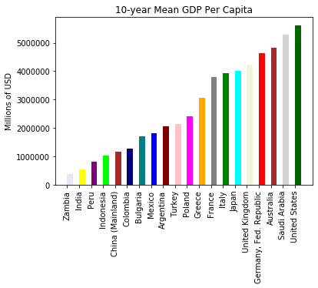
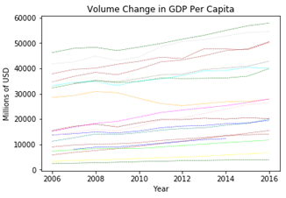
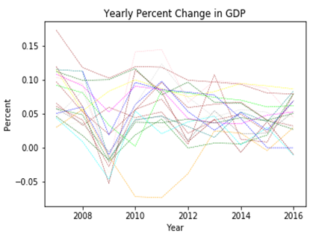
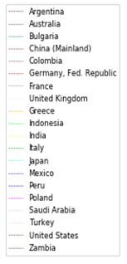
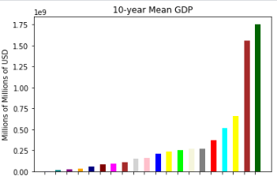
What does the GDP of each country reveal for the 2006 to 2016 timeframe? How can that information be used to make comparisons with livestock imports and exports? After initial data exploration, there were some interesting differences in overall GDP and GDP per capita. For instance, while China has a high overall GDP, it ranks much lower on GDP per capita. Looking at the change in GDP volume did not show a dramatic decline in 2008. However, comparing the percentage by which GDP rose or fell year-to-year clearly showed the decline occurring between the years of 2008 and 2009. The year-to-year percentage change was the best metric for comparing GDP to livestock imports and exports over time, as the following slides will show.
GDP 2006-2016

Slide 6
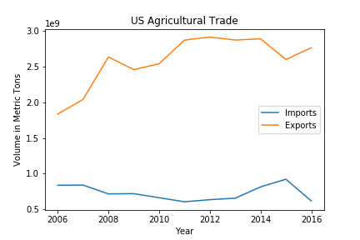
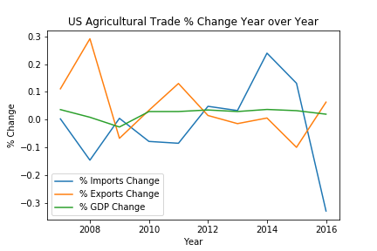
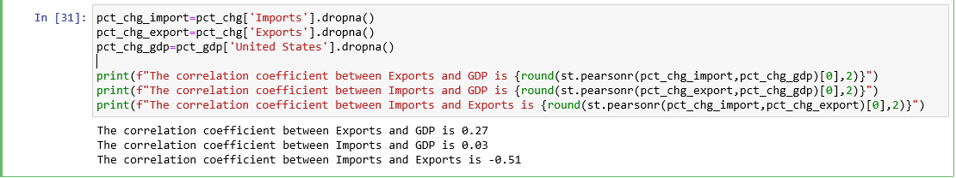
Comparing Aggregate Trade with GDP

Slide 7
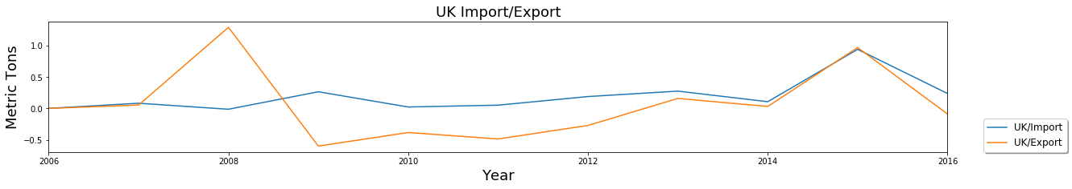
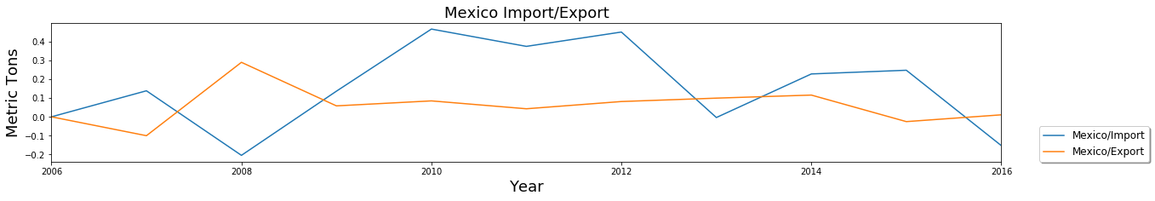
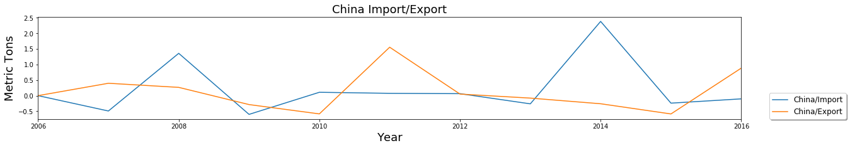
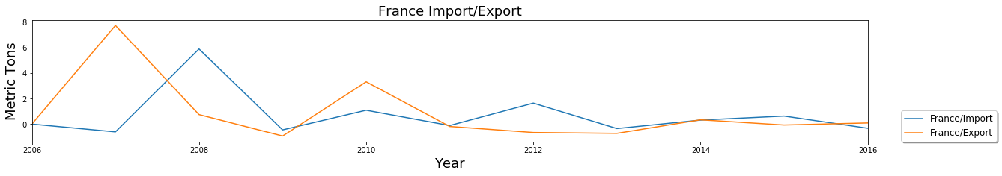
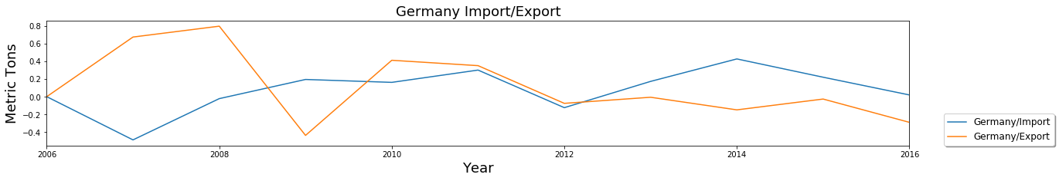
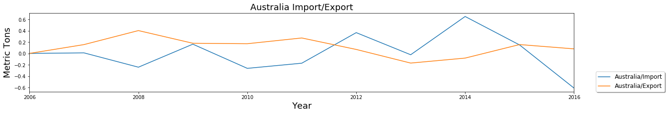
Gross Import/Export Data Percent Change per country
The financial crash did not appear to have a clear effect on gross livestock exports or imports.

Slide 8
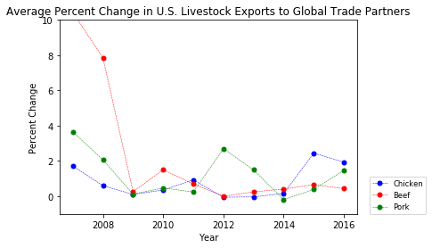
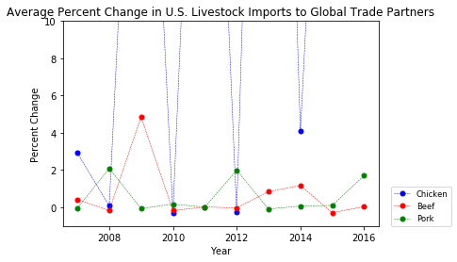
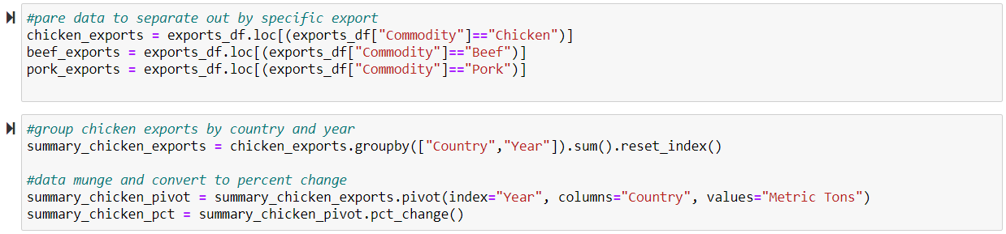
U.S. Livestock Exports and Imports 2006 - 2016
Which import/ export was most affected by the 2008-2009 housing market crash?
U.S. exports in all three markets declined after the 2008 financial crash
The beef export market decreased sharply during the crash but has stayed very stable in the years following
The imports market is a fraction of the size of the export market and is far less consistent; the market for U.S. chicken imports in particular has been very volatile since before the crash
6.1 billion metric tons
1.2 billion metric tons

Slide 9
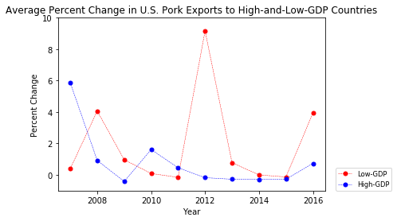
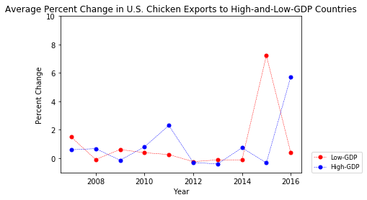
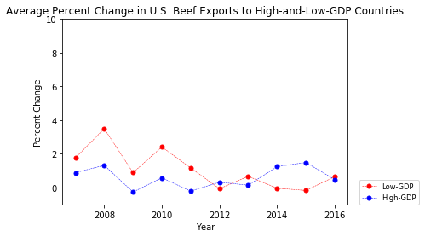
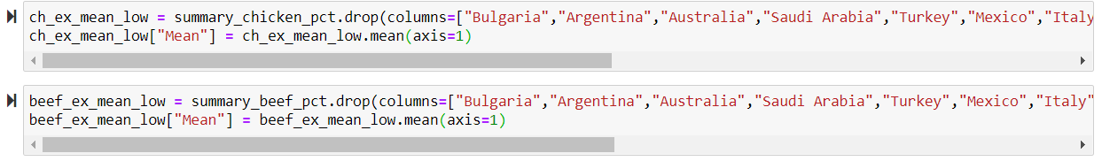
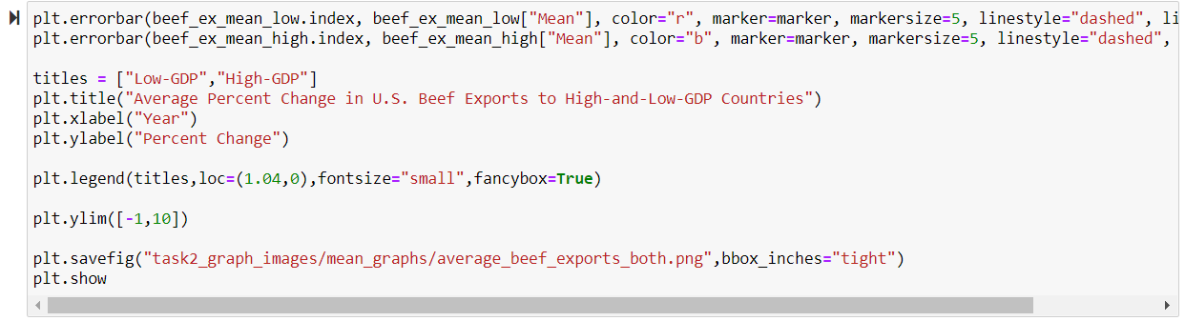
In summary, there is little evidence to show that any one commodity was more or less affected by the financial crash
Total U.S. exports decreased from 2008-2009 by .07%
Chicken exports showed the least change following the financial crash
Average percent change in exports decreased from 0.6% to 0.1% in 2009
Chicken exports to both high and low countries both showed some volatility from 2006 to 2016
Beef exports showed the most change following the financial crash
Average percent change in exports decreased from 7.8% to 0.2% in 2009
This volatility was driven by exports to moderate-level GDP countries like Indonesia and Australia – the beef export market was fairly stable for both the high GDP countries and low GDP countries studied
Pork exports showed the second greatest decrease after the financial crash, and the market for pork exports remained volatile
Average percent change in pork exports decreased from 2.1% to 0.1% in 2009

Slide 10
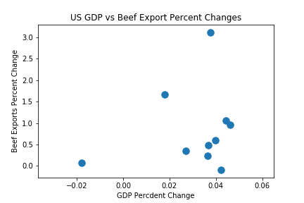
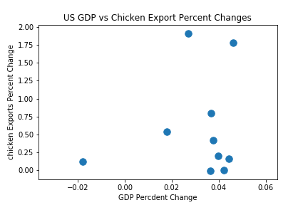
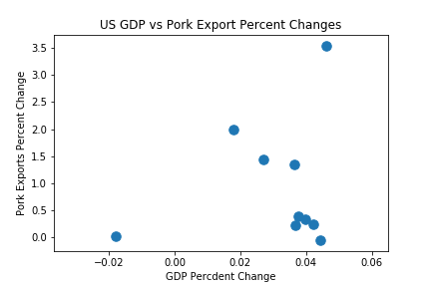
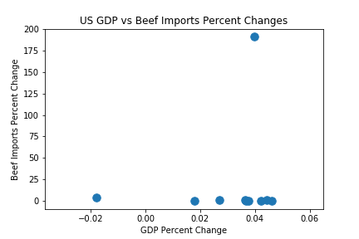
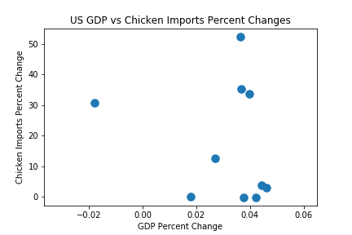
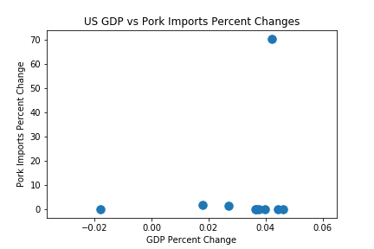
No Clear Correlation Between Yearly Fluctuations in GDP and Livestock Imports/Exports.
US GDP / Livestock Imports and Exports

Slide 11
Using most complete data sets (Mexico and Canada) for full timeframe available still did not show any discernable change after the 2008 financial crisis, or any relationship to GDP.
Checking the Effect of Missing Data
Results/ Post-Mortem
There appears to be no correlation between the market crash of 2008 and imports and exports of U.S. livestock
Other variables to consider
Currency fluctuation
Other pricing fluctuations cushion market
Slow response time in livestock market
Shifts in purchasing within consumer markets
Trade agreements
Future considerations:
Account for more variables
Use currency instead of volume and set a price index
Find a variable that eliminates fluctuations due to trade agreements
Build a model that uses API data to be more dynamic in analysis

