Slide 1

TA café: Playwright
14 dec. 2022 | Christian Bos
The battle

Slide 2


Christian Bos
Even voorstellen…
Test automation developer && trainer
5 jaar @ Immune-it
> 10 jaar @ Sogeti
software developer (Java || Python)
web developer (JavaScript)
test automation specialist
technisch test specialist
(Agile en DevOps) coach en Scrum master

Slide 3

1. Playwright introductie

Slide 4

Playwright
Framework voor web testing en automation
ontwikkeld door Microsoft
‘clone’ van Puppeteer
Ondersteunt testen op web engines
Chromium
Firefox
WebKit (Safari)
Mobile web emulatie
Google Chrome (Android)
mobile Safari

Slide 5
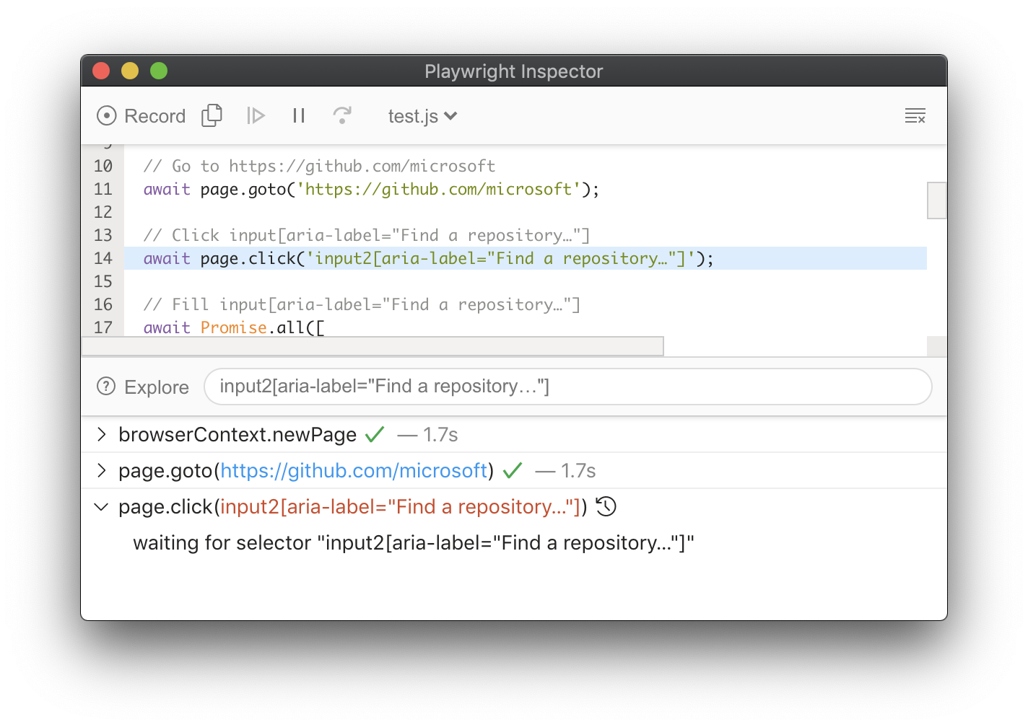
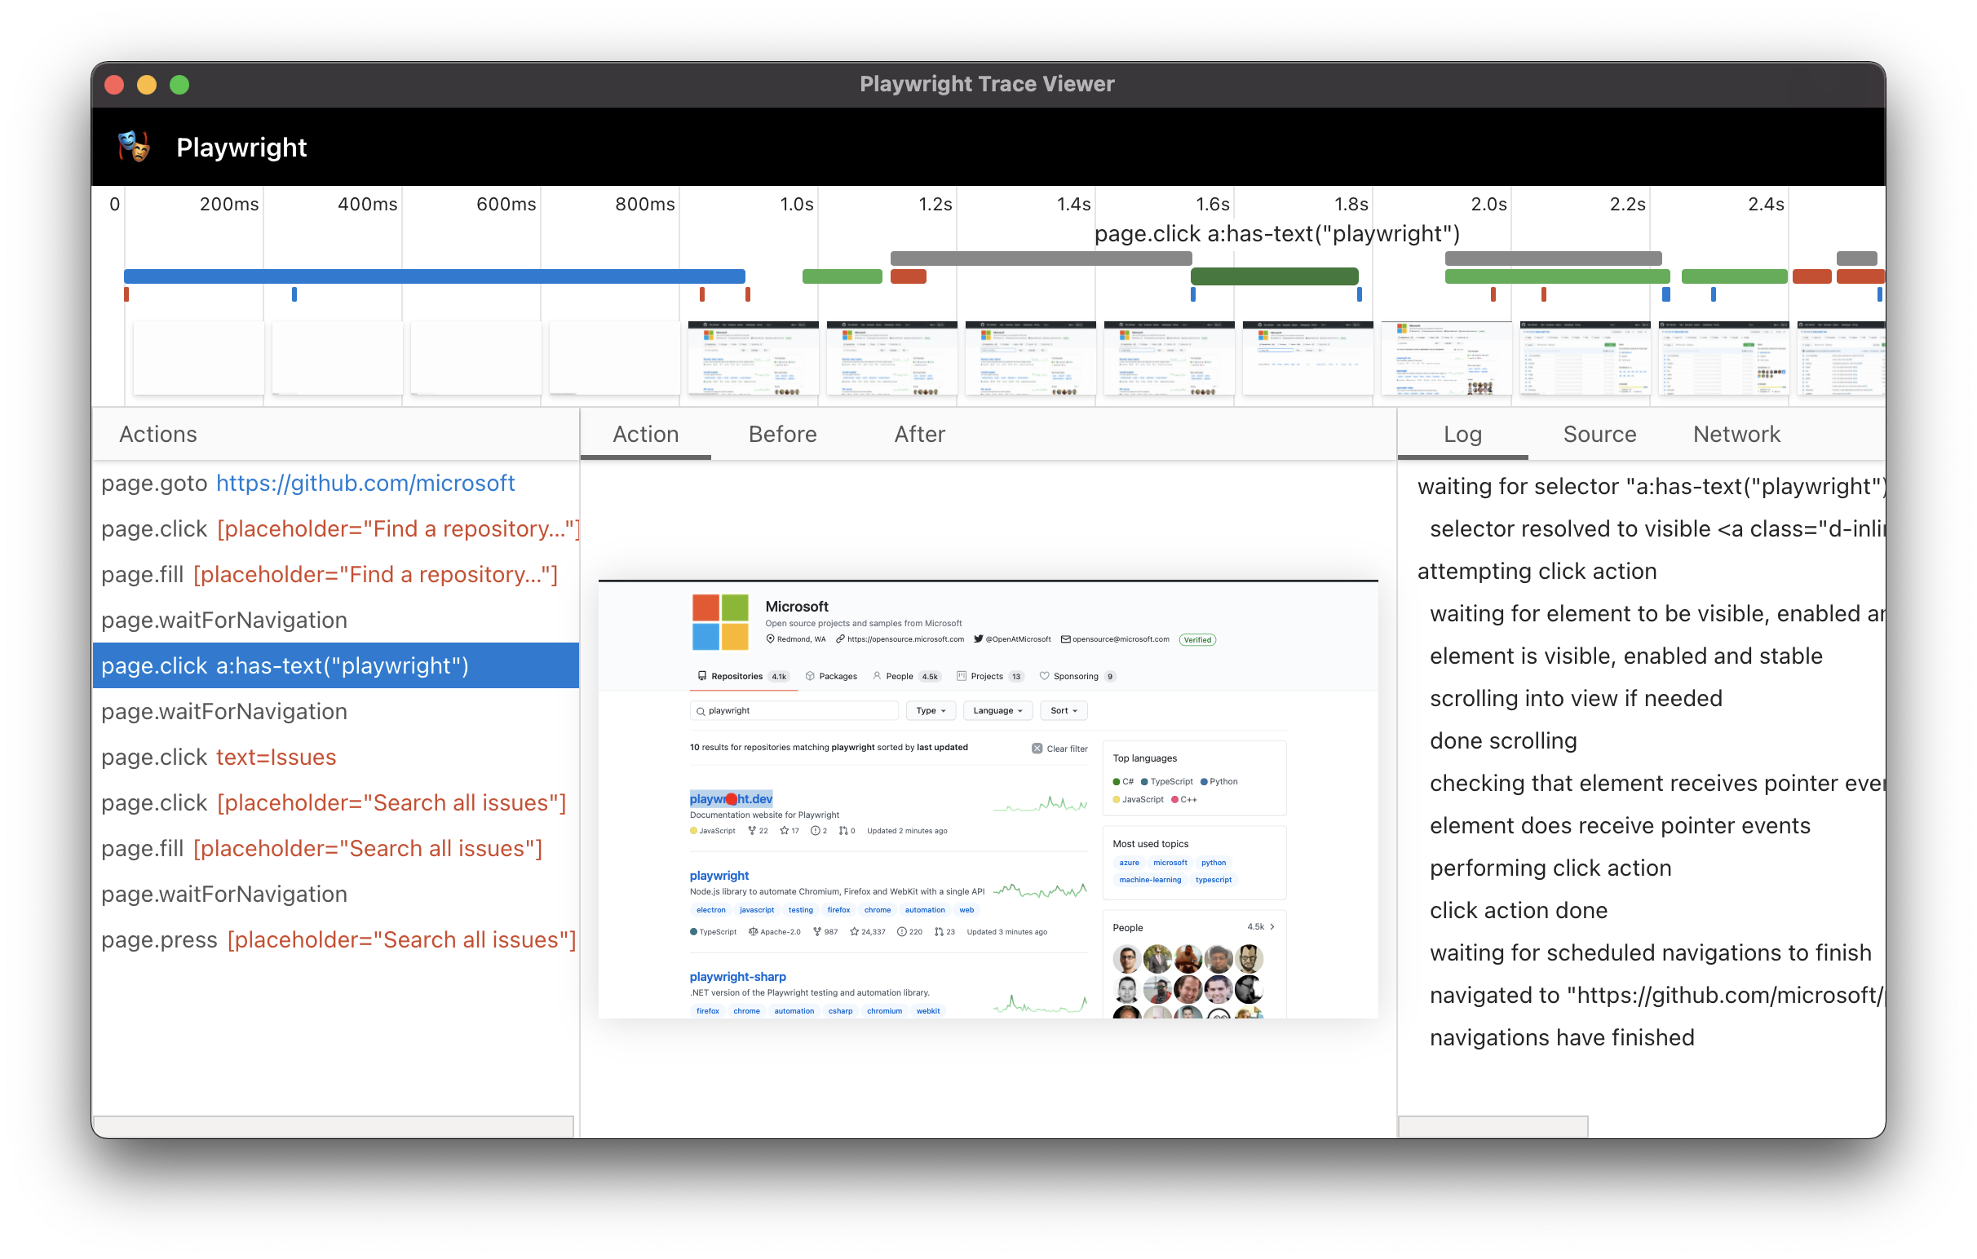
Playwright
Auto waiting
wachten op elementen (state)
assertions
Ondersteunt Shadow DOM
Playwright selectors
frames
Tools
Playwright Inspector (pick locator)
Test Generator
Trace Viewer

Slide 6
Twee tools…
Playwright
Cypress
JavaScript (TypeScript), Java, Python & C#
Browser engines: Chromium, Firefox & Webkit
Default parallel uitvoeren testcases
Zowel browsers, testsuites als testcases
Ondersteunt Mocha, Jest, Jasmine, AVA.
Default: Playwright Test
JavaScript (TypeScript)
Chrome, Firefox, Edge, Electron & Brave
Webkit (Safari) experimental
Parallel uitvoeren testcases alleen met betaald product
Alleen testsuites
Alleen Mocha wordt ondersteund

Slide 7
2. Playwright Test
(Project setup en eerste script)

Slide 8
Playwright Test
Default testrunner
configurabel (headless, viewport, …)
Ondersteunt parallel runnen van tests
default test files parallel, test cases in 1 file serieel
gebruik hooks (before/after (each))
aantal workers configurabel
Default aantal reporters meegeleverd
line, list, json, dot, …
combinatie van meerdere opties mogelijk
Automatisch test retry

Slide 9
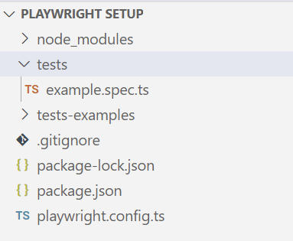
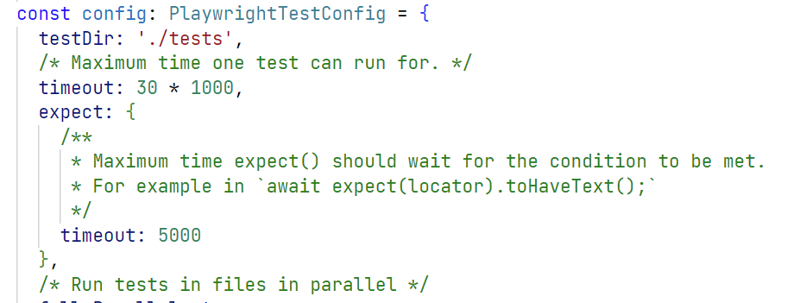
Playwright setup en configuratie
Installatie mbv VSCode extensie
standaard TypeScript
default folder structuur
Configuratie in playwright.config.ts
alleen suites in testDir worden herkend
Test suites moeten eindigen op .spec.ts

Slide 10
Testcase syntax
import { test, expect } from '@playwright/test';
test('Test case naam', async ({ page }) => {
// Test code
});

Slide 11
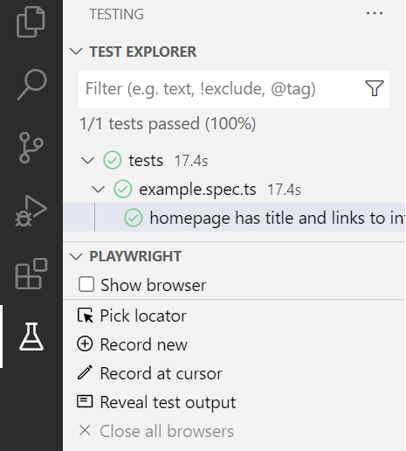
Testcases runnen
Via command line
npx playwright test
Via VSCode extensie
Show browser

Slide 12
3. Element locators en interaction

Slide 13
Element interactie
import { test, expect } from '@playwright/test';
test('Element interactie', async ({ page }) => {
// navigeren naar pagina
await page.goto('https://www.bol.com/nl/nl/');
// click op element
await page.locator('element.locator').click();
// input text in text field
await page.locator('element.locator').fill(‘text');
});

Slide 14
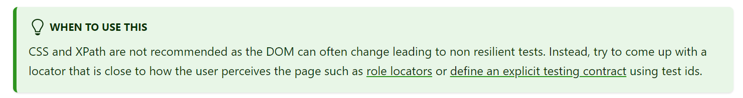
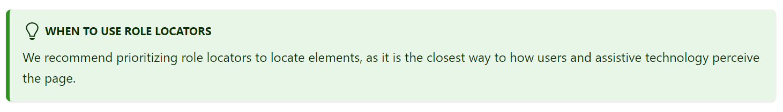
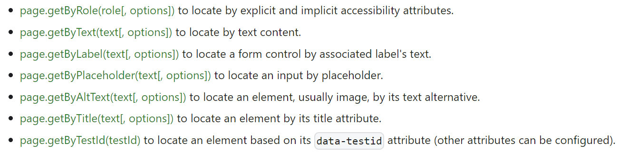
Element locators
CSS/XPath locators
Chaining locators
Built-in locators

Slide 15
Element interactie
await page.locator('[data-test="login-form-email"]').fill('mijn@emailadres.nl');
await page.getByLabel('E-mailadres').fill('mijn@emailadres.nl’);
await page.locator('[data-test="login-form-password"]').fill('12345’)
await page.getByPlaceholder('Wachtwoord').fill('12345’)
await page.locator('[data-test="login-form-submit"]').click();
await page.getByRole('button', { name: 'Inloggen' }).click();

Slide 16
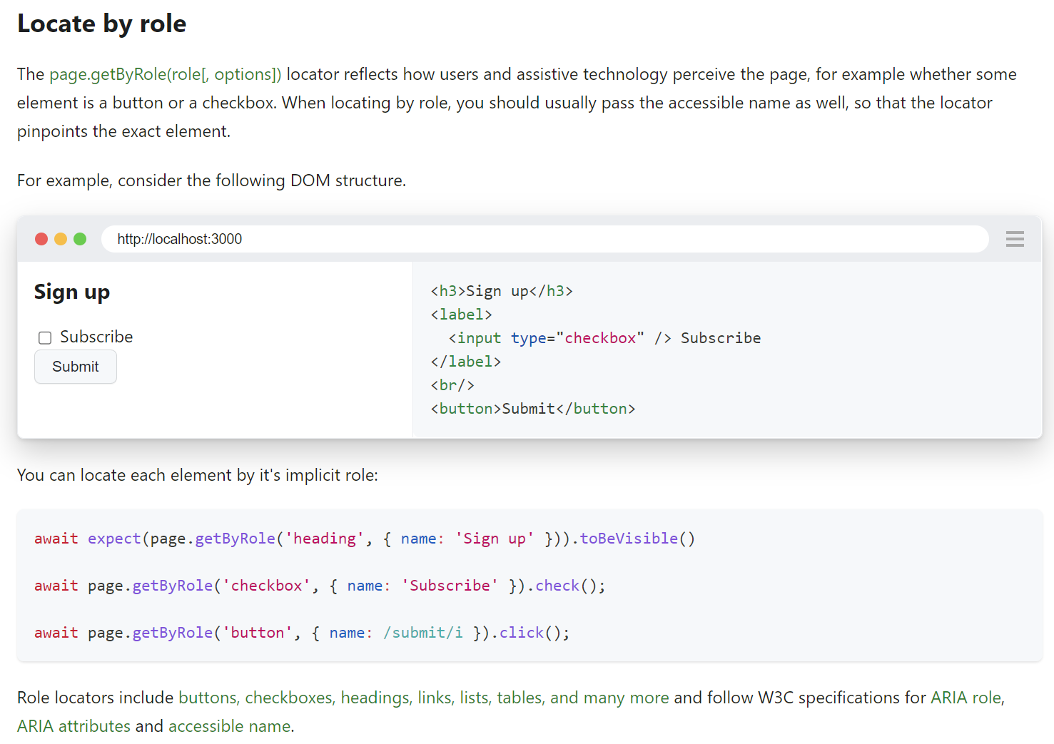
Element locators

Slide 17
Element interactie - dropdown
import { test, expect } from '@playwright/test';
test('Dropdown', async ({ page }) => {
// Select by value
await page.selectOption('id=dropdown', { value: 'Option 1'});
// Select by label
await page.selectOption('id=dropdown', { label: 'Option 1'});
// Select by index number
await page.selectOption('id=dropdown', { index: 0});
});

Slide 18
4. Assertions

Slide 19
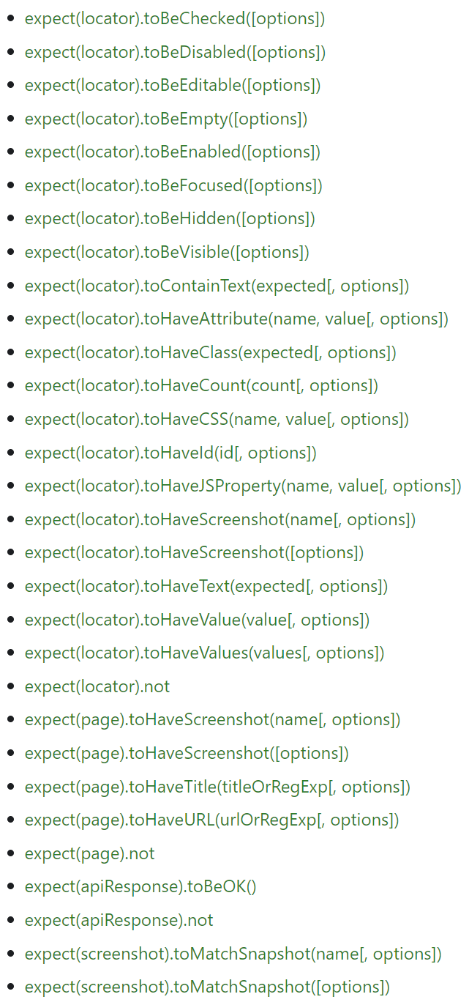
Assertions
Assertions
Playwright wacht op succesvol resultaat tot time-out
maken gebruik van .to… keywords
Soft assertions
niet by default
uitvoer stopt niet bij een falende assertion
uiteindelijk faalt de testcase wel
Custom error messages
meegeven als argument
rapportage leesbaar houden
Negating matchers
gebruik .not

Slide 20
Assertions
import { test, expect } from '@playwright/test';
test('Assertions', async ({ page }) => {
// check op paginatitel
await expect(page).toHaveTitle(‘Titel’);
// check op paginatitel – negating matcher
await expect(page).not.toHaveTitle(‘Titel');
// check elementtext
await expect(page.locator(locator’)).toHaveText(text’);
// check elementtext – soft assertion
await expect.soft(page.locator(locator’)).toHaveText(text');
// check element zichtbaar – custom error message
await expect(page, 'Mijn error message').toBeVisible();
});

Slide 21
5. Page object model

Slide 22
Page object – class
import { Page, Locator } from '@playwright/test';
export class LoginPage {
page: Page;
usernameInput: Locator;
passwordInput: Locator;
loginButton: Locator;
constructor(page: Page) {
this.page = page;
this.usernameInput = page.locator("id=login_email");
this.passwordInput = page.locator("id=login_password");
this.loginButton = page.locator("css=[data-test='login-form-submit']")
}
async login(username: string, password: string) {
await this.usernameInput.fill(username);
await this.passwordInput.fill(password);
await this.loginButton.click();
}
}

Slide 23
Page object – test script
import { test, expect, request } from '@playwright/test';
import { LoginPage } from '../models/LoginPage';
test('TC-01: Inloggen met juiste credentials', async ({ page }) => {
const loginPage = new LoginPage(page);
await loginPage.login("christian.bos@gmail.com", “w@chtwoord!%");
});

Slide 24
En nu… zelf aan de slag!

Slide 25

Github…
code voorbeelden
slides
handige links

Slide 26
Handige links
Playwright documentatie
https://playwright.dev/docs/getting-started-vscode
https://playwright.dev/docs/intro
https://playwright.dev/docs/writing-tests
https://playwright.dev/docs/running-tests
https://playwright.dev/docs/locators
https://playwright.dev/docs/selectors
https://playwright.dev/docs/test-assertions
https://playwright.dev/docs/pom
Youtube
https://www.youtube.com/@Playwrightdev
https://www.youtube.com/watch?v=fncL63KRA-0&t=1586s
https://www.youtube.com/watch?v=RwNZTjwhgXc&t=5512s
Test automation university
https://testautomationu.applitools.com/js-playwright-tutorial/

Slide 27
Handige links
Overige documentatie
https://testguild.com/what-is-microsoft-playwright-js/
https://www.programsbuzz.com/article/async-and-await-playwright
Github
.
https://github.com/applitools/webinar-cypress-vs-playwright

Slide 28


