Slide 1
Architectural Styles
Cody Brooks

Slide 2
Italianate
Early 19th century
Originated in Britain
  Spread across Northern Europe
  Popular in the US between 1840 and 60
John Nash was founding architect
Typically two to three stories
Brick and wood exterior
Symmetrical designs with lots of texture and ornate moldings and designs
Mostly natural or organic colors
Primary use is residential

Slide 3
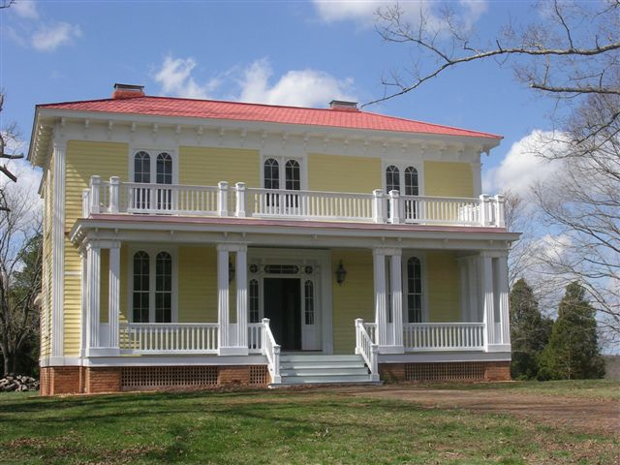
Italianate
Major Features
  Flat or low-pitched roofs
    Often hipped roofs
  Balconies with balustering or wrought-iron railings
  Arched windows with prominent archivolts

Slide 4
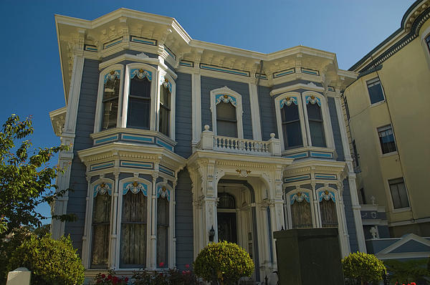
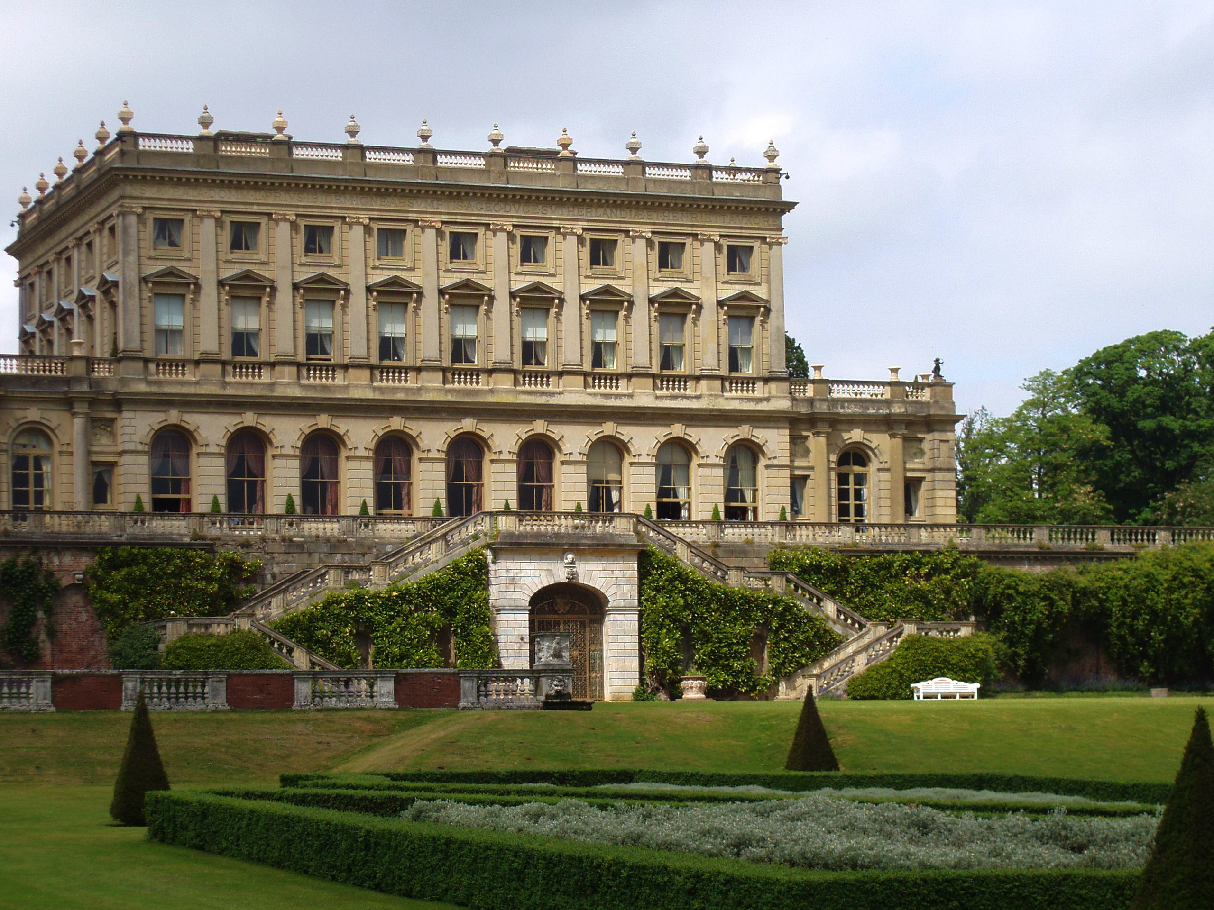

Italianate

Slide 5
Cubic
Early 20th Century
Result of the popular style of art called Cubism
Founder and location of origin are unknown
Mostly uses modern materials such as steel and other metals
Design consists of geometric shapes, primarily squares and cubes
Minimalistic style
Mostly smooth textures
Asymmetrical
Not a common style; used in mainly residential and commercial sectors
Wide variance in number of stories

Slide 6
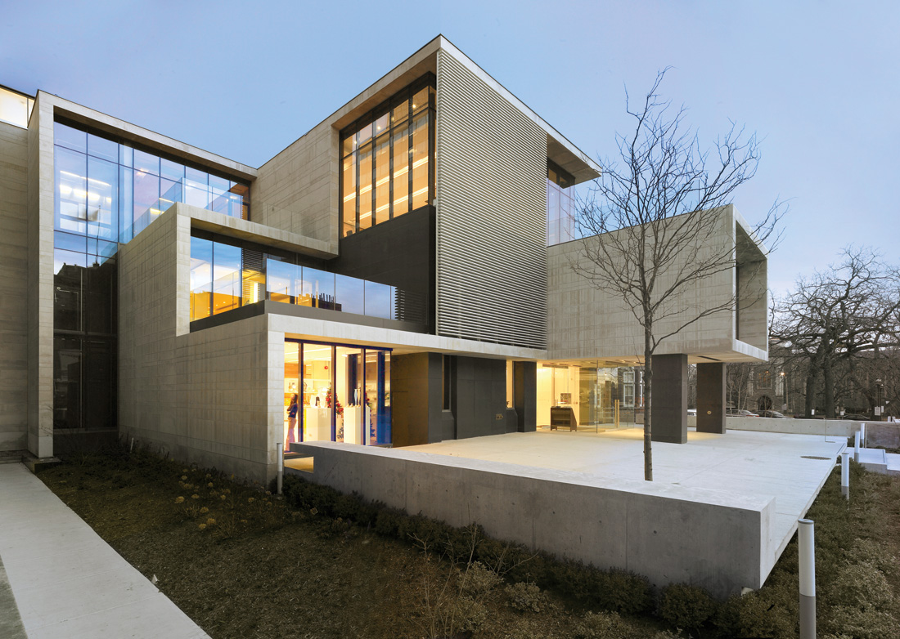
Cubic
Major Features
  Facetted texture
  Simple geometric patterns (such as cubes)
  Minimalistic design

Slide 7
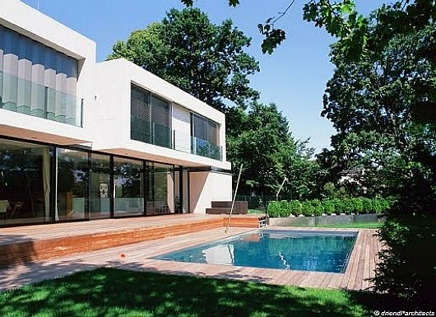
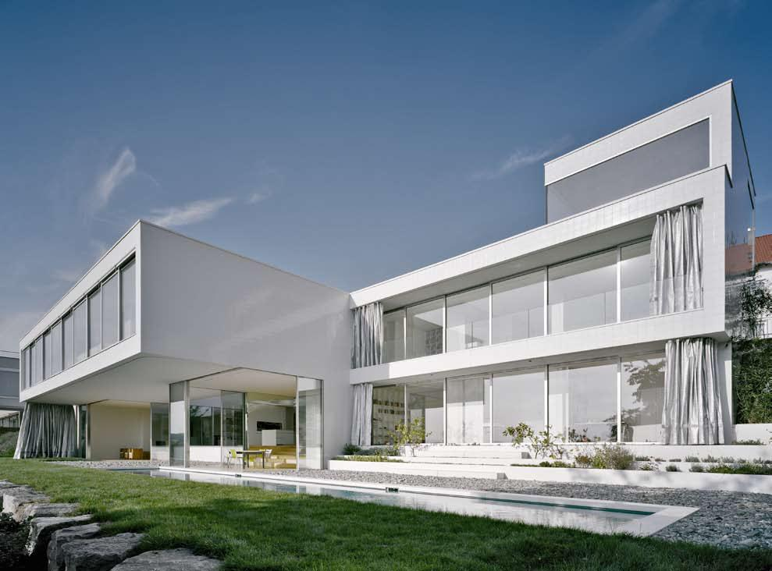
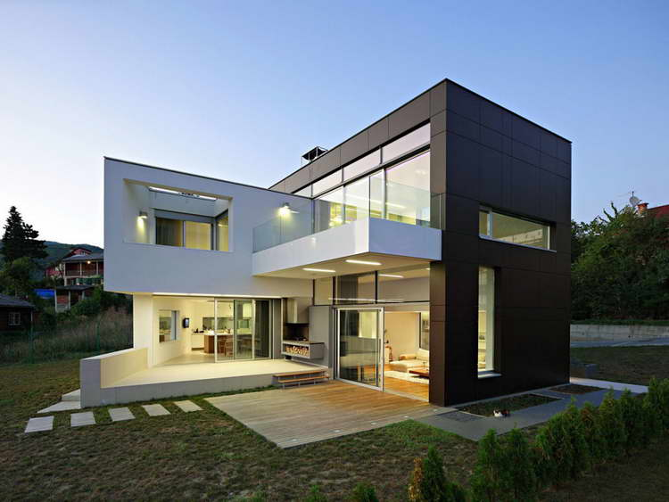
Cubic

Slide 8
Work Cited
"Historic Styles / Italianate 1840-1885." Italianate Architecture & Houses Facts and History. N.p., n.d. Web. 17 Aug. 2014.
"Italianate Architecture." Wikipedia. Wikimedia Foundation, n.d. Web. 19 Aug. 2014.
"Cubism." Wikipedia. Wikimedia Foundation, n.d. Web. 20 Aug. 2014.

