Slide 1
Habitat for Humanity House

Slide 2
Project Description

Slide 3
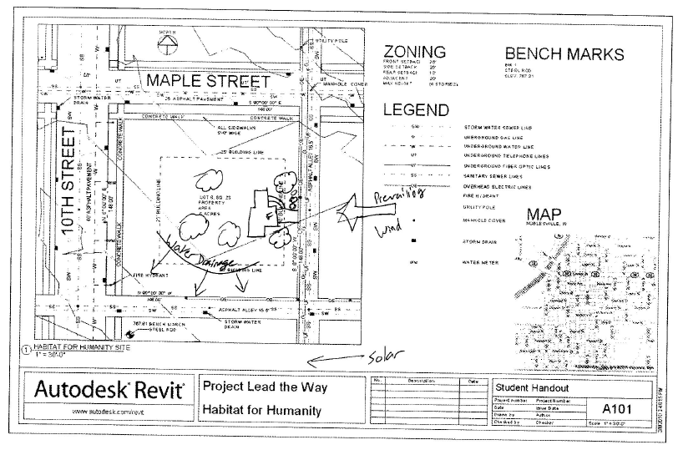
Construction Drawings: Site Plan

Slide 4
Construction Drawings: Rendering

Slide 5
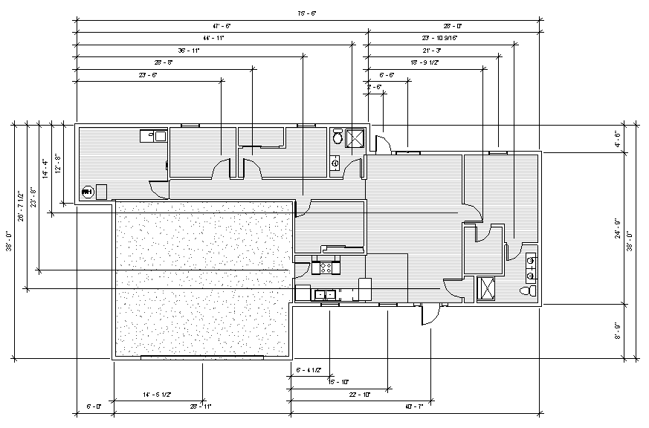
Construction Drawings: Floor Plan

Slide 6
Construction Drawings: Elevations

Slide 7
Construction Drawings: Wall Section

Slide 8
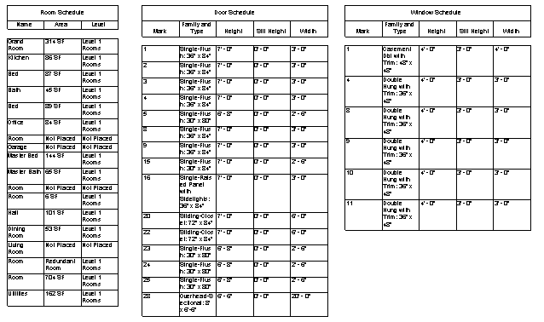
Construction Drawings: Schedule

Slide 9
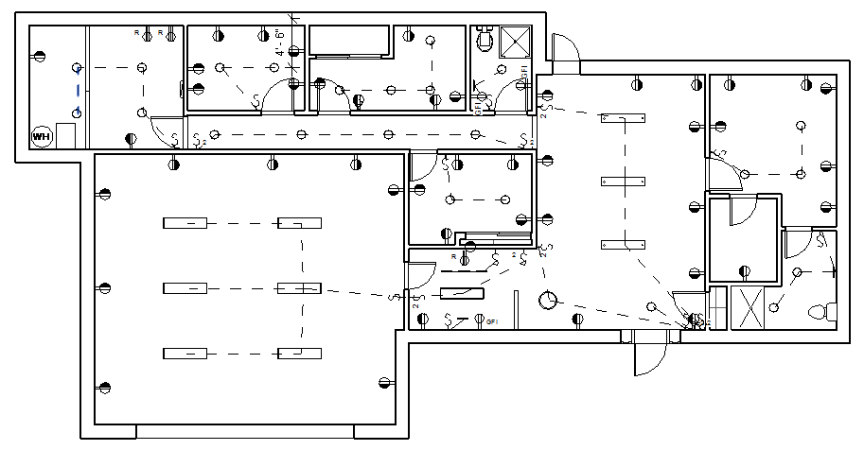
Construction Drawings: Electrical Plan

Slide 10
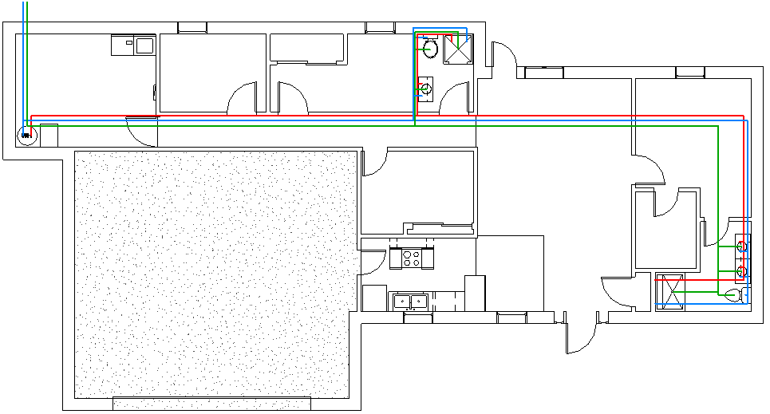
Construction Drawings: Plumbing Plan

