Slide 1

Did the Russian/Ukraine War Effect Commodity Prices in the US?
Presented by: Crystal Butler, James Senger, John Quinn, and Jared Worrick

Slide 2
Jared

Slide 3
Jared

Slide 4
Crystal

Slide 5
Crystal

Slide 6
John

Slide 7
John

Slide 8
James

Slide 9
James

Slide 10
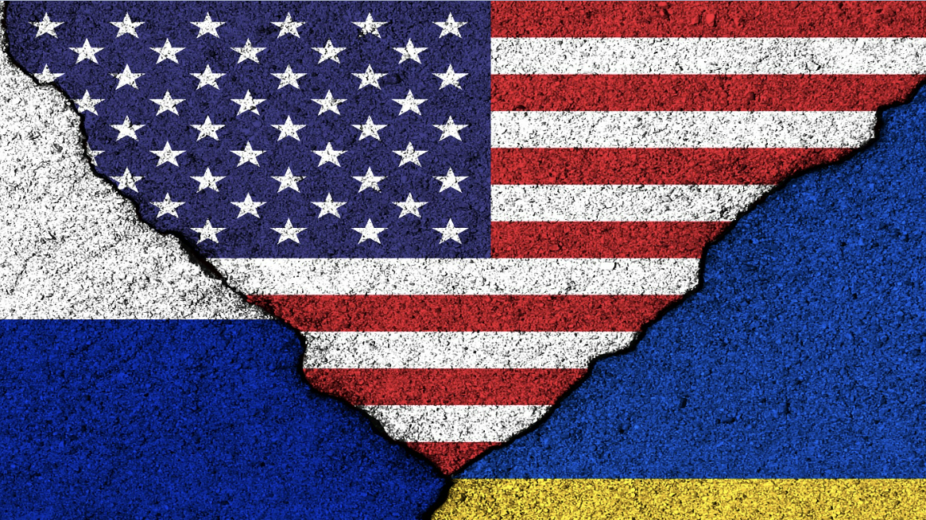
FINAL STATEMENTS

