Slide 1
A very high level intro to REST APIs Plus some hints on generating large NetProfiler reports
Chris Crampton, Riverbed CSA Team
July 2025

Slide 2
A Rapid Tour of RESTful APIs

Slide 3
What are REST APIs?
A RESTful API (REpresentational State Transfer) is an architecture for networked applications
Uses a stateless, client-server, cacheable communications protocol on top of HTTP
Key principles of RESTful APIs include:
Statelessness: Each request from a client to a server must contain all the information needed to understand and process the request. The server does not store any client context between requests.
Client-Server Architecture: The client and server are separate entities that communicate over a network.
Resource-Based: Resources (e.g., data entities) are identified by URLs (Uniform Resource Locators).
Uniform Interface: The API should have a consistent and uniform interface, typically using standard HTTP methods (GET, POST, PUT, DELETE) to perform CRUD (Create, Read, Update, Delete) operations on resources.
Representation: Resources can have multiple representations (e.g., JSON, XML). The client and server negotiate the representation format via HTTP headers.
Cacheable: Responses from the server can be cached by the client to improve performance. The server can indicate whether a response is cacheable and for how long.

Slide 4
Why use REST APIs?
In the context of Riverbed solutions, automation is used to offload repetitive workload from operators, facilitate custom analysis of data and promote integration across components
Requires product “APIs” to provide programmatical access to data and functionalities
All (or most?) Riverbed solutions provide a REST API
Documented and supported
Can be used to extract data or manipulate system configuration details
What is the SteelScript Python Software Development Kit?
An Open-Source project hosted on GitHub
A software package providing an abstracted programming interface to the REST APIs
Support for NetProfiler, NetIM, Portal and AppResponse (plus SteelHead, Wireshark, ...)
Resources:
REST APIs: https://support.riverbed.com/apis/
SteelScript: https://github.com/riverbed/steelscript
SteelScript docs: https://steelscript.readthedocs.io/en/latest/ (Old but nothing newer!)

Slide 5
REST API
API = Application Programming Interface
In general terms, it is a set of clearly defined methods of communication between various components
REST = Representational State Transfer
Set of architectural constraints
Client-server, stateless, cacheable, uniform interface, layered, code-on-demand
From the Fielding dissertation: https://www.ics.uci.edu/~fielding/pubs/dissertation/rest_arch_style.htm
Each request to the server is self-contained and stateless; i.e. does not require a sequence of API calls

Slide 6





The architecture of Riverbed automation
Automation
SteelScript SDK
RESTful APIs
NetIM
Portal
NetProfiler
AppResponse
Aternity

Slide 7
REST API Principles – Resources
All data is organized as resources with unique uniform resource identifiers (URIs)
For example:
Users as a collection of resources
https://my-netprofiler/api/1.0/profiler/users/ - collection of users
Specific User resources
https://my-netprofiler/api/1.0/profiler/users/1 - admin user
https://my-netprofiler/api/1.0/profiler/users/49 - demo user
Report data as a resource
https://my-netprofiler/api/profiler/1.0/reporting/reports/3461 - Report 3461

Slide 8
REST API Principles – Resource Representation
Access resources via standard HTTP methods:
GET – retrieve a copy of the resource from the server
PUT – update a resource on the server
POST – create a new resource, sometimes used as a form of GET
DELETE – delete a resource
PATCH - update only parts of a resource
Important to note that the representation of the resource does not have to match the servers’ internal resource

Slide 9
HTTP Status Codes
1xx (Informational): The request was received, continuing process
100: Continue
2xx (Successful): The request was successfully received, understood, and accepted
200: OK
201: Created
3xx (Redirection): Further action needs to be taken in order to complete the request
301: Moved Permanently
4xx (Client Error): The request contains bad syntax or cannot be fulfilled
401: Unauthorized
403: Forbidden
5xx (Server Error): The server failed to fulfill an apparently valid request
500: Internal Server Error

Slide 10
Riverbed REST API Status Codes and Errors
Error ID | HTTP Status | Comments
INTERNAL_ERROR | 500 | Internal server error.
AUTH_REQUIRED | 401 | The requested resource requires authentication.
AUTH_INVALID_CREDENTIALS | 401 | Invalid username and/or password.
AUTH_INVALID_SESSION | 401 | Session ID is invalid.
AUTH_EXPIRED_PASSWORD | 403 | The password must be changed. Access only to password change resources.
AUTH_DISABLED_ACCOUNT | 403 | Account is either temporarily or permanently disabled.
AUTH_FORBIDDEN | 403 | User is not authorized to access the requested resource.
AUTH_INVALID_TOKEN | 401 | OAuth access token is invalid.
AUTH_EXPIRED_TOKEN | 401 | OAuth access token is expired.
AUTH_INVALID_CODE | 401 | OAuth access code is invalid.
AUTH_EXPIRED_CODE | 401 | OAuth access code is expired.
RESOURCE_NOT_FOUND | 404 | Requested resource was not found.
HTTP_INVALID_METHOD | 405 | Requested method is not available for this resource.
HTTP_INVALID_HEADER | 400 | An HTTP header was malformed.
REQUEST_INVALID_INPUT | 400 | Malformed input structure.
URI_INVALID_PARAMETER | 400 | URI parameter is not supported or malformed.
URI_MISSING_PARAMETER | 400 | Missing required parameter.

Slide 11
Data Formats (XML vs JSON)
services.xml | services.json
<services> <service id="profiler"> <versions> <version>1.1</version> <version>1.0</version> </versions> </service> <service id="common"> <versions> <version>1.0</version> </versions> </service> </services> | [ { "id": "profiler", "versions": [ "1.1", "1.0" ] }, { "id": "common", "versions": [ "1.0" ] } ]
JSON is much more compact than XML and there are many ancillary tools for processing JSON (and XML) in the meantime – i.e. JSON is probably preferable in most cases

Slide 12
Riverbed API Documentation
https://support.riverbed.com/apis/index.html
Documentation is available per product, per version, per service
Notes:
REST API URL paths contain a version number which allow for modifications as products are updated without breaking existing scripts
NetIM, Aternity and IQ API documentation is available elsewhere, typically in the product documentation

Slide 13
Browser Test
Use a browser to test the product REST API service
Try the following information request in a browser against a NetProfiler, Flow Gateway or AppResponse appliance
https://<appliance>/api/common/1.0/info
Sample results
{"mgmt_addresses": ["10.180.85.131"], "device_name": "appresponse.demo.riverbed.com", "serial": "GEEUxxxxxxx", "model": "SCAN-08180", "hw_version": "", "sw_version": "11.20.0 #52790"}
Note, a browser, by default, only uses the HTTP GET method

Slide 14
More flexibility and more control with “cURL”
cURL = client URL
Command line tool for transferring data using URL / REST syntax
Native on Linux/Mac but needs to be installed on Windows
Has many options and controls to support many kinds of interactions
Allows for testing a much broader set of options in REST APIs than a browser
Can be used in Shell scripts for simple REST operations
Example: try the following request against an appliance (see previous slide)
curl –k https://<appliance>/api/common/1.0/info
Note the results – AppResponse does not even need any authentication for this operation
~ $ curl https://my-appresponse.xxx.com/api/common/1.0/info
{"mgmt_addresses": ["10.180.85.131"], "device_name": "my-appresponse.xxx.com", "serial": "GEEUUxxxxxx", "model": "SCAN-08180", "hw_version": "", "sw_version": "11.20.0 #52790"}

Slide 15
Example: creating a NetProfiler URL app definition
#!/bin/bash
# Hardwired apart from password which must be the first arguement
#
USER=admin
PASSWORD="$1"
URL="https://n31-prf/api/mgmt.applications/1.0/mappings/url"
JSON=l7app.json
# Create the new app mapping - no error checking!
#
curl --insecure -H "Content-Type: application/json" -X POST --data "@${JSON}" -u "$USER:$PASSWORD" "$URL"
# Get the L7 URL app definitions
#
curl --insecure -H "Content-Type: application/json" -u "$USER:$PASSWORD" "$URL"
Shell script
{
"name": "boston.com",
"enabled": true,
"signature": {
"url": [
"http://*.boston.com/" ,
"http://www.boston.com/*",
"https://www.boston.com/"
]
}
}
Using Riverbed Lab is an easy way to experiment with REST APIs – perfect sandbox with everything you need
Use a topology with a Linux server or client (or use the Windows desktop CLI)
Include the Riverbed products you need (NP, AR, NetIM, ...)
JSON code

Slide 16
Execution of script on the previous slide
# sh ./l7app.sh password
null
[
{
"app_id": "60076",
"name": "boston.com",
"enabled": true,
"signature": {
"url": [
"http://*.boston.com",
"http://www.boston.com/*",
"https://www.boston.com"
]
}
}
]

Slide 17
The Place of Python

Slide 18
Scripting with REST APIs
REST APIs can be used from pretty much any programming language if it provides for the generation of web requests and the manipulation of text
Shell scripting with cURL and other shell-level tools is one option
Quick and easy for simple tasks
Soon becomes too cumbersome when things get a bit more complicated
Other suitable scripting environments include Perl, Java and Python
Python has established itself as a de facto standard for this kind of programming

Slide 19
Introduction to Python
Popular scripting and programming language
Python is useful for scripting as the implementation of the language allows interactive execution
Efficient when compiled into bytecode
A de facto standard for utility programming and more
Created by Guido van Rossum in 1991 with a design philosophy that emphasizes code readability, notably using significant whitespace
Lots of freely available resources to aid developers and usage
Implementations of Python, programming environments (IDEs)
Modules to provide encapsulated functionality for every need (almost)
Training, documentation, examples, ...

Slide 20
Key Python Features: 3rd Party Utilities
Wide variety of open-source utilities that can be added to base Python installation to complete tasks
Examples
virtualenv – isolates Python installations from each other
pip – package manager for easy download and installation of upgrades
Django – Web framework
SteelScript!

Slide 21
Python equivalent of the earlier L7 app example
import requests
from requests.auth import HTTPBasicAuth
# build an auth object
basic = HTTPBasicAuth('admin', 'password')
# get current app defs
url = 'https://n31-prf/api/mgmt.applications/1.0/mappings/url'
response = requests.get(url, auth=basic, verify=False)
response.json()
# add a new app definition
jsonPayload = { "name": "boston.com", "enabled": True, "signature": { "url": [ "http://*.boston.com/" , "http://www.boston.com/*", "https://www.boston.com/" ] } }
response = requests.post(url, json=jsonPayload, auth=basic, verify=False)
response,json()
# Now delete it again – make sure the ID at the URL end matches what we created
url2 = 'https://n31-prf/api/mgmt.applications/1.0/mappings/url/60076'
response = requests.delete(url2, verify=False, auth=basic)
response.json()

Slide 22
SteelScript

Slide 23
SteelScript for Python
Python libraries that wrap the Riverbed REST APIs for easier use
Two benefits:
Much more convenient and easy way to access Riverbed APIs (for programmers)
A bunch of example scripts that cover many common use-cases (for mortals)
Development is a community effort so there may be some lag in keeping up with new product and REST API versions
Not all product APIs are accessible via SteelScript – feel free to extend it and contribute! ☺
Note that you CAN still use the REST APIs directly without using SteelScript – SteelScript should just make some things a bit easier

Slide 24
Where to find SteelScript
Open source on the Riverbed Community GitHub
https://github.com/riverbed/steelscript
Sub-packages with per product specific are also available
Various ways are provided for installing SteelScript, directly on a host or in a container, etc.
Prerequisites are Python 3.12+, Git and Docker (if containers are to be used)
Note Docker is not available on Windows or macOS without the Docker Desktop which has licensing restrictions for commercial use
Alternative is to use a Linux VM on on a Windows/Mac client
Note for Riverbed Lab users: the Linux client in Riverbed Lab already has Docker and Git installed (and an old version of SteelScript – ignore that)

Slide 25
Example of spinning up a SteelScript container
[elabadmin@n21-lnx ~]$ docker build --tag steelscript:latest https://github.com/riverbed/steelscript.git
[...may take a while as it downloads all the container data and prepares it...]
[elabadmin@n21-lnx ~]$ docker run -it steelscript:latest /bin/bash
root@5bdc5148c6b0:/steelscript/workspace# cd examples/steelscript-netprofiler/
root@5bdc5148c6b0:/steelscript/workspace/examples/steelscript-netprofiler# ls
alerter.py identity_report.py percentile.py timeseries.py traffic_flowlist.py traffic_timeseries.py wan_report.py
devices.py import_hostgroups.py service_byloc.py top_ports.py traffic_host_timeseries.py traffic_to_hostgroup.py
flowlist.py myreport.py template_report.py top_ports_time.py traffic_summary.py versions.py
root@5bdc5148c6b0:/steelscript/workspace/examples/steelscript-netprofiler# export RIVERBED_NETPROFILER_HOST=n31-prf
root@5bdc5148c6b0:/steelscript/workspace/examples/steelscript-netprofiler# export RIVERBED_NETPROFILER_USERNAME=admin
root@5bdc5148c6b0:/steelscript/workspace/examples/steelscript-netprofiler# export RIVERBED_NETPROFILER_PASSWORD=password
root@5bdc5148c6b0:/steelscript/workspace/examples/steelscript-netprofiler# python versions.py
NetProfiler version: 10.27.2 (release 35)
Supported API versions: [<APIVersion 1.2>, <APIVersion 1.16>, <APIVersion 1.14>, <APIVersion 1.8>, <APIVersion 1.1>, <APIVersion 1.7>, <APIVersion 1.9>, <APIVersion 1.3>, <APIVersion 1.13>, <APIVersion 1.6>, <APIVersion 1.4>, <APIVersion 1.10>, <APIVersion 1.0>, <APIVersion 1.17>, <APIVersion 1.11>, <APIVersion 1.15>, <APIVersion 1.12>, <APIVersion 1.5>]
Services API url: /api/common/1.1/services
[elabadmin@n21-lnx ~]$ docker start –attach –interactive 5bdc5148c6b0 # re-use existing container -> persistence

Slide 26
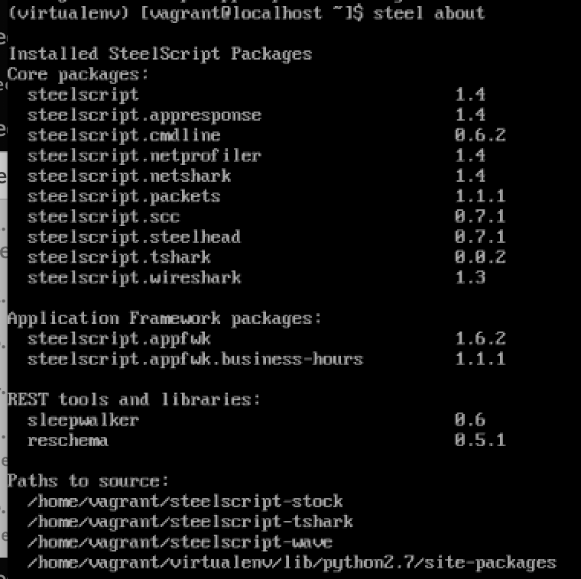
SteelScript SDK
Python libraries that wrap Riverbed REST APIs for easier use
Open-source project, maintained by a community
Documentation (legacy but there is nothing newer):
https://steelscript.readthedocs.io/en/latest/
$ steel install $ steel about

Slide 27
SteelScript Common Libraries
Applies to all supported platforms (NetProfiler, Flow Gateway, AppResponse)
Provide a set of common capabilities across the platform including
The Connection class
Logging
Time utilities
...

Slide 28
Common Connection Class
Found in steelscript.common.connection
Used as foundation class for all connections in SteelScript SDK
Key features
Logging facilities
Error handling and connection retries
Authentication mechanisms (Basic, Cookie, OAUTH2)
Native JSON support

Slide 29
Common Connections Class (cont.)
from steelscript.common.connection import Connection
hostname = 'https://n31-prf' url = '/api/profiler/1.0/users' verify = False auth = ('admin', 'password')
conn = Connection(hostname, auth=auth, verify=verify)
data = conn.json_request('GET', url)
data
…
url = '/api/profiler/1.0/devices'
data = conn.json_request('GET', url)
data
…
Setup
1
2

Slide 30
Logging
Application class instantiates logger after option parsing
Command-line option --loglevel=<debug|info|warning|critical|error>
Enormous number of options, some helpful references:
Standard library docs - http://docs.python.org/3/library/logging.html
Module of the Week - http://pymotw.com/2/logging/
Two lines at the top of the script will usually be enough to get started:
import logging logger = logging.getLogger(__name__)
From there, use logging.debug('...debug text here...')
For application information, logging.info may be a better choice

Slide 31
Time Utilities
steelscript.common.timeutils includes many helper functions
Timezone conversion
Only basic timezones of "local" and "UTC" are included
Covers most basic use cases
Excellent third-party module pytz covers the rest
Timestamp to Python datetime conversion
Useful for reading in human readable time information and converting to usable format
Time range parsing
Provides a flexible way to specify time ranges
Required for almost every report
Useful for packet capture start and end time filtering, for example

Slide 32
Time Utilities, Example
from steelscript.common import timeutils
from steelscript.netprofiler.core.filters import TimeFilter
# convenient last X <seconds|minutes|hours|days>
fltr = TimeFilter.parse_range('last 30 minutes')
print (fltr.start)
print (fltr.end)
>>>2025-05-15 13:54:05.588689
>>>2025-05-15 14:24:05.588689
In
Out

Slide 33
AppResponse Authentication in SteelScript
Three lines of code:
from steelscript.appresponse.core.appresponse import AppResponse
from steelscript.common import UserAuth
ar = AppResponse('$host', auth=UserAuth('$username', '$password'))
The ‘AppResponse’ object maintains the tokens as well as appliance information (e.g., device name, model, software version, serial)
Same model and concept applies to NetProfiler

Slide 34
AppResponse Reports
Reports can be run against published ‘sources’ and can contain a specified set of columns from a list of valid columns
The list of available sources can be obtained using the “list_sources.py” example script:
python list_sources.py n31-arx -u admin -p admin
The columns (and sources) that are available can be seen using a script available in the materials folder (see later):
python get_ar_sources.py n31-arx -u admin -p admin
python get_ar_columns.py n31-arx -u admin -p admin [--source aggregates|packets|alert_list]
Old documentation refers to the “steel appresponse columns ...” command which is no longer supported

Slide 35
SteelScript to get the AppResponse columns
#!/usr/bin/env python
# ...
"""
Get the list of columns available from an AppResponse.
Usage/Example:
python get_ar_columns.py <host> -u <username> -p <password> [--source packets|aggregates|alert_list]
Default source is “packets”
Output sample:
ID Description Type Metric Key/Value
------------------------------------------------------------------------------------------------
apps.test_servers Add it in the filter to test Auto boolean --- Key
Discovered Servers
apps.test_servers_name Add it in the filter to test Auto string --- Value
Discovered Servers
arp.class ARP packet class code integer --- Key...
"""
from steelscript.appresponse.commands.columns import Command
if __name__ == '__main__':
Command().run()

Slide 36
And similar for NetProfiler reports
Getting the column names for NetProfiler reports
# python get_np_columns.py n31-prf -u admin -p password
Key Columns Label ID Type
-----------------------------------------------------------------------------------------------
app_info Application 52 string
app_name Application 17 app
app_raw Raw app 94 string
c2s_flags C2S_FLAGS 50 string
[...]
Value Columns Label ID Type
--------------------------------------------------------------------------------------------------------
avg_bytes Avg Bytes/s 33 float
avg_bytes_app Avg App Bytes/s 504 float
avg_bytes_app_persecconn Avg App Bytes/s per Conn 578 float
avg_bytes_persecconn Avg Bytes/s per Conn 556 float
[...]

Slide 37
SteelScript to get the NetProfiler columns
#!/usr/bin/env python
# ...
"""
Get the list of columns available in the NetProfiler.
Usage/Example: python get_np_columns.py <host> -u <user name> -p <password> [--list-groupbys] [--centricity c] \
[--realm r] [--groupby g] [--ids colids] [--filter column-filter]
Output sample:
Key Columns Label ID Type
-----------------------------------------------------------------------------------------------
app_info Application 52 string
app_name Application 17 app
app_raw Raw app 94 string
c2s_flags C2S_FLAGS 50 string
"""
from steelscript.netprofiler.commands.columns import Command
if __name__ == '__main__’:
Command().run()

Slide 38
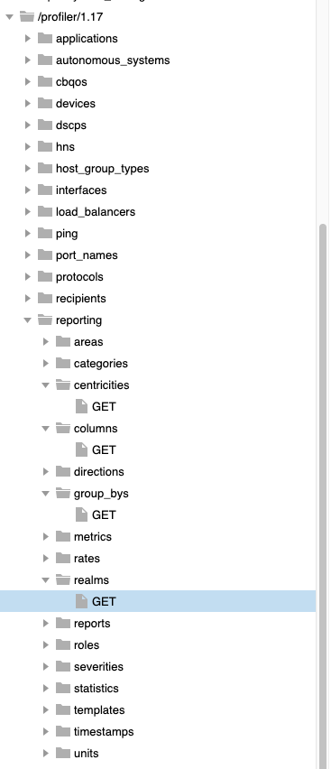
What about realms, centricities, group-bys, etc?
NetProfiler reports have some meta controls to define the perspective of the report
Realms – the type of report (flow list, time series, traffic summary, ...)
Many options – use the API call to check them out
/api/profiler/1.17/reporting/realms
Centricity – “hos” (host) or “int” (interface)
/api/profiler/1.17/reporting/centricities
Group-bys – how data should be aggregated (by host, by port, by host-pair with port, ...)
Many options, mostly familiar from the NetProfiler GUI reporting
/api/profiler/1.17/reporting/group_bys
Columns...
...and numerous other specification parameters

Slide 39
Rule #1: Beg, Borrow, and Steal
SteelScript code most likely exists for doing something similar to what you want to accomplish
Rather than start from scratch, try to use pre-existing code bases to complete tasks – for example:
The provided SteelScript examples included as part of the workspace installation
The Riverbed Community on GitHub (https://github.com/riverbed)
NetProfiler examples: https://github.com/riverbed/steelscript-netprofiler
AppResponse examples: https://github.com/riverbed/steelscript-appresponse
NetIM examples: https://github.com/riverbed/steelscript-netim
Note that much of the Portal REST API is shared with AppResponse
Other examples:
https://github.com/jkraenzle

Slide 40
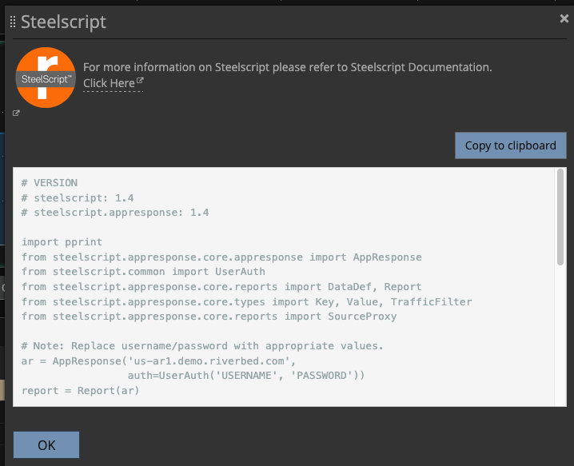
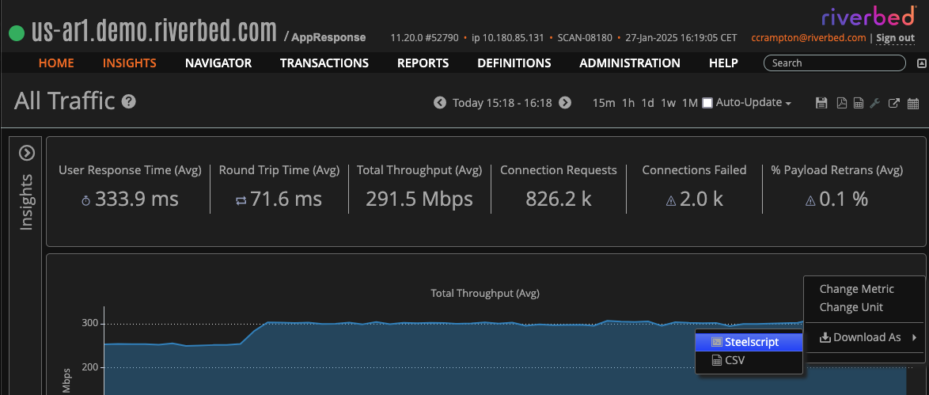
AppResponse can generate code on-demand
SteelScript Python template to obtain data will be generated for you as a starting point for further client ‘code-on-demand’
Start with the “Hamburger” menu...

Slide 41
Resources
These slides and some accompanying materials
EMEA NPM Inner Circle
Riverbed REST APIs (not NetIM)
https://support.riverbed.com/apis/
Current SteelScript in GitHub
https://github.com/riverbed/steelscript
NetProfiler: https://github.com/riverbed/steelscript-netprofiler
AppResponse: https://github.com/riverbed/steelscript-appresponse
OLD but still the most recent SteelScript Docs
https://steelscript.readthedocs.io/en/latest/
Engineering documentation for NetProfiler configuration APIs [internal]
https://rvbd-eng.atlassian.net/wiki/spaces/PROFILER/pages/102492407621/REST-API+--+New+Features+in+Jakarta
Sample scripts for NetIM – use WinSCP to access the scripts on a NetIM Core VM
Community resources:
https://github.com/jkraenzle/appresponse_utilities
https://github.com/jkraenzle/ar11utilities
https://github.com/jkraenzle/appresponse_cloudsync

Slide 42
Example: Running a NetProfiler Report

Slide 43
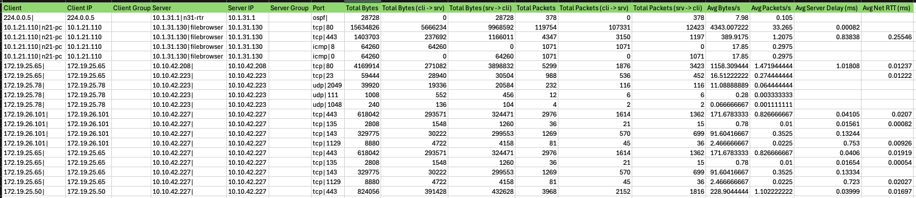
Running a report with SteelScript
The example scripts are a good basis
# python ./traffic_summary.py --user admin --password password --csv --columns cli_host_dns,cli_host_ip,cli_group_name,srv_host_dns,srv_host_ip,srv_group_name,protoport_parts,total_bytes,c2s_total_bytes,s2c_total_bytes,total_pkts,c2s_total_pkts,s2c_total_pkts,avg_bytes,avg_pkts,server_delay,network_rtt --groupby=host_pair_protoport n31-prf
Client,Client IP,Client Group,Server,Server IP,Server Group,Port,Total Bytes,Total Bytes (cli -> srv),Total Bytes (srv -> cli),Total Packets,Total Packets (cli -> srv),Total Packets (srv -> cli),Avg Bytes/s,Avg Packets/s,Avg Server Delay (ms),Avg Net RTT (ms)
224.0.0.5|,224.0.0.5,,10.1.31.1|n31-rtr,10.1.31.1,,ospf|,28728,0,28728,378,0,378,7.98,0.105,,
10.1.21.110|n21-pc,10.1.21.110,,10.1.31.130|filebrowser,10.1.31.130,,tcp|80,15634826,5666234,9968592,119754,107331,12423,4343.00722222,33.265,0.00082,
10.1.21.110|n21-pc,10.1.21.110,,10.1.31.130|filebrowser,10.1.31.130,,tcp|443,1403703,237692,1166011,4347,3150,1197,389.9175,1.2075,0.83838,0.25546

Slide 44
A sample script for generating a NetProfiler report
To illustrate how to obtain more than 10000 rows of output
NetProfiler makes it difficult to generate reports with more than 10K rows
But the REST API does support this – use with care!!
A REST API solution is described in the following slides
Modified SteelScript examples are available in the materials
A shell script is available with the materials – not Python!
bash+curl-report.sh with JSON specification file report-flow.json
JSON files specifies a flow-level detail report
See: https://github.com/cmc-rvbd/netprofiler-utils
Uses cURL to make multiple REST requests to start the report, poll the status, harvest the data
A separate JSON file is used to specify the report to be generated
The following slides will discuss the script and its implementation

Slide 45
An example of using NetProfiler RESTful APIs
Running Reports
Extracting report data is not a one-step operation; it is multi-step
Generating a NetProfiler report requires the following three steps:
Initiate a new report by posting report criteria to the server
Poll the running report status until the report completes
Retrieve the report data
For more details, checkout the NetProfiler RESTful API docs with overview information and sample report scripts
https://<your-netprofiler>/rest/api/index.php
Start the report
Poll the report status until complete
Collect the data

Slide 46
Generating a NetProfiler Report Step-by-Step
Step 1: Create a new report by posting report criteria to the server
From the NetProfiler RESTful API docs:
A criteria structure in either JSON or XML is submitted to the server using the HTTP POST method. The resource to which the criteria structure is posted is called /profiler/1.0/reporting/reports. The details are described in the Resources section of this documentation.
A key part of the report criteria is the ID of the template that should be used to run the report. A special system template ID 184 that provides a high degree of flexibility is used in demo reports in this documentation. [...] Once a template is saved, its ID can be obtained via the /api/profiler/1.0/reporting/templates REST resource.
NOTE THAT TEMPLATES OTHER THAN 184 DO NOT PRODUCE RELIABLE RESULTS!
For reliable reports always use report template ID 184
Start the report

Slide 47
Generating a NetProfiler Report Step-by-Step
Step 2: Poll report status until the report completes
From the RESTful API docs:
It may take a while for a report to complete. While the report is running, the client must poll for report status to know when the report completes. When the call to create a new report succeeds, it returns the URL for the newly created report. That URL may look similar to /profiler/1.0/reporting/reports/1000, where 1000 is the ID of the new report.
The general way to describe this in REST documentation is /profiler/1.0/reporting/reports/{id} so this documentation uses that syntax throughout. Note that the client does not need to know that {id} is really an ID of a report. Instead the client should treat a given report, for example /profiler/1.0/reporting/reports/1000, as a REST resource without parsing the parts of the URL.
The status of a report can be obtained by executing a GET method on the report URL. The client should wait while the report is running and until the status turns to complete.
Poll the report status until complete

Slide 48
Generating a NetProfiler Report Step-by-Step
Step 3: Retrieve the report data
From the RESTful API docs:
Once the report completes, the client can retrieve its data or the rendered version of the report in a number of formats
The following resources can be used to retrieve a rendered version of the report:
/profiler/1.0/reporting/reports/{id}/view.pdf
/profiler/1.0/reporting/reports/{id}/view.csv
These are for PDF and CSV versions respectively
If the client is a script that needs access to raw data, the /profiler/1.0/reporting/reports/{id}/queries resource can be used with the GET method to obtain the list of elements (queries) first. The data shown in a typical report on the user interface may come from more than one query, which is why the report structure needs to be determined first. However, the system template 184 described above will have only one query and is easy to use for simple scripts.
Collect the data

Slide 49
A sample script for generating a report
To illustrate how to obtain more than 10000 lines of output
A customer shell script is available in the following GitHub:
https://github.com/cmc-rvbd/netprofiler-utils
bash+curl-report.sh
Uses multiple REST requests to start the report, poll the status, harvest the data
A separate JSON file is used to specify the report to be generated
The following slides will discuss the script and its implementation

Slide 50

Anatomy of a NetProfiler report generating script
The report specification JSON file (report-def.jsn)
{
"criteria": {
"time_frame": {
"start": 1741850000,
"end": 1741860000
},
"query": {
"realm": "traffic_flow_list",
"group_by": "flw",
"sort_column": 40,
"traffic_expression": "",
"limit": 10001,
"columns": [
729, 40, 41, 158, 4, 14, 44, 10,
45, 46, 47, 48, 49
]
}
},
"template_id": 184
}
Parameters need specifying for each report according to the requirements, with at least the following values:
Template_ID
184 is the only one that works reliably
Start/end times – expressed in UNIX time
Realm – type of report
Group_by – aggregation type
Columns – metrics the report will include
Optional parameters:
Limit – the max. number of rows
Traffic_expression – as you can use in an Advanced Traffic Report

Slide 51
Anatomy of a report generating script
The header – how to use the script and some notes
# Usage:
# report.sh username password netprofiler-host rows report-spec output-file [format]
#
# Note that the "report-spec" file should be a JSON file specifying the report details (template,
# start/end times, etc) and the "limit" value must be set at least as high as the "rows" argument value
#
# E.g. to get a report with 12000 lines first edit the JSON file to have a "limit" value of at least 12000
# and set the start and end times accordingly and then run the command:
#
# report.sh admin adminpwd 10.100.20.1 12000 my-report.jsn output.txt xml
#
# The specified report template must contain a "summary" table or a "flow_list" table and only one of either
# and not both. As it stands, the script looks for either and uses the first one it finds.
# Ideally, all of the contents of the JSON file would be specified on the command line arguments and the
# JSON file generated on the fly.
#
# The possibilities for the realm, groupby and columns fields in the JSON file can be found via the REST API
# - /api/profiler/1.16/reporting/group_bys
# - /api/profiler/1.16/reporting/realms
# - /api/profiler/1.16/reporting/columns
# - /api/profiler/1.16/reporting/centricities
#
# The traffic expression is the same as you'd use in the Advanced Traffic report (same syntax).
#
# Note the script captures the output at each stage in files called "stageN.txt" for debug purposes only.

Slide 52
Anatomy of a report generating script
Step 1: initiate the report generation and grab the Report ID
#----------------------------------------------------------------------------------------------
# Start the report generation and grab the report ID from the response
#
REPORT_ID=`curl -sS --insecure -H "Content-Type: application/json" -X POST --data "@${JSON}" -u "${USER}:${PASSWD}" https://"${NPHOST}"/api/profiler/1.16/reporting/reports | tee step1.txt |
awk '{print $3}' | awk -F\" '{print $2}' | tr -d '\n'`
[ $? -ne 0 -o -z "$REPORT_ID" ] && fail "Report invocation failed"
echo "Report id: $REPORT_ID"
CURL is used to submit the REST requests
BASIC authentication is used – can be more secure

Slide 53
Anatomy of a report generating script
Step 2: poll the status of the report and wait for it to complete
#----------------------------------------------------------------------------------------------
# Get the report status and keep getting the report status until the progress is at 100%
#
REPORT_STAT=`curl -sS --insecure -H "Content-Type: text/xml X-Requested-With: XMLHttpRequest" -X GET -u "${USER}":"${PASSWD}" https://"${NPHOST}"/api/profiler/1.16/reporting/reports/$REPORT_ID | tee step2.txt |
awk '{print $5}' | awk -F\" '{print $2}'`
while [ "$REPORT_STAT" -ne 100 ]
do
REPORT_STAT=`curl -sS --insecure -H "Content-Type: text/xml X-Requested-With: XMLHttpRequest" -X GET -u "${USER}":"${PASSWD}" https://"${NPHOST}"/api/profiler/1.16/reporting/reports/$REPORT_ID | tee step2.txt |
grep "$REPORT_ID" | awk '{print $5}' | awk -F\" '{print $2}'`
echo "$REPORT_STAT% complete"
done
echo "Report done - saving to $OPFILE"
The status is repeatedly polled until the value is “100” (percent)
At this stage the report generation is finished and the data are ready to be collected

Slide 54
Anatomy of a report generating script
Step 3: harvesting the data
#----------------------------------------------------------------------------------------------
# Now the report has completed we need to extract the data in two steps:
# 1. Get a list of the report components (queries) and for the required component, extract the query ID
# 2. For the specified component/query, pull the data and output to the standard-output
#
# The report should really be deleted when done with...
#
QUERY_ID=`curl -sS --insecure -H "Accept: text/xml X-Requested-With: XMLHttpRequest" -X GET -u "${USER}":"${PASSWD}" https://"${NPHOST}"/api/profiler/1.16/reporting/reports/$REPORT_ID/queries | tee step3.txt |
grep actual_log | egrep 'type="(summary|flow_list)"' | head -1 | awk '{print $8}' | awk -F\" '{print $2}' | tr -d '\n'`
case "${FMT}"
in
xml|json)
curl -sS --insecure -H "Accept: text/xml X-Requested-With: XMLHttpRequest" -X GET -u "${USER}":"${PASSWD}" \
https://"${NPHOST}/api/profiler/1.16/reporting/reports/$REPORT_ID/queries/$QUERY_ID.${FMT}?${COLS}limit=${ROWS}" > "${OPFILE}"
;;
pdf|csv)
curl -sS --insecure -H "Accept: text/xml X-Requested-With: XMLHttpRequest" -X GET -u "${USER}":"${PASSWD}" \
https://"${NPHOST}/api/profiler/1.16/reporting/reports/$REPORT_ID/view.${FMT}" > "${OPFILE}"
;;
esac
The first CURL command gets the structure of the report with the various components (“queries”)
The component in the output is identified – should be “flow_list” or “summary”
The corresponding component data are then pulled and sent to the output file according to the specified output format

Slide 55
Running the test script
Proof that more than 10K rows are generated
# cat report-flow.json
{
"template_id": 184,
"criteria": {
"time_frame": {
"start": 1738200000,
"end": 1738232458
},
"queries": [
{
"sort_column" : 40,
"realm": "traffic_flow_list",
"group_by": "flw",
"limit": 15000,
"traffic_expression": "host 0/0",
"columns": [
14,10,4,45,123,124
]
}
]
}
}
#
# bash ./bash+curl-report.sh admin password n31-prf 15000 report-flow.json report.xml xml
Report id: 1274
0% complete
0% complete
[...]
0% complete
0% complete
99% complete
99% complete
99% complete
100% complete
Report done - saving to report.xml
# grep '</row>' report.xml | wc -l
15000

Slide 56
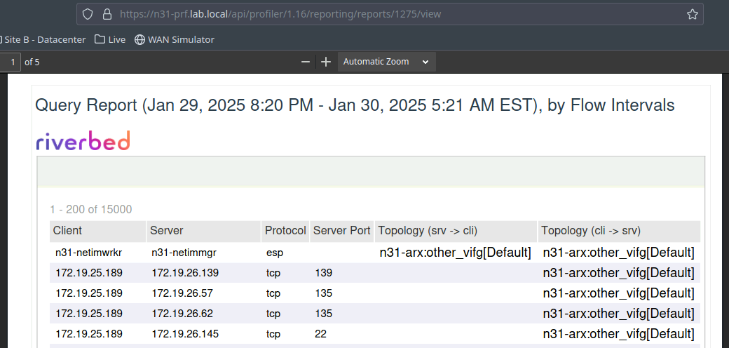
Running the test script
Requires this environment variable being set to stop the script cleaning up the report after downloading
# export REST_REPORT_KEEP=true

Slide 57
Conclusions
Using the REST API calls, it is possible to override the 10K row limit
This only works reliably with the Template 184
Reports with more than 10K rows only work with XML or JSON output formats
The report process has three stages: start, wait, collect
A JSON file is used to specify the details of the report including the row limit
Has to be carefully tailored to match the target template and the reporting requirements (template ID, realm, group_by, columns, start/stop time, etc)
The call used to collect the data has to request the required number of rows
The ”limit” value in the JSON file controls how many rows are generated
The REST call to harvest the data controls how many rows are actually downloaded
The sample script is primitive but proves the concept

Slide 58
Additional notes
The afore mentioned GitHub repository contains a couple of SteelScript example scripts with modifications to support row counts higher than 10K
Repository:
https://github.com/cmc-rvbd/netprofiler-utils
Modified scripts:
https://github.com/cmc-rvbd/netprofiler-utils/blob/main/traffic_flowlist.py
https://github.com/cmc-rvbd/netprofiler-utils/blob/main/traffic_summary.py

Slide 59
Thank you!

Slide 60
Internal notes
How to get columns for a specific template and use them
$ mazu $ mazu-reports --export-templates "template_ids=1164;preserve_schedule=false" --file /tmp/template-1164.txt –user ccrampton
$ python traffic_summary.py netprofiler.riverbed.com -u uname -p passwd., --timefilter='last 1 day' --columns 'cli_host_dns,cli_host_ip,cli_group_name,srv_host_dns,srv_host_ip,srv_group_name,protoport_parts,total_bytes,c2s_total_bytes,s2c_total_bytes,total_pkts,c2s_total_pkts,s2c_total_pkts,avg_bytes,avg_pkts,server_delay,network_rtt' --groupby=host_pair_protoport --limit 11000 > op
$ wc -l op 11003 op
$ python traffic_flowlist.py netprofiler.demo.riverbed.com -u uname -p passwd --timefilter='last 1 day' --columns 'cli_host_dns,srv_host_dns,protocol_name,srv_port,srv_topo_dns,cli_topo_dns' --trafficexpr 'tcp/443' --limit 11000 > op
$ wc -l op 11003 op

