Slide 2




1 2 3 4
1
2
$$Q_{ij}=E_{ij}^{Ewald}+E_{ij}^{Buckingham}$$
3
1
3
4
4
2
AlGaN
Al Al N N
Ga Ga N N
Al
Ga
Al
$$Q_{12}^{AlN}$$
Ga
$$Q_{12}^{GaN}$$
$$Q= Q^{GaN}−Q^{AlN}$$
N
N
N
N

Slide 3
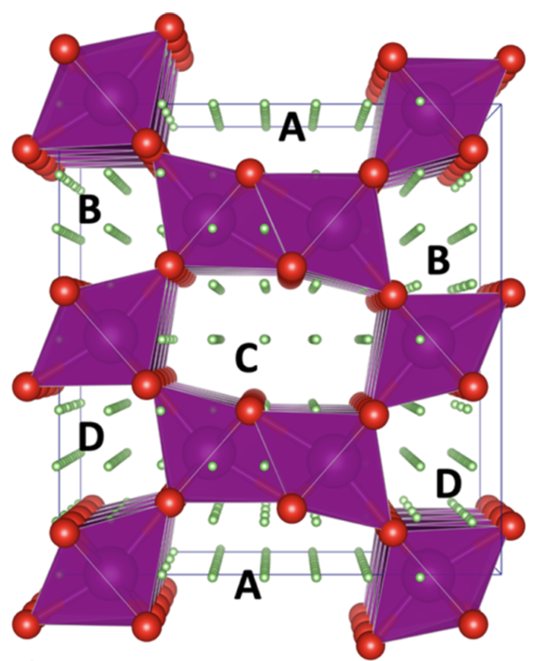
Mn Mn … Li Li … O O
Mn
Mn
…
Li
Li
…
O
O
Fixed lattice points
Grid
Smart remove

Slide 4
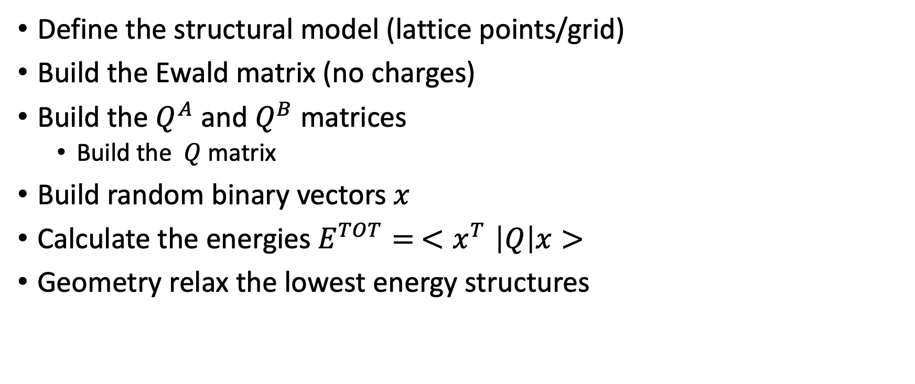
Step by step
Define the structural model (lattice points/grid)
Build the Ewald matrix (no charges)
Build the $Q^{A}$ and $Q^{B}$ matrices
Build the $Q$ matrix
Build random binary vectors $x$
Calculate the energies $E^{TOT}= {<x}^{T}\left|Q\right|x>$
Geometry relax the lowest energy structures

Slide 5
Data analysis
Test the grid size and ways of building it
Do the QUBO low energy structures correspond to the relaxed ones?

