Slide 1
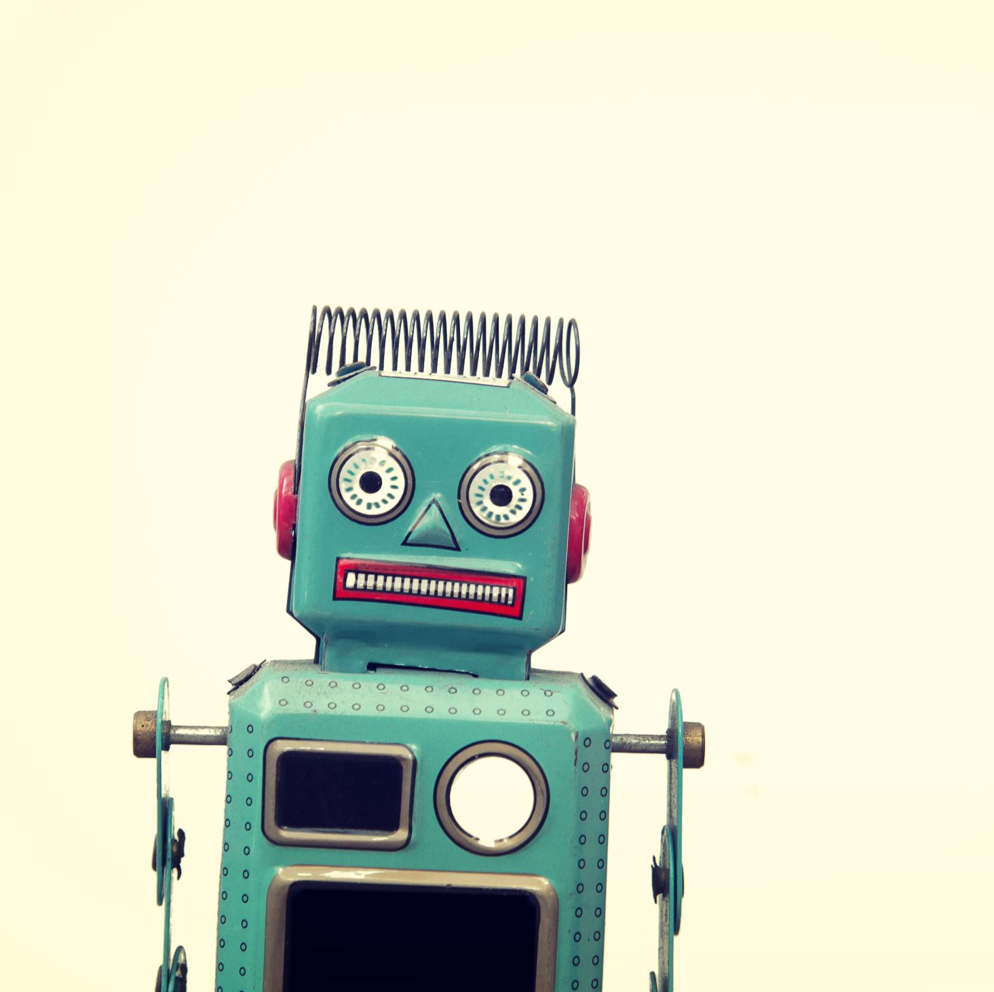
Alpha Version
By: Christian Carranza and Abhigyan Tripathi

Slide 2
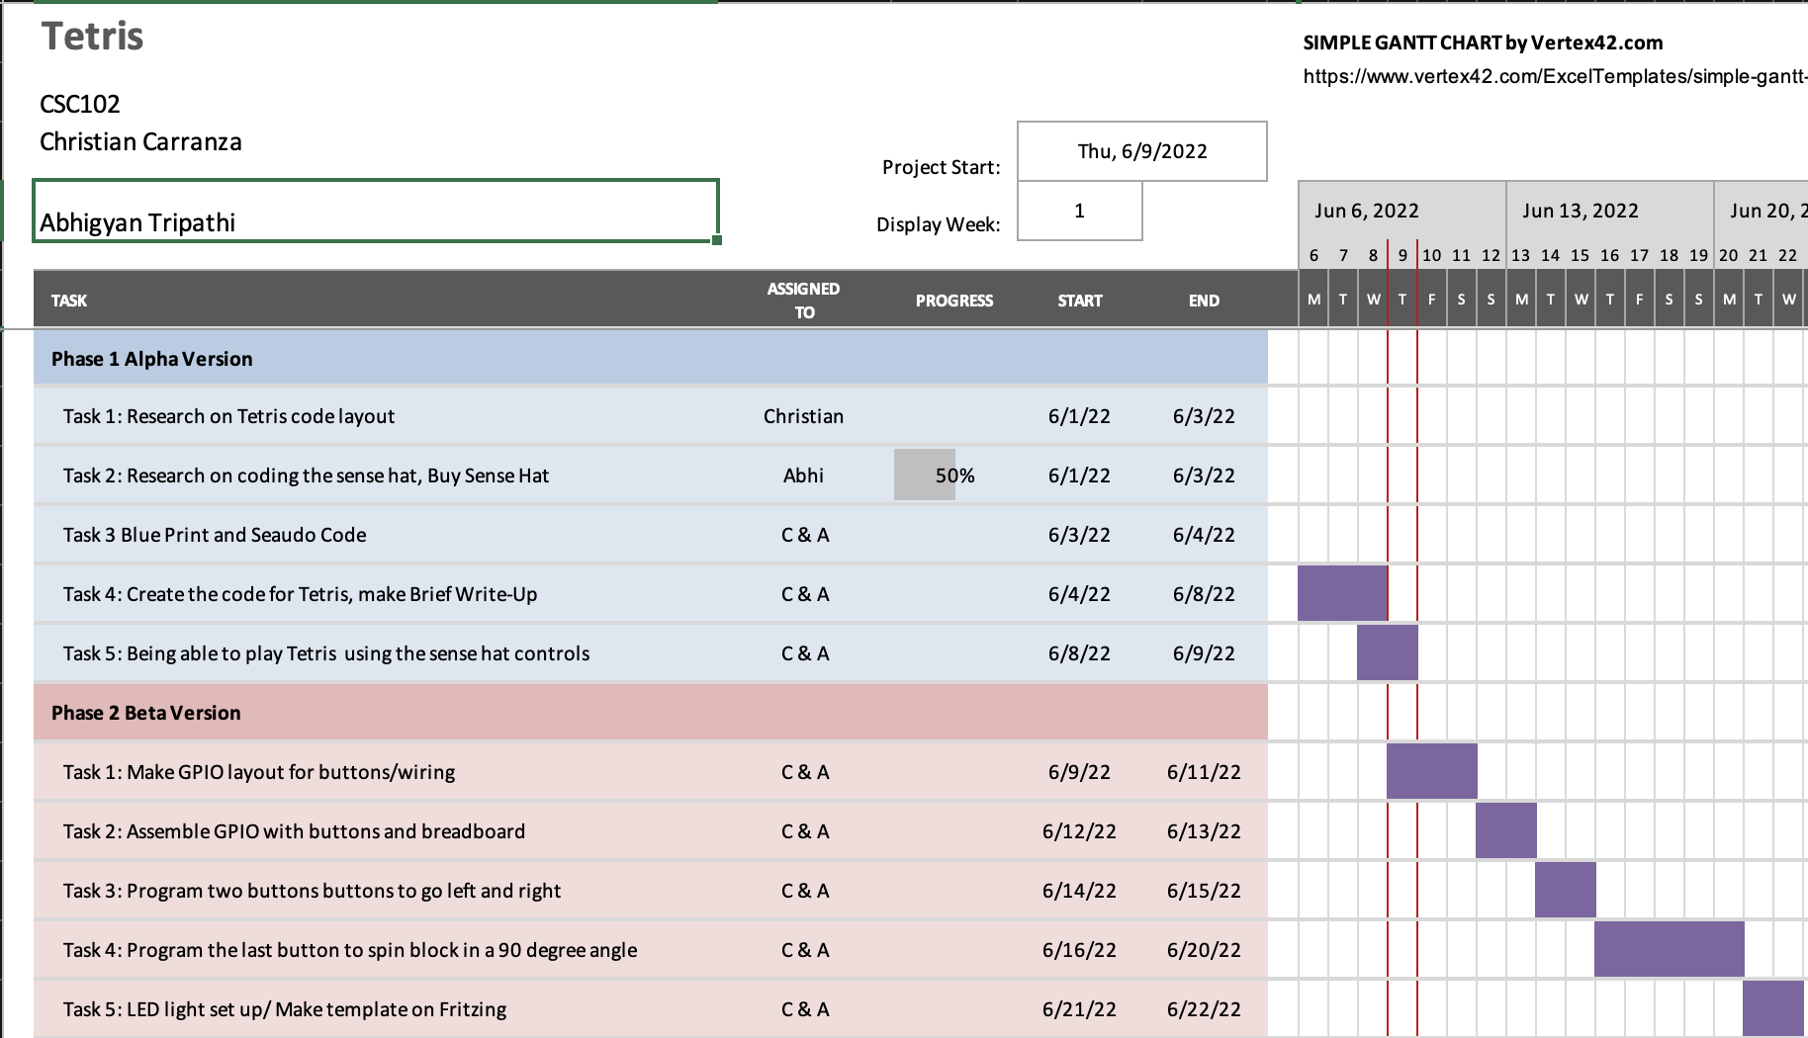
Gantt Chart Time:

Slide 3
Blueprint Time

Slide 4
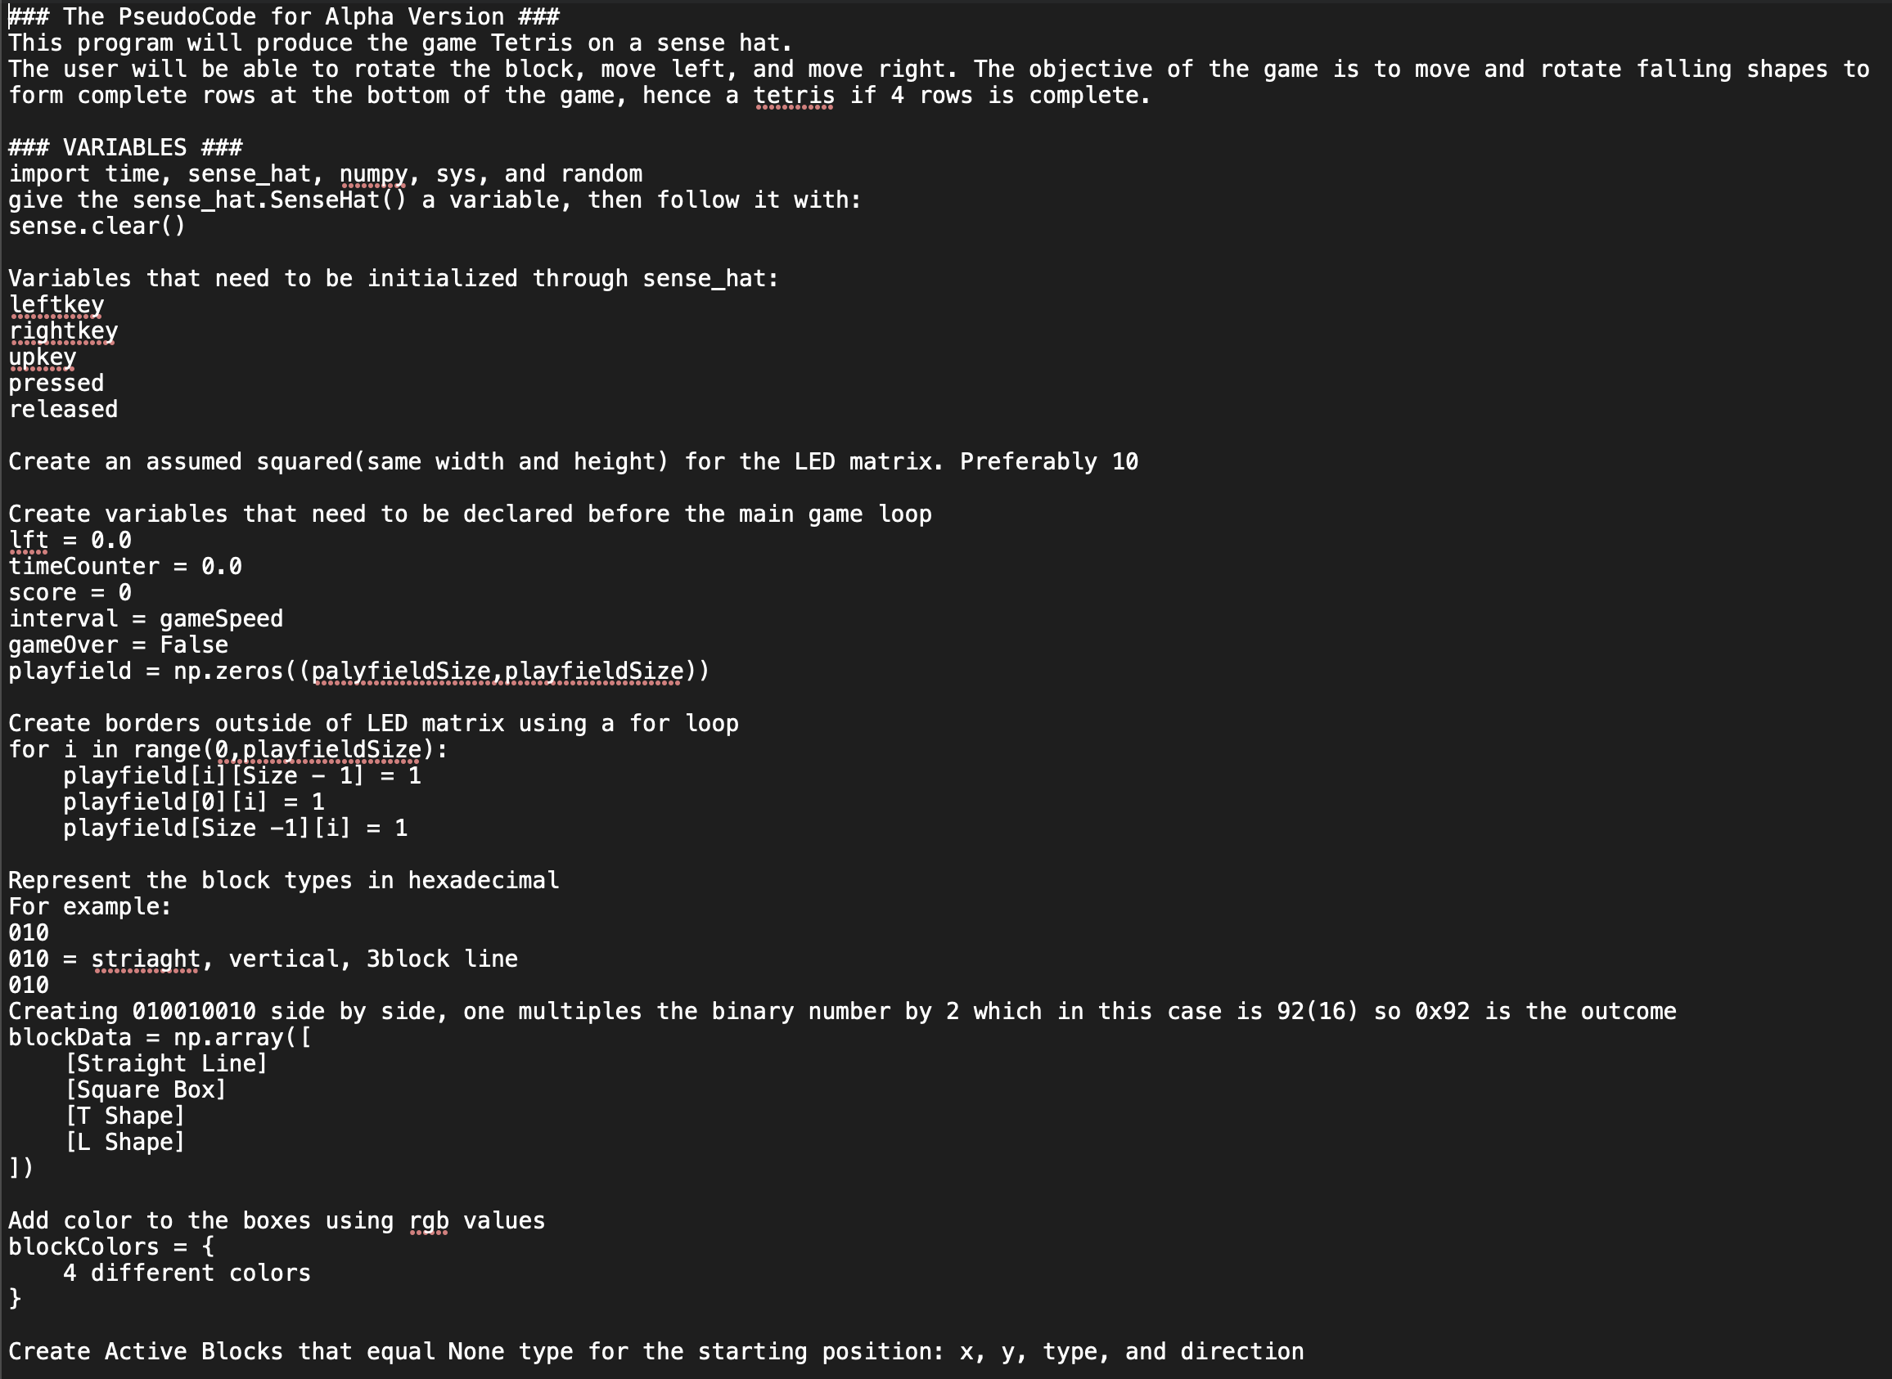

Slide 5
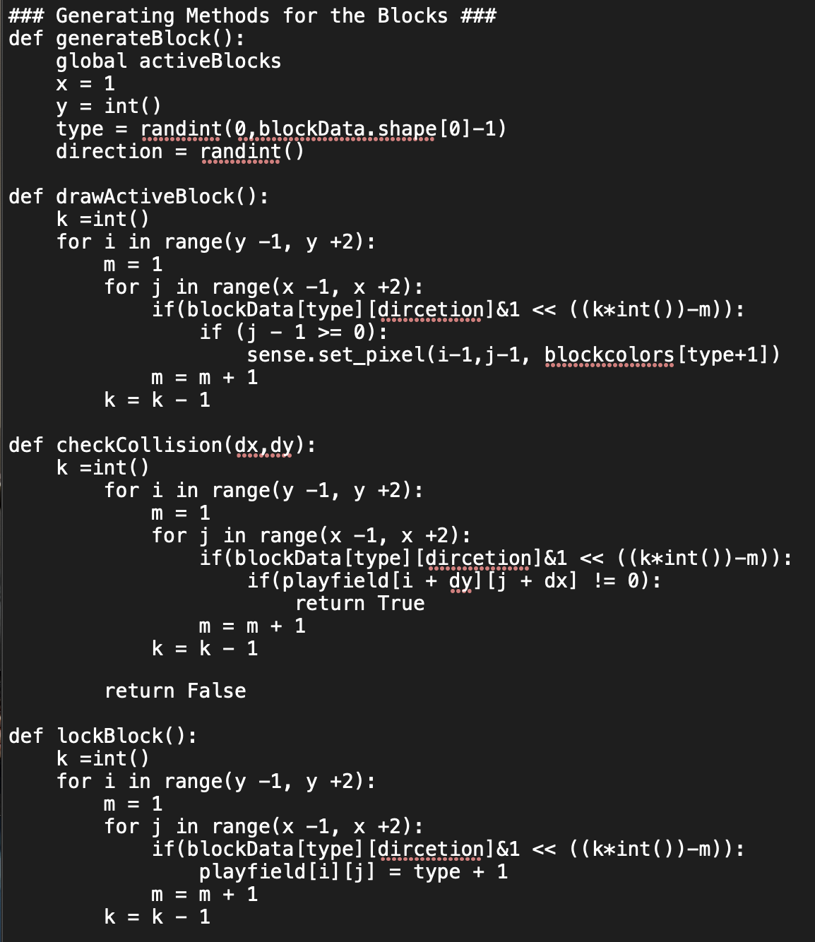
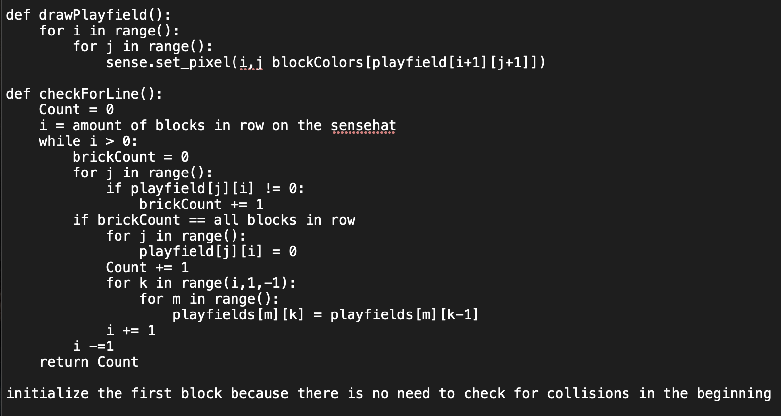

Slide 6
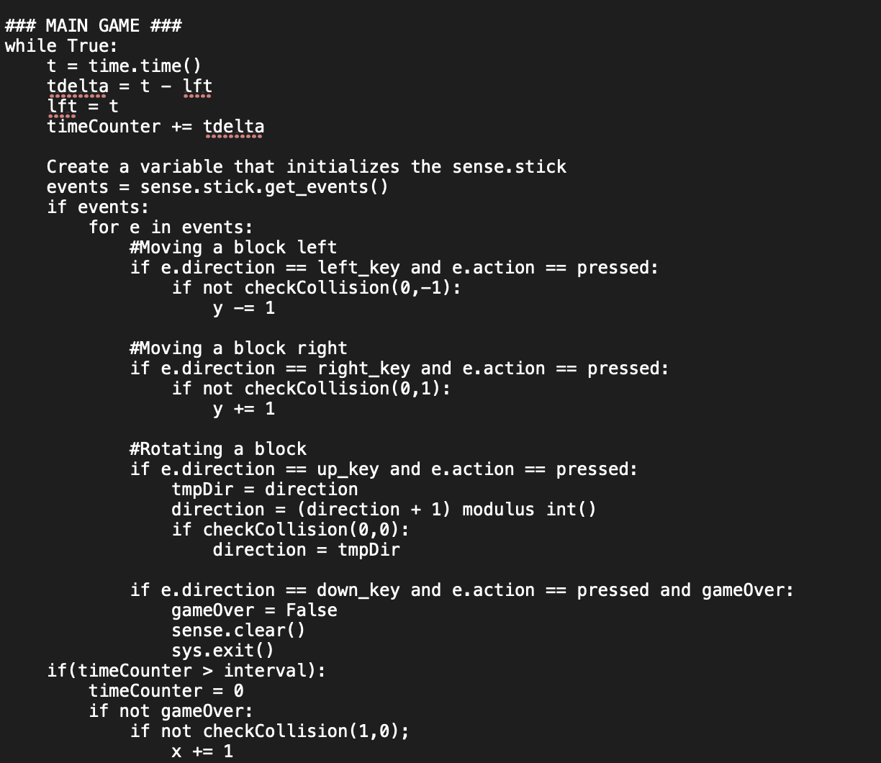
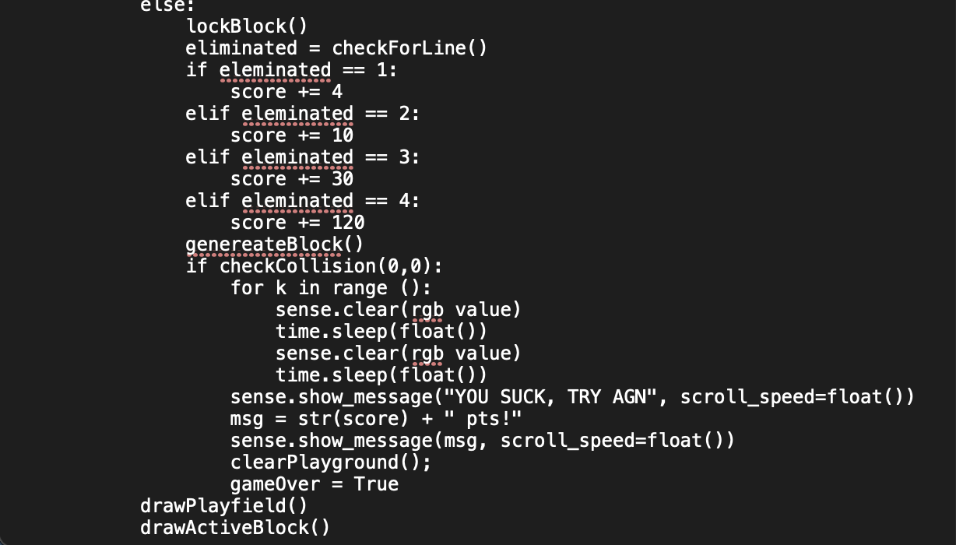

Slide 7
Sources that helped us with our Alpha Code:
https://www.youtube.com/watch?v=zfvxp7PgQ6c
https://levelup.gitconnected.com/writing-tetris-in-python-2a16bddb5318
https://github.com/tkupcewicz/sense-hat-tetris
https://dgkanatsios.com/2016/01/26/snake-and-tetris-like-games-with-sense-hat-on-a-raspberry-pi-2-loaded-with-windows-10/
https://github.com/AndrewCRichards/TetriPiSense

