Slide 1
Final Project
Christian and Abi

Slide 2
TETRIS
Our objective is to create and display the game Tetris using the Razzberry Pi, a sense hat, LED lights, and the speaker/audio piece that was given to us in our kit.

Slide 4
The GPIO
The GPIO will be implemented by using sound, LED lights (i.e., rainbow color when you get a Tetris).
We also added in audio when the user gets a Tetris.
Incorporated a High Score list where the user types their name.

Slide 5
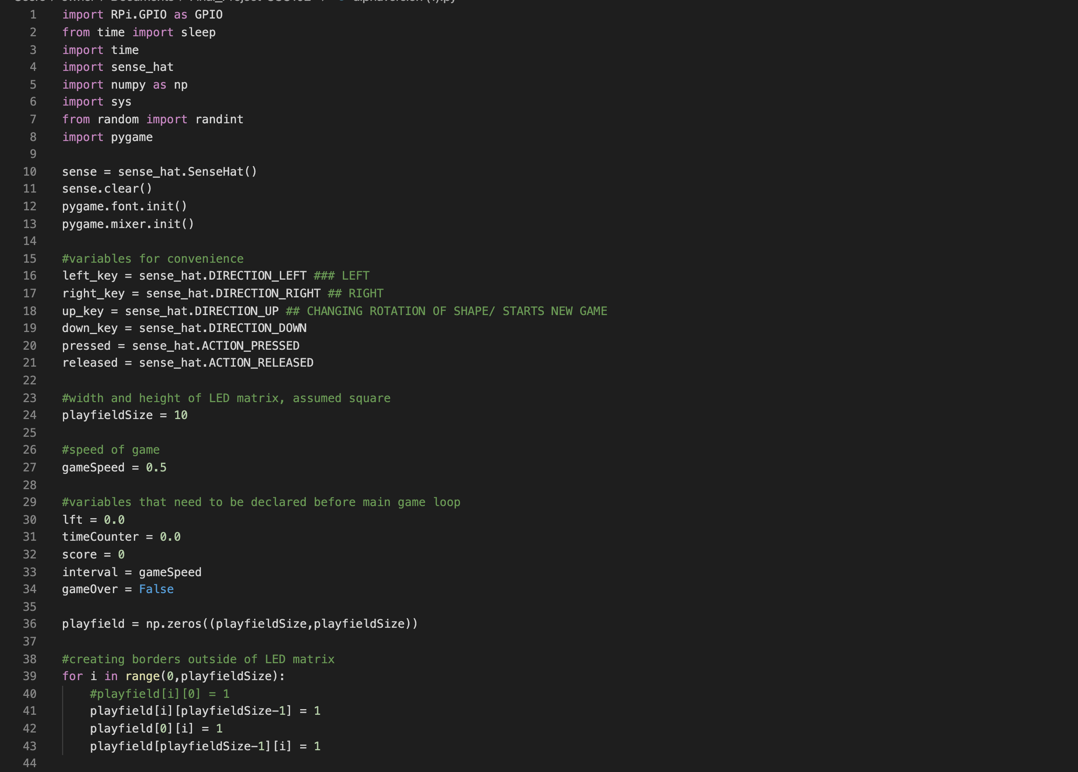
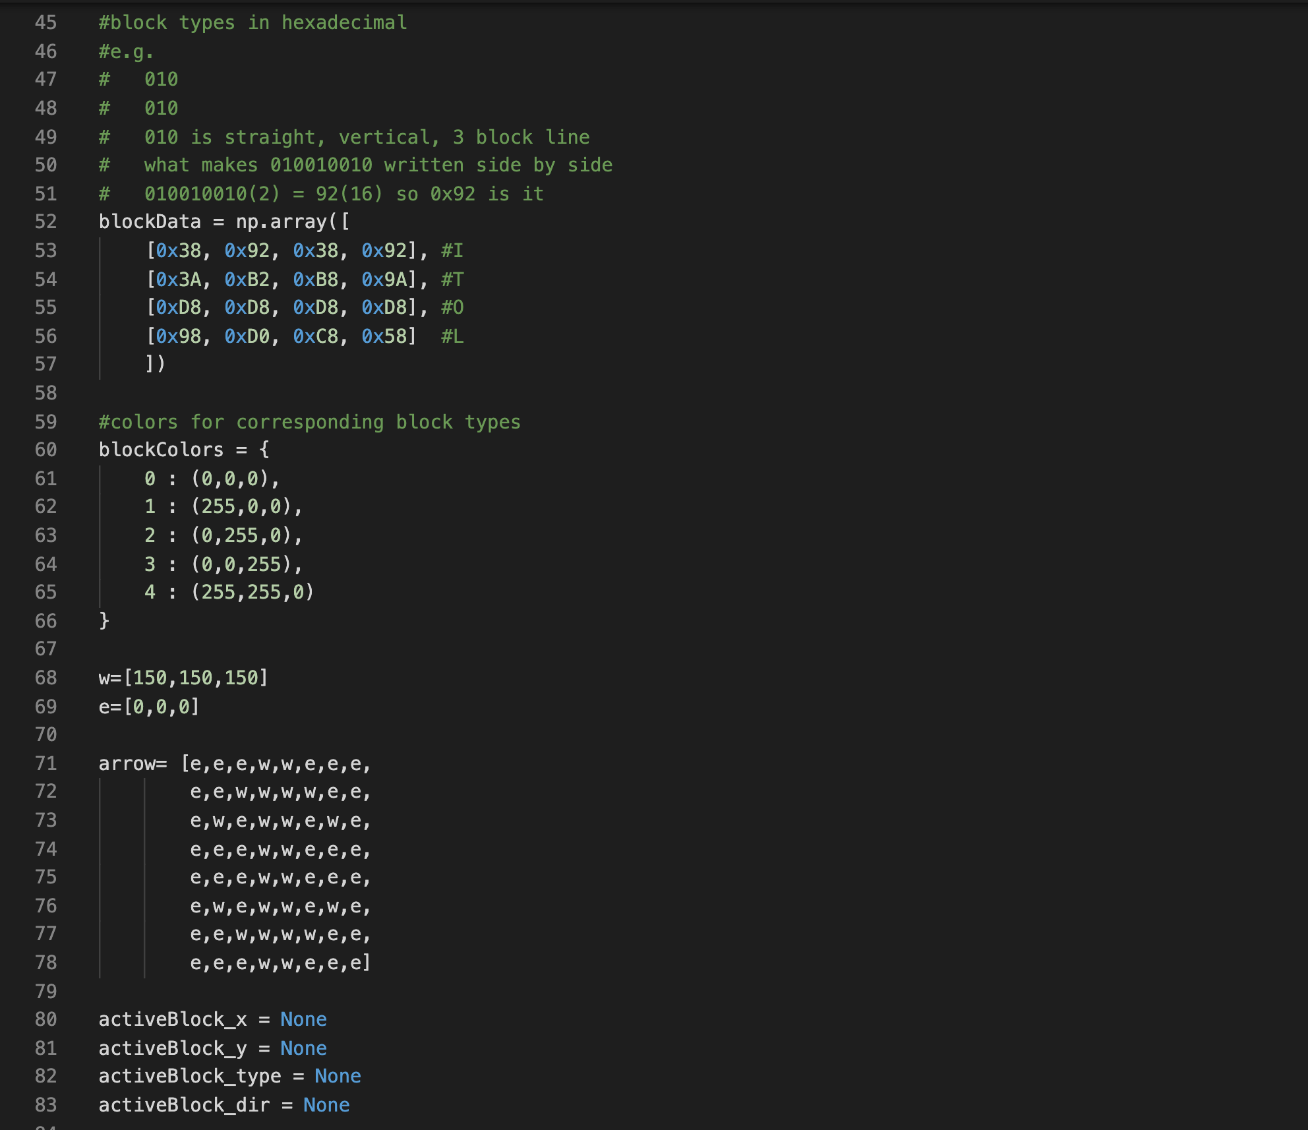

Slide 6
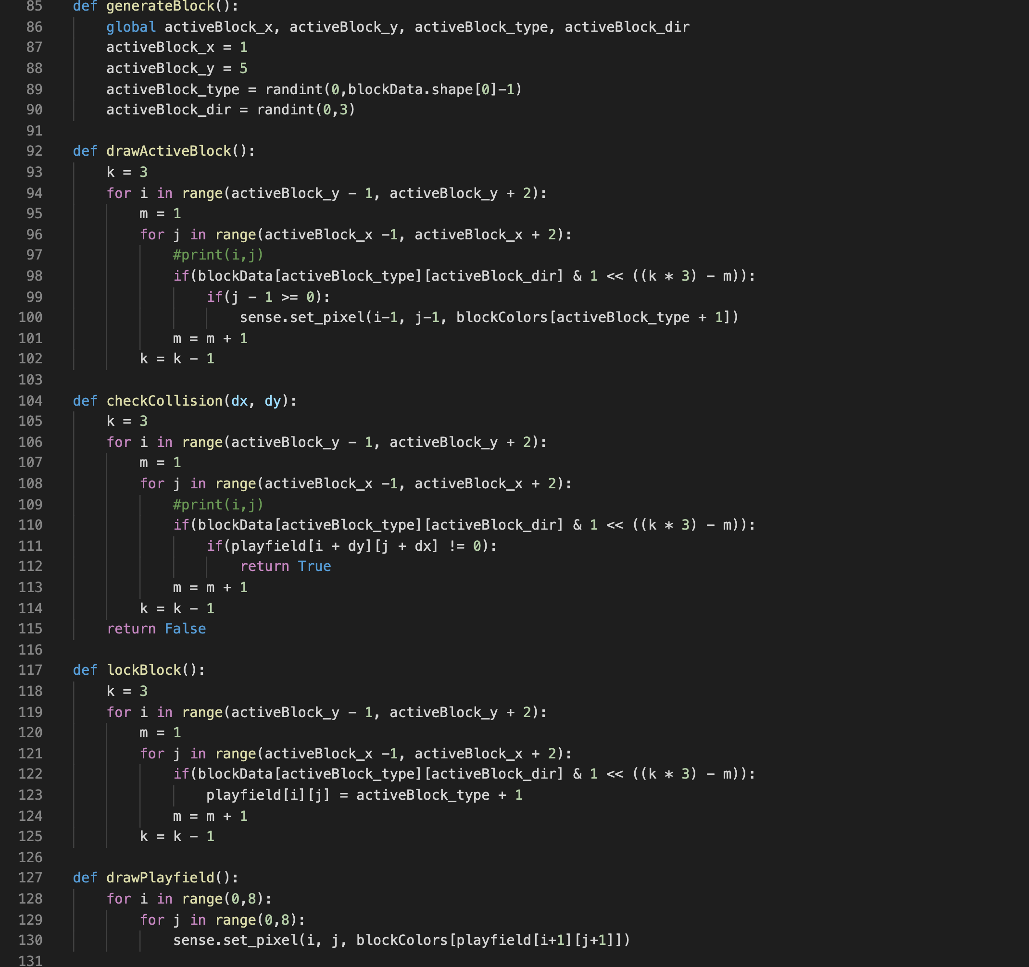
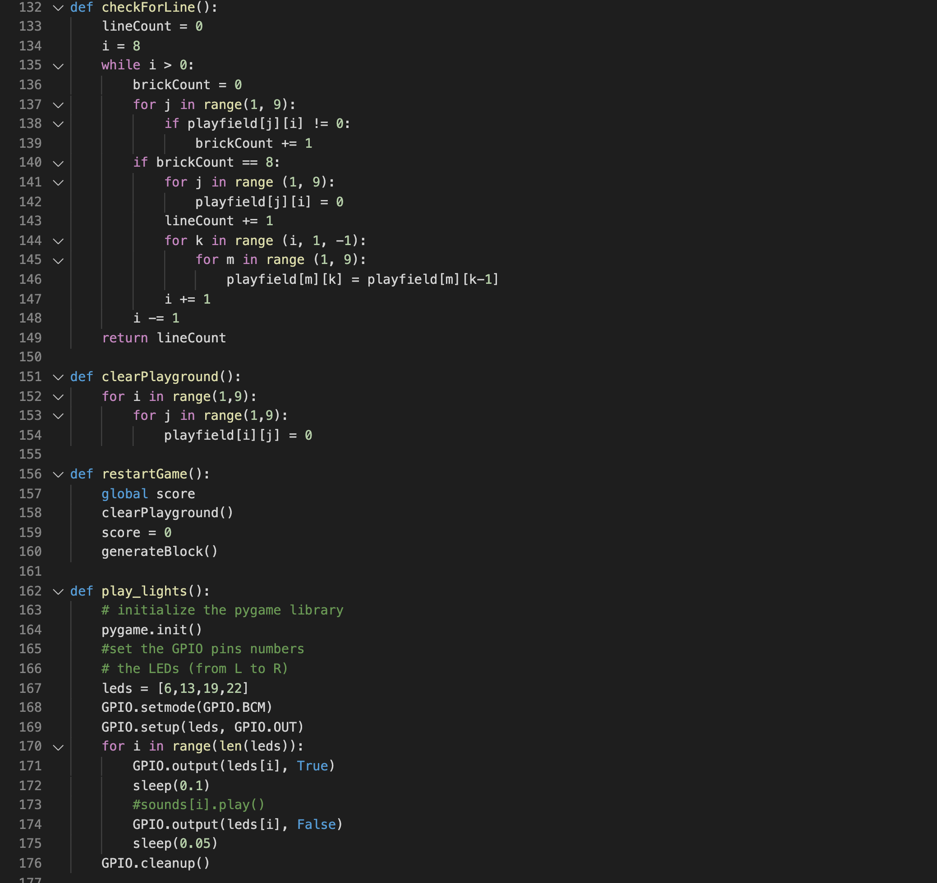

Slide 7
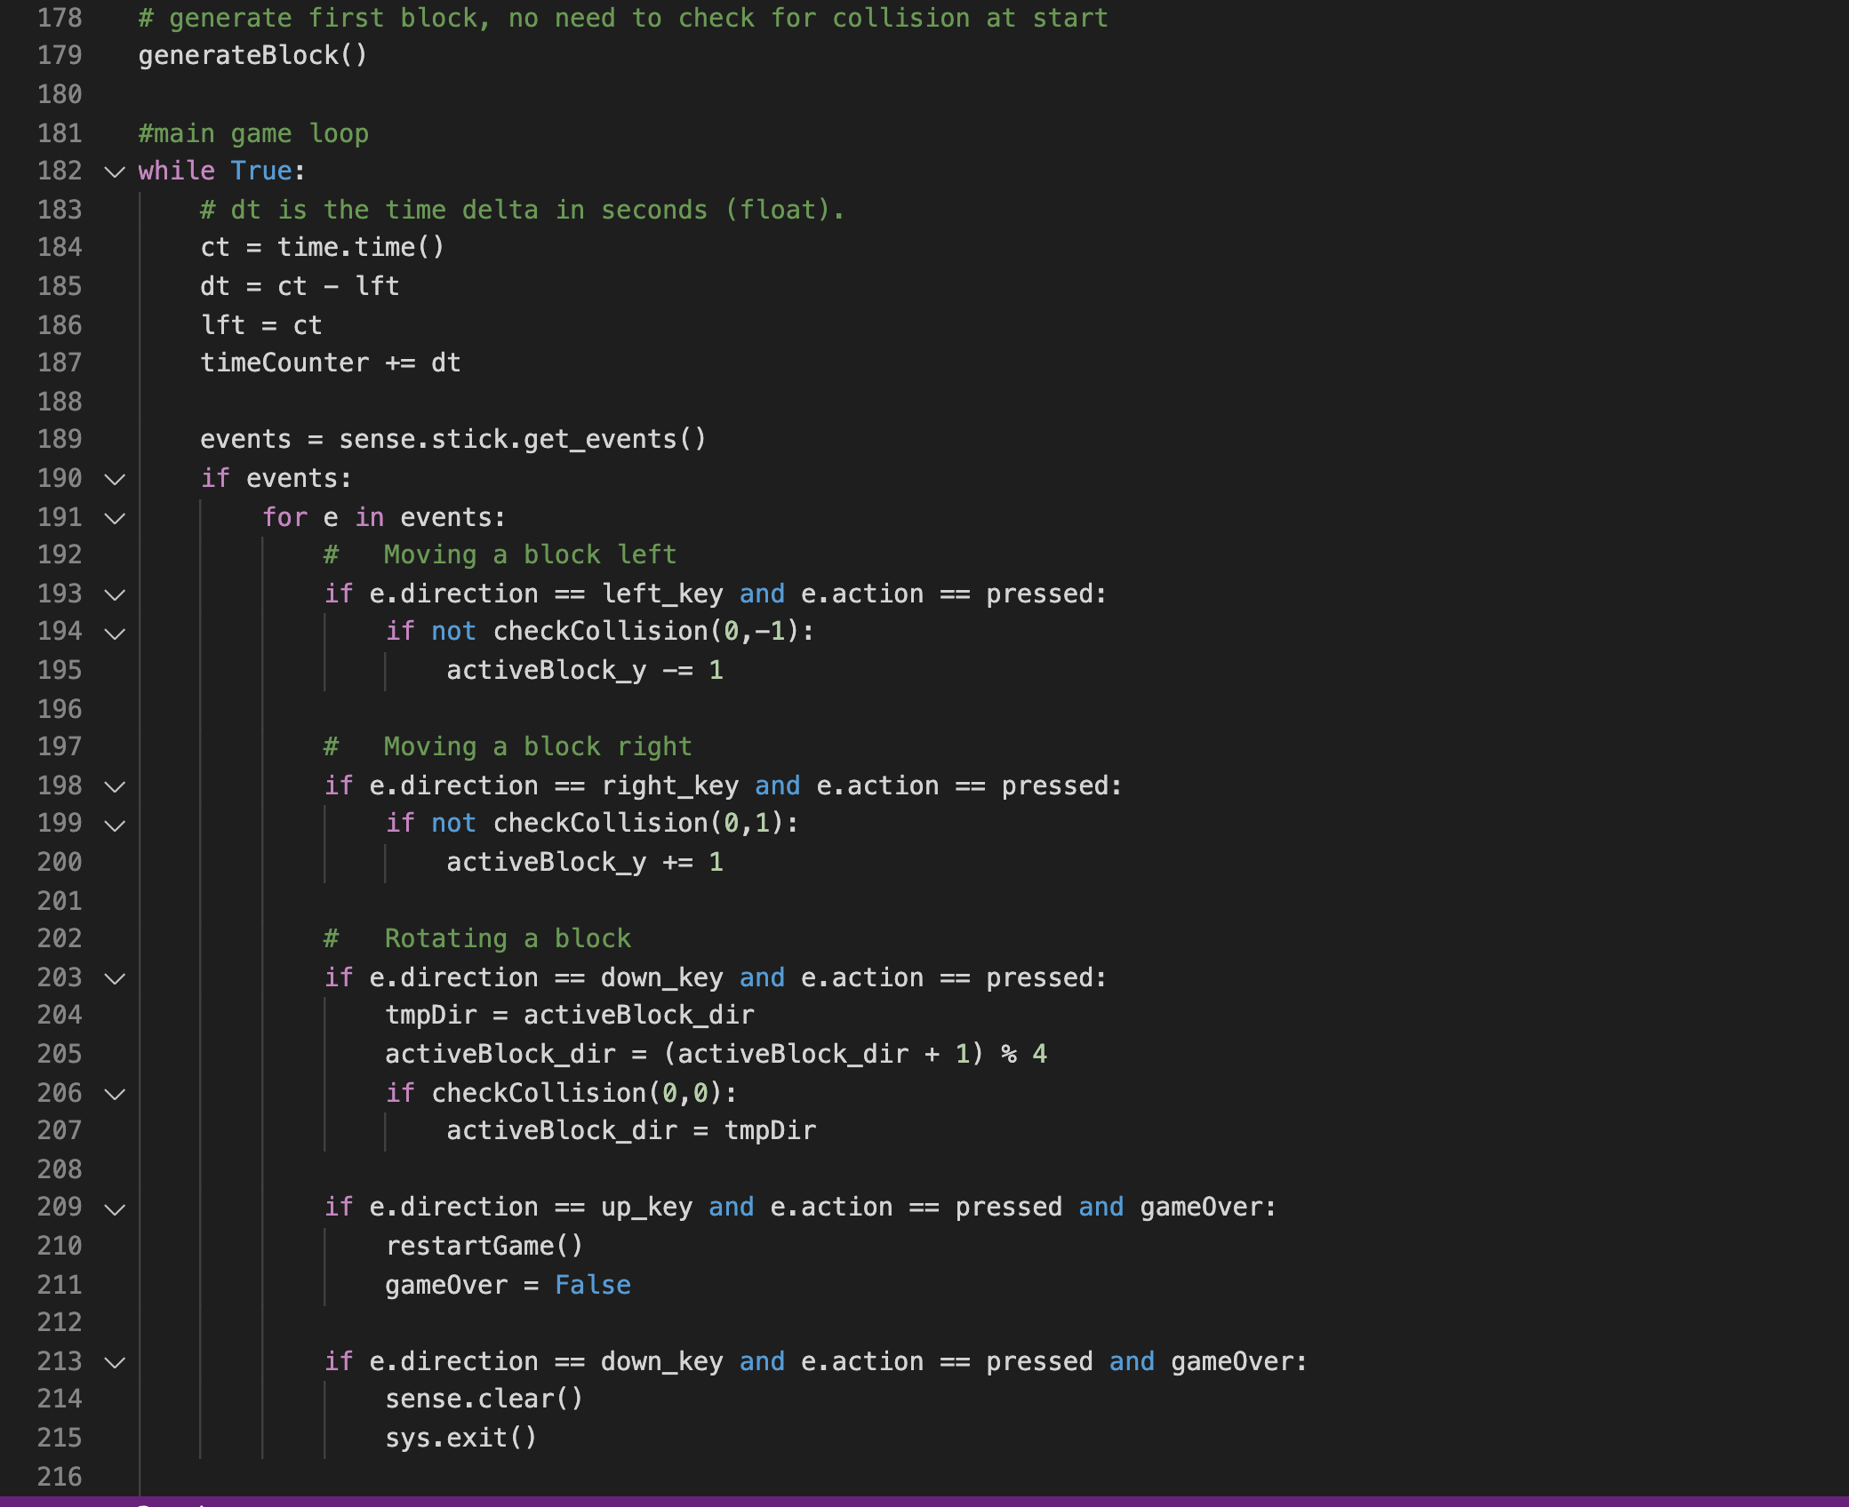

Slide 8
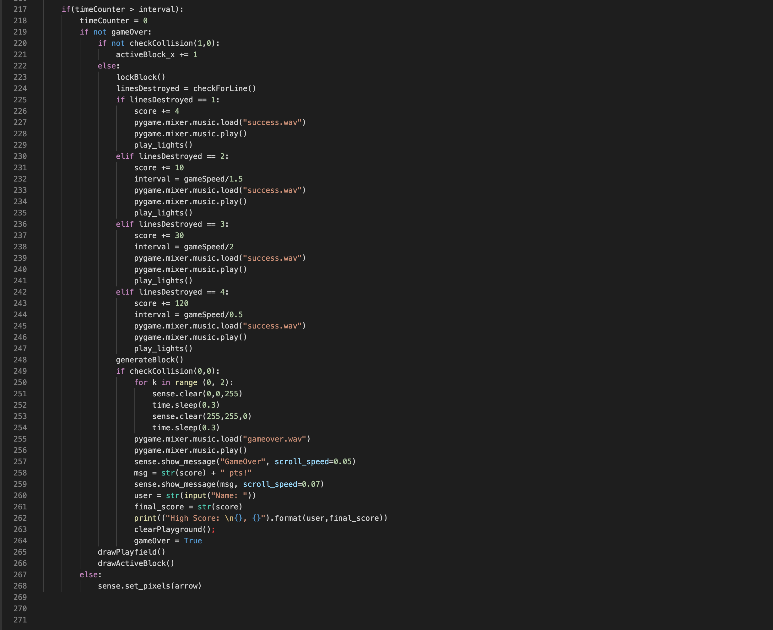

Slide 9
Goals from this Project
To learn more about using python towards creative projects
To display a visual for the Tetris game using a sense hat
To add in audio while the user is playing the game

Slide 10
Sources that helped us throughout our Project
https://www.youtube.com/watch?v=zfvxp7PgQ6c
https://levelup.gitconnected.com/writing-tetris-in-python-2a16bddb5318
https://github.com/tkupcewicz/sense-hat-tetris
https://dgkanatsios.com/2016/01/26/snake-and-tetris-like-games-with-sense-hat-on-a-raspberry-pi-2-loaded-with-windows-10/
https://github.com/AndrewCRichards/TetriPiSense

Slide 11
The URL to the GitHub
https://github.com/cmc1963/Final_Project-CSC102-
This repository is public

