Slide 1
Concession Analysis Analyzing the key drives behind service concessions
Cory McAboy
Notes:
Get SMART meaning
SBS project

Slide 2
Topics
Background Information
Project Overview
Concession Overview
Top Root Causes for Concessions
So What?

Slide 3
Topics
Background Information
Project Overview
Concession Overview
Top Root Causes for Concessions
So What?

Slide 4
Background information
Client Profile
The client is a large service call center (500+ EE’s) that serves a human resources software company (Payroll, Time, HR, etc) whose primary differentiation strategy centers around superior service.
Problem
The company spends ~60M year over year on “concessions.” Concessions are free handouts that are given to the client to help build goodwill and thus prevent churn. Examples include 1 month free payroll, free bundled upgrades, and discounts on future purchases.
Goal
Find the root cause behind concessions and provide a recommended action to lower concessions and increase client satisfaction.

Slide 5
Topics
Background Information
Project Overview
Concession Overview
Top Root Causes for Concessions
So What?

Slide 6
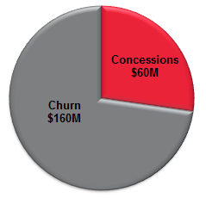
This project was launched to reduce client concessions and churn
Project Goal | Reduce Client Churn Reduce Client Concessions Proactive Model
Key Facts | Total Concession Opportunity: ~$60M YoY Total Churn Opportunity: ~$160M YoY ~46M rows of data
Challenges | Data is only 28 Months old 32 Different Sources of Data CRM data issues
Strategy | Gather hypotheses from interviews with key players Use data to find valid hypotheses Build business cases around root causes
Notes:
Understand causes of concession and leading indicators of churn so we can proactively reduce churn and concessions

Slide 7
Topics
Background Information
Project Overview
Concession Overview
Top Root Causes for Concessions
So What?

Slide 8
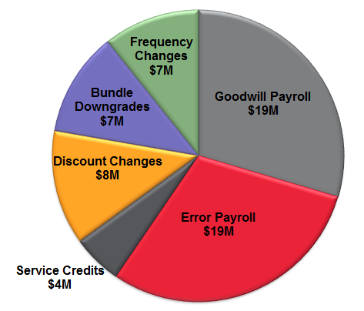
Concessions can be broken down into six different categories with Goodwill and Error payrolls being the most significant.
Total ~$60M YoY
Concession Types
Goodwill Payroll – Free payroll given due to client initiated error.
Error Payroll – Free payroll given due to company initiated error.
Service Credits – Refunds
Discount rate changes - % Discount given on customer’s monthly bill.
Revenue Leakages
Frequency changes – Customers pay based on payroll frequency. Customers can lower cost by choosing a decreasing payroll frequency.
Bundle downgrades – Downgrade to a smaller bundle
Notes:
Timeframe of data needs to be mentioned (Jan 2013 – April 2015)

Slide 9
Over 50 Interviews with stakeholders led to 38 Hypotheses that could be tested
Client Attribute | Sales | Client Start | Implementation | Service
Client Zip | Sales Associate Tenure/Office/Division | Hot Starts | # of & Types of Earnings | TLB
Client States | HR Bundle w/ <5 Pay Size | Last week of Month | State Applied-For | Price Increase
Client Tenure | Competitiveness | Jan & Feb Starts | State Jurisdiction | MMB
Clergy & Restaurant vs others | Direct vs Indirect | Last 2 Days of Month | Implementation Associate Tenure/Division/Office
Newly Formed business vs Wins from Competition | PC vs Tele |  | Local Jurisdiction
 | Referral Channel |  | 30-Day NPS Score
*Bolded items were most popular hypotheses
Notes:
Don’t talk about each individual one.
Additional hypotheses for Churn that are not represented here.
Strikethrough some w/ animation – These did not prove out during the analysis

Slide 10
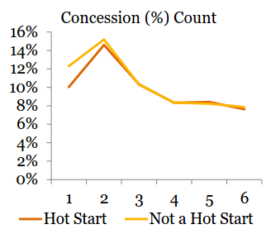
Surprisingly, competitive locations and client start dates were not significant drives in concessions.
Competition is not a factor for concessions
Client Start date is not a factor
Hot Starts
Last week of Fiscal Month
Last 2 days of Fiscal Month
% of Clients Claiming Concessions

Slide 11
Topics
Background Information
Project Overview
Concession Overview
Top Root Causes for Concessions
So What?

Slide 12
Concessions are mostly caused by the number of payroll jurisdictions (Fed, State, Local) customers were responsible for
 | Possible Explanation | Concession Impact | Revenue Leakage
State Jurisdiction | Adds complexity to the implementation process | $12.8M | $4.8M
Client State | Complex jurisdictions | $6.6M | $5.2M
Client Zip | Complex jurisdictions | $8.3M | $2.8M
Client Tenure | Client learning curve | $2.3M | $4.2M
Sales Division | Culture, complexity | $6.1M | -
Type of Deduction | Individual Associate Behavior | $2.9M | $1.2M
Notes:
Consider adding in Client Zip
Double check time period
Break down Concession vs Revenue Leakage

Slide 13
Telesales has the highest concession rate out of all sales divisions
*Telesales makes up ~$2.5M of concessions over 28 months or ~$1M YoY

Slide 14
The more payroll deductions a client has, the more concessions they receive
Top “Concession Causing” Deductions
Notes:
No volume data (if asked)

Slide 15
Clients appear to claim less concessions as they age, but survivorship bias could also play a role.
% of Clients Claiming Concessions &Total $ Concessions
Concession $ Amount
% of Clients Claiming Concessions
Client Tenure
Notes:
Explain bars vs line
Change line title to “Total $ amount YoY”

Slide 16
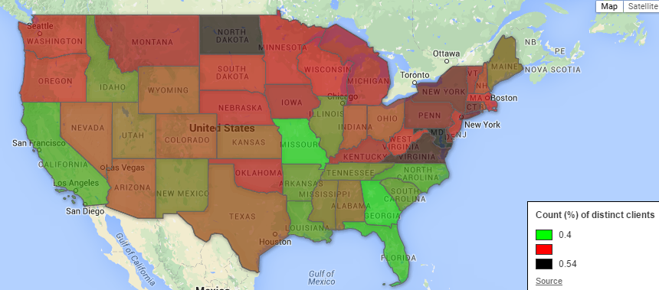
Concessions are very popular for northeastern states
Colors represent the % of clients claiming concessions
Notes:
Consider adding another slide with zoomed in on East Region

Slide 17
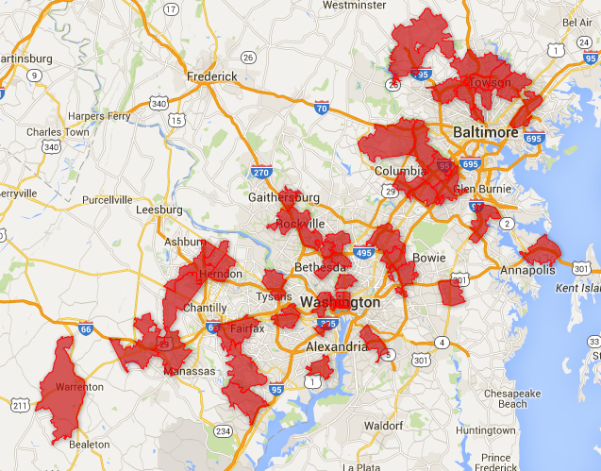
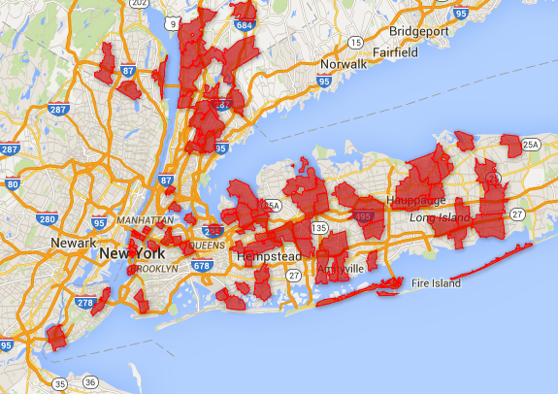
Top 10% of zip codes receive much higher concessions than the average
Greater DC Area
Greater NYC Area
*Minimum 50 clients in zip code
Notes:
Most of the top ten % of concession receiving Zip Codes reside in the greater NYC and Washington DC areas.

Slide 18
The more jurisdictions a customer is responsible for, the more concessions he or she is likely to claim.

Slide 19
Customers doing business in both NY/NJ and NJ/PA exhibit a very high percent in concessions relative to its peers
Jurisdictions by % of clients receiving concessions
*Minimum 500 clients in Jurisdiction
*Minimum $500,000 Concession $ amount in Jurisdiction
Notes:
These are sales regions, not service regions
What the %’s represent
Consider flipping largest to smallest

Slide 20
Topics
Background Information
Project Overview
Concession Overview
Top Root Causes for Concessions
So What?

Slide 21
Going forward, the first plan of action should be geared towards improving the state and local jurisdiction process.
There is potential for improvement, but how?
Potential Business Campaign | Cost | Level of Effort | Benefit
Intelligent Implementation Routing | Med | High | High
Knowledge Management Upgrade | Med | High | Med
State & Local Jurisdiction Audit | Lost | Low | Med
State & Local Jurisdiction Automation | Med | Med | High
Increased Sales Education | Low | Med | Med
Intelligent Service Call Routing | High | Low | ?^
Implementation Automation | High | High | High
Concession Safety for Low Competition | Low | Med | Med
^Can not know benefit until CRM data is analyzed
Notes:
Consider next step opportunities with chosen campaigns.

Slide 22
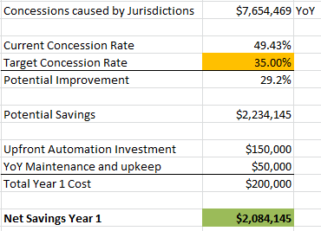
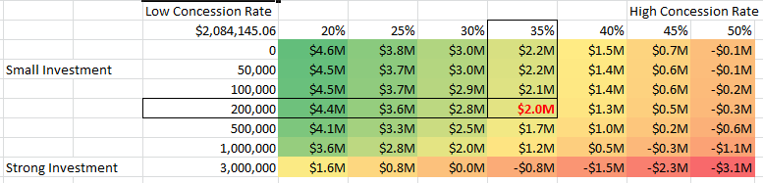
By automating the jurisdiction process, the client can save an estimated 2M just in the first year.
Example
Investment in Jurisdiction Automation
Benefits
Lower Concession Rates
Lower Implementation/Support time
Sensitivity Analysis – Year 1
Notes:
Fix formatting on dollars
5-10% is not realistic

Slide 23
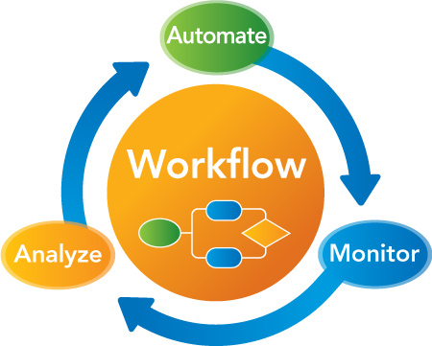
Ok great, How do I get started?
Next Steps
Appoint Project Champions
RUN Dev Lead
Julia Sobieski or Jurisdiction SME
Tech Arch Representative
Define Feature Requirements
Build Project Timeline
Risks
Errors in Automation
Learning Curve
Notes:
Fix formatting on dollars
5-10% is not realistic

Slide 24
Q&A
Notes:
Training on Jurisdiction Complexity
Semi-intelligent routing – Complex Jurisdictions get routed to more tenured associates

