Slide 1
Project SMART SBS Concession and Churn Analytics Project
Cory McAboy
Notes:
Get SMART meaning
SBS project

Slide 2


Cory McAboy
Emory University, Goizueta School of Business MBA Candidate 2016
Oklahoma State University
BS Computer Science, 2008
ADP Summer Internship
Role: Strategy
Location: Florham Park, NJ
Manager: John Hickey
Previous Experience
Cerner Corporation, Kansas City, MO
Technical Project Manager, 2013-2014
Technology Architect, 2011-2013
System Engineer, 2008-2011
Additional Information
Alumni Relations Chair – Goizueta Technology Club
Goizueta Consulting club – Member
Goizueta Entrepreneurship & VC Club - Member
Fun Facts
Traveled to Gulu, Uganda on a medical mission
Love to run, swim and play basketball
Huge Japanese anime fan
Favorite Reads
The Lean Startup
The Innovator’s Dilemma
Wikinomics
Notes:
Increase Font Size

Slide 3
Topics
SMART Project Overview
Concession Overview
Top Root Causes for Concessions
So What?
Wrap up

Slide 4
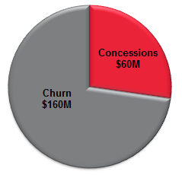
Project SMART Launched to Reduce Concessions and Churn
Project Goal | Reduce Client Churn Reduce Client Concessions Proactive Model
Key Facts | Total Concession Opportunity: ~$60M YoY Total Churn Opportunity: ~$160M YoY 46M rows of data
Challenges | Data is only 28 Months old 32 Different Sources of Data CRM data issues
Strategy | PricewaterhouseCoopers engaged Gather hypotheses from interviews with key players Use data to find valid hypotheses Build business cases around root causes
Notes:
Understand causes of concession and leading indicators of churn so we can proactively reduce churn and concessions

Slide 5
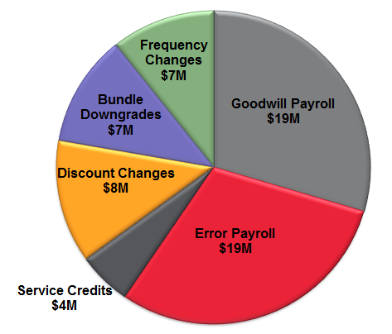
All Concessions are not the same
Total ~$60M YoY
Concession Types
Free payroll due to Goodwill
Free payroll due to Error
Service Credits
Discount rate changes
Revenue Leakages
Frequency changes
Bundle downgrades
Notes:
Timeframe of data needs to be mentioned (Jan 2013 – April 2015)

Slide 6
Interviews led to 38 Hypotheses that could be tested
Client Attribute | Sales | Client Start | Implementation | Service
Client Zip | Sales Associate Tenure/Office/Division | Hot Starts | # of & Types of Earnings | TLB
Client States | HR Bundle w/ <5 Pay Size | Last week of Month | State Applied-For | Price Increase
Client Tenure | Competitiveness | Jan & Feb Starts | State Jurisdiction | MMB
Clergy & Restaurant vs others | Direct vs Indirect | Last 2 Days of Month | Implementation Associate Tenure/Division/Office
Newly Formed business vs Wins from Competition | PC vs Tele |  | Local Jurisdiction
 | Referral Channel |  | 30-Day NPS Score
*Bolded items were most popular hypotheses
Notes:
Don’t talk about each individual one.
Additional hypotheses for Churn that are not represented here.
Strikethrough some w/ animation – These did not prove out during the analysis

Slide 7
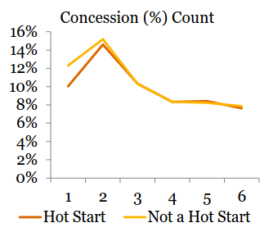
There were a few surprises…
Competition is not a factor for concessions
Client Start date is not a factor
Hot Starts
Last week of Fiscal Month
Last 2 days of Fiscal Month
% of Clients Claiming Concessions

Slide 8
Concessions are mostly caused by…
 | Possible Explanation | Concession Impact | Revenue Leakage
State Jurisdiction | Adds complexity to the implementation process | $12.8M | $4.8M
Client State | Complex jurisdictions | $6.6M | $5.2M
Client Zip | Complex jurisdictions | $8.3M | $2.8M
Client Tenure | Client learning curve | $2.3M | $4.2M
Sales Division | Culture, complexity | $6.1M | -
Type of Deduction | Individual Associate Behavior | $2.9M | $1.2M
Notes:
Consider adding in Client Zip
Double check time period
Break down Concession vs Revenue Leakage

Slide 9
Telesales has the highest concession rate out of all sales divisions
*Telesales makes up ~$2.5M of concessions over 28 months or ~$1M YoY

Slide 10
The More Deductions a Client Has, the More Concessions they receive
Top Concession Causing Deductions
Notes:
No volume data (if asked)

Slide 11
Clients Claim Less Concessions as They Age
% of Clients Claiming Concessions &Total $ Concessions
Concession $ Amount
% of Clients Claiming Concessions
Client Tenure
Notes:
Explain bars vs line
Change line title to “Total $ amount YoY”

Slide 12
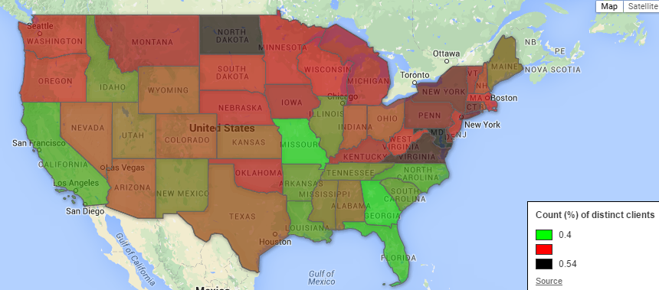
Concessions vary by State
Colors represent the % of clients claiming concessions
Notes:
Consider adding another slide with zoomed in on East Region

Slide 13
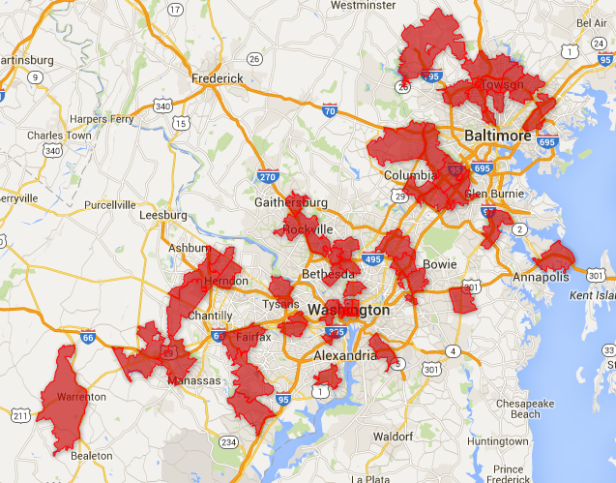
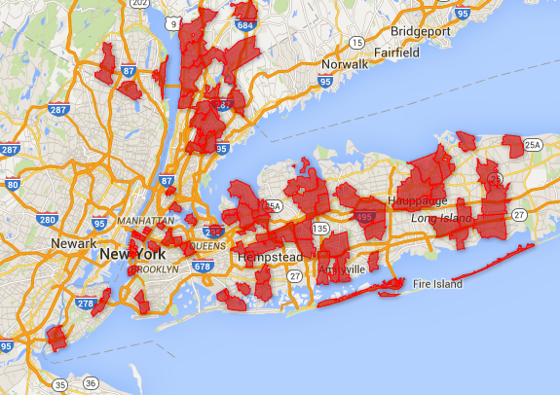
Top 10% of Zip Codes receive much higher concessions than the average
Greater DC Area
Greater NYC Area
*Minimum 50 clients in zip code
Notes:
Most of the top ten % of concession receiving Zip Codes reside in the greater NYC and Washington DC areas.

Slide 14
The More Jurisdictions, the More Concessions

Slide 15
State Jurisdictions to Focus on
Jurisdictions by % of clients receiving concessions
*Minimum 500 clients in Jurisdiction
*Minimum $500,000 Concession $ amount in Jurisdiction
Notes:
These are sales regions, not service regions
What the %’s represent
Consider flipping largest to smallest

Slide 16
So What?
There is potential for improvement, but how?
Potential Business Campaign | Cost | Level of Effort | Benefit
Intelligent Implementation Routing | Med | High | High
Knowledge Management Upgrade | Med | High | Med
State & Local Jurisdiction Audit | Lost | Low | Med
State & Local Jurisdiction Automation | Med | Med | High
Increased Sales Education | Low | Med | Med
Intelligent Service Call Routing | High | Low | ?^
Implementation Automation | High | High | High
Concession Safety for Low Competition | Low | Med | Med
^Can not know benefit until CRM data is analyzed
Notes:
Consider next step opportunities with chosen campaigns.

Slide 17
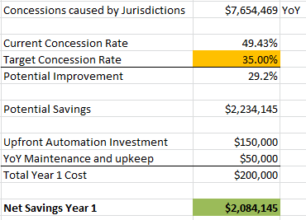
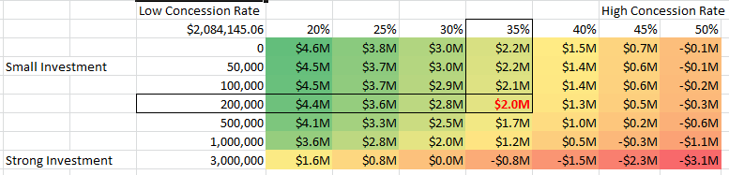
Let’s Improve the Jurisdiction Process
Example
Investment in Jurisdiction Automation
Benefits
Lower Concession Rates
Lower Implementation/Support time
Sensitivity Analysis – Year 1
Notes:
Fix formatting on dollars
5-10% is not realistic

Slide 18
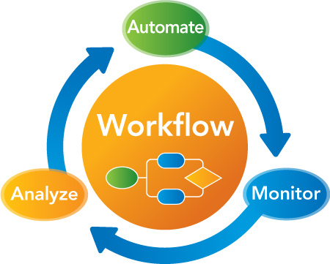
Ok great, How do I get started?
Next Steps
Appoint Project Champions
RUN Dev Lead
Julia Sobieski or Jurisdiction SME
Tech Arch Representative
Define Feature Requirements
Build Project Timeline
Risks
Errors in Automation
Learning Curve
Notes:
Fix formatting on dollars
5-10% is not realistic

Slide 19
Q&A
Notes:
Training on Jurisdiction Complexity
Semi-intelligent routing – Complex Jurisdictions get routed to more tenured associates

Slide 20
Appendix
Notes:
Training on Jurisdiction Complexity
Semi-intelligent routing – Complex Jurisdictions get routed to more tenured associates

Slide 21
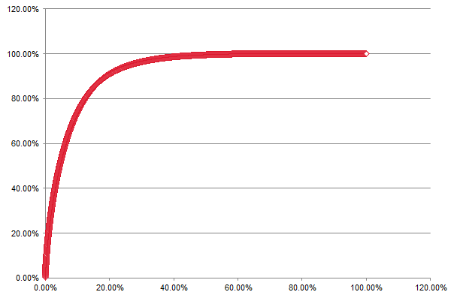
20% of our client zip codes account for 90% of overall concessions
~$64M
~90%
# of Zip Codes: 7565
Concession $: ~52M YoY
Concession $
Top 12 Zip Codes are in NY and make up ~$1.36M in concessions
High Concession $
Low Concession $
Zip Code Distribution
Notes:
Talk to Ahmer

Slide 22
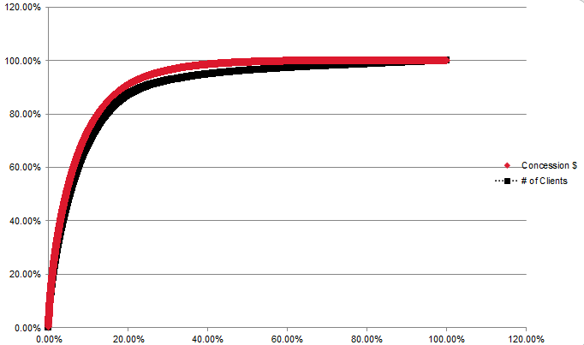
Zip Code – Concession $ vs # of Clients
Notes:
No volume data (if asked)

Slide 23
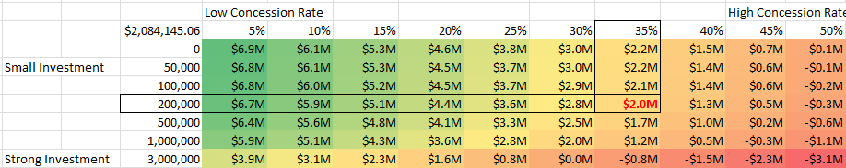
Expanded Sensitivity Analysis

