Slide 1
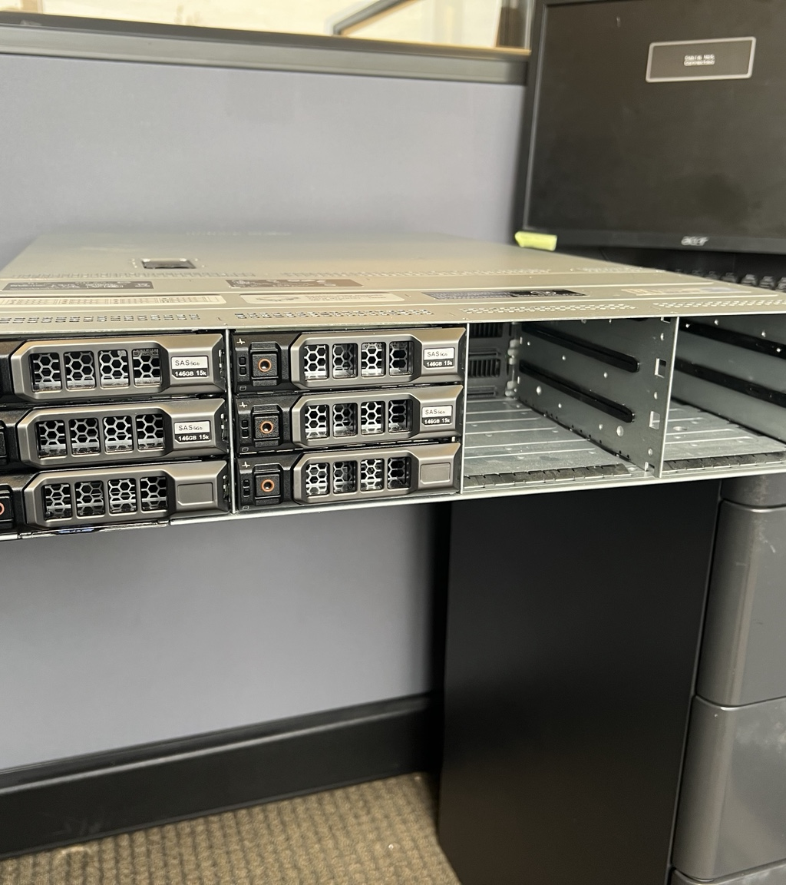
Dell PowerEdge R510
Hands-On Hardware
Inspection
Physical inspection, component identification, POST analysis, and fault assessment
Evidence captured during an on-site inspection
Manager briefing
Notes:
Evidence: evidence/01-server-front.jpeg. This presentation summarizes my direct physical inspection and the POST/BIOS evidence I captured.

Slide 2
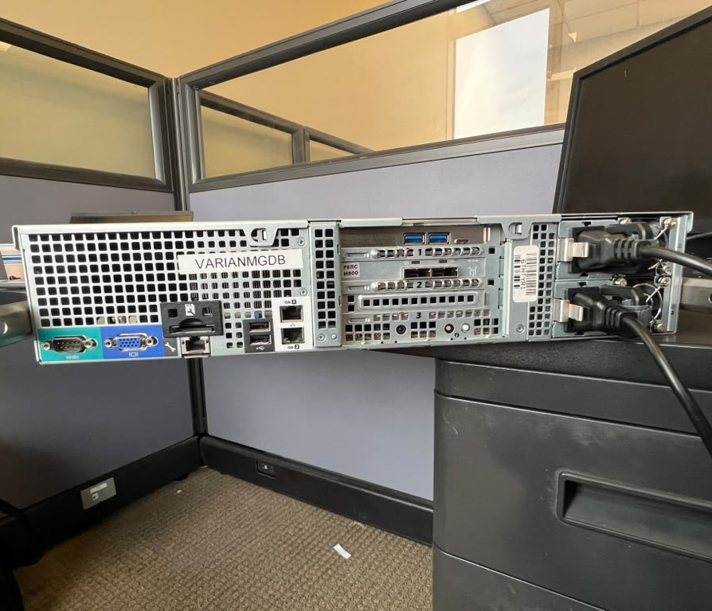
What I was asked to determine
A practical inspection, not a claimed repair
My objective
Identify the installed hardware and connections, capture the startup behavior, and define the most likely next diagnostic steps.
How I worked
I opened the chassis, handled removable parts, read the actual component labels, traced visible connections, and photographed POST and BIOS.
I did not initialize disks or change RAID settings.
Dell PowerEdge R510 inspection 02
Notes:
Evidence: evidence/11-rear-io.jpeg. The scope was visual inspection and startup capture only.

Slide 3
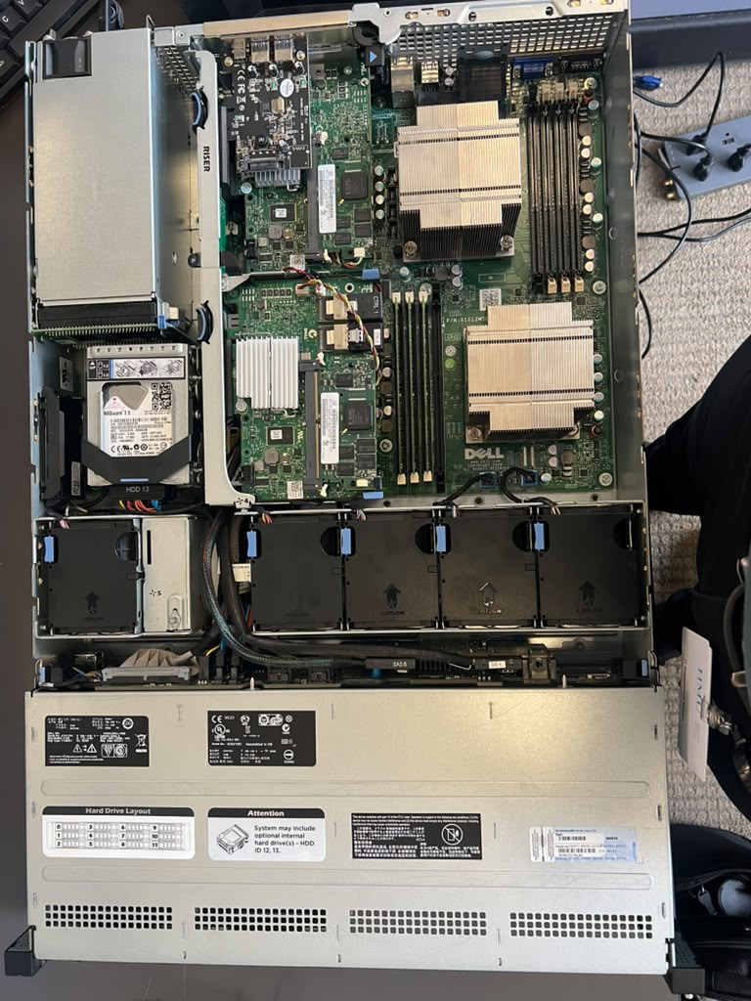
I opened the chassis and mapped the system
The wide view established the location of each major assembly
What I identified
Two processor sockets
Separate memory banks
Fan wall and airflow path
Internal and external RAID hardware
Two fixed internal SATA drives
Dual hot-swap power supplies
Physical condition
Moderate dust and normal wear. I saw no obvious burn damage or visibly swollen motherboard capacitors.
Dell PowerEdge R510 inspection 03
Notes:
Evidence: evidence/02-open-chassis.jpeg. Observations reflect a limited visual inspection, not an electrical test.

Slide 4
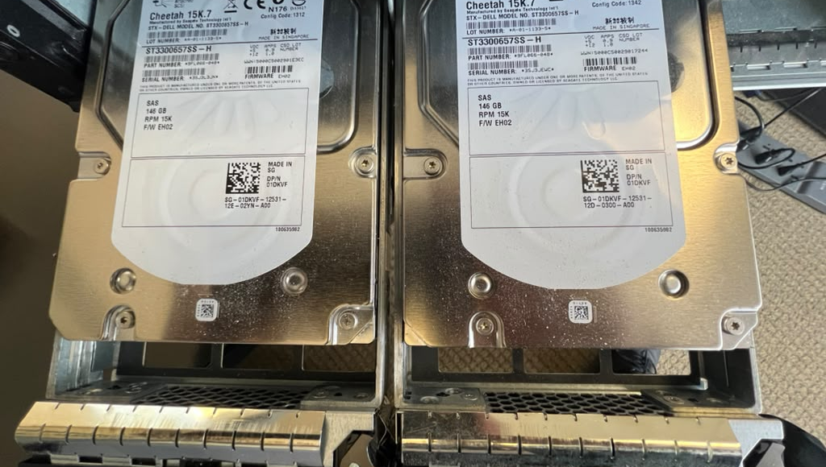
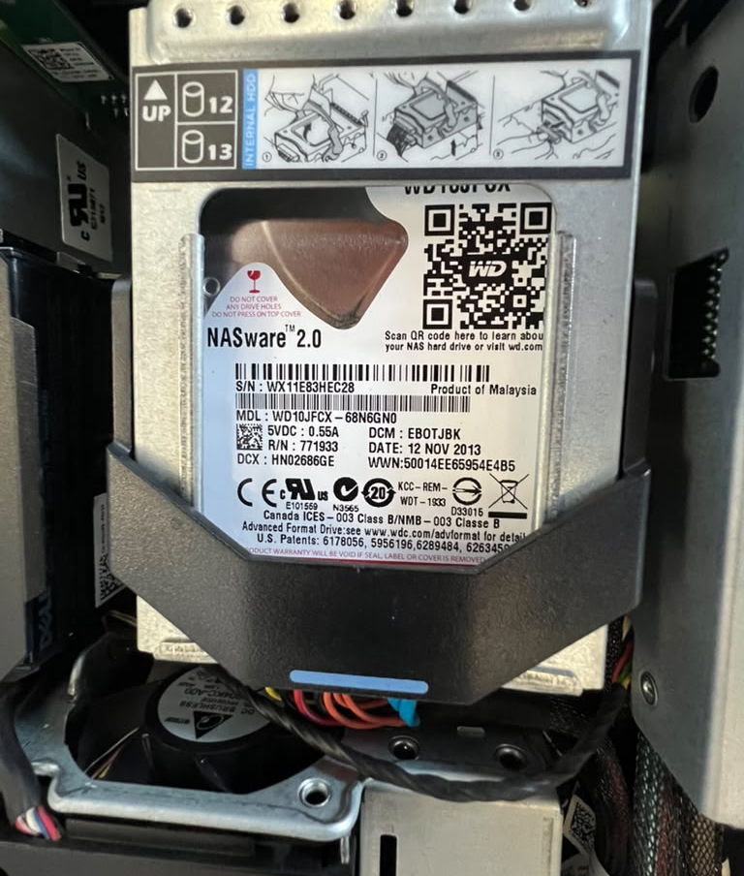
I removed and identified the storage devices
The disk labels, not the carrier labels, established the inventory
2.584 TB
label-reported raw capacity
Two visible front carriers were empty.
4 x 146 GB
2 x 1 TB
RAID level and disk health remain unknown.
Dell-labeled Seagate 15K SAS drives
WD Red SATA drives mounted internally
Dell PowerEdge R510 inspection 04
Notes:
Evidence: evidence/04-front-drive-labels.jpeg and evidence/05-internal-wd-red-drive.jpeg. Raw capacity does not equal usable RAID capacity.

Slide 5
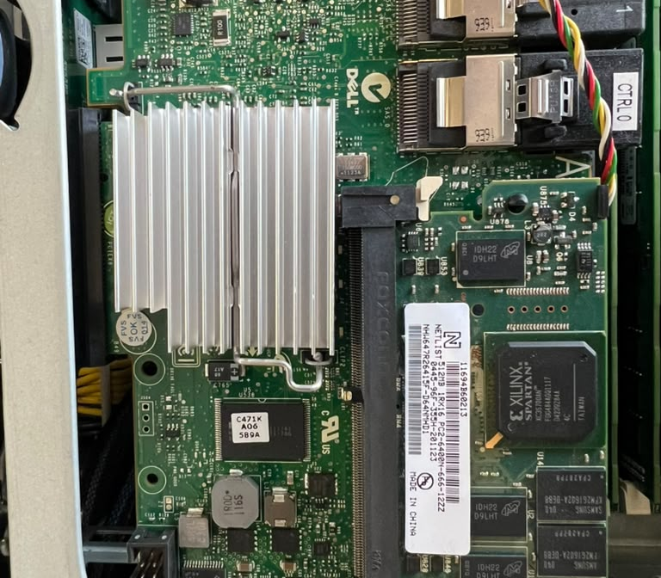
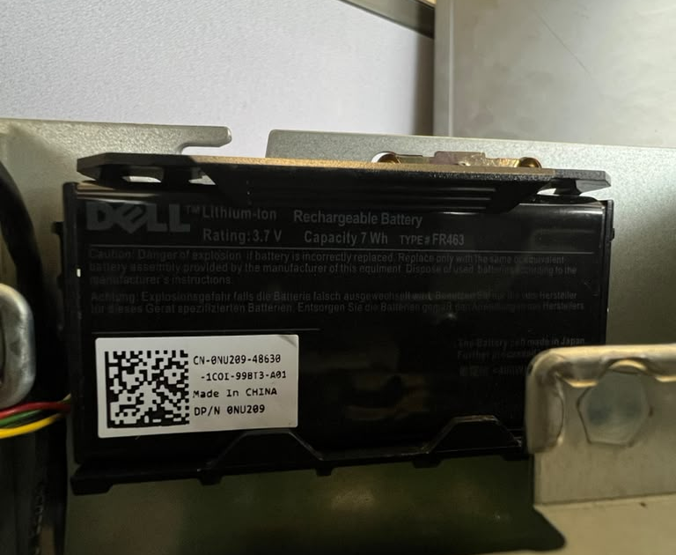
I inspected the RAID hardware and cache path
One physical condition became the main diagnostic lead
Observed
The cache or memory module closest to the power-supply area appeared visibly arched or mechanically stressed.
The battery was present. Its health was not tested.
Confirmed hardware
PERC H700 Integrated
PERC H800 reported by POST
Dell FR463 lithium-ion RAID battery
Dell PowerEdge R510 inspection 05
Notes:
Evidence: evidence/07-raid-controller-and-cache.jpeg and evidence/06-raid-battery.jpeg. The observed deformation is a diagnostic lead, not a confirmed root cause.

Slide 6
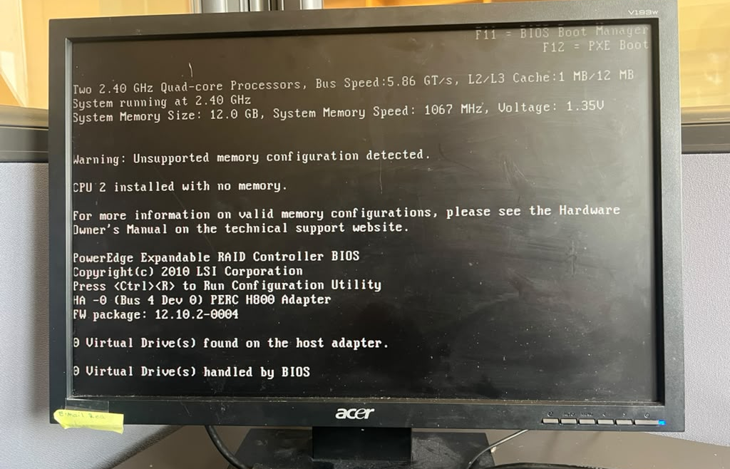
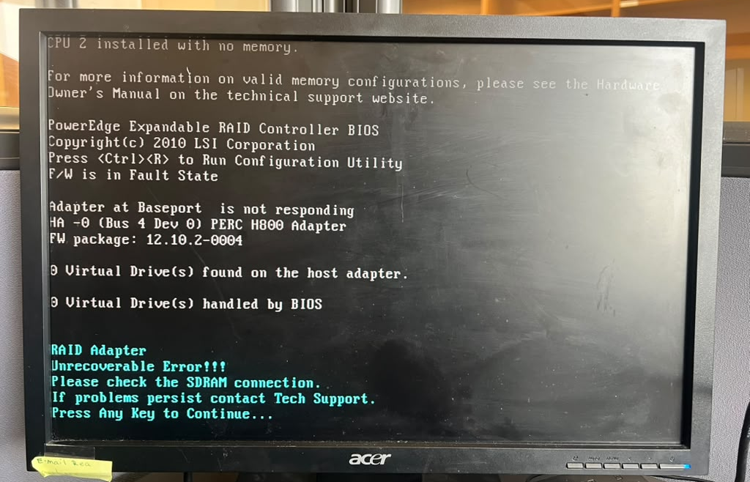
POST showed two separate configuration problems
The firmware messages match two areas I inspected physically
Memory topology
PERC H800
CPU2 installed with no memory
Firmware fault and SDRAM connection error
Dell PowerEdge R510 inspection 06
Notes:
Evidence: evidence/09-post-memory-warning.jpeg and evidence/10-post-raid-error.jpeg. POST also reported zero virtual drives on the H800.

Slide 7
How I connected the evidence without overclaiming
Observation and error point to the same subsystem, but the cause still needs testing
1
2
3
4
POST evidence
Physical evidence
Working hypothesis
Required proof
H800 reports a firmware fault and instructs the operator to check the SDRAM connection.
A RAID cache or memory module appeared bowed near the power-supply area.
The cache module, connector, or controller deserves priority during the next inspection.
Identify the exact adapter, inspect the connector, reseat safely, and compare the next POST result.
Current conclusion: strong diagnostic lead, unconfirmed root cause.
Dell PowerEdge R510 inspection 07
Notes:
This slide separates confirmed POST output, direct observation, hypothesis, and the test required to confirm or reject the hypothesis.

Slide 8
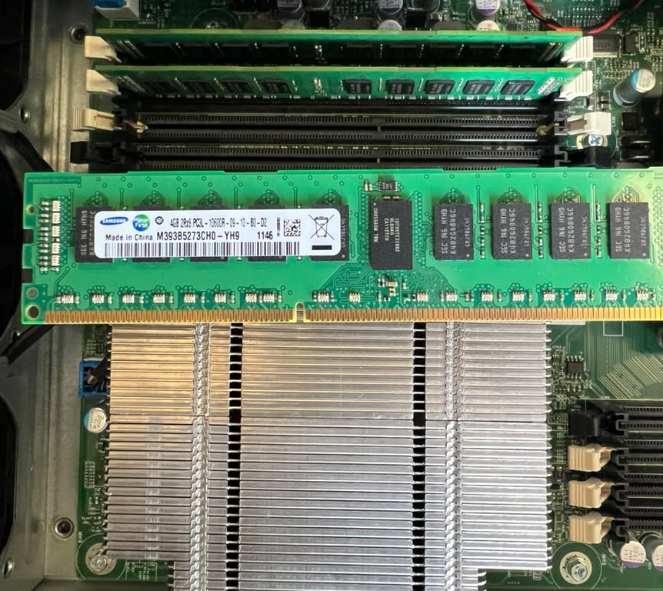
Other findings affect service readiness
The server starts, but several conditions remain unresolved
Unsupported memory layout
Three 4 GB DIMMs were installed in the CPU1 bank. CPU2 had no local memory.
No verified boot volume
POST did not find a bootable device. The available evidence does not establish whether the cause is the RAID fault, missing media, or boot configuration.
Unknown component health
Drive health, RAID membership, and battery condition were not tested.
Dell PowerEdge R510 inspection 08
Notes:
Evidence: evidence/08-memory-module.jpeg plus POST photographs. The visible memory layout matches the POST warning.

Slide 9
My next diagnostic sequence
This order protects the hardware and avoids destructive RAID changes
01
Power down and document
Disconnect both supplies, use ESD protection, and record every connection before moving hardware.
02
Inspect the H800 cache path
Match the physical adapter to POST, then inspect the module, socket, clips, and battery cable.
03
Repeat POST after one controlled change
Record whether the SDRAM and firmware errors change after safe reseating.
04
Capture RAID state without modifying it
Open both PERC utilities and document disks, virtual disks, and any foreign configuration.
05
Correct memory and run diagnostics
Use a supported two-processor DIMM layout, then run Dell hardware tests and review logs.
Do not initialize disks, clear foreign configurations, or create arrays until the existing data risk is understood.
Dell PowerEdge R510 inspection 09
Notes:
The sequence prioritizes non-destructive inspection and evidence capture before configuration changes.

Slide 10
What this project demonstrates
Hands-on work
Technical judgment
I opened the server, handled components, read physical labels, traced connections, and captured the startup evidence.
I separated confirmed findings from hypotheses and protected the existing storage configuration from unnecessary changes.
Responsible AI use
AI helped organize the notes, check terminology, and structure the documentation. The inspection, observations, and photographs came from my work with the server.
Detailed evidence and the full report are included in the GitHub repository.
Notes:
Closing statement. The repository README is the primary project narrative, with this deck and the report as supporting material.

