Slide 1
Nose
Mouth
Left Eye
Right

Slide 3
9 Feature Input
14 Hidden Units w/ ReLU
6 Unit Output
Softmax

Slide 4
Input
Sequence
Convolutional Filter
5 Hidden Unit Layer/ ReLU
Single Output unit/ Sigmoid

Slide 5
Input
Sequence
Convolutional Filter
10 Hidden Unit Layer/ ReLU
Single Output unit/ Sigmoid

Slide 6
Encoder
Decoder

Slide 7
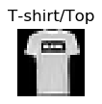










Slide 8
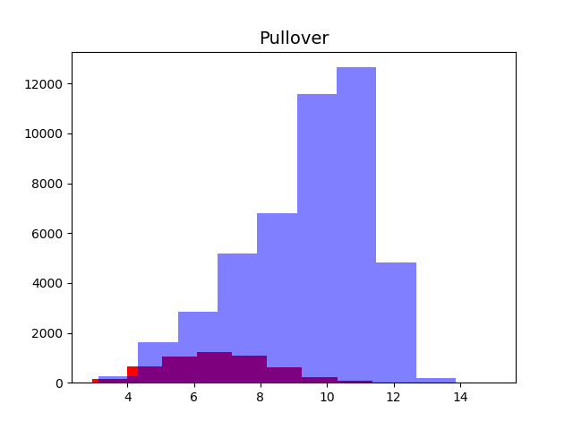
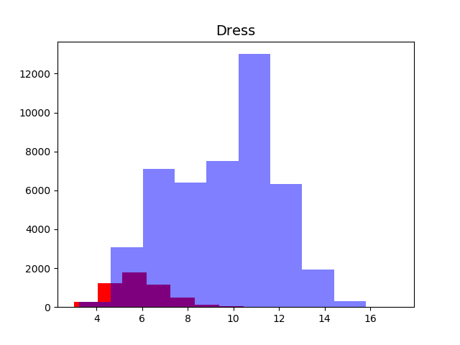
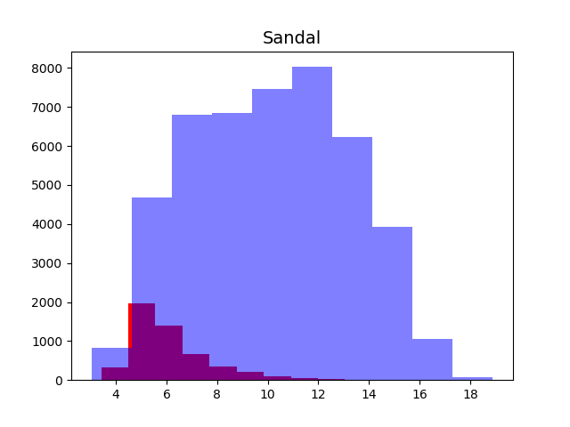
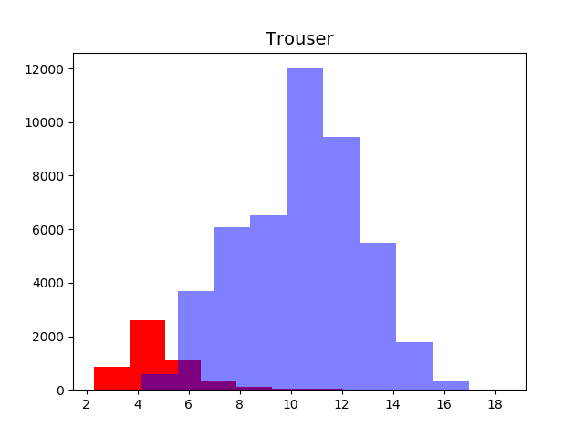

Slide 9
