Slide 1
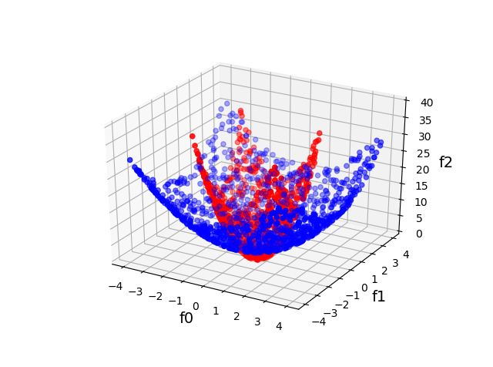
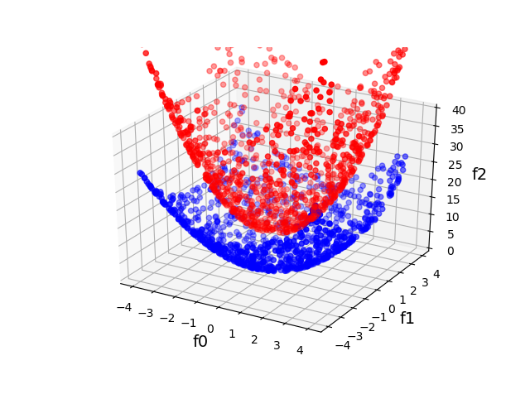

Slide 2
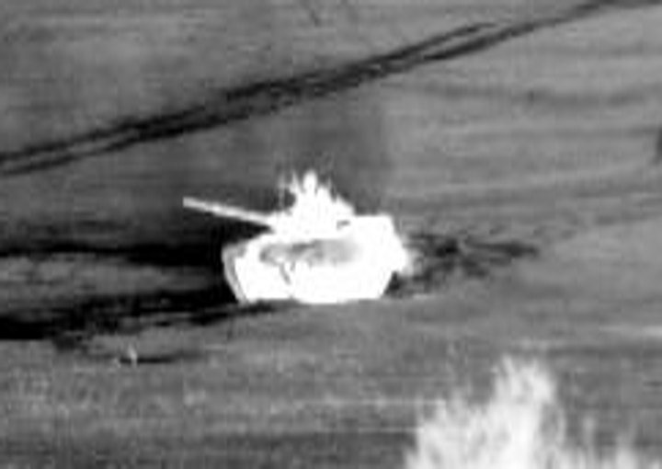
Target

Slide 3
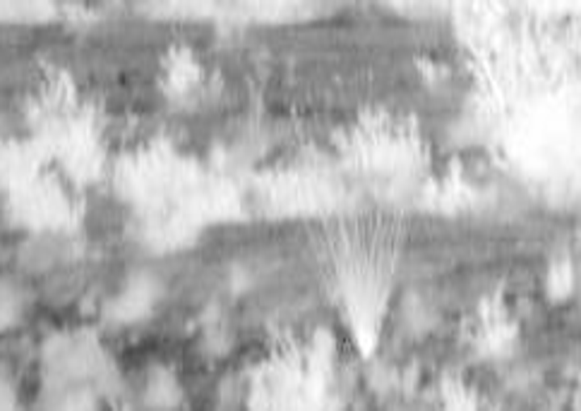
Background

Slide 4
-
-
-
-
-
-
-
-
-
Negative Bags
+
-
-
-
+
-
-
-
+
+
+
+
-
-
+
+
-
Positive Bags
-
-
+
+
+
-

