Slide 1
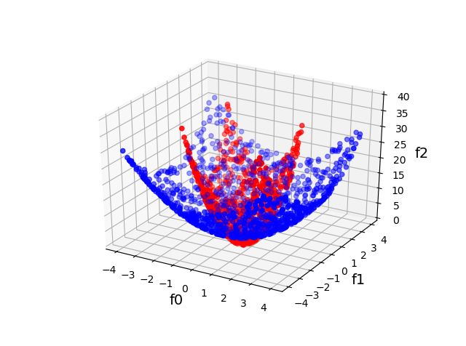
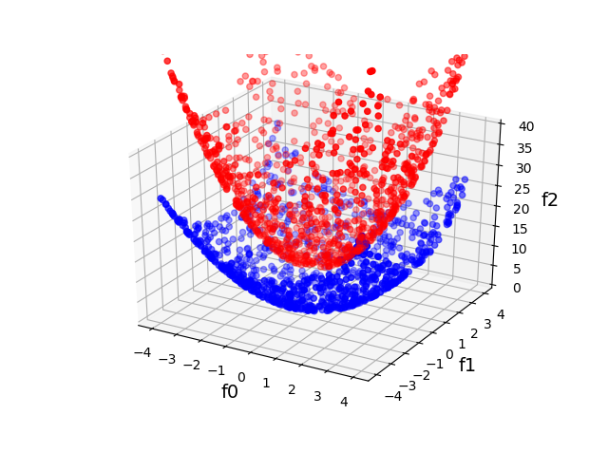

Slide 2
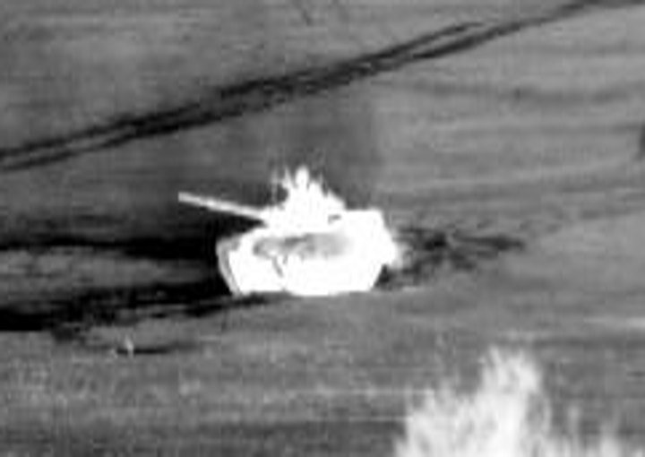
Target

Slide 3
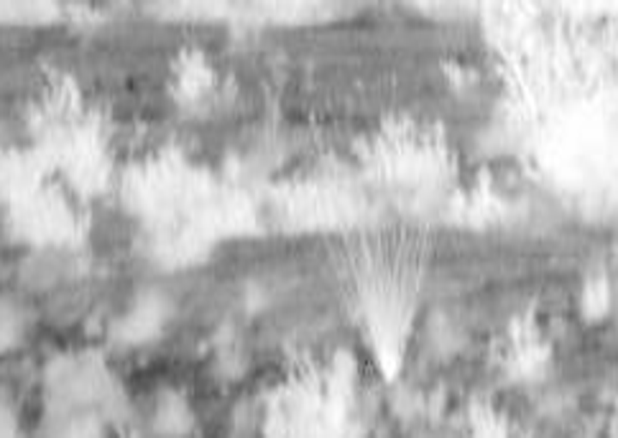
Background

Slide 4
-
-
-
-
-
-
-
-
-
Negative Bags
+
-
-
-
+
-
-
-
+
+
+
+
-
-
+
+
-
Positive Bags
-
-
+
+
+
-

Slide 5
+
+
+
+
+
+
+
+
+
+
Instance-Space (Standard) Classification
+
+
+
+
+
+
-
-
-
-
-
-
-
-
-
-
-
-
-
-
-
-
-
-
+
+
+
+
+
+
+
+
+
+
+
+
+
+
+
+
+
+
Bag-Space
Classification
-
-
-
-
-
-
-
-
-
-
-
-
-
-
-
-
-
-
-
-
+
+
+
+
+
+
+
Embedded-Space
Classification
+
+
+
+
-
-
-
-
-
-
-
+
-
-
-
-
-

Slide 6
+
+
+
+
+
+
+
+
+
+
Instance-Space (Standard) Classification
+
+
+
+
+
+
-
-
-
-
-
-
-
-
-
-
-
-
-
-
-
-
-
-
+
+
+
+
+
+
+
+
+
+
+
+
+
+
+
+
+
+
Bag-Space
Classification
-
-
-
-
-
-
-
-
-
-
-
-
-
-
-
-
-
-
-
-
+
+
+
+
+
+
+
Embedded-Space
Classification
+
+
+
+
-
-
-
-
-
-
-
+
-
-
-
-
-

Slide 7
+
+
+
+
+
+
+
+
+
+
Instance-Space (Standard) Classification
+
+
+
+
+
+
-
-
-
-
-
-
-
-
-
-
-
-
-
-
-
-
-
-
+
+
+
+
+
+
+
+
+
+
+
Bag-Space
Classification
+
+
+
+
+
+
+
-
-
-
-
-
-
-
-
-
-
-
-
-
-
-
-
-
-
-
-
+
+
+
+
+
+
+
Embedded-Space
Classification
+
+
+
+
-
-
-
-
-
-
-
+
-
-
-
-
-

Slide 8
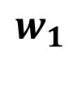
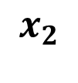
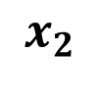
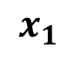
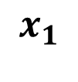

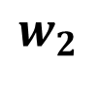

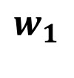

$$x_{2}$$
$$x_{2}$$
$$w_{1}$$
$$w_{1}$$
$$w_{2}$$
$$0$$
$$(0,0)$$
$$x_{1}$$
$$0$$
$$x_{1}$$

Slide 9
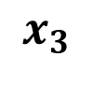

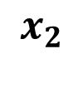

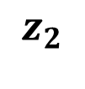
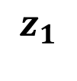
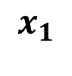
$$ℝ^{3}$$
$$z_{2}$$
$$ℝ^{2}$$
$$x_{3}$$
$$x_{2}$$
$$z_{1}$$
$$x_{1}$$

