Slide 1
STAT HAWKS
Ethan Murra
Cade McDonald

Slide 2
Overview
01
02
Data Selection
Data Cleaning & Modeling
03
04
Results
Questions

Slide 3
Data Selection
Datasets
Response
Modeling Assumptions
Reliability and practicality of variables.
HEQ010
Questionnaire data on if a person has ever been diagnosed with HepB
Linearity
Independence
No multicollinearity

Slide 4
Datasets Selected 2015-2020
Demographics
Hepatitis & Weight
Immunization
The Demographics Data helps model the Hep B risk for different portions of the population.
Contains an indicator of HepB for persons in the dataset. Gives a value to model risk profiles around.
Further information that is relevant in a person contracting HepB.

Slide 5
Variables Selected
Quantitative
Qualitative
Poverty Income Ratio
Height
Weight
Age
Gender
Race
Education

Slide 6
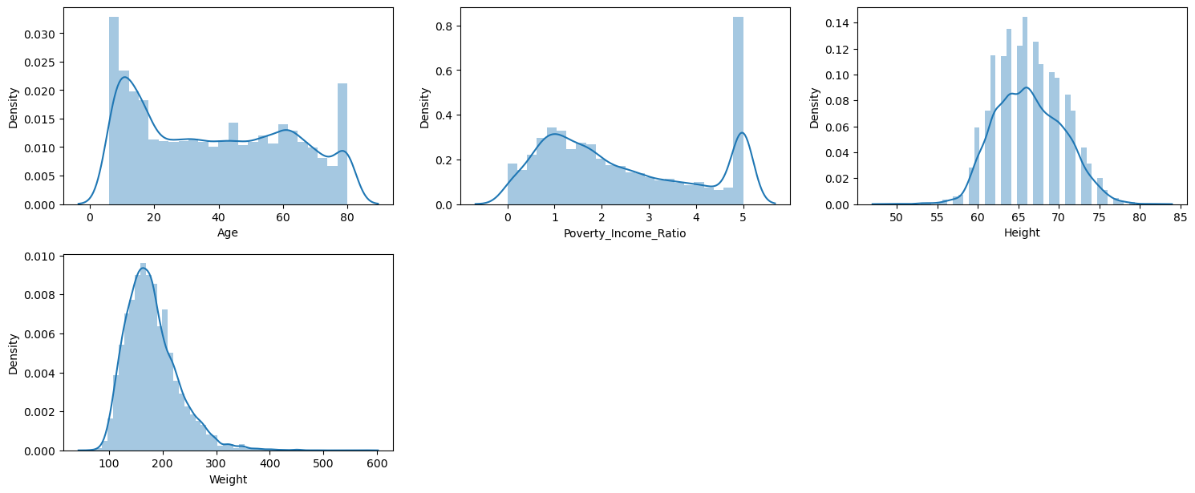
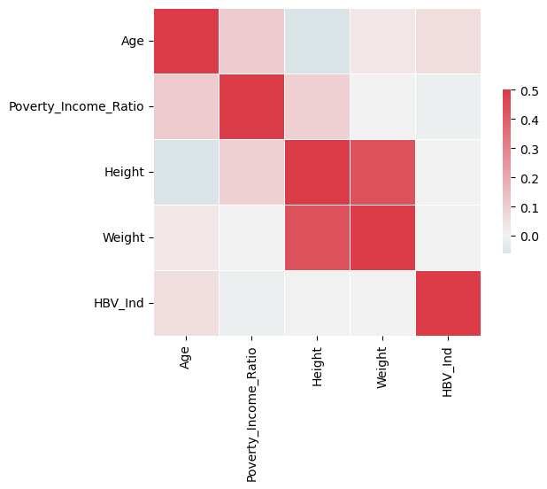
Data Visualization

Slide 7
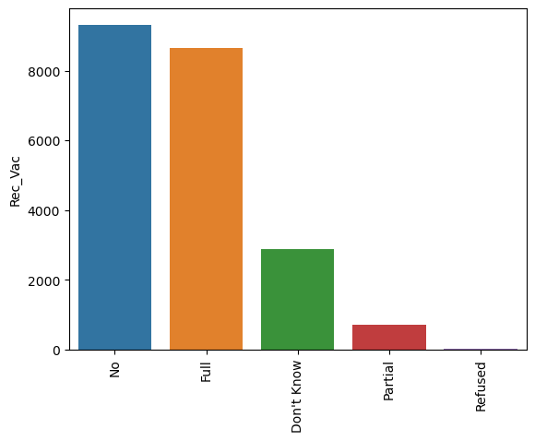
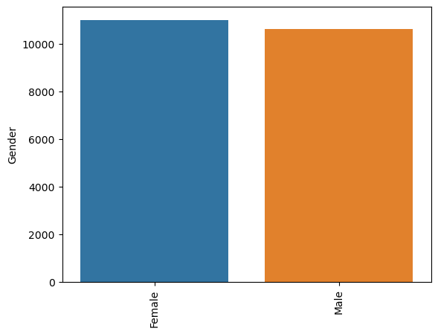
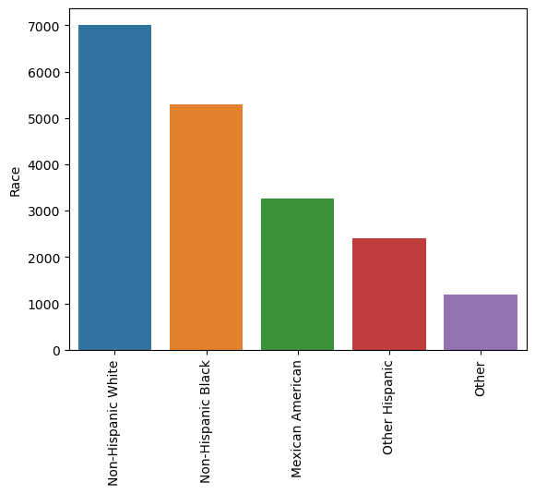
Data Visualization

Slide 8
Data Cleaning & Modeling
Model Selection
Evaluate model performance through various metrics.
Modeling Attempts
Utilize logistic regression and a random forest to build a predictive models for HBV
Data Cleaning
Implement strategies such as mean imputation to handle missing values.
Assessing the Problem
Identify key challenges, including consideration of missing data, variable reliability, and ethical data collection.

Slide 9
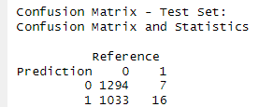
Model Performance
Specificity: .70
Sensitivity: .54
Threshold: 1% chance of HBV
Notes:
Confusion Matrix and Statistics
Reference
Prediction 0 1
0 21876 76
1 10106 198
Accuracy : 0.6843
95% CI : (0.6792, 0.6894)
No Information Rate : 0.9915
P-Value [Acc > NIR] : 1
Kappa : 0.0212
Mcnemar's Test P-Value : <2e-16
Sensitivity : 0.68401
Specificity : 0.72263

Slide 10
Questions
Ethan Murra
Cade McDonald
StatHawks

