Slide 1
Portfolio Website
Alex Chappel

Slide 2
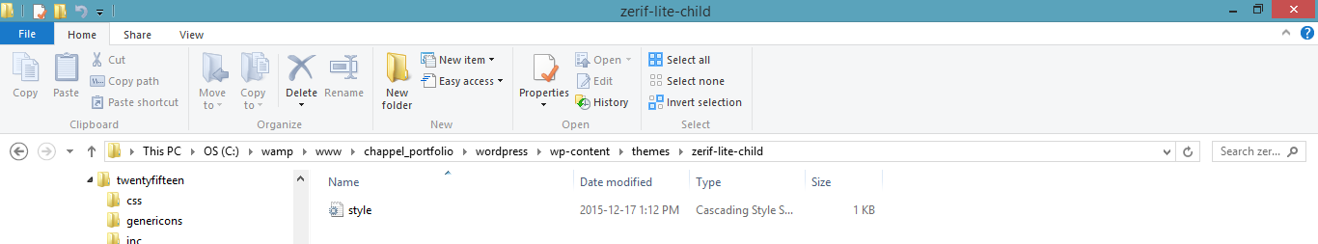
Path

Slide 3
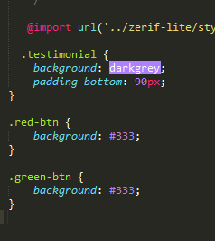




Style Tile
I only changed two buttons to black and a yellow background from the testimonial section to black. I didn’t change the fonts. I also changed some icons
buttons: #000000
dark grey: #a9a9a9
Logo

