Slide 1

CSS
Mark Zhang

Slide 2
What is CSS?
CSS allows you to style HTML elements, or define how they are displayed.
Examples:
  Changing the color of text
  Specifying the size and position of a div

Slide 3
What is CSS?
CSS is an alternative to the “style” attribute.
  <div style=“height:500px; width:200px”></div>
Advantages:
  Can control the style of many different elements with a single command.
  Separation of function: HTML can focus on content while CSS handles styling.

Slide 4
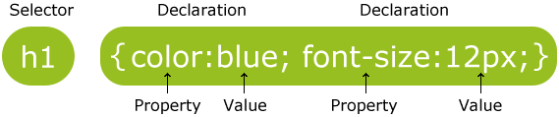
Selectors and Properties
Source: w3schools.com

Slide 5
Inserting CSS
External Style Sheet
Internal Style Sheet
Inline Style

Slide 6
Precedence
Browser default [Lowest]
External style sheet
Internal style sheet
Inline style [Highest]
  *If a link to an external style sheet is placed after an internal style sheet, the external will take precedence!

Slide 7
Precedence
If two rules otherwise have equal precedence, the last one declared wins.
The more specific rule has precedence.
  “p #paragraph_1” has precedence over “p”
  Sometimes this can be confusing:
    div p.bio {font-size: 14px}
    #sidebar p {font-size: 12px}
  Details here: http://www.vanseodesign.com/css/css-specificity-inheritance-cascaade/

Slide 8
Precedence Summary
The more specific rule wins (according to a well-defined set of specificity rules)
If two rules have equal specificity, the one that comes last wins.

Slide 9
Overriding Precedence
Use !important
It’s a hack, so use it sparingly.
Example:
P
{
  Color:blue;
  Background-color:green!important;
}

Slide 10
Page Layout with CSS

Slide 11
Box Model
Pretty much every HTML element can be thought of as a box, with a width and a height.
To get a desired page layout, you must carefully specify the width and height of each element.
Margins, padding, and borders are also important.
You must understand the box model to correctly specify your dimensions.

Slide 12
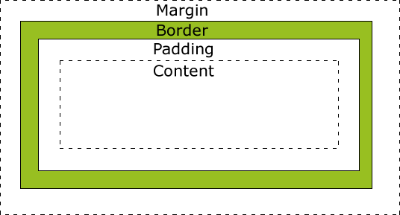
Box Model
Source: w3schools.com

Slide 13
Computing Box Dimensions
“width” and “height” of an element refers to the content. If you have margins, padding, etc. those also add to the dimensions of the box.
  To compute the box dimension, make sure to account for the margins, etc. on both sides (e.g. both left and right margin)
This is important because it is the entire box, and not merely the content, that takes space on the page.

Slide 14
Ways to Specify Size in CSS
Pixels (px)
Pt (1/72 inch) i.e. 12 pt font
mm, cm, in
em, ex (for font)
Percent % (usually of the browser window dimension)

Slide 15
Positioning
Uses the “position” property, i.e. position: static
Default is static.
Fixed – a fixed position in the browser window
Relative – relative to its normal static position
Absolute – placed in a spot on the page regardless of what else is there.
  Location is specified relative to first non-statically positioned parent.
  (If A is nested within B, B is the parent of A)

Slide 16
Positioning Helper Attributes
top, left, right, bottom properties allow you to specify location of an element.
  Has a different meaning under each type of positioning.
the z-index property allows to specify which element will be on top if two elements overlap
  The element with greater z-index will be on top.
  z-index only works if both elements have non-static positioning.

Slide 17
Normal Flow of the Page
Statically-positioned elements are positioned according to the “normal flow of the page”
Elements in the normal flow obey certain rules:
  Block elements – always take up the full width available, with newlines before and after
    div, h1, p, ul, table, etc.
  Inline elements – only take as much width as needed and do not force new lines
    Span, a, img, etc.

Slide 18
Display Property
Affects how an element is displayed
none – removes element from page. Other elements as positioned as if element doesn’t exist.
block – element is treated as a block element.
inline – element is treated as an inline element. You cannot specify width and height for inline elements.
inline-block– element only takes up available width and doesn’t force newlines, but you can specify width, height, margins, etc.
  Another way to get block elements to go side by side.

Slide 19
Float
Informally:
  Setting the float property on an element to “float: left” or “float: right” will take it out of the normal flow of the page, pushing it to the left or right of the containing element (or against another floated element).
  Block elements will ignore it.
  Inline elements will wrap around it.
One use for float is to allow text in a paragraph to wrap around an image.

Slide 20
Float
It is the common way to get block elements to sit side-by-side.
Specifics:
  A left-floated box will float to the left until it touches either the edge of the parent element, or the edge of another floated box
  If the size of the floated box exceeds the available horizontal space, the floated box will be shifted down

Slide 21
Clearing Floated Elements
If you don’t want an element to ignore floated elements, use the clear property.
This will prevent elements from floating to the left or the right of the cleared element. This is done by placing new-lines between the cleared and floated elements.

Slide 22
Page Layout Review
We’ve talked about:
  The Box Model and Element Dimensions
  The Position Property
    With top, bottom, left, and right
  The Display Property
  The Float Property
    With clear

Slide 23
Styling Various Elements

Slide 24
Background
You can style the background of anything that takes up space on the page
  <body> (the entire page)
  <div>
  <p>, <h1>, etc

Slide 25
Background CSS Properties
background-color
background-image
Background-repeat
  repeat (default), repeat-x, repeat-y, no-repeat
Background-attachment
  fixed or scroll (default)
Background-position

Slide 26
Color
Defined color names
  color: blue
  http://www.w3schools.com/cssref/css_colornames.asp
Hex-values
  color: #0000ff
rgb-values
  color: rgb(255, 0, 0)

Slide 27
Text CSS Properties
color
text-align
  center, right, justify
text-decoration
  Hyperlinks are decorated by default. Set to “none” to remove underline.
text-transform, text-indent, letter-spacing, line-height, etc.

Slide 28
Font CSS Properties
font-family
  controls the font in an element
  font-family:"Times New Roman", Times, serif;
  SANS-SERIF, SERIF, Monospace
font-size
  commonly in px, em, pt
font-style (italics), font-weight(thickness),

Slide 29
Hyperlinks
Link states:
  a:link - a normal, unvisited link
  a:visited - a link the user has visited
  a:hover - a link when the user mouses over it
  a:active - a link the moment it is clicked
Example:
  a:link {…}
  a#my_id:hover {…}
The link states must be defined in this order.

Slide 30
Pseudo-classes
:visited, :hover are known as “pseudo-classes”
More pseudo-class examples:
  p:first-line
  {
  color: green;
  }
  p:before
  {
  content: “Breaking news: ";
  }

Slide 31
Lists and Tables
Lists
  list-style-type
  list-style-image
Tables
  border-collapse: collapse

Slide 32
Conclusion

Slide 33
CSS3
Newest specification of CSS.
Text Effects
Rounded corners
Gradients
Transforms
Transitions
Animations

Slide 34
SASS
Extension of CSS3
Nested rules
Variables
Mixins
Selector inheritance

Slide 35
Resources
www.w3schools.com
  Comprehensive reference for CSS and CSS3
  Lots of examples
www.sass-lang.com for SASS

Slide 36

CSS
Mark Zhang

