Slide 1

HTML
Mark Zhang

Slide 2
What is HTML?
HTML allows you to describe the content of a website.
Headers
Paragraphs
Images
Hyperlinks
HTML also allows you to specify relationships between elements and group them.

Slide 3
Syntax
HTML revolves around tags.
Each tag has a special meaning to the browser.
Tags are keywords surrounded by brackets <>. They usually come in pairs: opening and closing tags.
Examples:
<b>content</b>
Will bold the word “content”
<p>more content</p>
Defines a paragraph

Slide 4
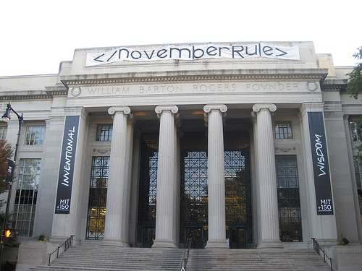
HTML Hack

Slide 5
Basic Web Page
<html>
<body>
<h1>My First Heading</h1>
<p>My first paragraph.</p>
</body>
</html>

Slide 6
Getting Started
Make a .html file using a text editor (even Notepad can do it)
Open it with your browser.
Usually, your default browser is already configured to open .html files.
So just click the file.

Slide 7
So Far
What is HTML?
Basic syntax
Tags
Getting started with HTML

Slide 8
Review
HTML describes content of a web-page.
HTML is all about tags.
`Keywords surrounded by brackets.
Opening and closing tags
Tags describe the content between them. <h1>…</h1> says the content is a heading.
<b>…</b> says the content should be bolded.
<body>…</body> says the content comprises the body of the HTML file, or the visible content.

Slide 9
HTML Element
Element is a pair of tags and the content between them.
<p>content</p> is a paragraph element.
Elements can have empty content and be closed in the start tag.
<br /> defines a new line.

Slide 10
Attributes
Attributes provide additional information about an element.
Attributes go in the starting tag.
Attributes take the form of a name/value pair.
Example:
<a href="http://6.470.scripts.mit.edu">6.470 Home Page!</a>

Slide 11
Classes and Ids
IDs are unique names that identify elements.
Classes are names that identify a group of elements.
Examples:
<p id = “paragraph_1”>…</p>
<h3 class=“small_headings”>…</h3>

Slide 12
Bigger example
<body>
<h3 id = “hd_1” class=“small_headings”>…</h3>
<p id = “paragraph_1”>…</p>
<h3 id = “hd_2” class=“small_headings”>…</h3>
<p id = “paragraph_2”>…</p>
</body>

Slide 13
Style Attribute
Allows you to control the style of HTML elements.
Redundant with CSS. “quick and dirty” styling.
<h1 style="color:blue; text-align:center">This is a header</h1>
<p style="color:green">This is a paragraph.</p>
The name-value pairs in the style definition are actually CSS property/value pairs.

Slide 14
That’s Pretty Much It!
Everything about HTML is using tags to define elements and using attributes to augment these elements.
All that’s left to learn about the common HTML elements and their attributes.
Although there are quite a few of them.
See our video lectures for some examples.

Slide 15
HTML 5
Newest revision of HTML
Most browsers support it
<video> for embedding videos
<audio> for embedding audio
<canvas> for graphics
Local storage (a little database in the browser)

Slide 16
Additional Resources
HTML:
www.w3schools.com
HTML5:
http://diveintohtml5.info/

Slide 17

HTML
Mark Zhang

