Slide 1

Understanding Power Consumption in Indian States
NAME OF PARTICIPANTS | NAME OF BATCH
1. Achyuth Thimirishetty | RBA 2_61
2. Akshita Sinha | RBA 2_65
3. Chandramohan Chauhan | RBA 1_18
4. Prachi Arora | RBA 2_96

Slide 2

Questions:
Before and during lockdown analysis, what difference did it make in terms of consumption — on a state and regional level?
Predicting the amount of power a state consumes each day.
To see how each state's monthly power consumption compares to the national average.
How much of overall energy consumption is derived from renewable and non-renewable sources?
How much power does a state use on a daily basis?
Region and State wise maximum and minimum consumption on a monthly basis
Analyzing the patterns of consumption in states that give free power for agricultural use.

Slide 3

Solution overview on the problem statement:
From our covid analysis, the power consumption across states during lockdown declined by 31.47%.
Using previous data points from any state, our algorithm can predict power consumption on a daily basis.
Top 15% most power consuming states are above the national average of 102.74 MU
From total consumption of 1709.73 MU, about 613.11 MU was consumed from Renewable Energy Sources.
Western states consumers most power on a daily basis, followed by Northern, Southern, Eastern and then NE states.
The maximum peak of power consumption happened in July 2019, and lowest in Feb 2019.
In terms of agricultural power consumption, the southern states outperform the northern states.
A heat map was created to depict the behavior of power consumption patterns across Indian states.
Visual analysis of power consumption utilization based on each state's latitude and longitude data

Slide 4
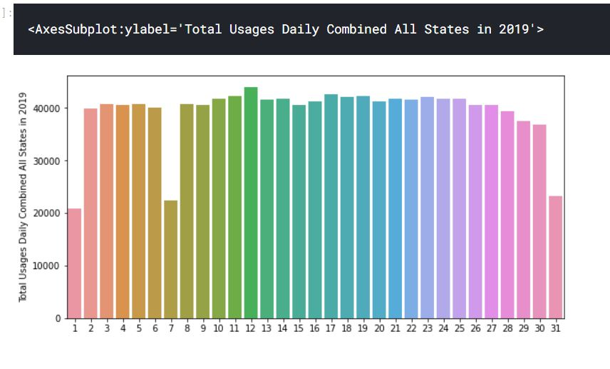
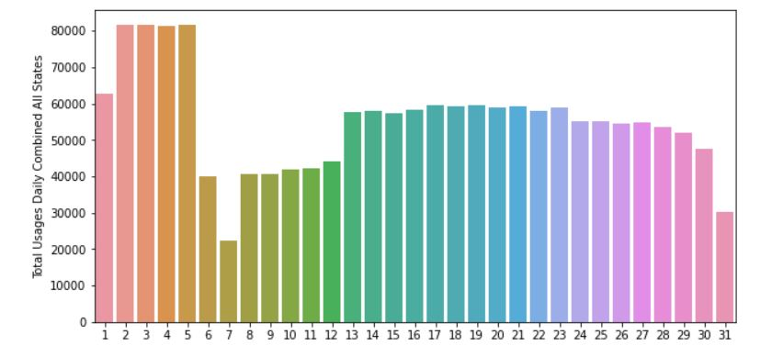
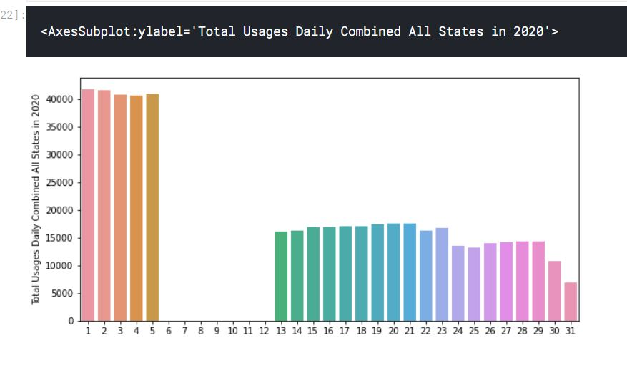
On which day, did we see the highest & lowest consumption in India – 2019 & 2020
Analysis based on:
Event
Industries
Elections
Population
State size- geographical areas

Slide 5
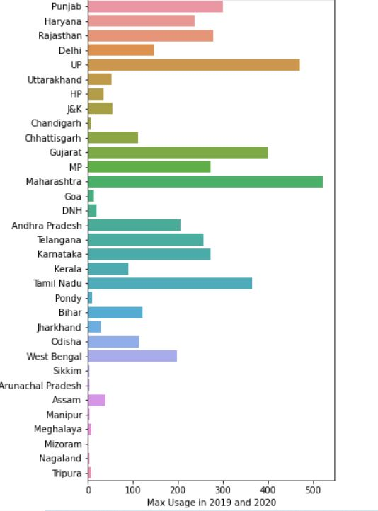
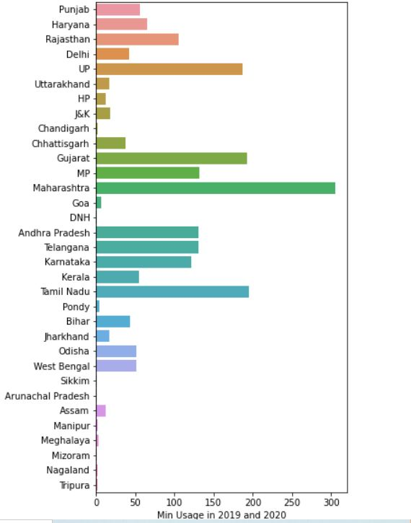
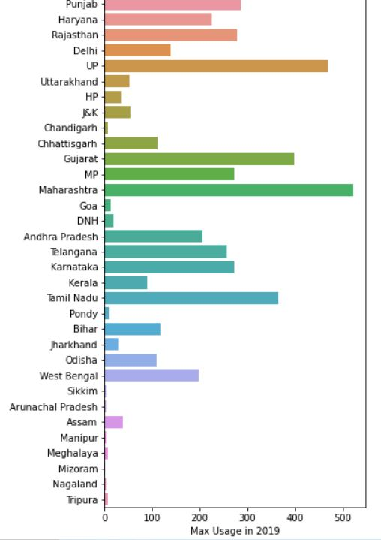
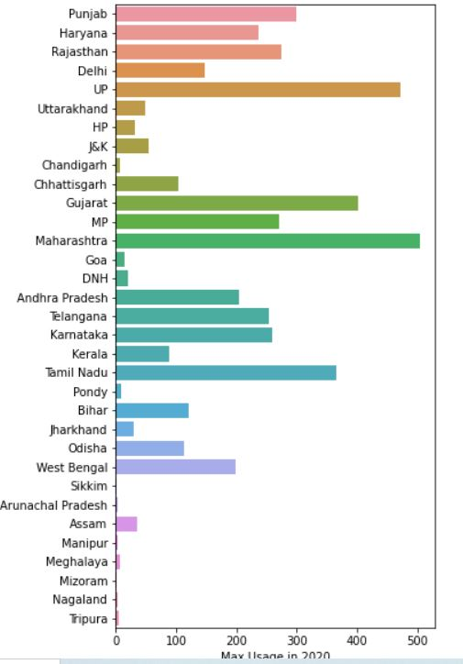
State wise, which date had the maximum and minimum usage both in 2019 and 2020?
State wise, which date had the maximum usage in each year?

Slide 6
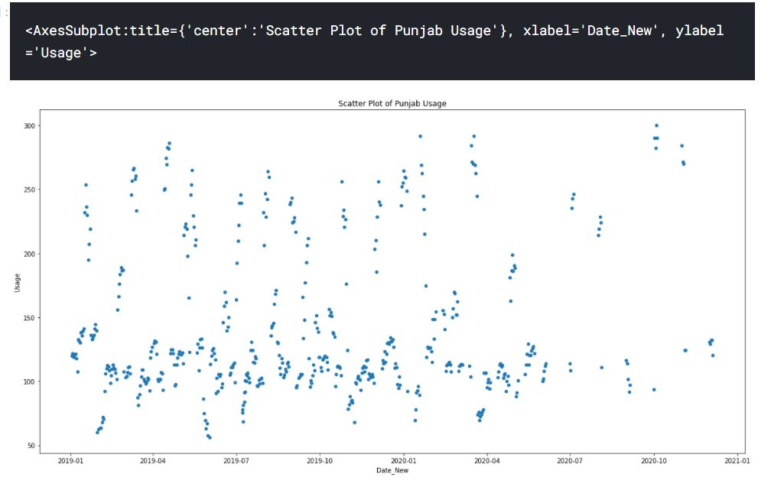
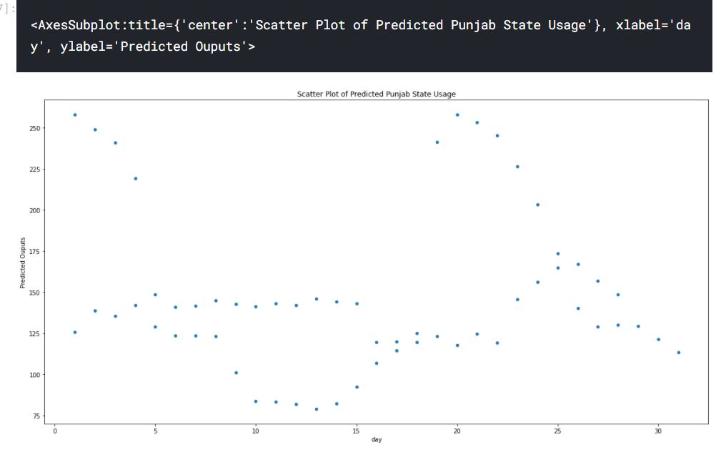
Scatter plot for electricity consumption of some states
Scatter Plot of Predicted Usage Values of Punjab State

Slide 7
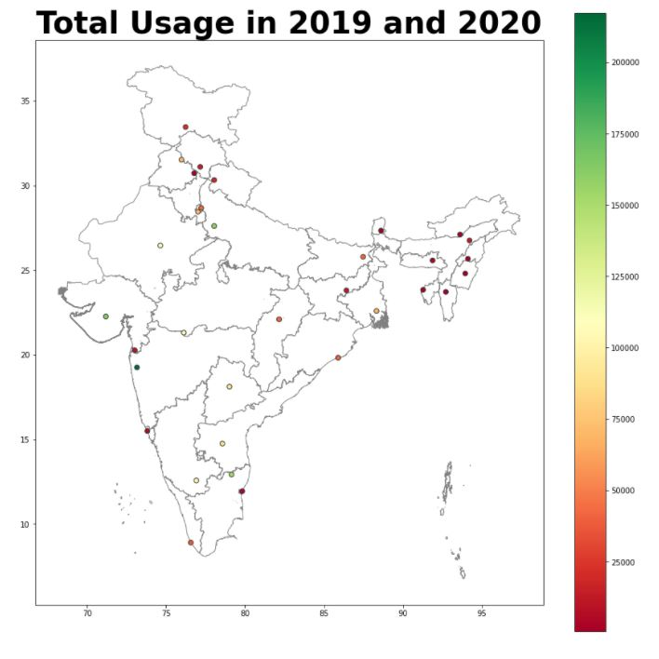
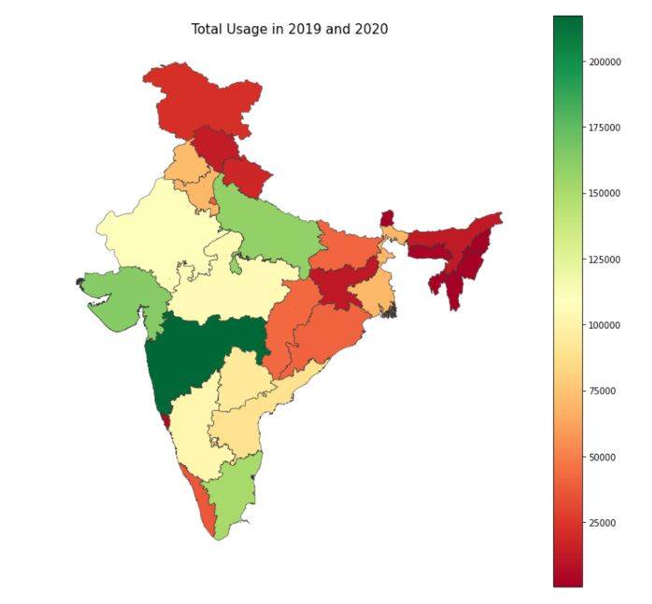
Heat Plot on India map
Bubble Plot usage on India map

Slide 8
Uniqueness of Solution extracted:
Calculated overall energy consumption derived from renewable and non-renewable sources?
Analyzed patterns of consumption in states that provide free power for agricultural use.
Analyzed power consumption patterns before and during covid lockdown
Predicting daily power consumption using historical data points from any state.
Calculated consumption according to geographical landscape data extraction

