Slide 1


IMA/RSS Workshop:
Working as a Statistical Consultant –
Technical & Wider Skills
30th June 2022
Sarah Littler (née Marley)
Senior Statistical Consultant

Slide 2
Agenda
My Background
Routes into Consultancy
Select Statistics
Our clients and projects
The Role of a Consultant
Technical and wider skills – what we look for in graduates
Continuing Professional Development
Life-long process of employability
Notes:
Workshop: "Involving employers in the development of the mathematical sciences curriculum"
What it’s like to be a statistical consultant (outside of academia), route to a stats consultancy role
Sorts of projects we tackle, what the role entails, and the technical and wider skills needed to be a consultant
What we look for in recruits
Ongoing CPD

Slide 3









My Background
BSc Math. Sciences
MSc Statistics
Statistical Services Unit
Senior Stats Consultant
Statistical Consultant
Clinical Discovery
Notes:
Traditional route…
A-Levels in Maths and Further Maths, followed by BSc in Mathematical Sciences
Master’s or PhD in statistics
Not only route – training through on-the-job experience, for example
(+Acting MD – maternity cover)

Slide 4
Routes into Consultancy
Join an established consultancy company
Join a university statistical consultancy unit
Join a clinical/contract research organisation (CRO)
Join the civil service
Government Statistical Service (GSS)/Office for National Statistics (ONS)
Join an in-house insights/analytics team (data science?!)
Freelance work
Start your own company!
Notes:
Larger organisations more likely to take on graduates (rather than post-graduate, as we tend to do)

Slide 5

Select Statistics
Established 2012
Full consultancy service: analysis, advice, training, research
Experienced in solving practical, real world problems. Academic credentials with commercial experience
Work with clients to deliver bespoke solutions using the most relevant statistical tools
We like to regularly communicate with our clients and often work in an iterative way
Notes:
Discuss problems as a team – bring together combined expertise/experience
Chartered Statisticians

Slide 6









Select Statistics
Notes:
Public, private, charity sector, etc.
Across sectors – healthcare, education, environment, business, agriculture, etc.

Slide 7
Select Statistics - Etc.
Statistical Modelling [core service]
Machine learning
Survey analysis
Acceptance sampling (for Quality Control)
Meta-analysis
Time Series/Forecasting
Imputation
Measurement agreement/accuracy
Diagnostic accuracy assessment
Sensitivity, specificity, predictive values
Study design
Standard sample size calculations
Simulations for sample size estimates for complex designs
Protocol/analysis plan development
Notes:
Mix of observation retrospective analysis and prospective studies
Clearly a need for technical skills – though, experience/exposure to different applications/areas can be learnt on the job

Slide 8
Select Statistics - Statistical Modelling
Comparing Failure Times of Medical Leads
Working with a cardiologist, we used survival modelling to analyse the time to failure of implantable-cardioverter defibrillator (ICD) leads, comparing the risk for different lead types used in clinical practice in their trust.
Using this approach, we isolated the effects associated with the different leads and explored time-dependent effects where the risk of failure depended upon the time since implantation.
Understanding Customer Retention
Notes:
Core service is statistical modelling
Note: Observational data/secondary data analysis, as well as, e.g., prospective RCTs…
ICD leads are used in large numbers and failures can have serious and immediate consequences for patients, therefore the better understanding of the survival rates of these medical devices and how they might differ between lead types, gained from the analysis, is crucial in informing clinical practice and improving patient care.
Survival modelling – developed in a medical context, but can be applied elsewhere
+ GLMs – logistic regression, multilevel, mixed-effects models, etc.

Slide 9
Select Statistics - Machine Learning
Predicting Propensity to Respond to a Marketing Campaign
Working with a marketing services organisation, used random forests to model responder/non-responder data to predict the likelihood to respond for new customers, based on their individual characteristics.
Understanding Types of Households that Fail to Save
Working with a debt charity, we used data from the Wealth and Assets Survey to partition households into groups according to a number of socio-economic factors via CART, maximising the differences between their propensity to save.
Notes:
Prediction (rather than interpretation) – more frequently using machine learning
Cumulative gains and lift
WAS – A survey of British households conducted by the ONS
Clustering, CART

Slide 10
Select Statistics - Survey Analysis
Estimating Sports Provision & Participation in Welsh Schools
We helped Sport Wales produce the sampling weights for their ‘School Sport Survey’ to account for differences between the sample of responses collected and the population of schools and pupils in Wales.
Account for non-response and under/over-representation in the distribution of key factors affecting sports participation.
Produce more accurate estimates of population characteristics and their sampling errors to ensure that the reporting of the results of the survey is representative of the population.
Notes:
Sport Wales is the national organisation responsible for developing and promoting sport in Wales and they are responsible for producing the biennial School Sport Survey.
The survey is used strategically by Sport Wales and the Welsh Government to monitor and shape sports policy, and by local authorities, governing bodies and schools to inform and plan local delivery.
Base weights and post-stratification weights – basic cell-weighting and raking.

Slide 11
Select Statistics - Etc.
Acceptance sampling (for Quality Control)
Meta-analysis
Time Series/Forecasting
Imputation
Measurement agreement/accuracy
Diagnostic accuracy assessment
Sensitivity, specificity, predictive values
Study design
Standard sample size calculations
Simulations for sample size estimates for complex designs
Notes:
Mix of observation retrospective analysis and prospective studies
Clearly a need for technical skills – though, experience/exposure to different applications/areas can be learnt on the job

Slide 12




Data Analysis
Excel – Limited data analysis tools and little flexibility over the methods used and the output given
More sophisticated tools…
SAS in the pharmaceutical industry
SPSS in the social sciences and market research
R – Software of choice for the majority of statisticians, analysts or data scientists
Notes:
In all of the previous examples, the common theme is that we used R
Require some experience in R and demonstration of ability to code
Python obvious also a popular choice
For a basic exploratory analysis many choose to use the statistical tools in Excel. Not only is it readily available as part of Microsoft Office, but its spreadsheet functionality means that most users find it easy to use, and it can also be easily integrated in interactive dashboards.

Slide 13


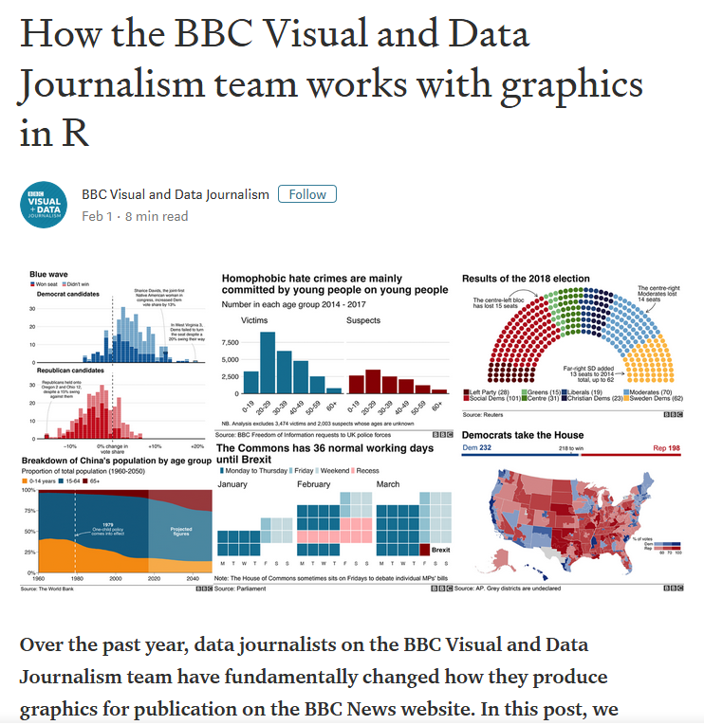
Notes:
Visualisation (communicating results), key part of what we do
https://medium.com/bbc-visual-and-data-journalism/how-the-bbc-visual-and-data-journalism-team-works-with-graphics-in-r-ed0b35693535
Over the past year, data journalists on the BBC Visual and Data Journalism team have fundamentally changed how they produce graphics for publication on the BBC News website.
Using R’s ggplot2 package to create production-ready charts, the have documented their process and code and shared what they have learned along the way.

Slide 14
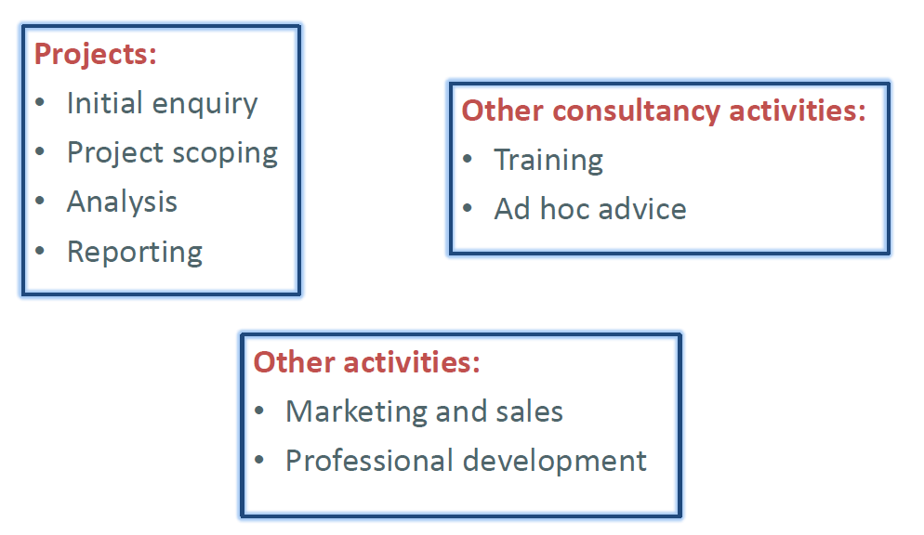
The Role of a Consultant
Notes:
Role encompasses project work (analysis as described), but also lots of wider activities…
Business activities – management, invoicing, payroll, etc., etc.

Slide 15
The Role of a Consultant
Technical skills (meticulous/attention to detail)
Statistical knowledge (critical thinking)
Coding – data processing, analysis & reporting/visualisation (R)
Quality control (self-checking as well as independent review, seek help)
Problem-solving (engaged/inquisitive)
Open-ended projects
Understanding problem (project scoping)
Aligning analyses with client objectives
Data wrangling (missing & messy data/unmet assumptions, etc.), EDA
Communication (affable/professional)
Team work (with colleagues & clients)
Client understanding/translating statistical concepts (exec summary)
Visualising/communicating results (& limitations) – phone/email/report/ppt
Time management/Prioritisation (organised/conscientious)
etc., etc.
Notes:
Meticulous, conscientious approach
Identifying where more help is needed
Project processes, etc. covered by induction

Slide 16
The Role of a Consultant
Quote from Professor David Hand OBE:
“What you need to be a successful consultant:
Affability
Availability
Ability
In decreasing order of importance!”
Technical aspects are not the only important thing –
People relationships are a critical factor!
Notes:
Approachable/helpful
Professor David Hand is Senior Research Investigator and Emeritus Professor of Mathematics at Imperial College, London, where he formerly held the Chair in Statistics. He is also Chief Scientific Advisor to Winton Capital Management. He is a Fellow of the British Academy, and an Honorary Fellow of the Institute of Actuaries, and has served (twice) as President of the Royal Statistical Society. He is a non-executive director of the UK Statistics Authority, and is Chair of the Board of the UK Administrative Data Research Network. He has published 300 scientific papers and 28 books, including Principles of Data Mining, Information Generation, Measurement Theory and Practice, The Improbability Principle, and The Wellbeing of Nations. In 2002 he was awarded the Guy Medal of the Royal Statistical Society, and in 2012 he and his research group won the Credit Collections and Risk Award for Contributions to the Credit Industry. He was awarded the George Box Medal in 2016. In 2013 he was made OBE for services to research and innovation.

Slide 17
The Role of a Consultant
Listen to a client & ascertain what they want (it may be different from what they think they want!)
What are the constraints?
Client understanding
What can be achieved
Timescales/budget
Data
Honesty is paramount.
Choose the right tool for the job (often an adequate solution will do).

Slide 18
The Role of a Consultant
Things I like about the job
Using a wide variety of methods
Learning about other people’s businesses/research
Working closely with clients (and other consultants)
Being helpful is rewarding
Contrasts with, e.g., academic/researched focussed roles
No scope to initiate my own research - projects are dictated by the client
Can’t always pursue interesting side-lines
Generally shorter deadlines
Managing clients’ expectations
Notes:
Need recruits that make effective use of their time…
Can pursue own CPD/self-directed learning of course.
Shorter term projects.

Slide 19
Continuing Professional Development
Lifelong process of employability – get into good habits early
Take and make opportunities to expand technical knowledge – learn new techniques and applications
Keep up-to-date with changes in the field – statistics is not only a huge body of knowledge, but it’s always moving (lots of new, rapid developments since my uni. studies)
Maintain awareness of statistical issues/debates – be part of the wider community and conversation
Develop via different activities – work based learning, professional activity, formal/educational, self-directed learning, other activities
Notes:
Continually build knowledge/experience (can’t know everything!).
Keeps things from getting stale (learning is fun!).
Expands toolkit and problems you can tackle.
Bring learning/approaches from one application area to another.
Maintain competence and ensure ethical practice.
Stay relevant, keep up-to-speed with competition and use the best tools available.
Build self confidence and self assurance.
Contribute to progress in the field.
Keeps it interesting and provides more opportunities for development.
Self-directed learning can be as effective as an expensive training course (utilising, e.g., online materials).
See possible benefits of activities carried on outside of professional life, which can be brought to job role.

Slide 20
Ongoing CPD
Recognise the variety of skills – not just technical, statistical development but wider professional skills, including consultancy skills (scoping, advice, etc.), communication, leadership, staff management, project management, application area knowledge, etc., etc.
Actively reflect (not just admin!) – not a box-ticking exercise as part of internal biannual review process or for revalidating professional accreditation/chartership, but an opportunity to reflect on skills and experience and take responsibility for own development
Keep an ongoing record – maintain a process for recording activities as they are completed (internal, bespoke timesheet/project management software)
Continually monitor – ongoing process of review and reflection to track progress and achievements, and identify next steps
Notes:
Benefits in terms of overall role and career progress, not just technical expertise (be competitive in job market).
As a consultant these wider skills are often just as important to a successful project (need to deliver projects on budget and communicate the results to stakeholders)
Helps to identify opportunities.
Leads to directed CPD, resulting in faster progress and development in areas that you need/want to grow.
Managed CPD to ensure variety of areas of growth.
Up-to-date evidence for reviews, professional accreditation/revalidation, and interviews.
Reduces burden of record keeping – going back is always more difficult than at the time.
Facilitates reflection.

Slide 21
Ongoing CPD
See the benefit – identify the ultimate benefits and beneficiaries of development not just what was done, e.g., increased quality of professional practice and service delivery might benefit company, colleagues, clients, the wider statistical community, the public, etc.
Promote your CPD – let employer, manager, colleagues, clients, etc. know about your CPD
Allow CPD to develop with role – different types of development at different stages of my career
Notes:
This is what makes it worthwhile (and makes it feel rewarding)!
Helps promotes useful CPD activities.
Motivates further development activities.
Gain recognition (of professional training and experience, and commitment to excellence).
Help raise your profile and respect/trust (as a professionally active statistician and in particular a consultant).
Promote yourself and company (reassurance to clients who are not necessarily statistically/scientifically literate).
Raise profile of qualified statisticians more widely.
Ensure CPD activities are relevant to where you are and where you want to be.
More wider skills with growing experience and expansion of role.
Project and client management
Resourcing
Line management
HR
Recruitment
Business development
etc.
Less opportunity for ‘doing statistics’, but supervising projects offers lots of potential for technical learning too.

Slide 22
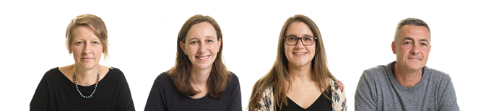
Questions?
Thanks for listening!
Find out more about Select at: https://select-statistics.co.uk/

