Slide 1
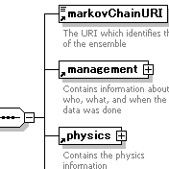
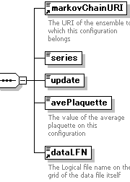
Common Rules for Data and Metadata
mc://JLDG/nf2/b205k1356
ensemble
XML
configuration
XML
QCDml: XML markup language for
QCD ensembles/configurations metadta
<npClover>
<kappa>0.1354</kappa>
<cSW> 1.684 </cSW>
</npClover>
markovChainURI and data LFN:
Logical names of ensemble/configs,
and keep correspondence of (meta-) data
configuration file
lfn://JLDG/nf2/b205k1356-A200
file-format XML
size, precision
packed
with LIME
configuration binary data
Lattice QCD Interchange
Message Encapsulation
(B.Joo and C.DeTar)
lfn://JLDG/nf2/b205k1356-A200

