Slide 1
Employability in our maths and data science programmes
Dr Craig McNeile
Offer holder day (2026)

Slide 2
Who I am…
Lecturer in Theoretical Physics at the University of Plymouth, since 2013;
Employability and placements lead for maths students;
PhD in Theoretical Physics, Edinburgh University (1992);
Research interests:
  Simulations of nuclear and particle physics,
  High Performance Computing and Quantum Computing
  Data Science
Teaching:
  Modules on Operational Research, linear algebra, and Quantum Computing for undergraduate maths students.
  Software Development and Databases and project supervision for MSc Data Science students.

Slide 3
Regular employability activities
Regular timetabled sessions on employability:
  Career planning (Explore, prepare)
  Job searching
  Personal development
  CV writing/applying for jobs
  Speakers from industries
  Graduate speakers
  Placements preparation
Designed and delivered by professional career advisors in cooperation with academic staff.

Slide 4
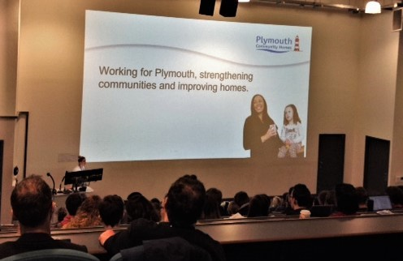
One-off events
Job fairs and career events
  General university-wide job fairs
  Intensive workshop in year 1: Enhance Your Future Programme
  Maths Careers Mini-Conference:
    talks and workshops
    Various sectors and different
      types of careers.
    Met Office, Civil Service, GCHQ, ONS,
      GlaxoSmithKline, Babcock, …
    Many speakers are our graduates

Slide 5
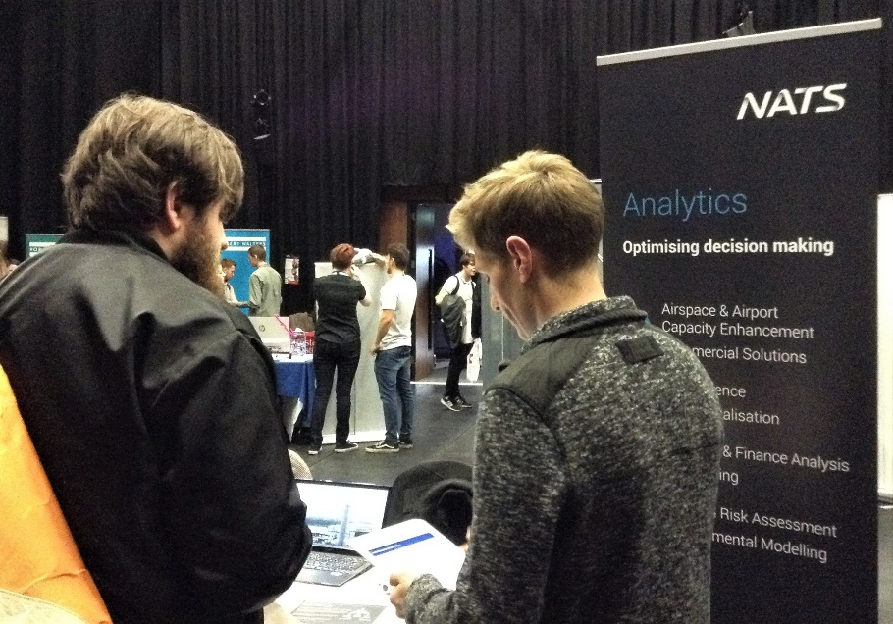
Placements
Year-long placement
  Academic tutor throughout the year
Summer placement before the final year
  At least 20 days long
  Counts as one of the final year
  modules
Some of the past placements:
  National Air Traffic Services
  Office for National Statistics
  Home Office
  Mastercard

Slide 6



Employability on our modules
Cooperation with employers
Stage 2 Operational Research module:
  Real-life problems
  Software used in industries (eg. SIMUL8)
  Independence and initiative
  Cooperation with others
Projects in the final year:
  individual or in groups
  real-life problems
  In cooperation with industries: Plymouth Community Homes, BT, Babcock, …
  Presentations, school poster day.

Slide 7

School Placements
Available to all students
  Core for Mathematics with Education
  Optional for otherwise
You get experience in a classroom
  Helps to decide if teaching is for you
  Communication skills
Advantage when applying
for PGCE

Slide 8
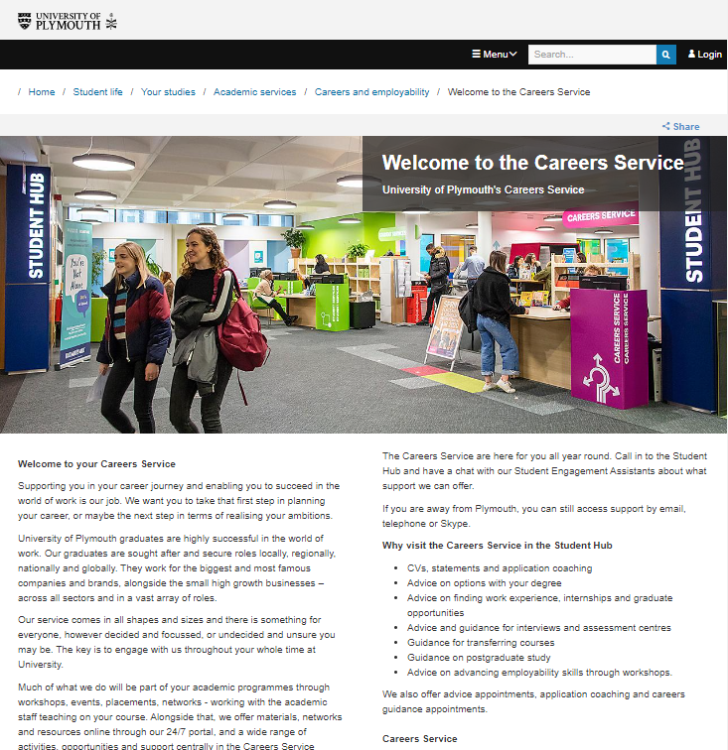
University’s Careers Service
Careers Service
  Professional careers consultants
  One-to-one appointments:
    Advice
    Careers guidance
    Application coaching
  Available even after graduation
  Finalists at the Institute of Student Employers Awards in 2025.
  plymouth.ac.uk/student-life/your-studies/academic-services/careers-and-employability/careers-service
  AI and applying for jobs

